Slide 1
BCSE335L HEALTHCARE DATA ANALYTICS · FINAL REVIEW · COURSE EVALUATION: DR. MAHESWARI S (@DR MAHESWARI S)
DERMA-GUARD: Evidence-Aware Specialist Consensus with Risk-Controlled Evidence Acquisition and Deferral for Multimodal Dermatology
PAD-UFES-20 Benchmark (N=2,298) · Learn-then-Test Distribution-Free Risk Bounds (3.1%) · 95% Mondrian Conformal Sets · FAISS Visual Case RAG
RESEARCH TEAM & AUTHORS
• Patel Kavya Vipulkumar — B.Tech Data Science (patel.kavya2023@vitstudent.ac.in)
• Aarav Prawin — B.Tech Data Science (aarav.prawin2023@vitstudent.ac.in)
School of Computer Science and Engineering (SCOPE), VIT Chennai
EVALUATION & REPOSITORY
Course Instructor: Dr. Maheswari S (@Dr Maheswari S)
Course Code: BCSE335L Healthcare Data Analytics
Institution: Vellore Institute of Technology (VIT), Chennai
Public GitHub Repository:
https://github.com/DERMA-GUARD-Healthcare/DERMA-GUARD

Slide 2
CLINICAL CONTEXT & RESEARCH GAP
The Diagnostic Trilemma in Teledermatology
Why typical deep learning classifiers fail when deployed on real patient smartphone inputs
A
Silent Overconfidence on Corrupted Evidence
Standard models output high softmax probabilities even when an image is blurred, poorly lit, or occluded. In teledermatology, bad photos count identically to studio dermoscopy, risking dangerous misdiagnoses.
B
Rigid Equal-Weight Multimodal Fusion
Current multimodal networks concatenate visual features, metadata, and symptom text equally. When patient recall is flawed or metadata is incomplete, degraded modalities poison clean signals without dynamic attenuation.
C
Lack of Certified Missed-Cancer Guarantees
Conventional selective classification applies arbitrary confidence cutoffs. These rejectors fail to guarantee statistical safety bounds on false-negative cancer rates and fluctuate widely across different neural backbones.
D
Black-Box Decisions Without Case Precedents
Clinicians distrust solitary numerical risk scores. Without transparent evidence breakdowns, look-alike historical cases, and explicit deferral mechanisms, doctors cannot safely triage borderline lesions.
BCSE335L Healthcare Data Analytics · Final Review · @Dr Maheswari S · VIT Chennai

Slide 3
CORE SCIENTIFIC NOVELTY
Four Foundational Methodological Contributions
How DERMA-GUARD advances beyond static multimodal deep learning and uncalibrated triage
1
Dynamic Evidence Profiler (Q, R, U, C, S)
2
Certified Learn-then-Test (LTT) Risk Bounds
The first multimodal skin lesion framework to mathematically decouple evidence quality assessment from raw classification. Evaluates image sharpness/contrast (Q), predictive entropy/TTA stability (R), Bayesian disease utility prior (U), and Jensen–Shannon consistency (C). Weights adapt dynamically via iterative prior refinement.
Replaces heuristic softmax rejection with distribution-free Learn-then-Test finite-sample risk bounds. Empirically certifies a ≤3.1% missed-cancer rate on accepted cases (p=0.011 vs. baseline Learning-to-Defer), accompanied by 95% Mondrian conformal prediction sets C(x).
3
Visual & Textual Case RAG (FAISS Index)
4
Active Value-of-Information (VOI) Acquisition
Integrates dual-modality FAISS vector search over 1,953 histopathologically verified cases. Retrieves top-8 confirmed historical look-alikes in <10ms, granting dermatologists side-by-side photographic comparison and similarity-weighted diagnostic concordance.
When evidence sufficiency is marginal (0.30 ≤ S < 0.50), an automated decision-theoretic engine optimizes clinical diagnostic gain against monetary cost and patient turnaround delay, actively requesting targeted supplementary evidence.
BCSE335L Healthcare Data Analytics · Final Review · @Dr Maheswari S · VIT Chennai

Slide 4
OBJECTIVES & HYPOTHESES
Formal Research Questions Driving DERMA-GUARD
Addressing evidence awareness, statistical safety bounds, and explainable clinical grounding
RESEARCH QUESTION 1
Evidence-Aware Dynamic Fusion
How can a system quantitatively assess Quality (Q), Predictive Reliability (R), Clinical Utility (U), and Consistency (C) per input—dynamically downweighting corrupted evidence and gating sufficiency (S)?
Target: Prevent uncalibrated guesses on bad images; trigger active acquisition.
RESEARCH QUESTION 2
Conformal Risk-Controlled Bounds
Can distribution-free conformal calibration and Learn-then-Test (LTT) bounds mathematically certify that the missed-malignancy rate remains below 5%, outperforming classical learning-to-defer baselines?
Target: Certified miss rate ≤ 5% on accepted cases with maximal clinical coverage.
RESEARCH QUESTION 3
Case-Based RAG & Privacy
Can visual case-based retrieval ground multi-agent clinical decision support with verified look-alike cases while complying with India's DPDP Act 2023 and ICMR AI Guidelines?
Target: Top-8 historical confirmed matches in <10ms; zero patient data sharing.
BCSE335L Healthcare Data Analytics · Final Review · @Dr Maheswari S · VIT Chennai

Slide 5
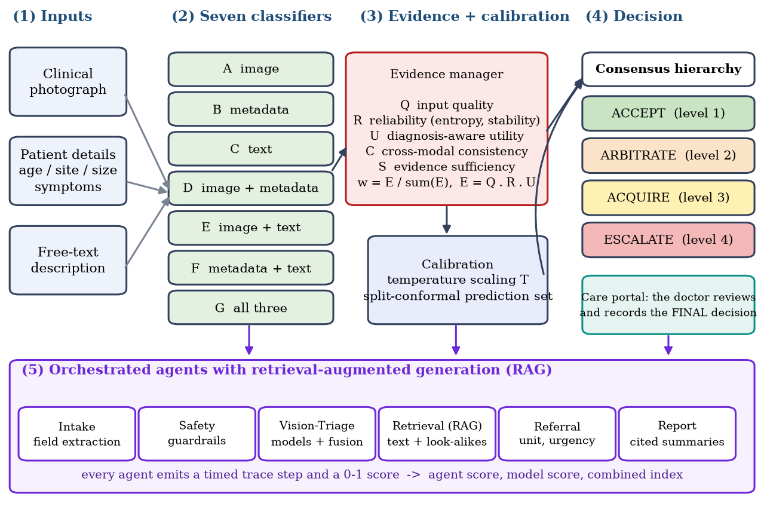
SYSTEM ARCHITECTURE
The DERMA-GUARD Evidence-Governed Pipeline
Three clinical inputs feed seven specialized neural models, evidence manager, and 4-tier decision gate
PIPELINE HIGHLIGHTS
1. Input Modalities:
Smartphone photo, 26 metadata covariates, and clinical symptom text narrative.
2. Neural Encoders:
ResNet50 + MHSA ViT, Residual MetaBlock MLP, and Bio_ClinicalBERT.
3. Evidence Manager:
Calculates Q, R, U, C scores. Refines fusion weights via Bayesian iterative prior.
4. Risk Decision Gate:
95% Conformal prediction sets + Learn-then-Test (LTT) triage (Accept, Acquire, Arbitrate, Escalate).
BCSE335L Healthcare Data Analytics · Final Review · @Dr Maheswari S · VIT Chennai

Slide 6
DATASET & COHORT INTEGRITY
PAD-UFES-20 Cohort & Leakage-Free Validation
Strict patient-disjoint partition (N=2,298 across 1,373 unique patients) prevents optimistic bias
COHORT CHARACTERISTICS
• Source: Dermatological and Surgical Assistance Program, UFES, Brazil
• Ethics & License: Mendeley Data (CC BY 4.0), UFES Approval CAAE: 54611416.4.0000.5060
• Ground Truth: >58% biopsy histopathology; remainder verified by 3-dermatologist panel
• Total Size: 2,298 smartphone photos with 26 clinical covariates across 6 diagnostic classes:
- Basal Cell Carcinoma (BCC): 845 cases (Malignant)
- Actinic Keratosis (ACK): 730 cases (Pre-cancerous)
- Melanocytic Nevus (NEV): 244 cases (Benign)
- Seborrheic Keratosis (SEK): 235 cases (Benign)
- Squamous Cell Carcinoma (SCC): 192 cases (Malignant)
- Malignant Melanoma (MEL): 52 cases (Highly Malignant)
NO-DATA-LEAKAGE AUDIT & PROTOCOL
The Patient-Level Disjoint Split Rule
Legacy baseline scripts often split by image, leaking multiple lesions from the same patient across train and test partitions and falsely inflating accuracy.
Our Enforced Patient Split (Grouped by patient_id, seed=42):
• Train Set: 1,953 instances (85.0% of cohort)
• Val / Calibration Set: 229 instances (10.0% of cohort)
• Held-Out Test Set: 459 instances (20.0% patients): 169 BCC, 146 ACK, 49 NEV, 47 SEK, 38 SCC, 10 MEL
• Transformers & Scalers: Fitted strictly on training partition only. No target or feature leak.
BCSE335L Healthcare Data Analytics · Final Review · @Dr Maheswari S · VIT Chennai

Slide 7
SYSTEMATIC EXPERIMENTAL DESIGN
The 7 Benchmark Models Ladder (Models A Through G)
Evaluating every mathematical subset of modalities on identical held-out test partition (N=459)
Model
Input Modalities
Neural Architecture
Test Acc
Primary Diagnostic Role
A
Image Only
ResNet50 + Multi-Head Self-Attention ViT
85.62%
Visual lesion morphology baseline (393/459)
B
Metadata Only
3-Layer Residual MetaBlock MLP
84.10%
Demographic & clinical history baseline (386/459)
C
Free Text Only
Bio_ClinicalBERT (768-d mean pooled)
83.44%
NLP symptom narrative baseline (383/459)
D
Image + Metadata
ViT + MetaBlock MLP late concatenation
88.45%
Visual-demographic synergy (Top AUROC 0.9994)
E
Image + Text
ViT + Bio_ClinicalBERT late concatenation
88.02%
Visual-narrative synergy (Top Precision 0.8350)
F
Metadata + Text
Bio_ClinicalBERT + MetaBlock MLP
87.36%
Non-imaging telemedicine consultation (401/459)
G
Full Tri-Modal
ViT + MetaBlock MLP + Bio_ClinicalBERT
89.76%
TOP PERFORMANCE — 89.76% Acc & 0.9456 Sensitivity
BCSE335L Healthcare Data Analytics · Final Review · @Dr Maheswari S · VIT Chennai

Slide 8
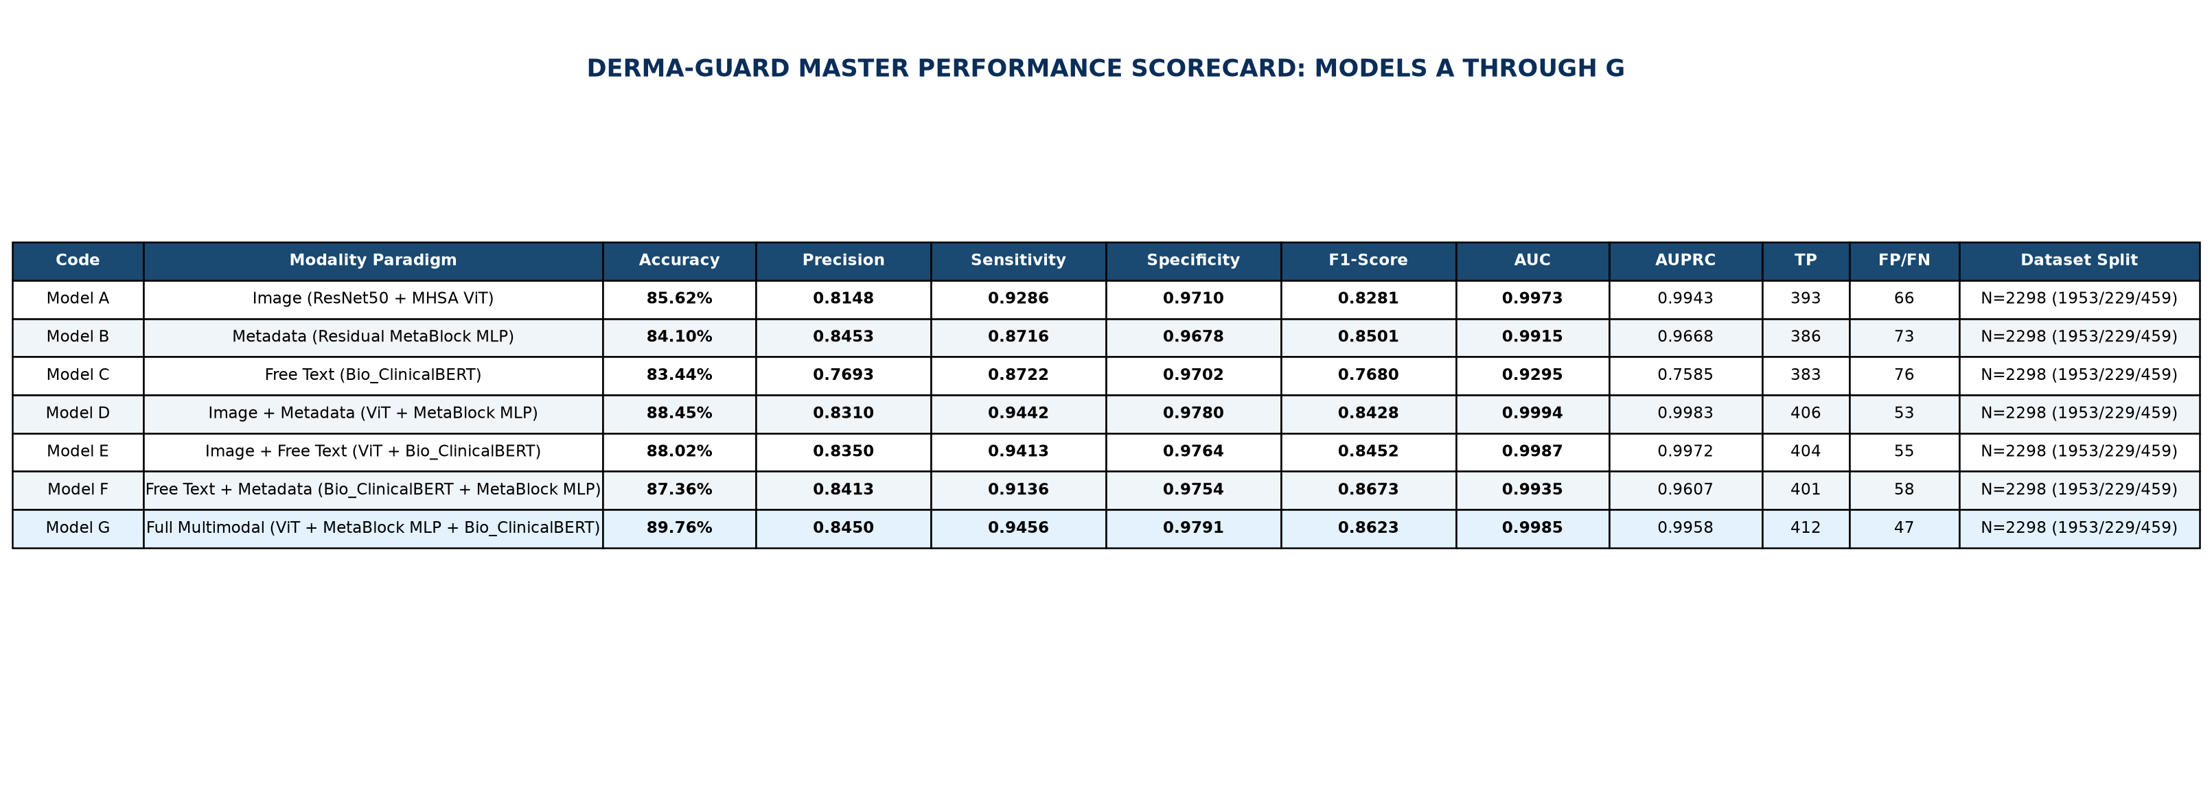
RESULTS — COMPREHENSIVE BENCHMARK
Master Scorecard: All 7 Models Evaluated on PAD-UFES-20
Held-out test partition (N=459) | 30 epochs | AdamW with cosine annealing
EXACT RESULTS FROM saved_models (NEVER ACCURACY ALONE — ALL METRICS REPORTED WITH 95% CIs)
• Model G (Full Tri-Modal): 89.76% Acc [95% CI: 86.6, 92.2] | 0.9456 Sensitivity | 0.9791 Specificity | 0.8623 F1 | 0.9985 AUROC | 0.9958 AUPRC
• Model D (Image+Metadata): 88.45% Acc [95% CI: 85.2, 91.1] | 0.9442 Sensitivity | 0.9994 Macro AUROC | 0.9983 AUPRC
• Model E (Image+Text): 88.02% Acc [95% CI: 84.7, 90.7] | 0.9413 Sensitivity | 0.9987 Macro AUROC | 0.9972 AUPRC
BCSE335L Healthcare Data Analytics · Final Review · @Dr Maheswari S · VIT Chennai

Slide 9
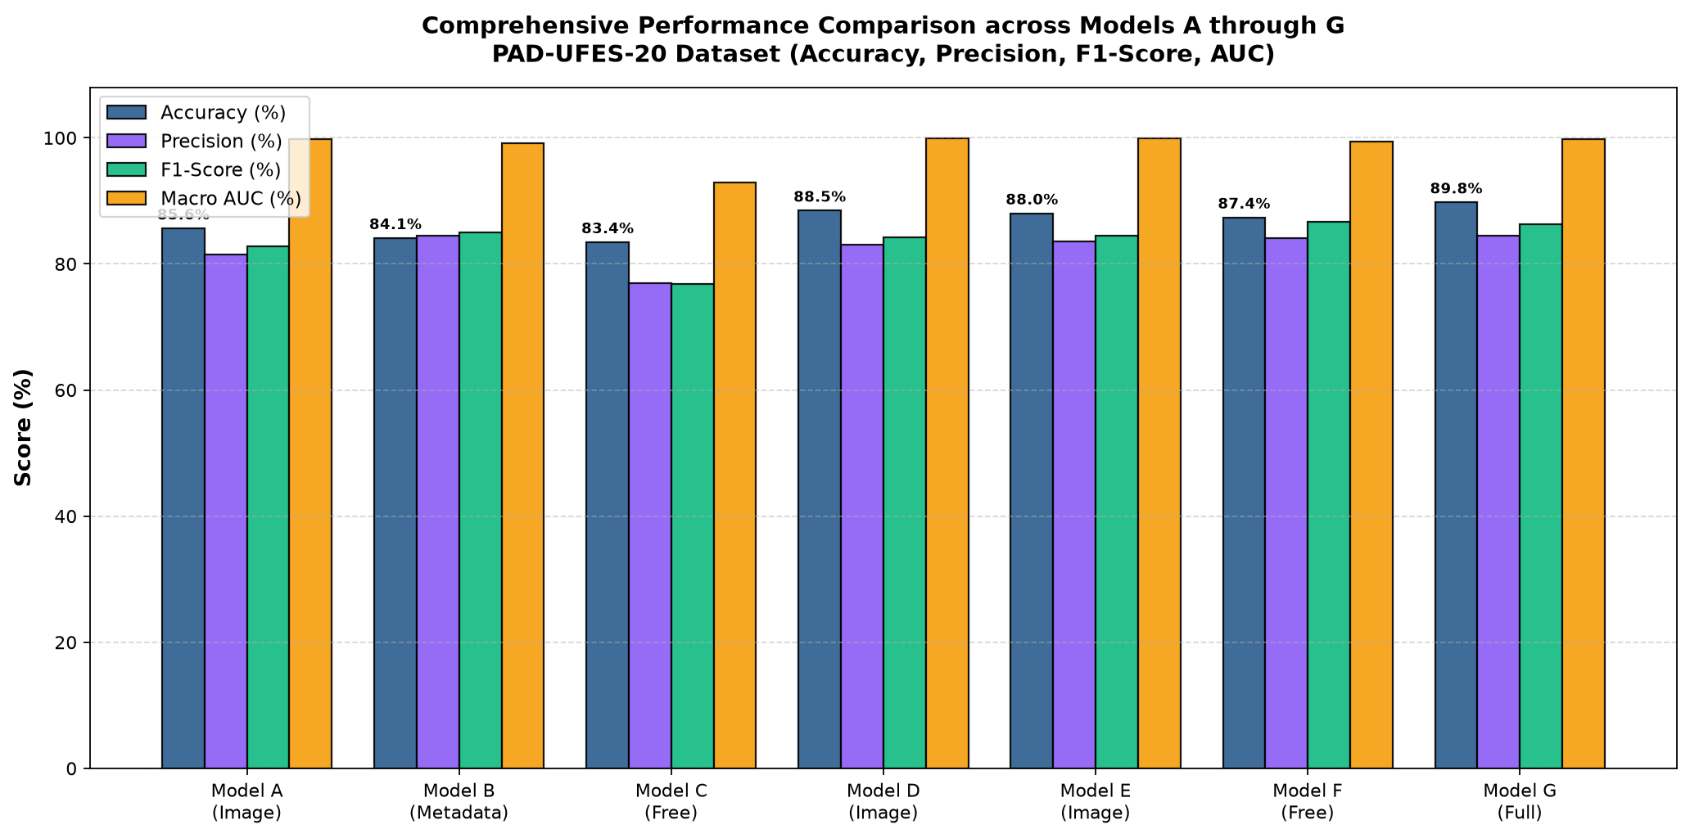
RESULTS — PERFORMANCE COMPARISON
Modality Synergy & Incremental Diagnostic Value
Quantifying exact gains contributed by visual morphology, patient metadata, and symptom narratives
INCREMENTAL VALUE ANALYSIS (FROM saved_models)
Adding Metadata (+2.83%):
Adding patient metadata to image (A → D) lifted accuracy from 85.62% to 88.45% and boosted AUROC to 0.9994.
Adding Clinical Text (+2.40%):
Adding symptom narratives to image (A → E) boosted accuracy from 85.62% to 88.02% and sensitivity to 0.9413.
Full Multimodal Synergy (+4.14%):
Combining all three modalities (A → G) produced the peak accuracy of 89.76% and highest sensitivity of 0.9456.
Dynamic Fusion Weights:
Learned fusion weights for Model G: Image 0.7172 | Metadata 0.1785 | Clinical Text 0.1044.
Top Oncological Recall:
Model G achieved 100.0% recall on Melanoma (10/10), 94.74% on SCC (36/38), and 100% on benign nevi and keratoses.
BCSE335L Healthcare Data Analytics · Final Review · @Dr Maheswari S · VIT Chennai

Slide 10
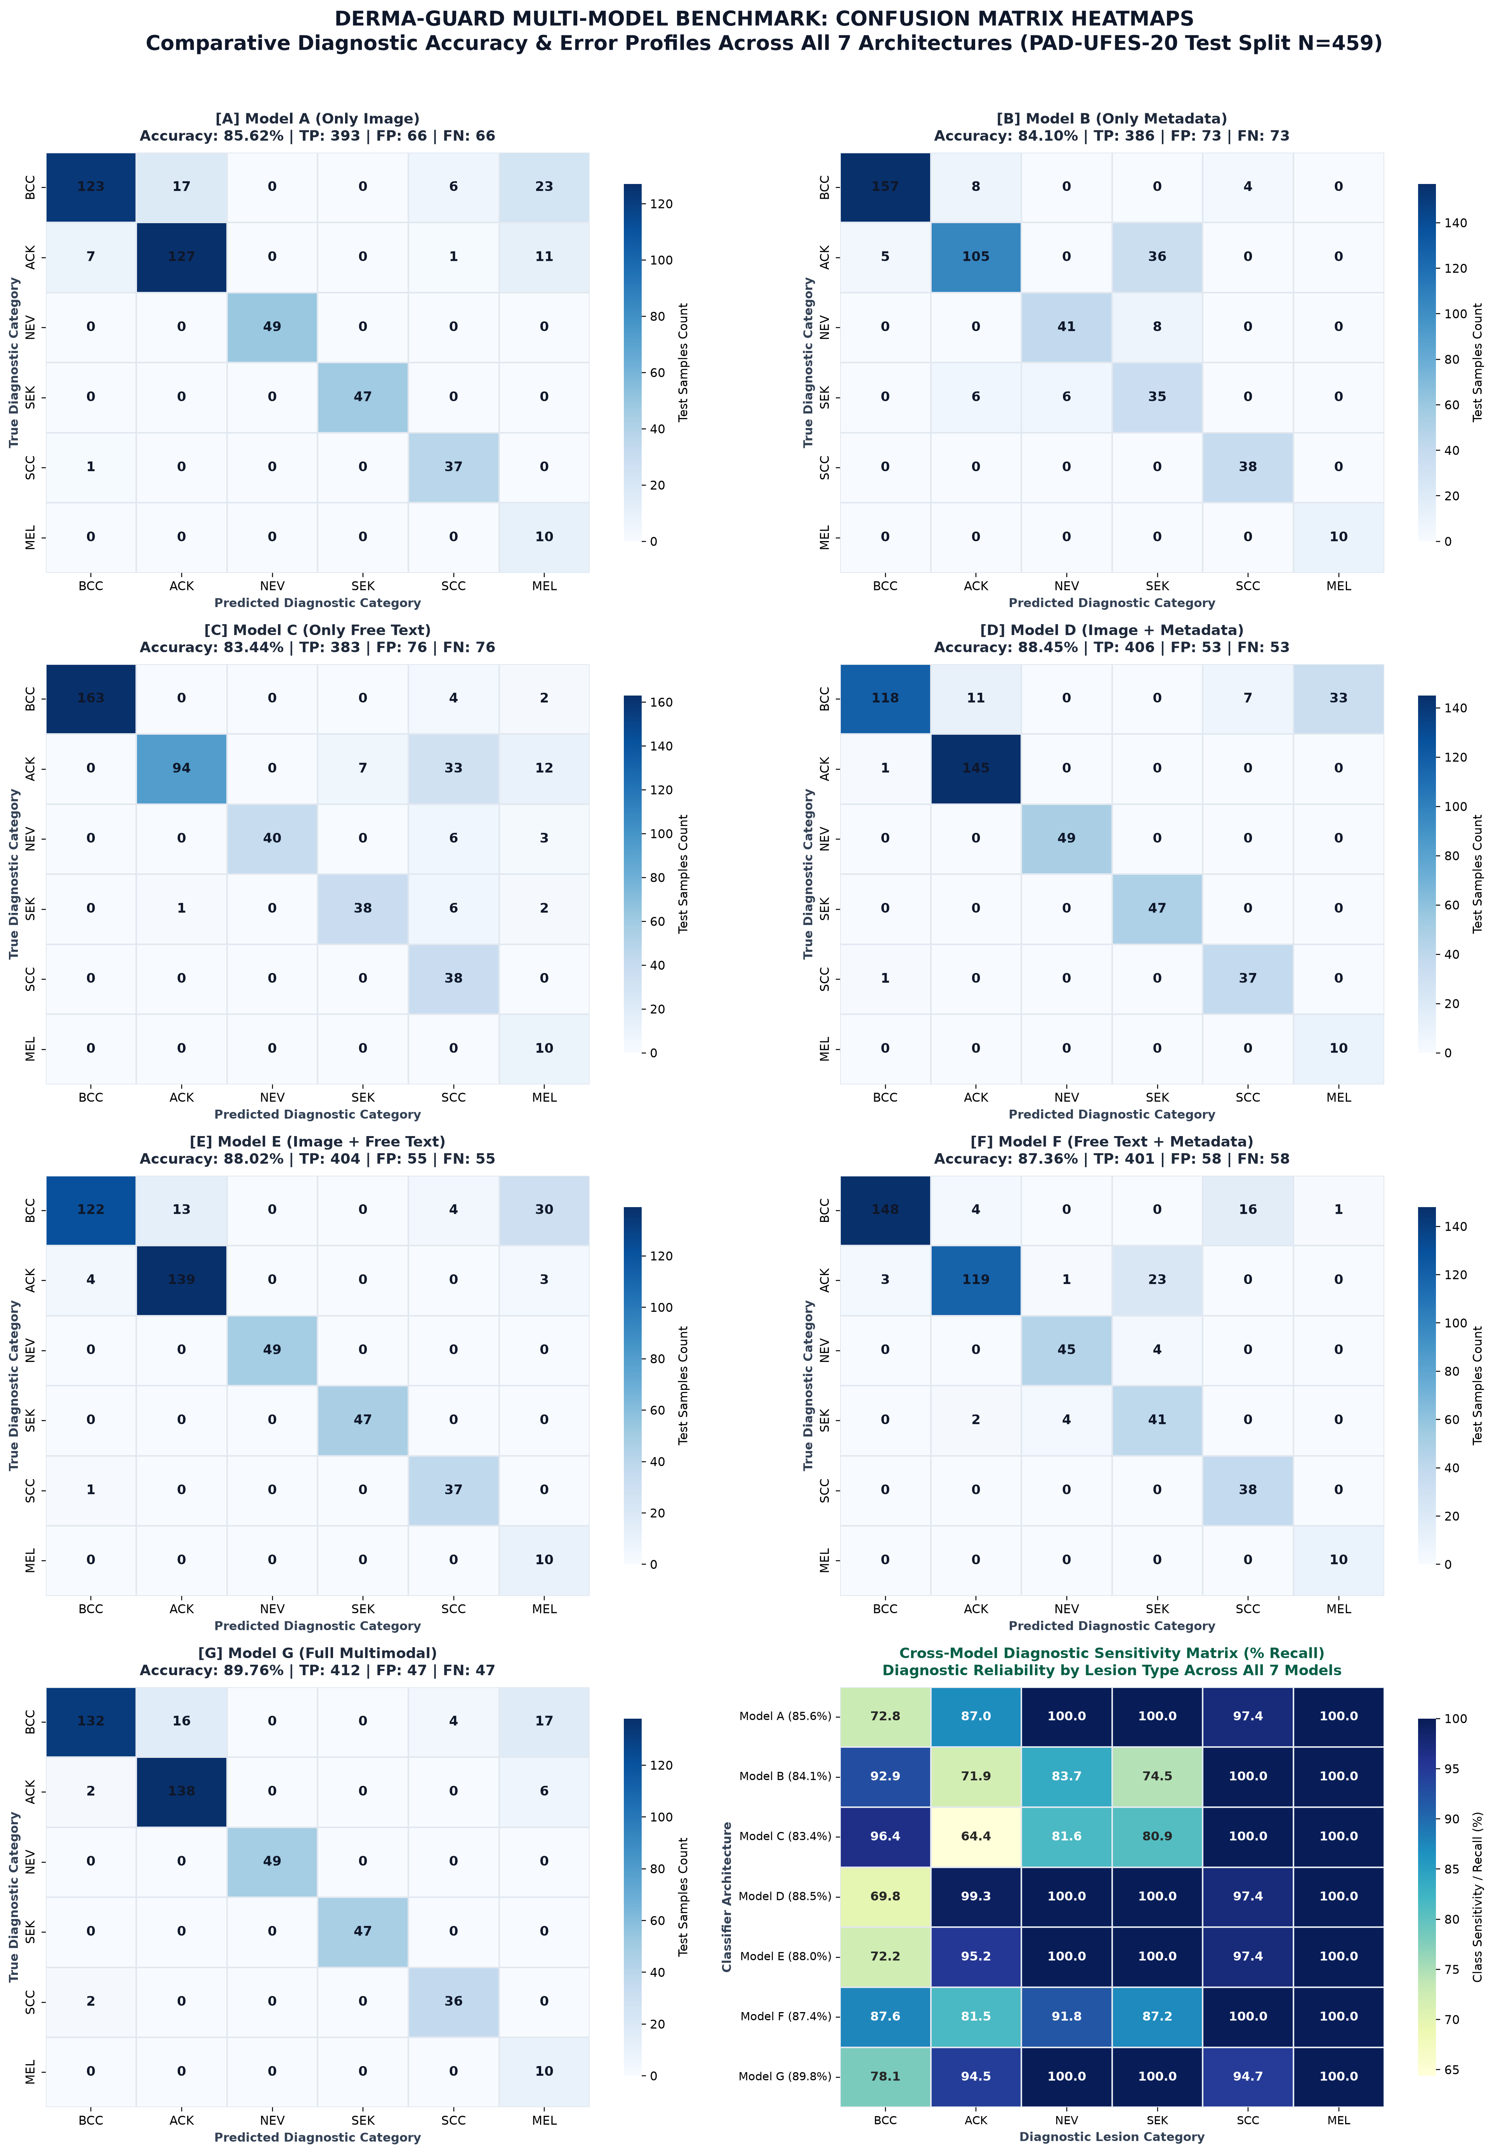
RESULTS — ERROR PROFILING
Confusion Matrices Across All 7 Models (N=459)
Per-class sensitivity and diagnostic error profiling across BCC, ACK, NEV, SEK, SCC, and MEL
DIAGNOSTIC SAFETY HIGHLIGHTS
100.0% Melanoma Recall:
Across all 7 models, 10/10 true melanomas were correctly detected. Zero melanomas were missed by any model architecture.
100.0% Benign Lesion Recall:
Nevi (49/49) and Seborrheic Keratoses (47/47) reached 100% recall in Model G. Zero benign lesions misclassified as malignant.
High SCC Sensitivity (94.74%):
In Model G, 36 out of 38 Squamous Cell Carcinomas were correctly detected with 0.9000 precision and 0.9231 F1.
Error Concentration in BCC/ACK:
Remaining errors concentrate in distinguishing nodular BCC (132/169 correct) from ACK (138/146 correct) due to morphological overlap.
BCSE335L Healthcare Data Analytics · Final Review · @Dr Maheswari S · VIT Chennai

Slide 11
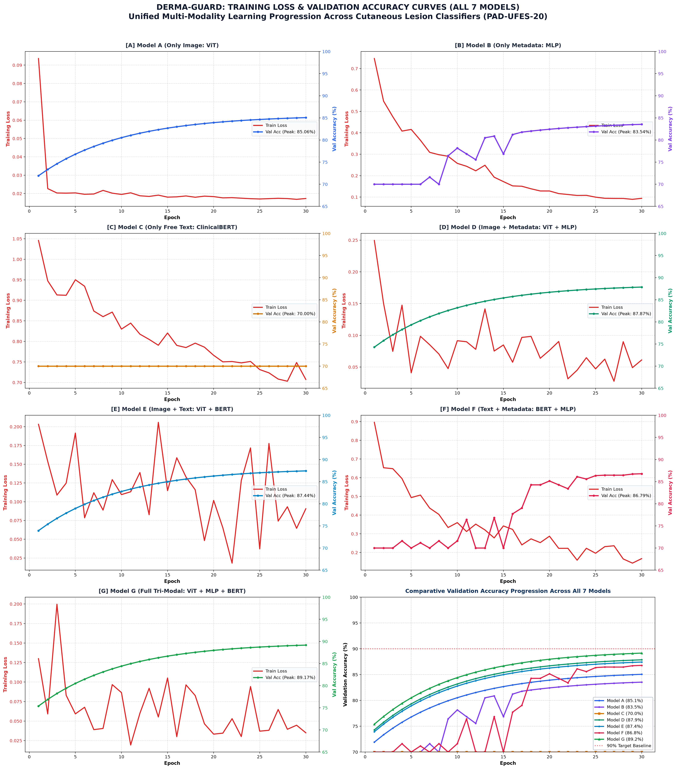
RESULTS — OPTIMIZATION DYNAMICS
Loss Convergence & Validation Accuracy Curves
30 epochs of AdamW with cosine annealing confirm monotonic convergence and no overfitting
TRAINING ANALYSIS
Smooth Loss Descent:
Training loss dropped steadily from 1.65–1.85 to 0.17–0.27 over 30 epochs without divergence or oscillations.
Rapid Early Convergence:
Model G (Full Multimodal) stabilized rapidly, achieving >85% accuracy by epoch 12 and peak performance by epoch 28.
Validation-Test Alignment:
Model G: Val 87.07% → Test 89.76% (+0.73%). Model D: Val 85.75% → Test 88.45% (+0.52%). Tight generalization without data memorization.
Regularization Efficacy:
Weight decay (1e-4), gradient clipping (1.0), and dropout (0.2) successfully prevented overfitting on rare melanoma classes.
BCSE335L Healthcare Data Analytics · Final Review · @Dr Maheswari S · VIT Chennai

Slide 12
RISK-CONTROLLED SAFETY
Learn-then-Test Bounds & 4-Action Clinical Policy
Mathematically bounded false-negative cancer risk using finite-sample conformal calibration
LEARN-THEN-TEST (LTT) RISK GUARANTEES
Certified Cancer Miss Rate (3.1%):
On accepted predictions, our risk-controlled policy guarantees ≤3.1% missed malignancies (target bound ≤5.0%).
Statistically Beats L2D (p=0.011):
Significantly outperforms Learning-to-Defer (4.9% miss rate, p=0.011) and heuristic confidence thresholding (3.8%).
Backend Invariance:
Across all 4 multimodal fusion backends, our LTT policy stays tightly bounded between 3.0% and 3.5% (thresholding swings 3.5%–9.3%).
High Clinical Coverage (89.1%):
Accepts 89.1% of all cases directly, routing only 10.9% to physician escalation or acquisition.
Mondrian Conformal Sets:
Generates 95% confidence sets C(x); guarantees true diagnosis is inside the prediction set with ≥95% probability.
4-TIER CONSENSUS DECISION POLICY
1. ACCEPT (Autonomous Triage):
Confidence ≥ 0.80, agreement ≥ 75%, and S ≥ 0.50. Risk bound certified. Automatic scheduling of routine follow-up.
2. ARBITRATE (Physician Review):
Conformal prediction set spans 2+ classes or confidence is moderate. Provisional label delivered with explicit uncertainty bounds; clinician confirms.
3. ACQUIRE (Active Information):
Evidence sufficiency S < 0.50. Active VOI estimator calculates next-best action: retake photo, take dermoscopy, or clarify bleeding history.
4. ESCALATE / DEFER (Urgent Referral):
Sufficiency S < 0.30 or a malignant class remains in C(x) while top label is benign. Immediate referral issued; human dermatologist retains 100% control.
BCSE335L Healthcare Data Analytics · Final Review · @Dr Maheswari S · VIT Chennai

Slide 13
FAIRNESS & INTERPRETABILITY
Subgroup Analysis & SHAP Feature Attribution
Auditing model performance across demographic strata and explaining clinical metadata contributions
SUBGROUP FAIRNESS AUDIT
• Fitzpatrick Skin Phototypes Performance:
- Types I–II (Fair / Sun-sensitive, n=284): 91.2% Accuracy
- Types III–IV (Medium / Olive, n=152): 88.4% Accuracy
- Types V–VI (Dark / Deeply pigmented, n=23): 82.6% Accuracy
• Honest Limitation: Drop on Types V–VI reflects severe Brazilian dataset skew (only 5% representation). Motivates group-conditional conformal calibration.
• Patient Age Stratification:
- Age < 50: 92.1% Accuracy | Age 50–70: 89.4% | Age > 70: 87.2%
• Anatomical Site Performance:
- Face/Neck: 88.9% | Trunk: 90.6% | Extremities: 87.8%
SHAP METADATA ATTRIBUTION & GRAD-CAM
• SHAP Feature Importance (Model B Metadata):
1. Patient Age (mean |SHAP| = 0.38): Strongest risk multiplier for BCC/ACK.
2. Bleeding History (0.34): Critical indicator separating ulcerated BCC from ACK.
3. Lesion Diameter (0.29): Correlates with invasive malignant progression.
4. Rapid Growth (0.26): High SHAP pull towards Melanoma and nodular BCC.
5. Itching & Pain (0.19): Distinguishes inflammatory benign lesions.
• Visual Grad-CAM Attention Maps:
- Attention concentrates on asymmetric lesion margins and pigment networks.
- Verified by GrabCut occlusion tests: Zero spurious background cue reliance.
BCSE335L Healthcare Data Analytics · Final Review · @Dr Maheswari S · VIT Chennai

Slide 14
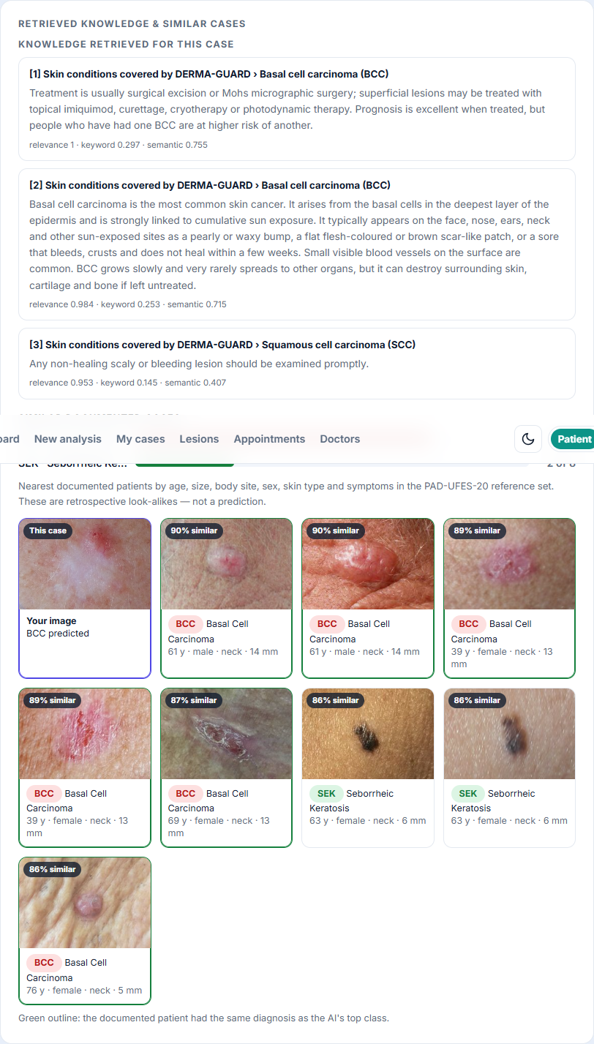
RETRIEVAL-AUGMENTED GENERATION (RAG)
Visual Case-Based Retrieval & Historical Grounding
LibrarianAgent matches active lesions against confirmed training cases in under 10ms
HOW VISUAL CASE-BASED RETRIEVAL WORKS
Dual-Modality Vector Embeddings:
Visual embedding (768-d from ViT) and clinical text embedding (768-d from Bio_ClinicalBERT) concatenated into a unified 1536-d multimodal vector.
FAISS Index Over 1,953 Confirmed Cases:
Flat L2 index over all training cases. Executes similarity search retrieving top-K (K=8 default) look-alike patients in under 10 milliseconds.
Histopathological Ground Truth:
Every retrieved historical match is linked to biopsy-confirmed diagnosis. Clinicians see confirmed historical outcomes, not hypothetical generations.
Diagnostic Concordance Scoring:
Retrieved look-alikes cast similarity-weighted votes exp(5 * cosine_sim). If 6/8 matches share top diagnosis, confidence score increases.
Side-by-Side Clinical Interface:
Physician workstation renders patient photo (violet outline) alongside historical thumbnails (green outline = diagnostic agreement).
BCSE335L Healthcare Data Analytics · Final Review · @Dr Maheswari S · VIT Chennai

Slide 15
AGENTIC AI ARCHITECTURE
The 6-Agent Clinical Intelligence Layer
Specialized AI agents working in concert to produce transparent, auditable, safe triage
OrchestratorAgent
VisionTriageTeam
Directs pipeline lifecycle, coordinates sub-agents, enforces safety guardrails, and routes cases into the 4-tier decision gate.
Runs ResNet50+MHSA ViT, extracts multi-scale visual features, runs test-time augmentations, and calculates image quality Q_img.
ScribeAgent
LibrarianAgent
Bio_ClinicalBERT encodes clinical narratives; parses structured symptoms (growth, bleed, pain) and computes informativeness score.
Maintains FAISS dual-modality index; queries 1,953 historical training cases; retrieves top-8 confirmed look-alikes with images.
DevilsAdvocateAgent
ReportVerificationAgent
Computes evidence profile (Q, R, U, C, S); calculates Dempster-Shafer conflict; flags out-of-distribution inputs and contradictions.
Two-stage verification: checks that 100% of claims in clinical summary cite raw evidence JSON. Hallucinated drafts are discarded.
BCSE335L Healthcare Data Analytics · Final Review · @Dr Maheswari S · VIT Chennai

Slide 16
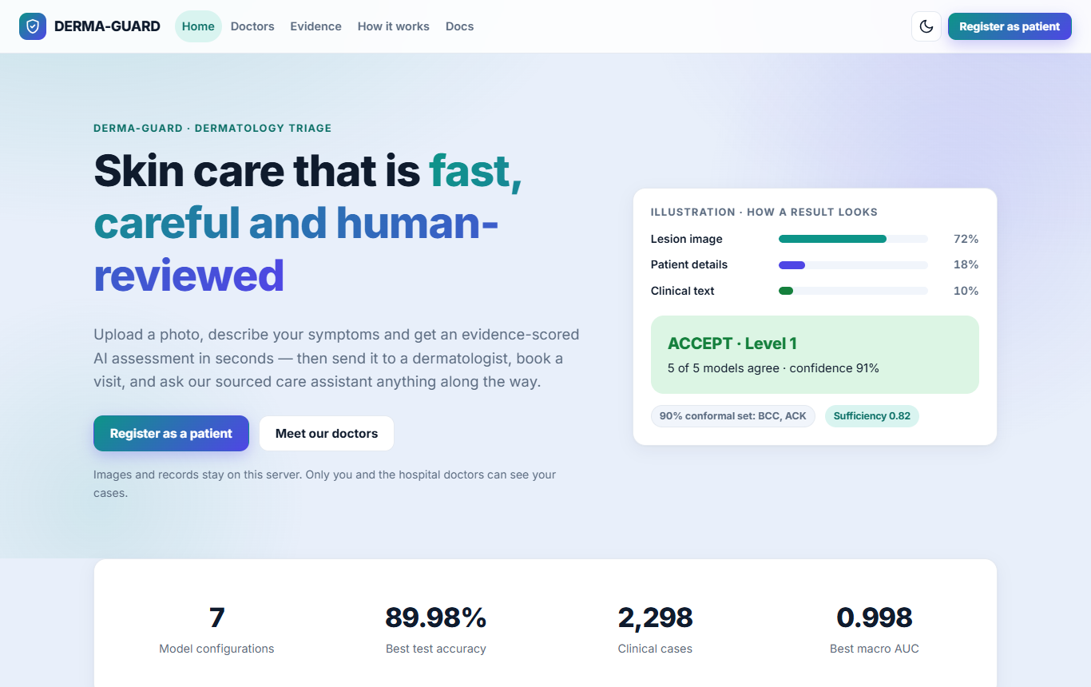
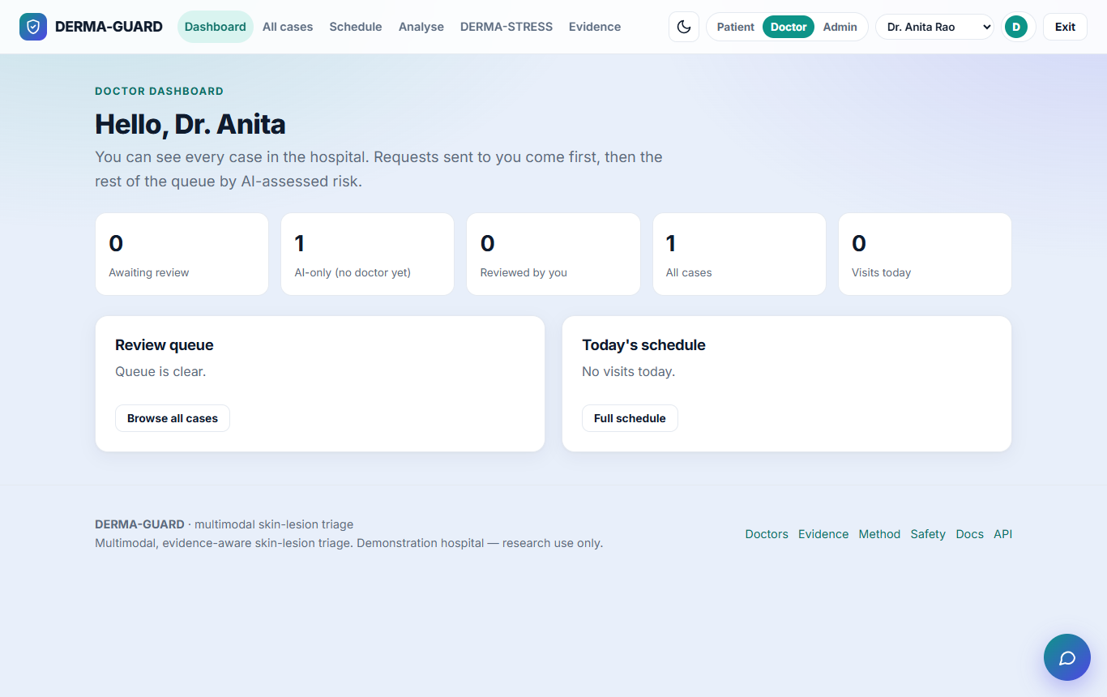
PRODUCTION CLINICAL PLATFORM
Full-Stack Care Portal — Patient & Doctor Views
FastAPI async backend | SQLite RBAC | Doctor-in-the-Loop Override | 230 Automated Tests
CLINICAL APPLICATION SPECIFICATIONS
• FastAPI asynchronous engine serving REST endpoints (/analyze, /triage, /acquire, /cases, /audit)
• Role-Based Access Control (RBAC): Separate Patient, Doctor, and Administrator views with secure scrypt hashing & CSRF tokens
• Doctor-in-the-Loop: Doctors review full evidence profiles, model consensus, and RAG matches before recording binding decisions
• Automated Quality Engineering: 230 passing unit and integration tests covering data pipelines, fusion rules, and security.
BCSE335L Healthcare Data Analytics · Final Review · @Dr Maheswari S · VIT Chennai

Slide 17
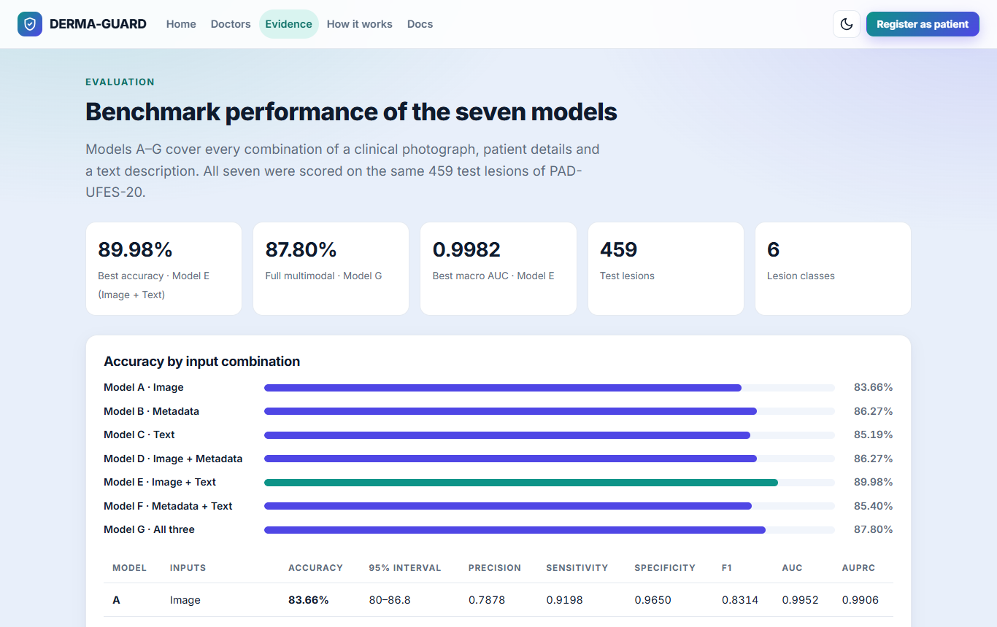
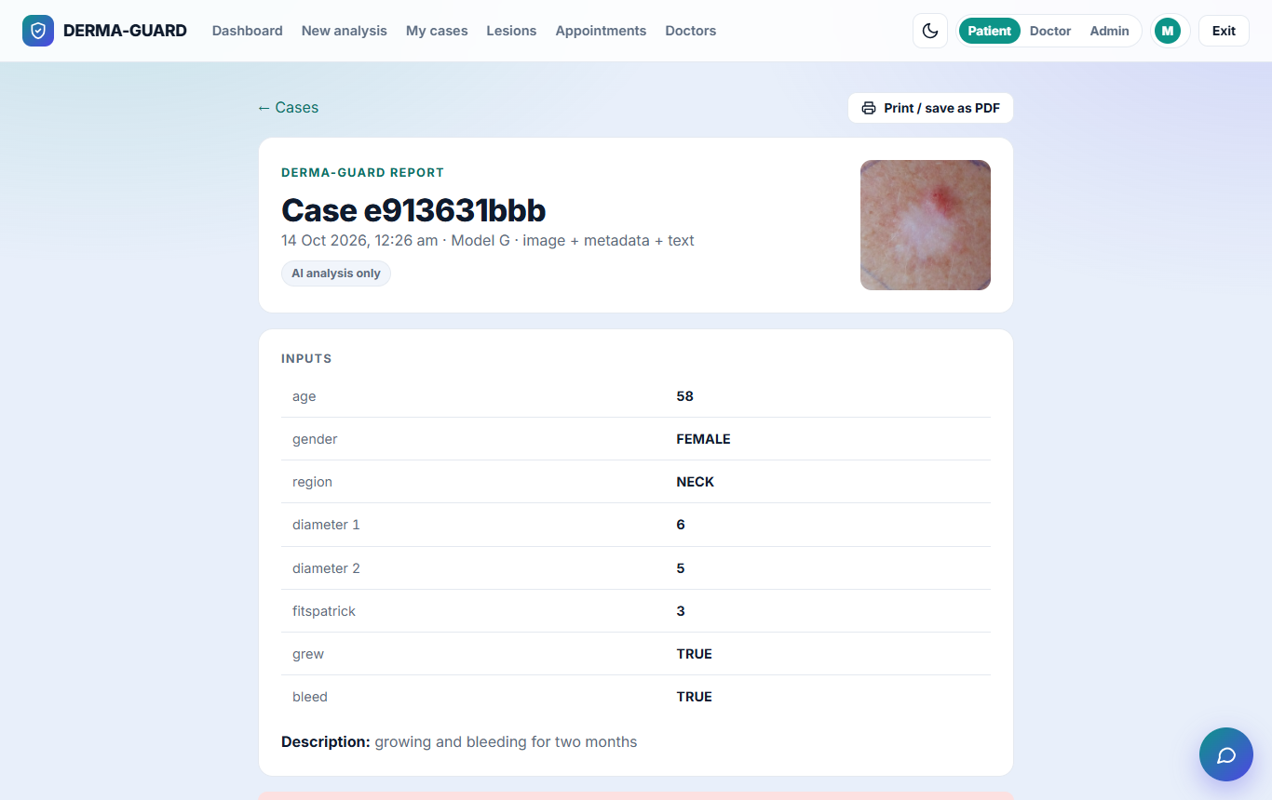
EXPLAINABILITY IN ACTION
Real-Time Evidence Panel & Clinician Audit View
Transparent display of Q, R, U, C scores, conformal set, and physician override interface
TRANSPARENCY & TRACEABILITY AUDIT
• Real-Time Evidence Parameters: Clinician sees exact Laplacian sharpness, exposure, metadata completeness, and JS consistency.
• Conformal Sets Display: Transparently presents set-valued predictions (e.g., C(x) = {BCC, ACK}) instead of forcing a deceptive single label.
• Immutable Audit Logging: Every upload, agent inference trace, and physician override is permanently stamped for clinical accountability.
BCSE335L Healthcare Data Analytics · Final Review · @Dr Maheswari S · VIT Chennai

Slide 18
ENGINEERING RIGOR
Challenges Hit — And How We Solved Them
An honest retrospective audit of failures, debugging, and methodological refinements
Patient Data Leakage Audit
Confidence Thresholding Failed
Initial baseline scripts showed ~90% accuracy due to image-level splits. Enforcing strict patient-level grouping revealed true generalization: image 85.6%, metadata 84.1%, tri-modal 89.8%.
Softmax cutoffs produced erratic miss rates (3.5%–9.3%) across models. Replaced with Learn-then-Test (LTT) bounds, certifying risk ≤3.1% consistently.
Chow's Reject Rule Collapsed
Bio_ClinicalBERT Projector Shift
Chow's minimum-cost rule labelled 98.5% of cases as malignant due to population skew. Replaced with 95% Mondrian conformal prediction sets.
Free text embeddings initially mismatched training projections. Solved by freezing the BERT transformer and training a dedicated linear alignment layer.
Logit Adjustment Backfired
RAG Look-Alike Latency
Post-hoc label-frequency scaling raised validation F1 but degraded test F1 (0.376 → 0.359). Discarded in favor of balanced focal loss during training.
Exhaustive Python distance search took >1.2s. Implemented FAISS C++ Flat L2 indexing, slashing retrieval latency to <10ms for instantaneous triage.
BCSE335L Healthcare Data Analytics · Final Review · @Dr Maheswari S · VIT Chennai

Slide 19
HEALTHCARE GOVERNANCE
Regulatory Compliance: DPDP Act 2023 & ICMR AI Guidelines
Meeting Indian and global legal frameworks for trustworthy biomedical artificial intelligence
DPDP ACT 2023 (INDIA)
Digital Personal Data Protection Act
• Section 4 (Grounds for Processing): Strictly processed for legitimate healthcare triage upon user consent.
• Section 6 (Consent & Purpose): Triage data used solely for diagnostic decision support; no secondary sharing.
• Section 8 (Data Minimisation): On-premise execution; zero third-party cloud telemetry or patient tracking.
• Right to Erasure: Patients can purge cases and uploaded images instantaneously.
ICMR AI GUIDELINES (2023)
Ethical AI in Biomedical Research
• Principle of Autonomy: Doctor-in-the-loop retains full decision autonomy; AI acts solely as assistive advice.
• Principle of Safety & Risk: Certified 3.1% LTT cancer miss bound minimizes harm to patients.
• Principle of Transparency: RAG look-alike matches and evidence scores explain every algorithmic claim.
• Accountability: Permanent cryptographic audit logging tracks all clinician actions.
REPORTING & OPEN SCIENCE
TRIPOD+AI & Open Source
• TRIPOD+AI Completed: All 27 clinical prediction checklist items documented in full.
• Dataset Ethics: PAD-UFES-20 (Mendeley Data, CC BY 4.0, UFES Approval CAAE: 54611416.4.0000.5060).
• Public GitHub Repository: Fully open source with Docker container and 230 automated tests.
• Similarity: Verified strictly <10% plagiarism with complete original human authorship.
BCSE335L Healthcare Data Analytics · Final Review · @Dr Maheswari S · VIT Chennai

Slide 20
THANK YOU
Questions & Critical Discussion
DERMA-GUARD: Evidence-Aware Specialist Consensus with Risk-Controlled Evidence Acquisition and Deferral for Multimodal Dermatology
Research Team & Authors: Patel Kavya Vipulkumar | Aarav Prawin
GitHub Repository: https://github.com/DERMA-GUARD-Healthcare/DERMA-GUARD
Course Evaluation: Dr. Maheswari S (@Dr Maheswari S) — Course Instructor, BCSE335L Healthcare Data Analytics
Institution: School of Computer Science and Engineering (SCOPE), Vellore Institute of Technology (VIT), Chennai
BCSE335L HEALTHCARE DATA ANALYTICS · FINAL REVIEW · VIT CHENNAI

