Slide 1


SKYHACK 2.0
Optimizing Call Center Performance:
Data-Driven Insights and Recommendations WITH UNITED AIRLINES
TEAM Name: Jet set analyst
Team members: heena & kavya
College: igdtuw

Slide 2

INTRODUCTION
This analysis aims to optimize call center performance by reducing agent workload and improving customer satisfaction.
PROBLEM STATEMENT
Call center efficiency is affected by the unnecessary escalation of self-solvable issues to agents, increasing workload and handling times. United Airlines seeks to improve AHT and AST through targeted optimizations.
OBJECTIVES
Analyze drivers of long AHT and AST.
Identify self-solvable issues and recommend IVR improvements.
Enhance call categorization to streamline processes and reduce manual efforts.

Slide 3
KEY METRIC PERFORMANCE OVERVIEW
Silhouette Score: 0.87 (High)
Davies-Bouldin Index: 0.167 (Low)
AHT & AST by Call Reason:
Baggage: AHT 333s, AST 542s (relatively low complexity)
IRROPS: AHT 785s, AST 360s (high complexity)
Voluntary Change: AHT 653s, AST 527s (moderate complexity)
EXPLANATION:
These metrics indicate that our clustering model has performed exceptionally well in identifying patterns in call reasons and customer behavior, providing reliable data to inform our recommendations.
INSIGHT:
The clustering analysis shows reliable segmentation, meaning the call reasons are clearly identified. This gives us confidence in targeting specific categories for improvement.

Slide 4
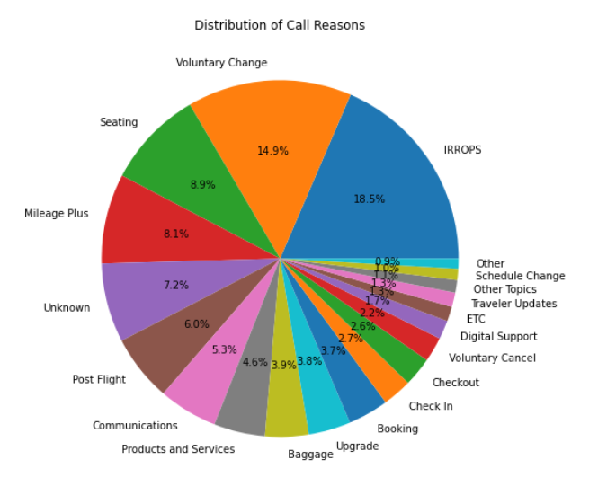
FREQUENT CALL REASONS AND CURRENT PERFORMANCE
Top 5 Frequent Call Reasons:
IRROPS (13,057 calls)
Voluntary Change (10,291 calls)
Seating (6,223 calls)
Mileage Plus (5,487 calls)
Post-Flight (3,869 calls)
Key Drivers of Long AHT/AST:
Silence Percentage Average
Agent Performance
Average Sentiment
Loyalty
Call for Reason.
CONCLUSION:
Most frequent issues are a mix of low-complexity (Seating, Baggage) and high-complexity (IRROPS, Mileage Plus) problems. Targeting automation for simpler cases will reduce workload on agents and improve AHT.

Slide 5
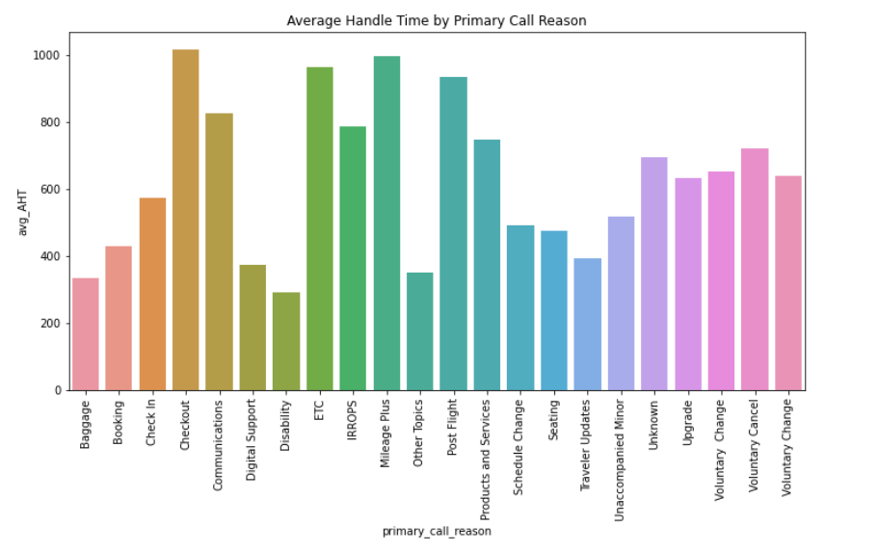
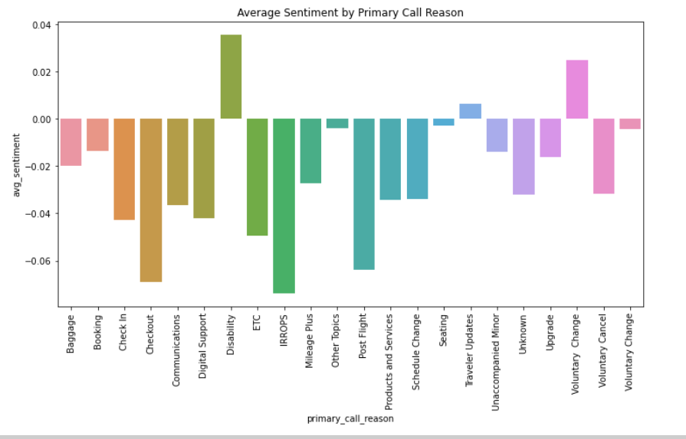
RECOMMENDATION FOR SELF SERVICES/ IVR AUTOMATION
Baggage: Automate status inquiries via IVR to reduce agent involvement in repetitive tasks.
Booking & Seating: Allow customers to modify bookings and select seats via IVR.
Schedule Change: Enable automated flight schedule changes via IVR.
Voluntary Cancel/Change: Automate cancellation and voluntary changes using self-service portals.
OUTCOME:
Implementing IVR/self-service for frequent, low-complexity issues will reduce AHT and AST.
Free up agents for complex tasks like IRROPS and Mileage Plus.
Improve customer satisfaction by providing faster solutions.

Slide 6
ISSUES REQUIRING AGENT BASED RESOLUTION
IRROPS: Involves operational disruptions that require human assistance.
Mileage Plus: Loyalty and personalized issues are too complex for automation.
Checkout & Post-Flight: Payment and post-flight issues involve sensitive data and need human support.
Reasoning:
These tasks are more complex and personalized, requiring agent expertise to maintain customer satisfaction.

Slide 7
PERFORMACE METRICS
AHT (Average Handle Time) for Key Call Reasons:
Baggage: 333 seconds
Booking: 427 seconds
Seating: 475 seconds
Voluntary Change: 653 seconds
IRROPS: 785 seconds
AST (Average Speed to Answer):
Baggage: 542 seconds
Seating: 571 seconds
Voluntary Change: 527 seconds
IRROPS: 360 seconds
RECOMMENDATION:
Focus on reducing AHT and AST for high-frequency, low-complexity issues through automation to improve overall efficiency.

Slide 8
FURTHER AREAS OF INVESTIGATION
Sentiment Analysis: Explore deeper into the correlation between customer sentiment and call escalation to predict high-frustration cases.
Agent Performance: Investigate how agent experience affects AHT and customer satisfaction to create optimized agent training programs.
Customer Loyalty: Analyze the role of customer loyalty in escalations and how loyalty programs could reduce customer frustration.
REASONING:
These areas will help further refine our understanding of the factors driving long call durations and escalations, and help us tailor strategies to improve performance.

Slide 9
CONCLUSION
Automating simple, frequent tasks like baggage tracking, booking modifications, and seating changes can drastically reduce AHT and AST, while more complex issues still need agent involvement
RECOMMENDATION
Implement IVR/self-service for repetitive tasks, and focus agent time on complex, high-sensitivity cases to optimize performance and improve customer satisfaction.

