Slide 1
🛡️ COMPOSITE RISK GUARDIAN
Aurora
A personal safety system that acts before you have to ask.
Continuous multi-signal behavioral telemetry • Anti-coercion check-in • 100% on-device privacy
Hackathon Submission 2026 | Production Deployment & Architecture Deck

Slide 2
PROBLEM STATEMENT
The Critical Flaw of Reactive Safety Apps
🚨 The Manual Action Fallacy
Most apps assume the victim can recognize danger and act mid-crisis (unlock phone, open app, press button). Under real panic, restraint, or distraction, that assumption fails.
🤐 The Coercion Blindspot
Attackers routinely force victims to unlock phones and reply "I'm fine." Existing check-in systems treat any reassuring response as safety confirmation and stand down.
⏱️ Hesitation & Fear of Embarrassment
Users hesitate to trigger panic buttons out of social embarrassment or false-alarm fear until it is already too late for early prevention.
🔋 Always-On Fatigue & Disablement
Constant 24/7 family GPS tracking causes heavy battery drain and surveillance discomfort on both ends, leading users to disable safety features entirely.

Slide 3
CORE PHILOSOPHY
Inverting the Safety Model: Default Toward Caution
TRADITIONAL MODEL: REACTIVE
Assumes Safe Until Explicit Panic
• Passive state: App sleeps until manual trigger
• Danger response: Waits for user to unlock and press SOS
• Verification: Any response ("I'm fine") dismisses alert
• Result: Fails completely if user is restrained or coerced
AURORA MODEL: PROACTIVE
Assumes Risk Upon Anomalies; Proof Required
• Continuous telemetry: Evaluates speed, stillness, time, zones, battery
• Multi-factor compounding: Correlated risks trigger quiet check-in
• Strict safe-word stand-down: Only exact private word cancels alert
• Fail-Closed: Silence or wrong word instantly escalates to SOS

Slide 4
ENGINE ARCHITECTURE
Composite Risk Scoring Engine (0 – 100)
1. Passive Input Signals
• Transit Pace (Walk / Accelerating / Sprint)
• Stillness Duration (Stationary seconds)
• Time of Day (Day vs Night Diurnal Cycle)
• Route Familiarity (500m Geofenced Zones)
• Battery Discharge (Gradual vs Instant Plunge)
• Crowd Density (Isolated vs Populated Area)
2. Compounding & Decay
• Correlated Cross-Signal Multipliers:
2 Factors: 1.15x | 3 Factors: 1.25x
4+ Factors: 1.35x compounding multiplier
• Asymmetric Response Dynamics:
Instant Escalation: Threat bursts jump score immediately without sluggish lag
Gradual Temporal Decay: 0.5 pts/sec (30 pts/min) de-escalation once calm returns
3. Worked Threat Scenario
Scenario: Night Evasive Sprint
• Night Vulnerability Baseline (+15 pts)
• Unfamiliar Route Perimeter (+12 pts)
• Deserted Isolated Area (+10 pts)
• Sudden Accelerating Pace (+15 pts)
• 4-Factor Compounding (1.35x Multiplier)
─────────────────────
Formula: (15 + 12 + 10 + 15) x 1.35 = 70.2
RESULT: Score 70 / 100 -> [HIGH TIER]
Trigger: Quiet Safe-Word Check-In Prompt

Slide 5
VERIFICATION PIPELINE
Fail-Closed Anti-Coercion Protocol
CORE INSIGHT: Coerced Confirmations Are Inherently Untrustworthy
In an active confrontation, a victim can easily be intimidated into typing "I am okay" or tapping an "I'm safe" button. Traditional apps cancel alerts upon receiving reassurance — Aurora treats unauthenticated reassurance as an active coercion indicator.
1. Elevated Risk Trigger
When composite score crosses into Elevated/High tier, Aurora suppresses alarms and presents a discreet verification prompt without alerting bystanders.
2. Strict Secret Safe Word
Only the user's secret arbitrary phrase (e.g. "AURORA7") stands down the alert. Typing "I'm fine" or any wrong word immediately triggers Emergency SOS.
3. Silence Escalation Timeline
Complete silence gives 3 timed retry windows (30s window + 10s gap). If unanswered after 3 attempts, Emergency SOS automatically broadcasts.

Slide 6
PRIVACY & ENGAGEMENT
Session-Scoped Sharing vs Always-On Surveillance
👤 Solo Mode
Zero Sharing by Default
Designed for maximum privacy. All risk evaluation, sensors, and state remain 100% on-device. Nothing is ever broadcast to anyone except when the user or silence escalates to local Emergency SOS links.
👥 Connected Mode
Emergency-Only Circle
Configures 1 to 3 trusted contacts. Circle is never notified during routine safe commutes. Contacts are only alerted during genuine emergencies (Critical tier transitions or Emergency SOS dispatch).
📍 Live Journey Share
Time-Boxed Active Walk
User explicitly starts monitoring before a specific walk (e.g. night transit) and it auto-terminates on arrival. Sharing is strictly scoped to moments the user chooses, completely eliminating notification fatigue.

Slide 7
MARKET COMPARISON
Genuinely Novel Differentiators vs Market Apps
Reference Benchmark: Established safety apps (Life360, Noonlight, bSafe, Safetipin) rely on manual panic buttons or static pre-computed neighborhood scores. None combine live multi-signal behavioral fusion with fail-closed coercion defense.
1. Live Multi-Signal Fusion
Existing apps score an area once in advance; Aurora scores a dynamic live moment as it happens by continuously compounding kinematics, diurnal time, geofencing, and battery telemetry.
2. Fail-Closed Safe Word
Existing panic buttons treat any tap as safe; Aurora defaults to security — silence and false reassurance fail closed and immediately arm Emergency SOS.
3. Session-Scoped Privacy
Eliminates standing 24/7 location tracking. Users activate Live Journey Sharing only when needed, avoiding notification fatigue and privacy erosion.
4. Reusable Modular Core
Pure-function scoring engine decoupled from UI. Can swap risk 'lenses' (e.g. medical falls, pregnancy, elder care) without rewriting app architecture.

Slide 8
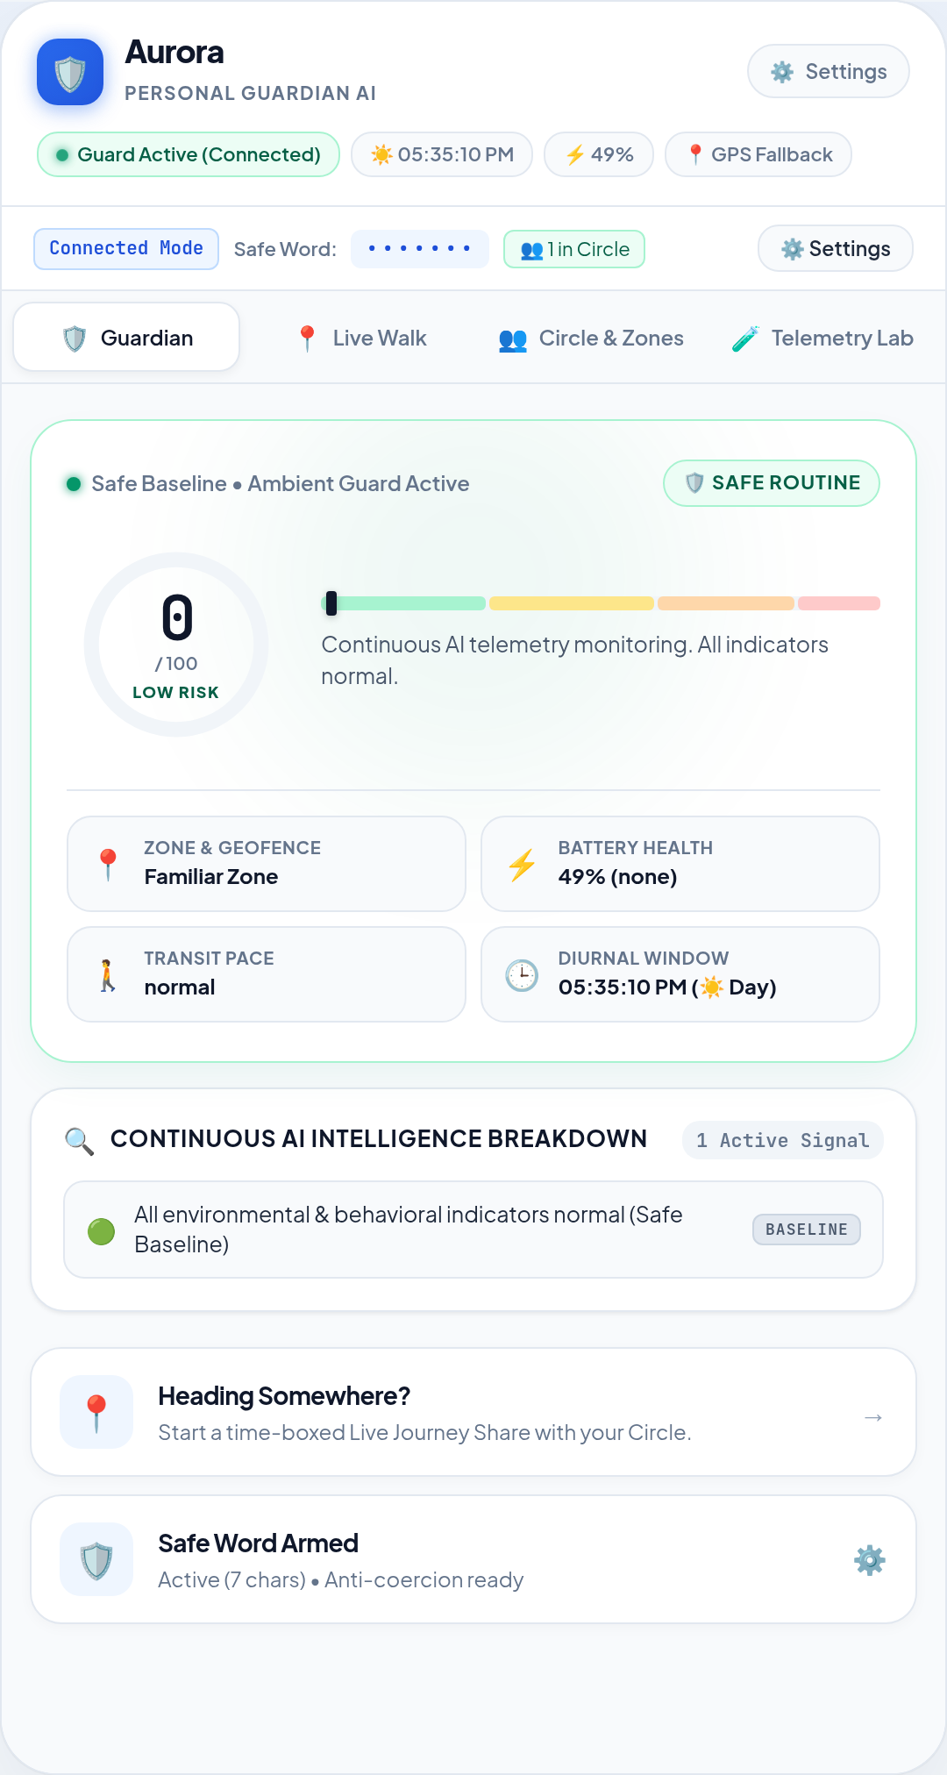
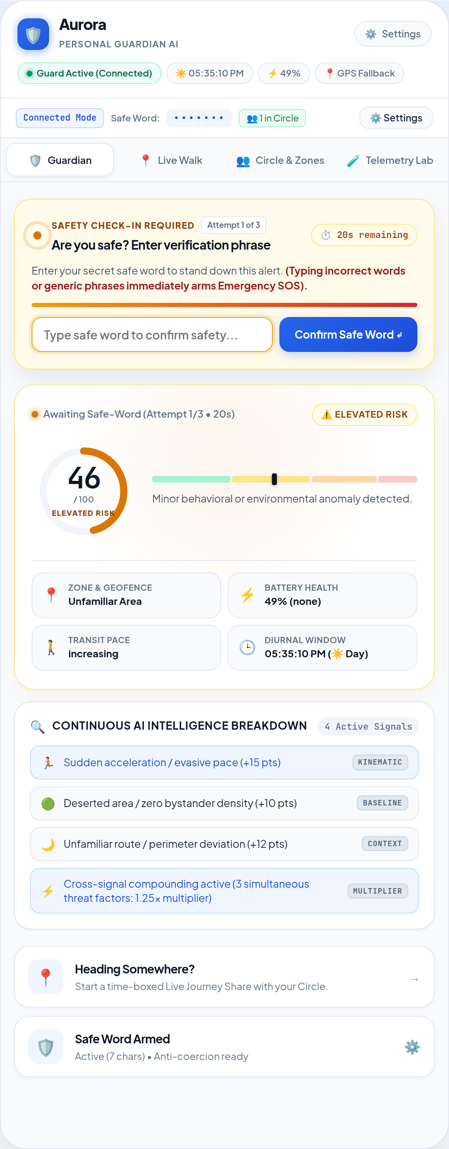
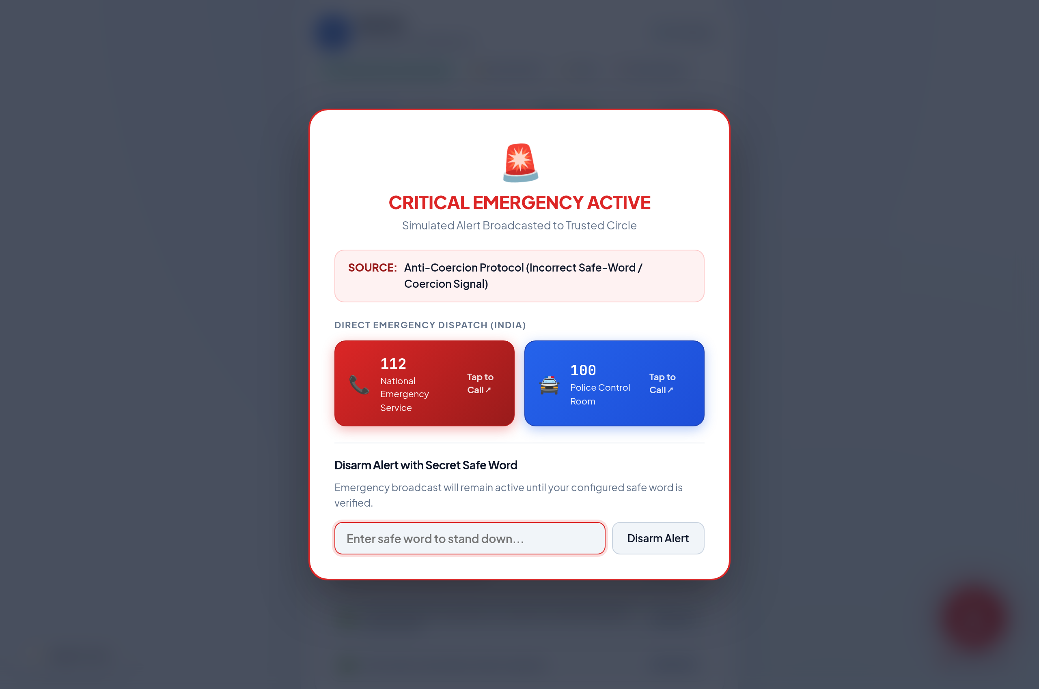
PRODUCT DEMONSTRATION
Live Application Interfaces (Deployed & Running)
1. Threat Radar & Guard HUD
Circular gauge, diurnal & GPS chips, and AI contributing factors breakdown.
2. Anti-Coercion Check-In
Discreet countdown prompt triggered upon elevated risk anomalies.
3. Emergency SOS & Direct Dispatch
Tap-to-call links (112, 100) and strict safe-word disarm authentication.

Slide 9
TECHNICAL DESIGN
Architecture: 100% On-Device & Zero Backend Attack Surface
📡 Real Browser Telemetry
• System Clock API (Diurnal Day/Night)
• Geolocation API (Haversine Velocity, Stillness)
• Battery Status API (Level & Anomaly Gradient)
• Graceful Manual Fallback Dials if restricted
⚙️ Pure Function Risk Engine
• Zero DOM, Zero React State, Zero External API
• Input: Signals Object -> Output: Score & Tier
• Fully reusable across Edge Workers, React Native, Wearable OS, and backend microservices
🔒 Local On-Device Persistence
• All safe words, contact profiles, and zones persist strictly in browser localStorage
• Zero database tracking, zero user tracking
• Eliminates backend credential leak vulnerabilities

Slide 10
LIMITATIONS
Intellectual Honesty: Known Proof-of-Concept Constraints
📡 Simulated Notification Delivery
Trusted Circle notifications are currently simulated in the client UI. A production rollout requires dedicated SMS/Push gateways (e.g. Twilio, FCM) for off-device recipient alerting.
🚔 Direct Dispatch Integration
Emergency flow surfaces native tap-to-call links (112, 100 in India). Automated PSAP dispatch integration requires governmental and public-safety institutional partnerships.
🗺️ Area Crime Statistics
Route familiarity is currently derived from user-saved geofenced zones. Integrating macro historical incident crime data (e.g. NCRB records) remains future scope.
🛡️ Physical Coercion Ceiling
Software cannot physically stop a determined in-person assailant. Safe-word protocols significantly raise the barrier to spoofing, but have physical real-world limits.

Slide 11
FUTURE SCOPE
Engineering Roadmap & Production Extensions
📊 Predictive NCRB Crime Heatmaps
Ingesting historical police precinct records to automatically adjust geographical baseline risk without manual user geofencing.
🎙️ Ambient Distress Sound AI
On-device lightweight audio classification (Google YAMNet) detecting screams or breaking glass as an emergency signal without storing audio.
👆 Duress-Specific Biometrics
Alternate fingerprint or disguised spoken phrases that visually appear to confirm safety to an attacker but silently trigger emergency escalation.
⌚ Wearable Sensor Integration
Smartwatch biometric monitoring (heart-rate spikes, sudden fall acceleration) and discreet physical confirmation tap gestures.
💬 Dedicated Messaging Gateway
End-to-end encrypted SMS & automated voice dispatch through carrier gateways to deliver reliable alerts in low-connectivity areas.

Slide 12
Aurora: Safety Built for Reality
Because in a real crisis, you should never have to remember to ask for help.
🌐 LIVE PRODUCTION APP:
https://safesignal-five.vercel.app
📦 GITHUB REPOSITORY (PUBLIC):
https://github.com/KavyaSingla244/Aurora
Ready for immediate evaluation • Includes interactive Judge Scenario Preset injector & live GPS feeds.

