Slide 1
Simple Calendar Application
Kavya Sree Katakam

Slide 2
Overview
Backend + UI Overview
  Calendar and appointment management system
  Prevents overlapping events
  Supports daily views, remaining events, and availability search
Built using Spring Boot (Backend) and React (UI)

Slide 3
Problem Statement
Create a simple calendar system
Users can:
  Create events with title, event type (Out of Office, Reminder, Holiday), date, start time, end time
  View events by day
  See remaining events for today
  Find next available slot of given duration
Overlapping events must be prevented
No database required
Note that event type doesn’t hold logic around any liberal meaning - it is just a basic selection of event type.

Slide 4
Overall Approach
Split application into Backend and Frontend
Backend exposes REST APIs
Frontend consumes APIs and provides interactive UI
Business rules enforced at both UI and backend levels
Data persisted using a local JSON file

Slide 5
Backend Design
Technology
  Java
  Spring Boot
  Jackson (JSON serialization)
Architecture
  Model → Controller → Service → File Storage
  REST-based communication
  Stateless APIs
Persistence
  File-based storage (events.json)
  No database dependency

Slide 6
Backend Key Files & Folders
calendar-backend/
|── controller/
| └── EventController.java
|── service/
| └── EventService.java
|── model/
| └── Event.java
| └── AvailableSlot.java
|data/
│ └── events.json
| ── CalendarBackendApplication.java

Slide 7
Backend Core Features
Create, update, delete events
Prevent overlapping events
Fetch events:
  All events (of all days/dates)
  By date
  Today
  Remaining for today
Find next available slot – Working hours enforced (9 AM – 5 PM) only for this method

Slide 8
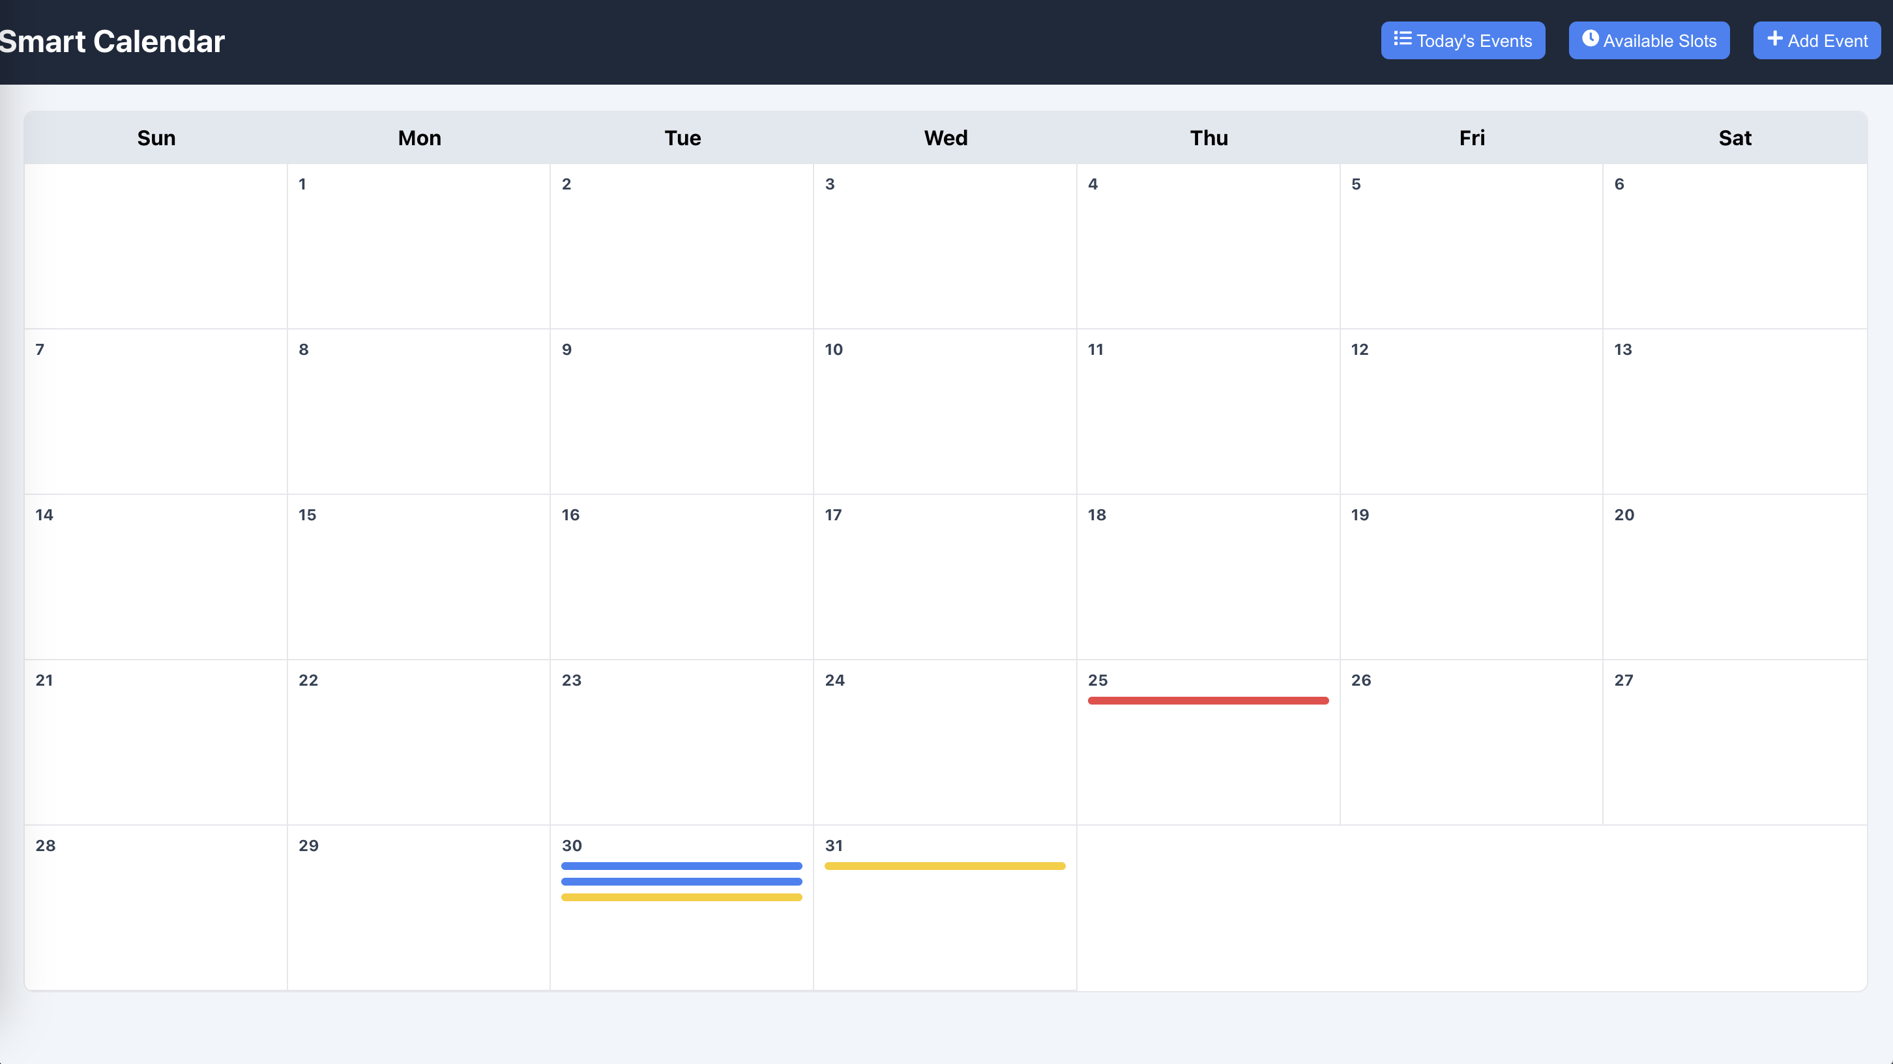
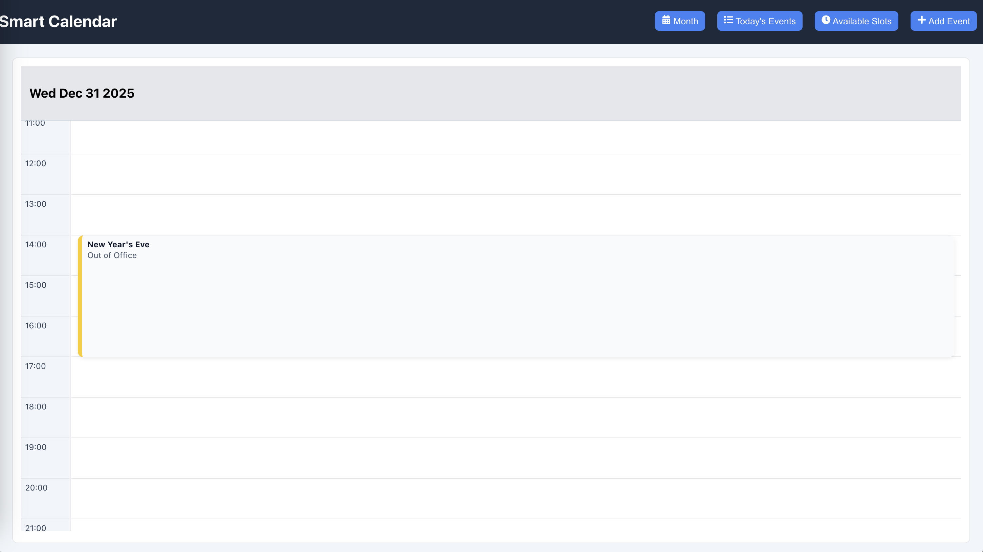
Frontend Design
Technology
  React (Functional Components + Hooks)
Responsibilities
  Calendar views (Month / Day)
  – Limited to a month for now.
  Event creation, editing & deleting
  Client-side validation
  API integration
  User-friendly interactions
Backend remains source of truth.

Slide 9
Frontend Key Files & Components
Calendar-app/
── src/
| └── api/
| | └── eventsApi.js
| └── components/
| | └── MonthCalendar.js
| | └── DayView.js
| | └── EventDialog.js
| | └── EventModal.js
| | └── AvailableSlotDialog.js
| | └── EventsPanel.js
| | └── TopBar.js
| | └── Modal.js
| | └── RightDrawer.js
| └── utils/
| | └── calendarUtils.js
| | └── eventTypes.js

Slide 10
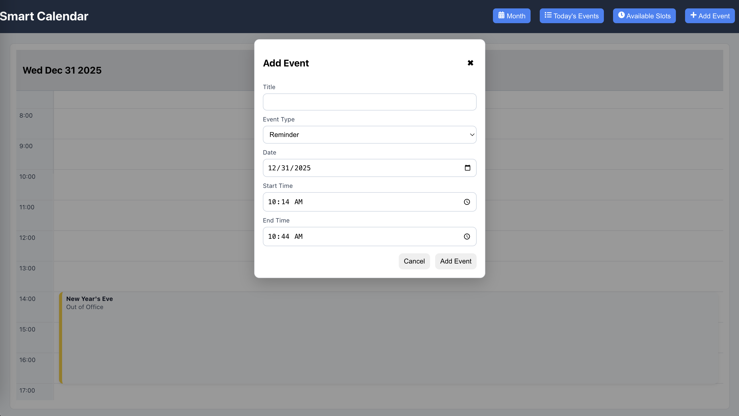

UI Features
Month view with event indicators
Day view with time grid
Click empty slot to add event (Only for today and future dates)
Right-click event to edit/delete (Only for today and future dates)

Slide 11
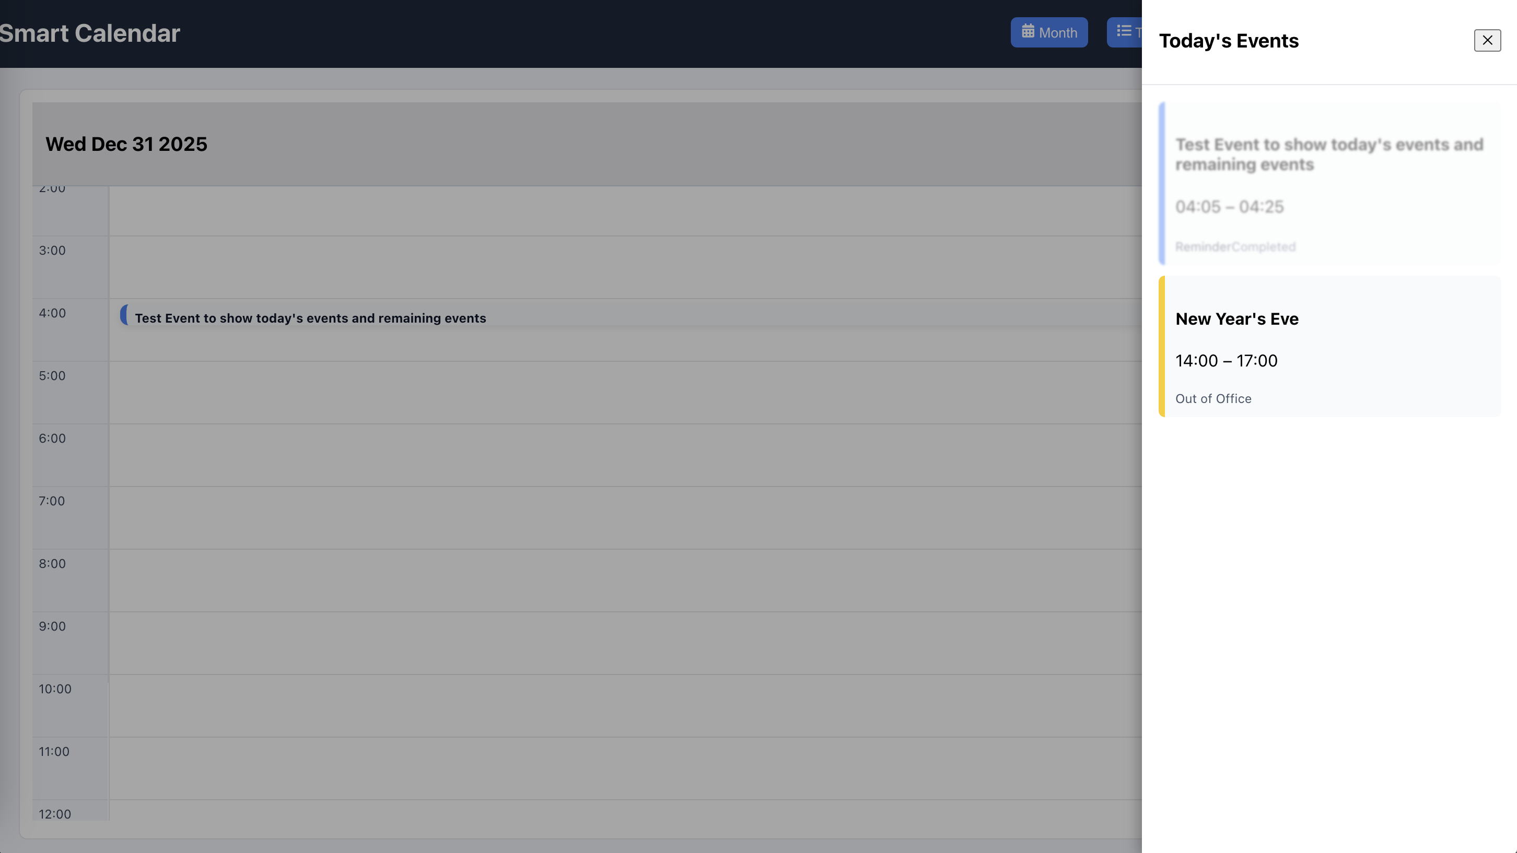
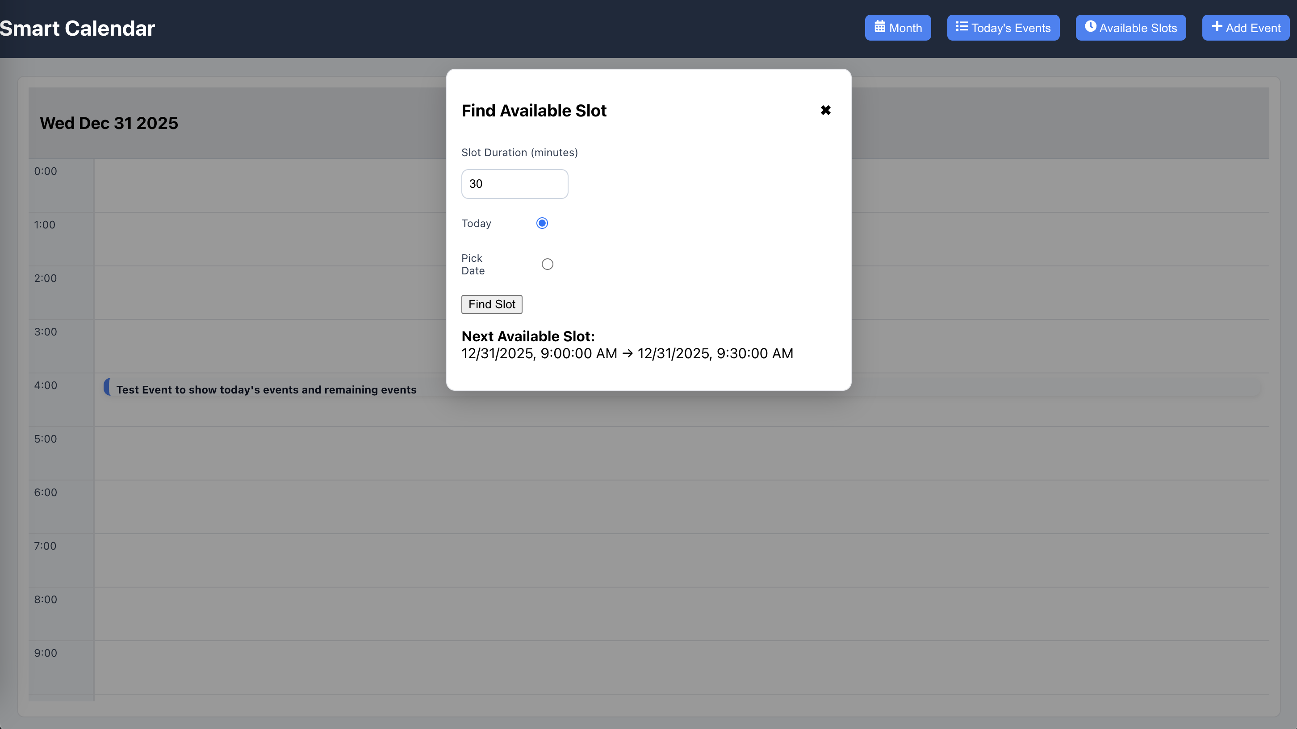
UI Feature cont.
Today’s all and remaining events panel
Available slot finder
Color-coded event types

Slide 12
API Integration (UI → Backend)
Centralized API calls via eventsApi.js
APIs used:
  Get all events
  Get events by date
  Get today’s events
  Get remaining events
  Add / edit / delete events
  Get next available slot
Error handling and messages

Slide 13
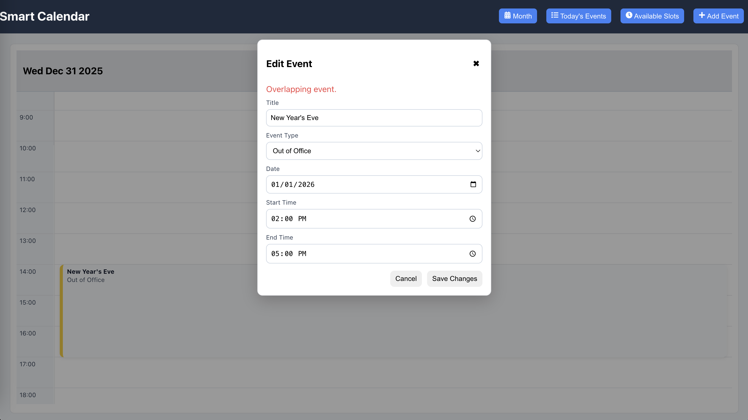
Validation Strategy
Client-side
  Prevent creation and modification of past events
  End time must be after start time
  Prevent overlapping events visually
Server-side
  Final overlap validation
  Date-based filtering
  Time-bound slot calculation

Slide 14
How to Run the Application
Clone calendar-application project :
  git clone https://github.com/KavyaSreeKatakam/calendar-application.git
Backend
  Open calendar-backend folder in IntelliJ
  Run:
  mvn spring-boot:run or Click on Run option in Intellij
  Runs on:
  http://localhost:8080
Frontend
  Open calendar-app folder in VS Code
  Run:
  npm install
  npm start
  Runs on:
  http://localhost:3000

Slide 15
Seed Data & Test Data
Stored in
  calendar-backend/data/events.json
Seed Data
  [{"id":"052f0433-3b08-4bfe-9f67-f6296c1ce883","title":"New Year","type":"HOLIDAY","date":"2026-01-01","startTime":"09:00","endTime":"17:00"},
  {"id":"799b0007-f99c-4d97-9d25-2cd53813752a","title":"New Year's Eve","type":"OOO","date":"2025-12-31","startTime":"14:00","endTime":"17:00"}]
Test Data
  Try editing :
  {"id":"799b0007-f99c-4d97-9d25-2cd53813752a","title":"New Year’s Eve","type":"OOO","date":"2025-12-31","startTime":"14:00","endTime":"17:00"}
  to
  {"id":"799b0007-f99c-4d97-9d25-2cd53813752a","title":"New Year’s Eve","type":"OOO","date":"2026-01-01","startTime":"14:00","endTime":"17:00"}

Slide 16
Testing & Verification
Use UI to:
  Add events
  Attempt overlapping events
  Edit and delete events
  View daily and monthly views
Use Postman to:
  Call REST APIs directly
  Verify conflict responses
  Test available slot endpoint

Slide 17
Key Assumptions
Events do not span multiple days
Time format: HH:mm
Date format: yyyy-MM-dd
Working hours: 9 AM – 5 PM (Only in case of searching for available slots for now)
No authentication required
Backend-only persistence

Slide 18
Future scope and improvements
Extended Calendar Views
  Enhance the calendar grid to support year-level or multi-year views, enabling long-term planning and navigation.
Stronger and Controlled Input Validation
  Introduce additional validations to handle edge cases more robustly, including stricter checks for invalid or inconsistent inputs like:
    To not make date and time manually editable
    Validations for past date while manually editing date and time instead of using Date Picker or Time Picker

Slide 19
Summary
Clean separation of UI and backend
File-based persistence (no DB)
Strong validation and overlap prevention
Simple, scalable design
Fully functional end-to-end calendar application

