Slide 1
PJM Electricity Load Forecasting using Machine Learning
Professor: Chaojie Wang
Course: Data-606 Capstone
Presenter: Kavya Sri Arroju

Slide 2

Introduction
Electricity demand fluctuates hourly depending on human activities.
Power grids need to ensure balance between supply and demand
Inaccurate predictions result in losses and power interruptions.
Prediction will be vital for optimization and stabilization.

Slide 3


Problem Statement
Electricity demands vary based on certain variables.
They include, but are not limited to, time and seasons
Conventional approaches cannot account for their complexities.
An innovative approach is needed for accurate prediction.

Slide 4

Objective
Develop a model to predict hourly electricity demand.
Train the model using past time-series data.

Slide 5

Dataset
Dataset downloaded from Kaggle (PJM electricity data).
Has hourly data spanning from 2002 to 2018.
Approximately 140,000 observations.
Includes timestamp and electricity load measurements.

Slide 6
Data Understanding
One observation corresponds to one hour of electricity consumption.
Target variable: PJME_MW (electricity load in megawatts).
Data is time-Series and sequential.
Needs feature extraction based on time.

Slide 7
Exploratory Data Analysis
Analyzed trends in electricity consumption over time.
Detected daily, weekly, and seasonal trends.
Compared trends during weekdays and weekends.
Observed consistent repeating trends in data.

Slide 8
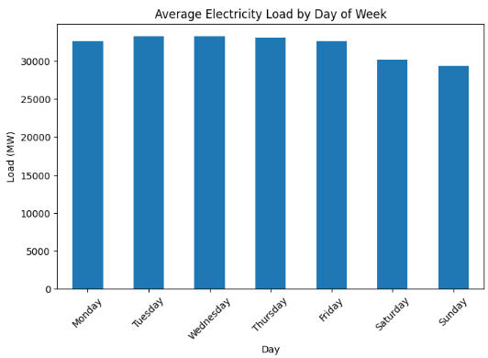
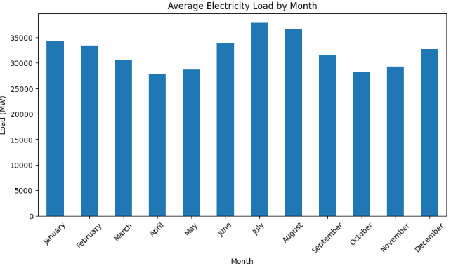
EDA Visualizations
Higher demand is seen more on weekdays than weekends.
Seasonal trends show variation across months.
Peaks in demand happen during very hot or cold times.
This pattern can be helpful in feature engineering.

Slide 9
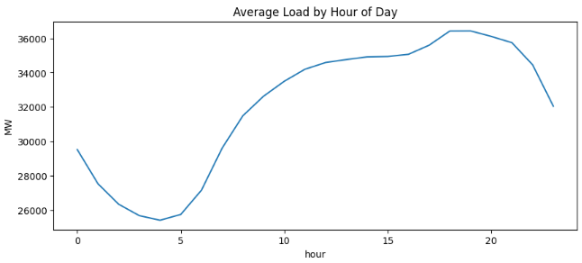
Hourly Pattern
Higher demand is seen when people work.
Usage peaks in the late afternoon/ evening.
Daily cycles are clearly visible from the graph.

Slide 10
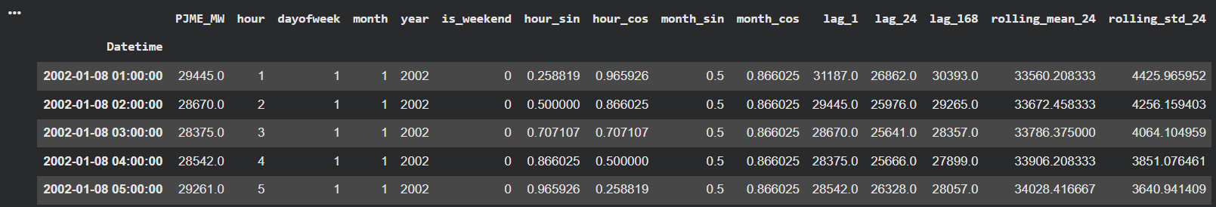
Feature Engineering
Time features such as hour, day, and month extracted.
Lag features were created to capture previous observations.
A rolling average feature was included for smoothing trends.
Cyclical encoding is used for time-related trends.

Slide 11
Model Building
Training and testing data divided (80% training/20% testing).
Linear Regression serves as the baseline regression algorithm.
Random Forest used as an advanced predictive model.
Models built to understand electricity demand patterns.

Slide 12
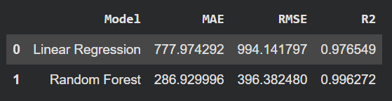
Evaluation Metrics
Mean Absolute Error calculates the average error rate.
Root Mean Square Error emphasizes large deviations.
R² shows how well model explains variance.
Used to compare model performance.

Slide 13
Results
The Random Forest model shows less errors compared to Linear Regression.
It achieved great accuracy with the R² approaching 1.
It shows good performance in terms of prediction.
The model can be used to accurately estimate the electricity

Slide 14
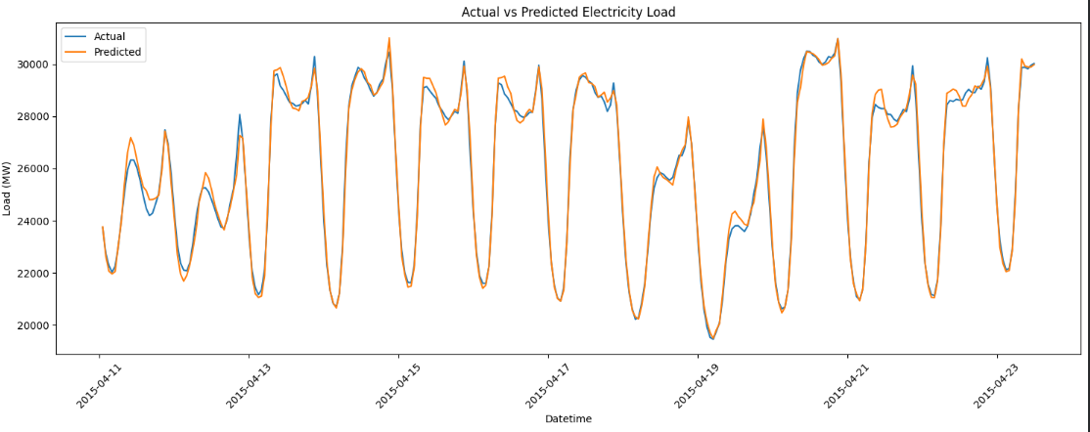
Actual vs Predicted
It is evident that the predicted demand values are very close to the actual values.
The model was able to capture the overall trend and fluctuations.
There is very little difference between the two lines (actual and predicted).
This proves that the model was highly accurate.

Slide 15
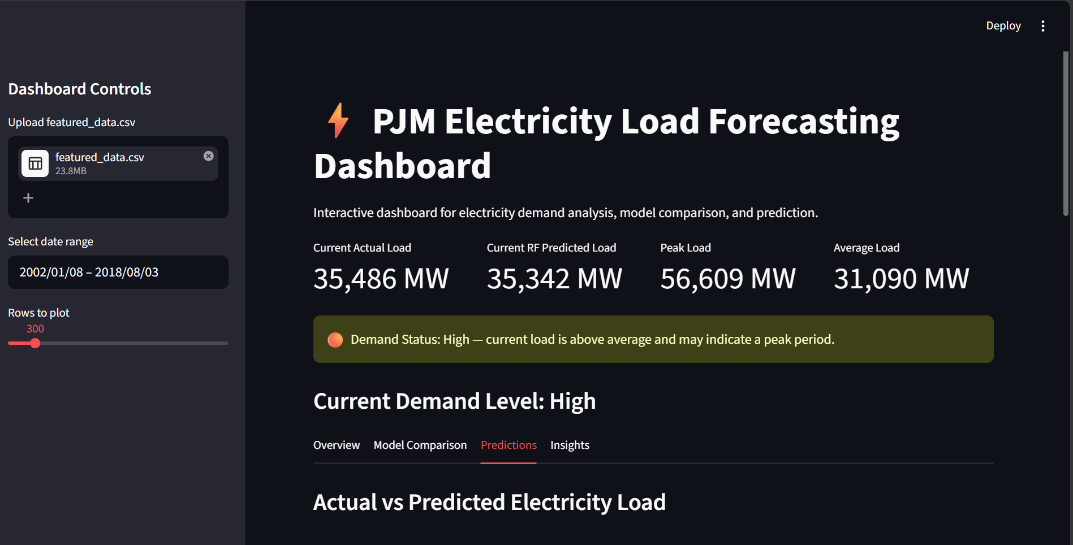
DASHBOARD
Created an interactive dashboard with the help of Streamlit.
Allows visualization of electricity demand data and prediction results.
Model comparison and performance evaluation can be performed.
Has a demand status indicator.

Slide 16
Conclusion
Electricity demand exhibits strong temporal patterns.
Feature engineering enhances the performance of the model.
Random Forest can predict non-linear relationships.
The prediction accuracy achieved by the model is almost perfect.

Slide 17

Future Work
Incorporate weather data in the model.
Include features based on holidays and events.
Use deep learning models such as LSTM.
Create a real-time forecasting system.

Slide 18
Thank You

