Slide 1
Kavya Swetha J
Final Project

Slide 2
IMAGE INPAINTING

Slide 3


AGENDA
3/21/2024 Annual Review

Slide 4

PROBLEM STATEMENT
Unwanted text or objects in images can degrade their quality and utility.
Manual removal of such artifacts is time-consuming and labour-intensive.
Automated methods for image inpainting are needed to efficiently restore images.

Slide 5

PROJECT OVERVIEW
Goal: Develop an image inpainting system to remove unwanted text from images.
Approach: Utilize deep learning techniques to predict and fill missing regions in images.
Tools: PyTorch, matplotlib, numpy.

Slide 6

WHO ARE THE END USERS?
Photographers and designers.
E-commerce platforms for product image enhancement.
Forensic analysts for image restoration in legal cases.

Slide 7

YOUR SOLUTION AND ITS VALUE PROPOSITION
Implement a neural network-based approach for image inpainting.
Train the model to predict missing regions based on surrounding context.
Evaluate the model's performance using quantitative and qualitative metrics.

Slide 8

THE WOW IN YOUR SOLUTION
Leveraging deep learning for high-quality image inpainting.
Integration of skip connections to capture long-range dependencies.
Optimization of hyperparameters for enhanced inpainting results.
3/21/2024 Annual Review

Slide 9
MODELLING
NEURAL NETWORK ARCHITECTURE
We adopt a skip-connection-based architecture for image inpainting, which facilitates the propagation of information across different layers.
The architecture consists of encoder and decoder pathways, with skip connections connecting corresponding layers.
Skip connections enable the network to capture both low-level and high-level features, enhancing its ability to reconstruct missing regions accurately.

Slide 10
MODELLING
LOSS FUNCTION FORMULATION
The choice of loss function is critical in guiding the training process and evaluating the performance of the model.
We utilize Mean Squared Error (MSE) loss to quantify the difference between the predicted and ground truth images.
Additionally, perceptual loss functions may be incorporated to align the model's predictions with human perceptual judgments.

Slide 11
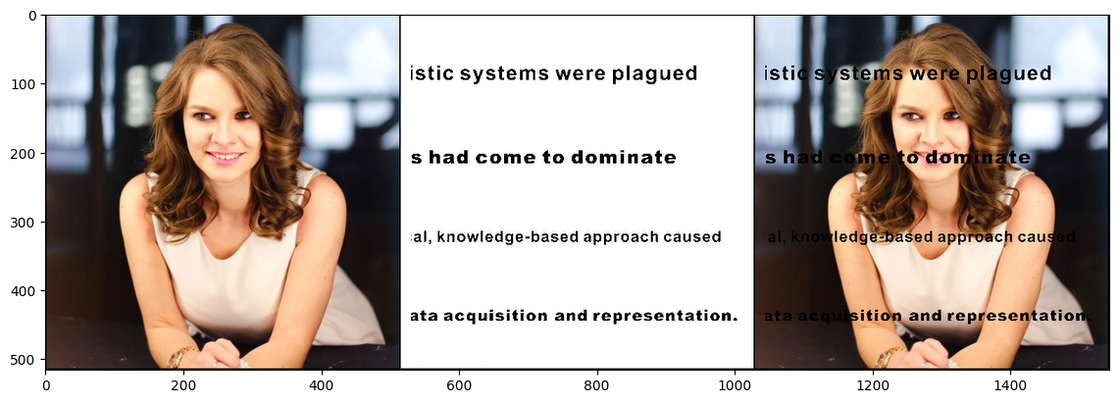
RESULTS
INPUT

Slide 12
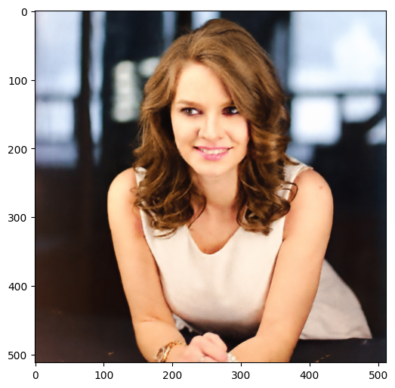
RESULTS
OUTPUT
Demo Link

Slide 13
THANK YOU

