Slide 1
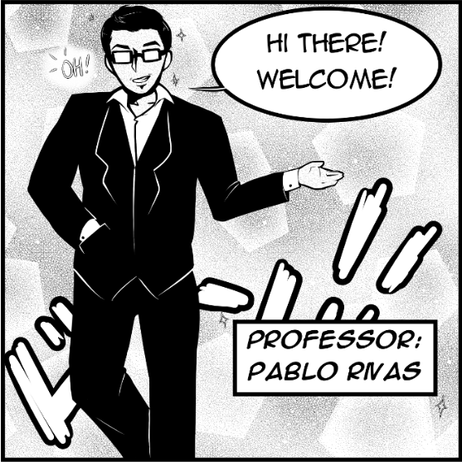
Security Algorithms and Protocols REEV.US
Professor: Mr. Pablo Rivas
Name: Kavya Reddy Vemula
20076569

Slide 2
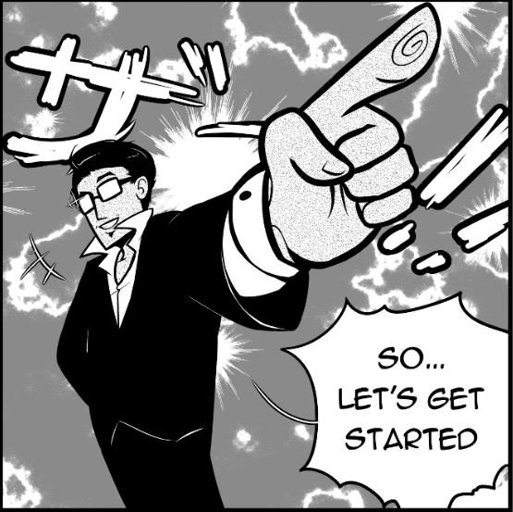
What is Reev.us?
Reev.us is an attempt to replicate our class website and
make an app version of it.
This makes it easy to access wherever you are.
This application also has few additional features:
Logging in feature
FAQ’s section
Trial and Error Section

Slide 3
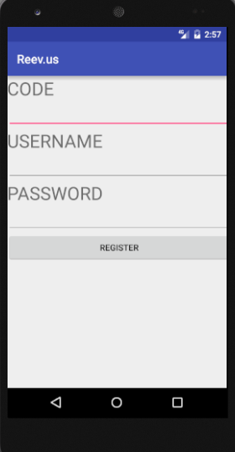
Logging In Section
Every user can view the introduction page of the app but only registered users can log in and access the schedule and Trial and Error section.
Log in based on the code
This section encrypts the login details using SHA-1.
Java.security.MessageDigest package
This MessageDigest class provides applications the functionality of a message digest algorithm, such as SHA-1. Message digests are secure one-way hash functions that take arbitrary-sized data and output a fixed-length hash value.

Slide 4
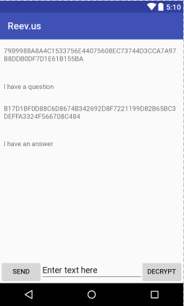
FAQ section
In this section, students can ask any question.
The question will be visible in encrypted form.
Every user on registering gets a “key” that they will be using to decrypt this question
On entering the correct key, the question will be decrypted and anyone who knows the answer can reply. This will be encrypted as well.
All the messages in this section are in encrypted form and can be decrypted by entering the right key.
AES- 128 bits for the encryption.

Slide 5
Trial and Error Section
This section consists of list of ciphers.
When clicked on a cipher, you will be able to try different inputs and see their outputs after encryption.
The selected cipher will be used to encrypt the input and the output is an encrypted text.
This section is mainly intended to try and explore different encryption algorithms and have a better understanding.

Slide 6
What I achieved and what needs to be done
I was able to understand the concepts of android app development, implementing AES algorithm, java cryptography packages.
I was able to replicate our class website into an android app.
I was able to implement logging in feature that stores user details in database.
I was able to implement FAQ section.
I need to implement Trial and Error Section

Slide 7
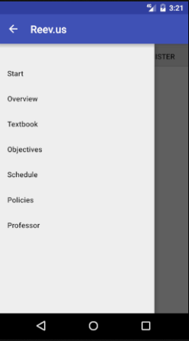
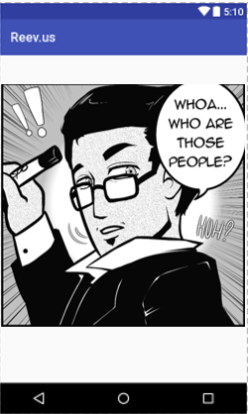
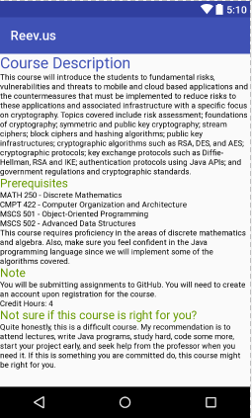
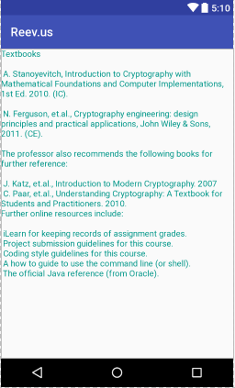
Screenshots

Slide 8
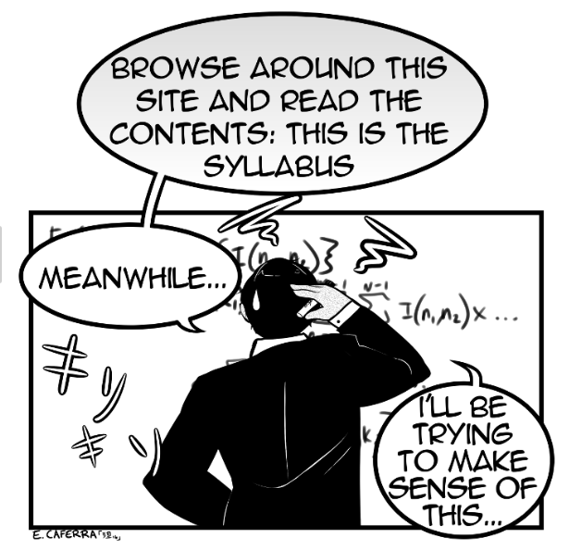
Future Enhancements
User Interface -> Improved Look and feel
Notification Function for the app whenever a question is posted
Few additional functionalities like announcements, puzzles that incorporate cryptography.
Extend it as an IOS app.

Slide 9
Thank you!!

