Slide 1

Preplacement project
Analyzing Historical
Gold price
by
SV.Kavyadara

Slide 2
Title: Analyzing Gold price
Year & month: January 2000 to
December 2022
Currency: USD

Slide 3
steps
Understanding the historical gold price data
Data Pre processing
Time Series Analysis
Data visualizations
conclusion

Slide 4
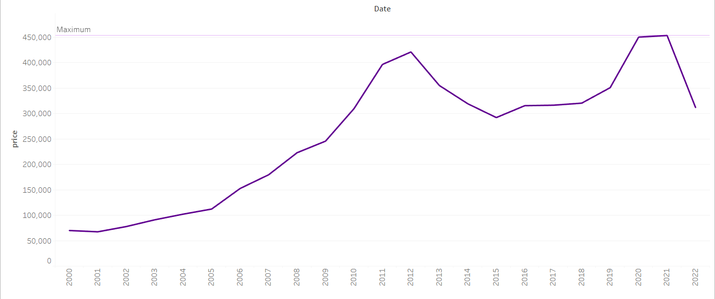
Annual Gold price trend
In USA Gradual increase from 2001 to 2012 due to economic uncertainty.
After 2012, gold prices went down because things were getting better economically. People were less worried, so they didn't buy as much gold.
Between 2015 and 2020, gold prices were unstable .
Another increase from 2020 to 2022 amid the COVID-19 pandemic and concerns about inflation.

Slide 5
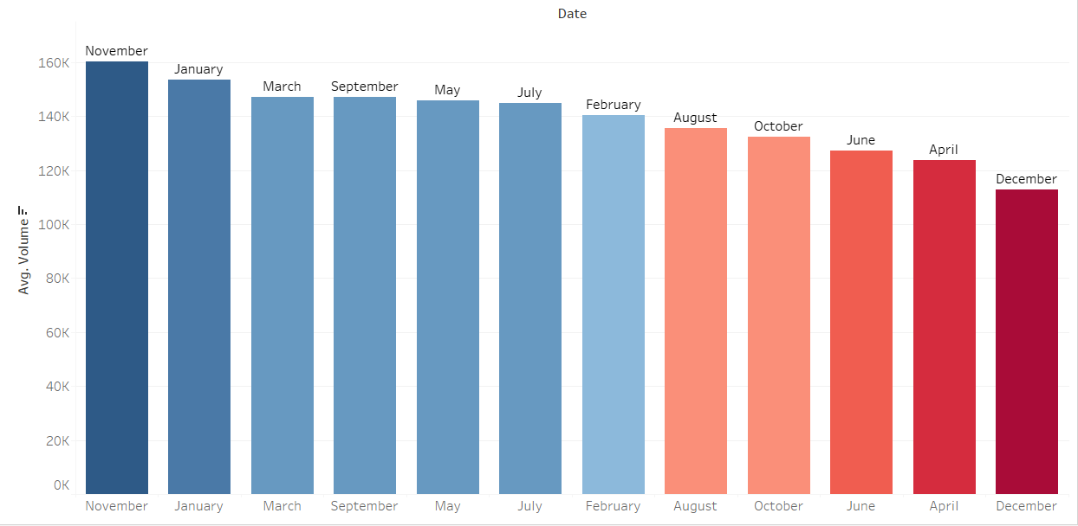
Average Monthly Volume of Gold Trades
Monthly gold volume in the USA varies throughout the year.
November consistently registers high trading volume for gold.
Investors tend to be more active in November.
Possible reasons include year-end financial planning and market dynamics.
November holds significance for gold traders and investors.

Slide 6
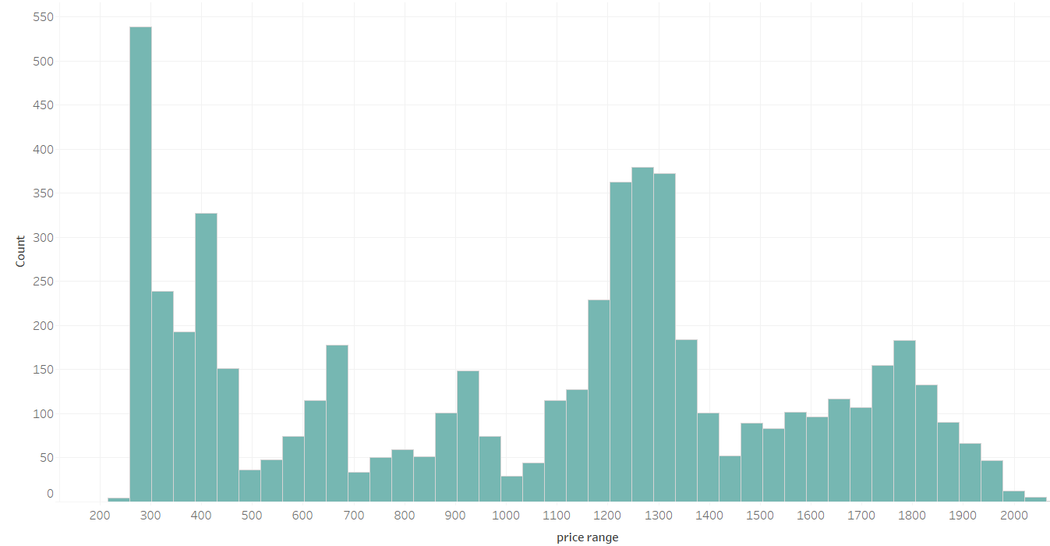
Gold Price Distribution
The graph shows how many times gold prices in the USA fall into different price ranges.
Most often, gold prices are between 200 and 300.
There's also a good number of times when gold prices are between 1200 and 1300.
This means gold prices often fall into these two price ranges.
The graph helps us see where most gold prices tend to be in the USA.
. helps us understand the price behavior of gold

Slide 7
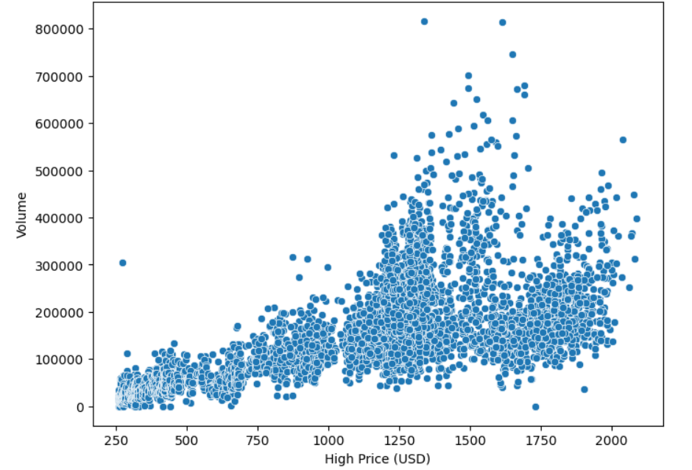
High Price vs. Volume
Gold prices between 250 and 500 had steady trading with no big changes in activity.
But, in the range of 1250 to 1750, many people traded a lot of gold.
This price range attracted more investors and traders, making it very active.
When gold prices hit 2000, the volume remained high, suggesting continued interest in gold at this elevated price level.
Different price ranges impact trading volume and investor behavior.
This information helps us understand how gold prices and trading volume are related in the USA market.

Slide 8
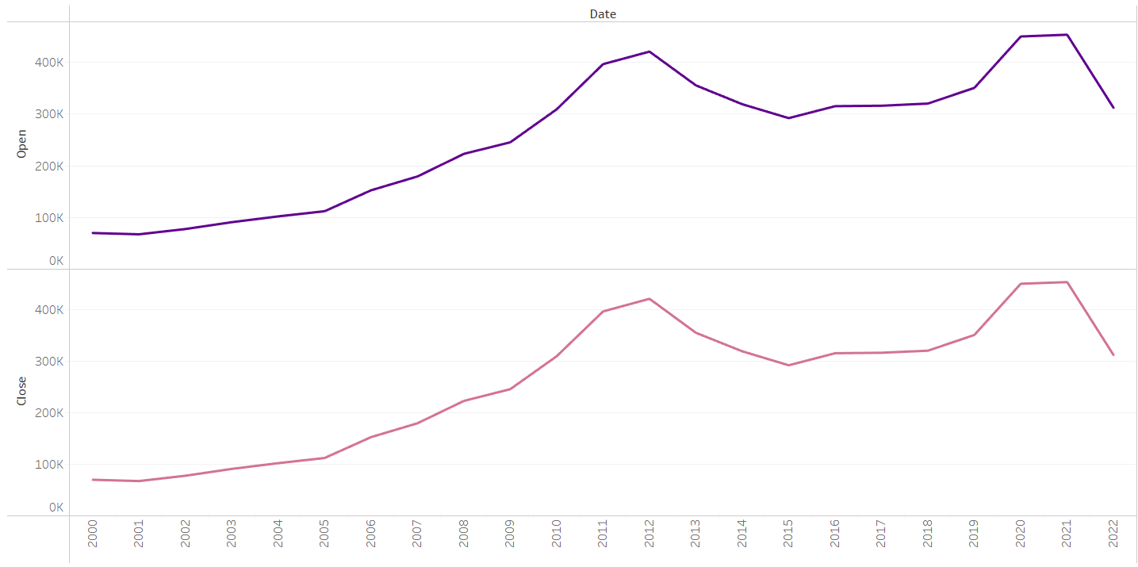
Open price
vs
close price
From 2000 to 2022, a consistent pattern was observed in the USA's gold market.
During this period, the open and close prices for gold tended to follow a similar trend.
This means that the starting price (open) and the ending price (close) for a given day or period were often very close.
Such a trend suggests a level of stability or symmetry in the market, with minimal price variation within a trading day or period.
This pattern indicates a balance in supply and demand for gold, where market forces kept the open and close prices relatively aligned over the years.

Slide 9
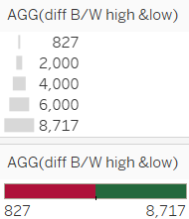
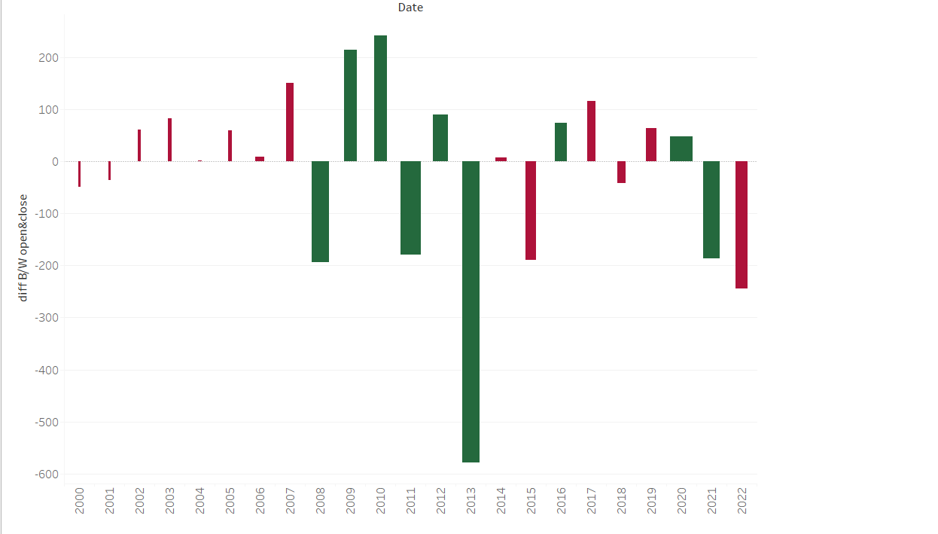
Annual Gold Price Fluctuations
while the trends in open and close prices often exhibit similarity, it's worth noting that in some years, losses were incurred.
This demonstrates that while price stability is a common trend
it's essential to consider both the open-close patterns and high-low differences for a comprehensive understanding of market dynamics.

Slide 10
Investors in gold come from various backgrounds and industries.
Individual Investors
Institutional Investors
Central Banks(united states)
Retail Investors
Mining Companies
Investment Firms
Financial Institutions
Jewelry Manufacturers
Industrial Users

Slide 11
Historical Price Trends
Economic Influence
COVID-19 Effect
Monthly Trading Patterns
Investor Behavior
Price Ranges
Price-Volume Relationship
Price Stability
Market Dynamics
In the USA, gold prices went up and down from 2000 to 2022. They went higher when people were worried about things like inflation and the COVID-19 pandemic.
Every November, lots of people trade gold. Maybe they do this because it's the end of the year, and they want to manage their money better.
Gold prices often fit into certain price ranges.
Some ranges make more people trade a lot of gold, while others don’t.
Even though gold prices are stable, looking at both the starting and ending prices and how high and low they get is important for understanding the market.

Slide 12
Thank you..

