Slide 1



KONGU ENGINEERING COLLEGE
(AUTONOMOUS)
PERUNDURAI, ERODE - 638060
Department of Computer Science and Engineering
An Enhanced Hybrid CNN–Transformer Model for Brain Tumor Segmentation Using BraTS Datasets
PRESENTED BY:
HARSHINI C R 23CSR081
KAYADARSHINI M 23CSR108
KISHORE SANKAR G 23CSR116
Notes:
9/11/2024
1
1-59

Slide 2

PROBLEM STATEMENT
Brain tumors are among the most life-threatening diseases. Accurate segmentation of tumors from MRI images is essential for:
Early diagnosis
Treatment planning
Surgery assistance
Patient monitoring
However,
Tumors vary in size and shape.
MRI images contain noise and low contrast.
Manual segmentation is time-consuming.
Results depend on radiologist expertise.
Hence, an automatic and accurate brain tumor segmentation system is required.
Notes:
9/11/2024
2
1-59

Slide 3
OBJECTIVE
Segment brain tumors from MRI images using deep learning techniques.
Preprocess the BraTS2020 dataset for model training and testing.
Implement the U-Net++ model for brain tumor segmentation.
Implement the SwinUNETR model for brain tumor segmentation.
Compare the performance of both models using evaluation metrics as Dice Score.
Assist radiologists by providing accurate and automated brain tumor segmentation for better diagnosis and treatment planning.
Notes:
9/11/2024
2
1-59

Slide 4
LITERATURE SURVEY
S.No | Paper Title | Algorithm / Model Used | Achieved Dice Score | Implementation / Key Contribution
1 | Brain Tumor Segmentation with Contextual Transformer-Based U-Net (CT-UNet) (Base Paper, 2026) | Contextual Transformer + U-Net + Dynamic Modality Fusion | 0.92 | Integrated Transformer blocks into U-Net with dynamic modality fusion for accurate multimodal brain tumor segmentation.
2 | TransUNetB: An Advanced Transformer–UNet Framework for Efficient and Explainable Brain Tumor Segmentation (2025) | CNN + Transformer (TransUNetB) | 0.87 | Combined CNN feature extraction with Transformer attention to improve segmentation accuracy and explainability.
3 | MWG-UNet++: Hybrid Transformer U-Net Model for Brain Tumor Segmentation (2025) | U-Net++ + Transformer | 0.86 | Enhanced U-Net++ using Transformer blocks to improve multi-scale feature learning for MRI segmentation.
Notes:
9/11/2024
3
1-59

Slide 5
S.No | Paper Title | Algorithm / Model Used | Achieved Dice Score | Implementation / Key Contribution
4 | Hybrid Vision UNet Architecture for Brain Tumor Segmentation and Classification (2025) | Hybrid Vision Transformer + U-Net | 0.90 | Combined Vision Transformer with U-Net architecture for improved segmentation and tumor classification.
5 | Swin UNETR: Swin Transformers for Semantic Segmentation of Brain Tumors in MRI Images (2021) | Swin Transformer + U-Net Encoder-Decoder | 0.89 | Introduced hierarchical Swin Transformer blocks for capturing both local and global contextual information in 3D MRI segmentation.
Notes:
9/11/2024
3
1-59

Slide 6
RESEARCH GAP IDENTIFIED
Existing System
CNN-based models capture only local features.
Transformer-based models require high computational resources and longer training time.
Individual models have limitations in segmentation accuracy.
Most existing methods do not effectively combine CNN and Transformer strengths.
Proposed Research Gap
Develop a Hybrid CNN–Transformer Model capable of:
Combining U-Net++ for local feature extraction.
Integrating SwinUNETR for global contextual learning.
Improving brain tumor segmentation accuracy (Dice Score).
Providing robust and precise tumor boundary segmentation.
Notes:
9/11/2024
4
1-59

Slide 7
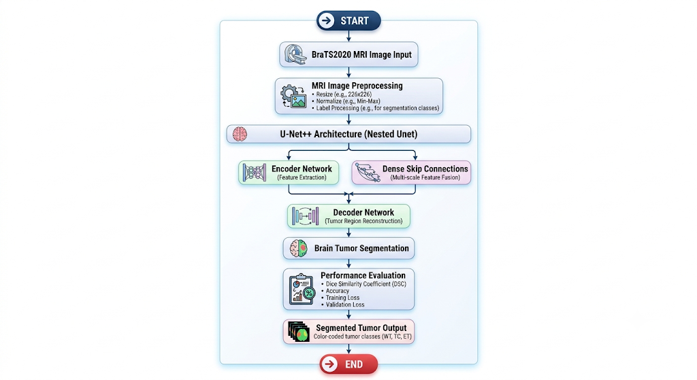
PROPOSED ARCHITECTURE
Notes:
9/11/2024
5
1-59

Slide 8
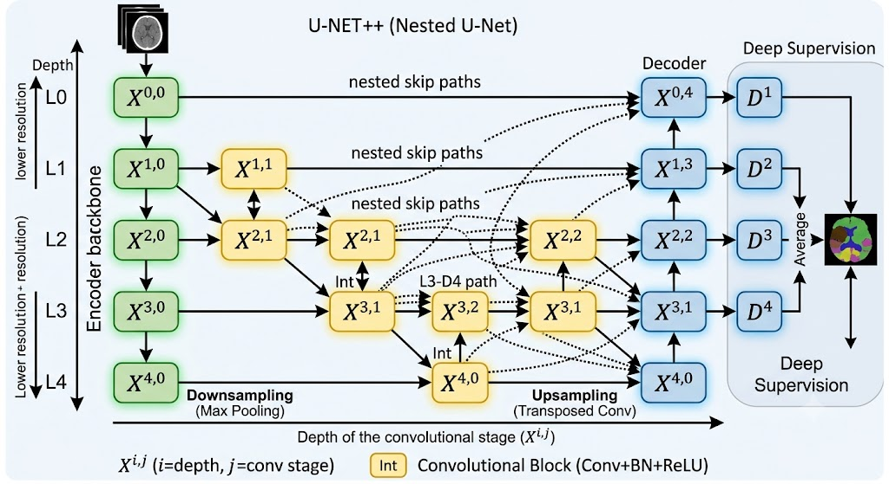
UNET++ ARCHITECTURE
Input Layer – Receives MRI brain images from the BraTS2020 dataset.
Encoder – Extracts local image features using convolution and max-pooling layers.
Dense Skip Connections – Connect encoder and decoder to preserve detailed spatial information.
Decoder – Reconstructs the feature maps into the original image resolution.
Output Layer – Generates the segmented brain tumor mask.
Notes:
9/11/2024
5
1-59

Slide 9
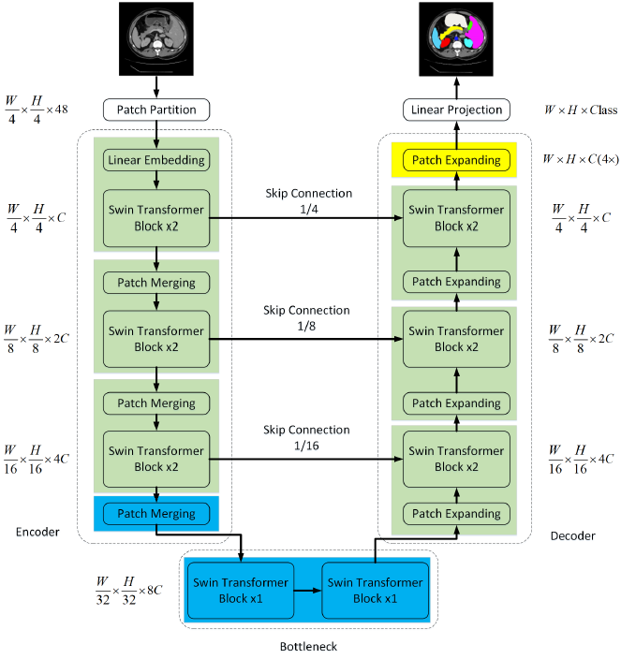
SWIN-UNET(transformer)ARCHITECTURE
Input Layer – Takes MRI brain images as input.
Patch Partition – Divides the image into small non-overlapping patches.
Linear Embedding – Converts image patches into feature vectors.
Swin Transformer Encoder – Learns local and global contextual features using shifted-window attention.
Skip Connections – Transfers encoder features to the decoder for accurate localization.
U-Net Decoder – Upsamples the extracted features to reconstruct the segmentation map.
Output Layer - Produces the final segmented brain tumor image.
Notes:
9/11/2024
5
1-59

Slide 10
PROPOSED WORK WITH PLANNED INNOVATION
Proposed Work
Collect and preprocess MRI brain images from the BraTS2020 dataset.
Implement the U-Net++ model for brain tumor segmentation.
Implement the SwinUNETR model for brain tumor segmentation.
Train and evaluate both models using segmentation performance metrics.
Compare the performance of U-Net++ and SwinUNETR using Dice Score
Planned Innovation
Develop a Hybrid CNN–Transformer architecture by integrating U-Net++ and SwinUNETR.
Utilize the BraTS 2025 dataset to improve the model's robustness and generalization.
Enhance local and global feature extraction through hybrid feature fusion.
Improve brain tumor segmentation accuracy, Dice Score, and boundary detection.
Notes:
9/11/2024
5
1-59

Slide 11
MODULES OF THE PROJECT
BraTS2020 Dataset Collection
Collect multimodal brain MRI images and corresponding segmentation masks from the BraTS2020 dataset.
MRI Image Preprocessing
Perform image normalization, resizing, and label preprocessing to prepare data for model training.
U-Net++ Feature Extraction
Extract multi-scale local features using the nested skip connections of the U-Net++ architecture.
SwinUNETR Feature Extraction
Learn global contextual information from MRI images using the Swin Transformer-based encoder.
Performance Evaluation
Evaluate segmentation performance using Dice Score, Accuracy, Training Loss, and Validation Loss.
Notes:
9/11/2024
3
1-59

Slide 12
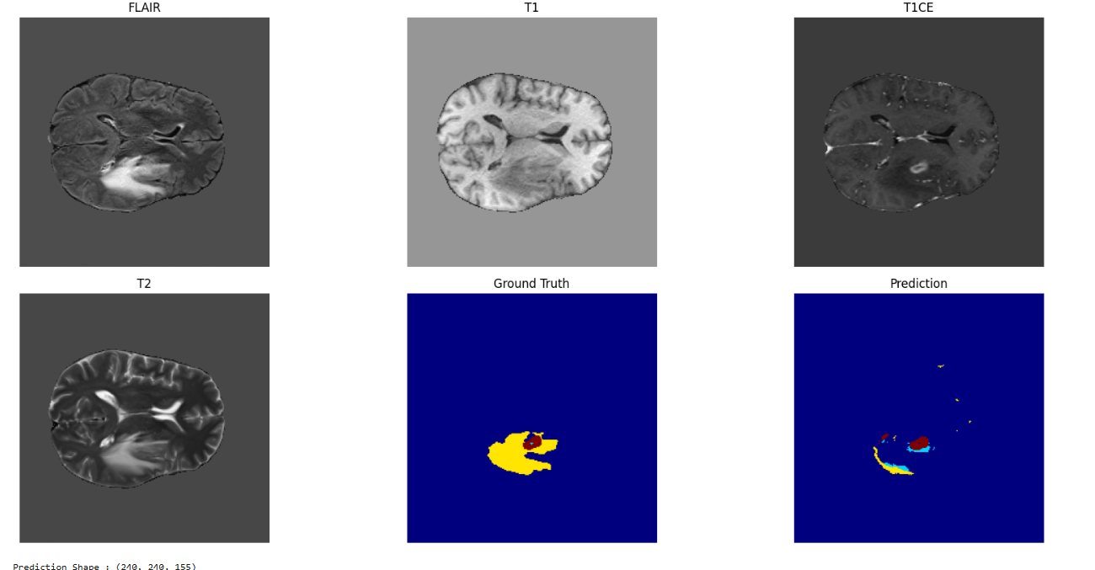
SWIN-UNET - IMPLEMENTATION
Notes:
9/11/2024
3
1-59

Slide 13
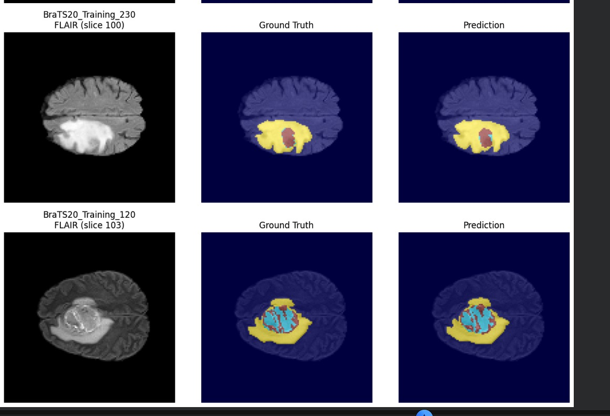
UNET++ - IMPLEMENTATION
Notes:
9/11/2024
3
1-59

Slide 14
Intermediate Results
Metrics | U-Net++ | SwinUNETR
Dataset | BraTS2020 | BraTS2020
Training Images | 295 | 295
Validation Images | 74 | 74
Testing Images | 118 | 118
Training Status | Completed | Completed
Dice Score | 0.95 (or your actual value) | 0.59
Segmentation Status | Successful | Successful
Notes:
9/11/2024
3
1-59

Slide 15
FUTURE SCOPE
Develop a Hybrid CNN–Transformer architecture by integrating U-Net++ and SwinUNETR.
Validate the hybrid model using the BraTS2025 dataset for improved robustness.
Improve segmentation accuracy, Dice Score, and tumor boundary detection.
Optimize the model for faster training and lower computational cost.
Deploy the model as an AI-assisted tool for real-time clinical brain tumor segmentation.
Notes:
9/11/2024
3
1-59

Slide 16
THANK YOU
Notes:
9/11/2024
3
1-59

