Slide 1

Employee Data Analysis using Excel
STUDENT NAME: KAVYANJALI.P
REGISTER NO: 312210001
E-mail ID: patnamkavyanjali@gmail.com
NM ID: A6C1066257E75F5851842981D3E18C93
DEPARTMENT: B.COM
COLLEGE: VALLIAMMAL COLLEGE FOR WOMEN
1

Slide 2





PROJECT TITLE
Employee Performance Analysis using Excel
2

Slide 3




AGENDA
Problem Statement
Project Overview
End Users
Our Solution and Proposition
Dataset Description
Modelling Approach
Results and Discussion
Conclusion
3
3/21/2024 Annual Review

Slide 4

PROBLEMSTATEMENT
Utilize Excel to efficiently analyse employee data by leveraging functions such as PivotTables, and conditional formatting. This enables the identification of key trends, such as current employee rates, performance levels. Decision-making processes by visualizing this data through pie chart.”
4

Slide 5

PROJECT OVERVIEW
This project focuses on analysing employee data to identify trends and insights that can drive better decisions. Excel will be used to clean, organize, and visualize key metrics such as employee demographics, performance, and retention rates. The analysis will highlight areas of improvement in workforce management, helping to optimize resource allocation. Outcomes will include detailed reports and dashboards for management review. The findings aim to support strategic planning.
5

Slide 6

WHO ARE THE END USERS?
The end users of the employee data analysis are HR managers, team leads, and senior management.
6

Slide 7
OUR SOLUTION AND ITS VALUE PROPOSITION
Conditional formatting – highlights missing cells Filter- helps to remove the empty cells Formula – helps to identify the performance of employees Pivot table – helps to summarise Pie chart – shows the data
7

Slide 8
Dataset Description
EMPLOYEE ID FIRST NAME LAST NAME BUSINESS UNIT EMPLOYEE TYPE EMPLOYEE CLASSIFICATION TYPE GENDER PERFORMANCE SCORE CURRENT EMPLOYEE RATE PERFORMANCE LEVEL
8

Slide 9
THE "WOW" IN OUR SOLUTION
Performance level =IFS(Z9>=5,”VERY HIGH”,Z9>=4,”HIGH”,Z9>=3,”MED”,TRUE,”LOW”)
9
9

Slide 10

MODELLING
DATA COLLECTION Identification Gathering Preparation DATA CLEANING
Standardization Correction Validation SUMMARY
Data analysis involves examining, transforming, and modeling data to extract meaningful insights, identify patterns, and support decision-making.
10
10

Slide 11
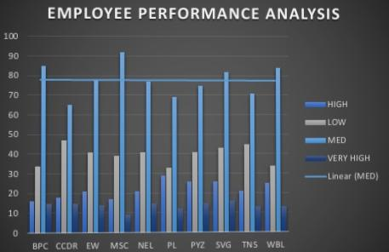
RESULTS
11
11

Slide 12

conclusion
In conclusion, the employee data analysis conducted using Excel provided valuable insights into workforce trends, enabling more informed decision-making. The use of Excel allowed for efficient data organization, visualization, and reporting, ultimately helping to enhance HR strategies, improve employee satisfaction.
12

