Slide 1

FinAware
Personalized Financial Management System
A Web-Based Application for Budget Planning,
Expense Tracking & Smart Financial Suggestions
PBL-4 End Term Project | CSE Dept. | Jan–May 2026
Manipal University Jaipur
React (TS)
Tailwind CSS
ShadCN UI
Rule-Based AI

Slide 2
AGENDA
What We'll Cover
01
Introduction & Problem Statement
05
Smart Suggestion Engine
02
Objectives
06
Screenshots & Demo
03
System Architecture & Tech Stack
07
Advantages & Limitations
04
Module Walkthrough
08
Future Enhancements & Conclusion
FinAware | PBL-4 End Term Report | Manipal University Jaipur
Overview

Slide 3
INTRODUCTION
The Problem We're Solving
Young adults lack structured tools to manage personal finances
The Challenge
FinAware's Answer
› No structured expense tracking system
A unified, intelligent web platform combining:
• Budget Planning
• Daily Expense Tracking
• Smart Savings Suggestions
• Visual Financial Dashboard
Targeting students & early professionals aged 18–25 with zero-dependency, free-to-use access.
› Habitual overspending in food & entertainment
› Limited savings strategy awareness
› No affordable personalised advisory access
› Generic tools fail beginners (18–25 age group)
FinAware | PBL-4 End Term Report | Manipal University Jaipur
01 / Introduction

Slide 4
OBJECTIVES
Project Objectives
01
02
03
Budgeting System
Real-Time Tracker
Suggestion Engine
Plan income, fixed & variable expenses, and savings goals in one place
Log daily expenses with auto category assignment and visual insights
Rule-based AI generating personalised financial recommendations
04
05
06
Visual Dashboard
Financial Literacy
Scalable Frontend
Doughnut charts & progress bars for quick financial health overview
Promote discipline among young adults with actionable guidance
Built with React + TypeScript for maintainability & growth
FinAware | PBL-4 End Term Report | Manipal University Jaipur
02 / Objectives

Slide 5
TECH STACK
Technology Stack
Frontend
Styling
UI Library
React (TypeScript)
Tailwind CSS
ShadCN UI
UI Components & Logic
Responsive Design
Pre-built Components
18.x
3.x
Latest
State Mgmt
Persistence
Notifications
React Hooks
localStorage
Sonner
Local State Mgmt
Client-side Storage
Toast Notifications
Built-in
Browser API
Latest
FinAware | PBL-4 End Term Report | Manipal University Jaipur
03 / Architecture

Slide 6
ARCHITECTURE
System Architecture
Feature-based front-end architecture for maximum modularity
components/
Reusable stateless UI elements (buttons, cards, modals)
Data Flow
Budget Planner
features/
Core modules: budget-planner, tracker, suggestions
▼
localStorage
services/
Abstraction for localStorage read/write operations
▼
utils/
Date formatting, currency, percentage helpers
Dashboard / Tracker
▼
types/
TypeScript interfaces for all data models
Suggestion Engine
FinAware | PBL-4 End Term Report | Manipal University Jaipur
03 / Architecture

Slide 7
MODULES
Four Core Modules
01
02
Budget Planner
Dashboard
Define monthly income, fixed & variable expenses, and savings targets. Doughnut chart for quick visual breakdown.
Financial command centre: total income, cumulative expenses, net savings, remaining balance, and progress bars.
03
04
Daily Expense Tracker
Smart Suggestions
Log transactions with auto-category assignment. Colour-coded status indicators. Downloadable expense report.
Rule-based engine generates personalised financial recommendations based on age range and profession profile.
FinAware | PBL-4 End Term Report | Manipal University Jaipur
04 / Modules

Slide 8
SUGGESTION ENGINE
Smart Suggestion Engine
The distinguishing feature — a rule-based expert system
01
02
03
→
→
Profile Parser
Spending Analyser
Rule Resolver
Extracts age range & profession, maps to canonical profile ID
Computes category-wise totals, % allocations, peak spend area
Applies rule matrix → ranked suggestions with explanations
Sample Rules
IF
Age 18–25 + Food > 30% income → Suggest meal prepping & reduce dining-out
IF
Salaried + Savings < 15% → Set up automated monthly savings transfers
IF
Entertainment = highest category → Audit & consolidate streaming subscriptions
IF
Transport expenses high → Recommend carpooling or monthly transit pass
FinAware | PBL-4 End Term Report | Manipal University Jaipur
05 / Engine

Slide 9
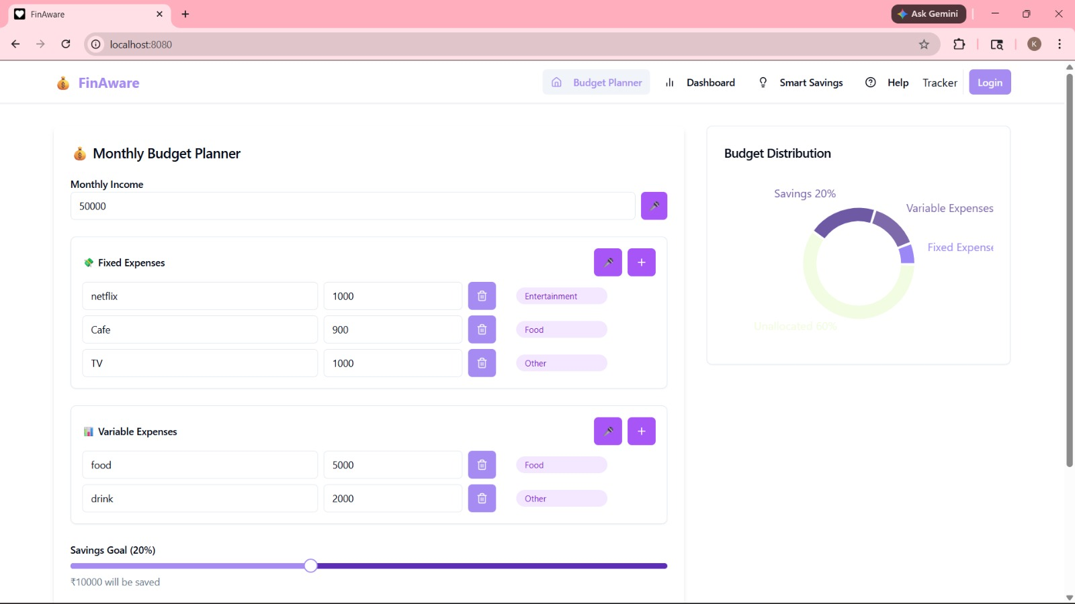
SCREENSHOTS
Monthly Budget Planner
Screenshot 1 of 4
Budget Planner — income entry, fixed/variable expenses, auto-tagged categories, and doughnut chart distribution
FinAware | PBL-4 End Term Report | Manipal University Jaipur
06 / Screenshots

Slide 10
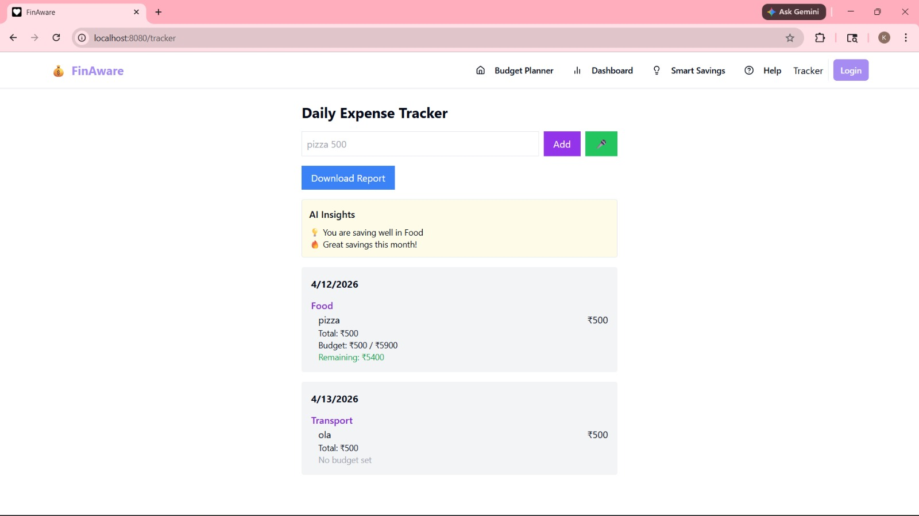
SCREENSHOTS
Daily Expense Tracker
Screenshot 2 of 4
AI Insights panel + date-grouped transactions with auto-categorisation and colour-coded budget status indicators
FinAware | PBL-4 End Term Report | Manipal University Jaipur
06 / Screenshots

Slide 11
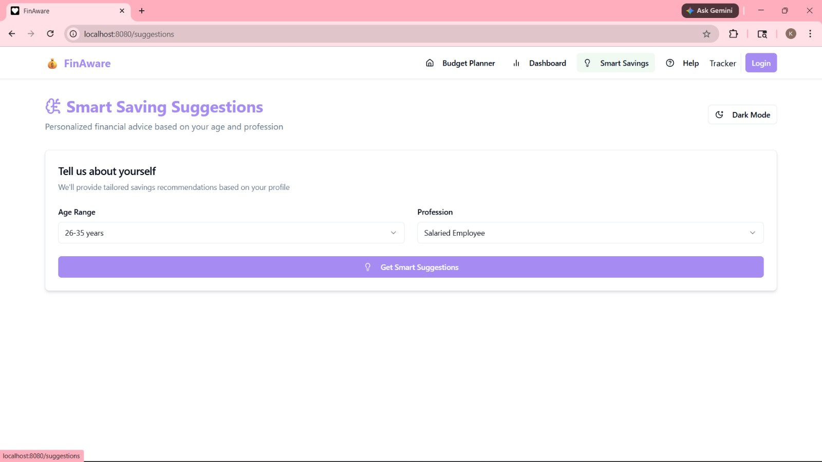
SCREENSHOTS
Smart Savings Suggestions
Screenshot 3 of 4
Age range & profession dropdowns trigger personalised suggestions. Dark Mode toggle available top-right.
FinAware | PBL-4 End Term Report | Manipal University Jaipur
06 / Screenshots

Slide 12
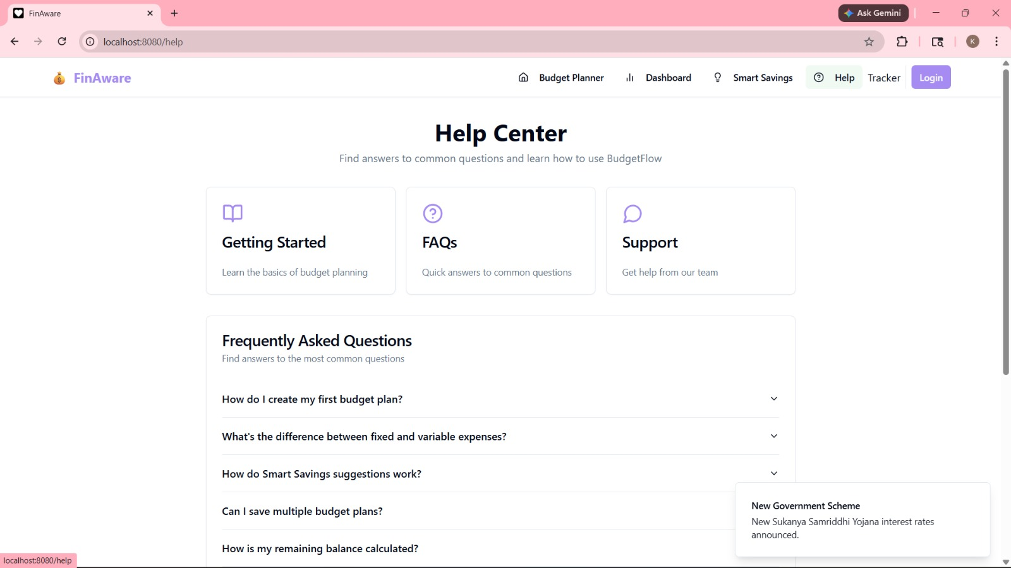
SCREENSHOTS
Help Centre
Screenshot 4 of 4
Getting Started, FAQs & Support sections. Real-time toast notification (bottom-right) showing Sukanya Samriddhi Yojana update.
FinAware | PBL-4 End Term Report | Manipal University Jaipur
06 / Screenshots

Slide 13
EVALUATION
Advantages & Limitations
✓ Advantages
✗ Limitations
Beginner-friendly, guided UI
Device-specific storage (no sync)
Personalised AI suggestions
No user authentication / login
Zero-dependency static deployment
Rule-based (not ML-based) engine
Real-time category feedback
No bank API / auto-import
Visual charts & progress bars
INR only — no multi-currency
Cross-session localStorage persistence
No push notification system
FinAware | PBL-4 End Term Report | Manipal University Jaipur
07 / Evaluation

Slide 14
FUTURE ENHANCEMENTS
Future Roadmap
01
02
03
04
Backend Integration
User Authentication
AI/ML Recommendation
Bank API Integration
PostgreSQL + REST API for cross-device sync
OAuth 2.0 / JWT multi-user support
Replace rule engine with trained ML model
Plaid / Yodlee / RBI Account Aggregator
05
06
07
08
Push Notifications
Mobile App
Multi-Currency
Shared Budgets
Browser alerts when budget thresholds exceeded
React Native iOS & Android companion app
Real-time exchange rate conversion
Collaborative plans for households / groups
FinAware | PBL-4 End Term Report | Manipal University Jaipur
08 / Future

Slide 15
Conclusion
FinAware — Project Achieved All Objectives
FinAware successfully delivers a complete personal financial management system — integrating budgeting, real-time expense tracking, and intelligent financial suggestions in a single accessible platform.
The project demonstrates how modern web technologies address real-world financial challenges for the 18–25 demographic, while establishing an extensible foundation for ML-powered recommendations and full backend integration.
✓ Budget Planner
✓ Expense Tracker
✓ Suggestion Engine
✓ Visual Dashboard

