Slide 1
Internship Presentation
on
“Online Furniture Store Management System”
Presented By: Kavyashree CR
VIII Sem ‘A’ Section
Department of CSE, Vemana IT

Slide 2
Contents
2023 - 2024
Abstract
Introduction
Problem Statement and Scope of project
Software Requirements
Design
Implementation
Output
Future Work
Conclusion
22-Mar-2024
Department of CSE, Vemana IT
1
Notes:
25-10-2017
Department of CSE, Vemana IT
Title

Slide 3
Abstract
2023 - 2024
Efficient Product Management: Simplifies catalog updates and inventory tracking, offering customers the latest in furniture designs.
User-Friendly Shopping: Enables straightforward account setup, easy navigation, and secure checkout for an effortless shopping experience.
Rapid Order Processing: Features a robust system for quick order handling and provides timely delivery updates, enhancing customer satisfaction.
Streamlined Administration: Offers intuitive tools for product and inventory management, alongside analytics for informed decision-making, all through a user-centric interface.
22-Mar-2024
Department of CSE, Vemana IT
2
Notes:
25-10-2017
Department of CSE, Vemana IT
Title

Slide 4
Introduction
2023 - 2024
The Online Furniture Shop is a web-based platform designed to transform furniture shopping into a convenient and enjoyable experience from home.
This platform combines a constantly updated and extensive selection of products with an easy-to-navigate shopping experience, ensuring customer satisfaction through quick order processing and delivery
Features like hassle-free home delivery and easy communication for queries or feedback via email further streamline the shopping process.
Provides administrators with efficient tools for store oversight and analytics, supporting seamless operations and strategic insights.
22-Mar-2024
Department of CSE, Vemana IT
3

Slide 5
Problem Statement and Scope
2023 - 2024
Limited Physical Store Access :By providing an online platform, it eliminates geographical constraints, allowing customers to access a wide range of furniture products without the need to visit multiple physical stores.
Time-Consuming Process: The system streamlines the shopping experience, enabling users to browse and purchase furniture efficiently, thus saving valuable time previously spent traveling to and from stores.
Inadequate Customer Support: The platform includes a feature for customers to send queries or feedback via email, ensuring a responsive and engaging customer service experience.
Inefficient Order Tracking: With secure user registration, customers can easily track their orders, view delivery status, and access their order history for a seamless shopping experience.
22-Mar-2024
Department of CSE, Vemana IT
4

Slide 6
Software Requirements
2023 - 2024
Operating system : Windows 2000 or later
Front End : HTML,CSS
Back End : SQL Server
Scripting Language : PHP
22-Mar-2024
Department of CSE, Vemana IT
5

Slide 7
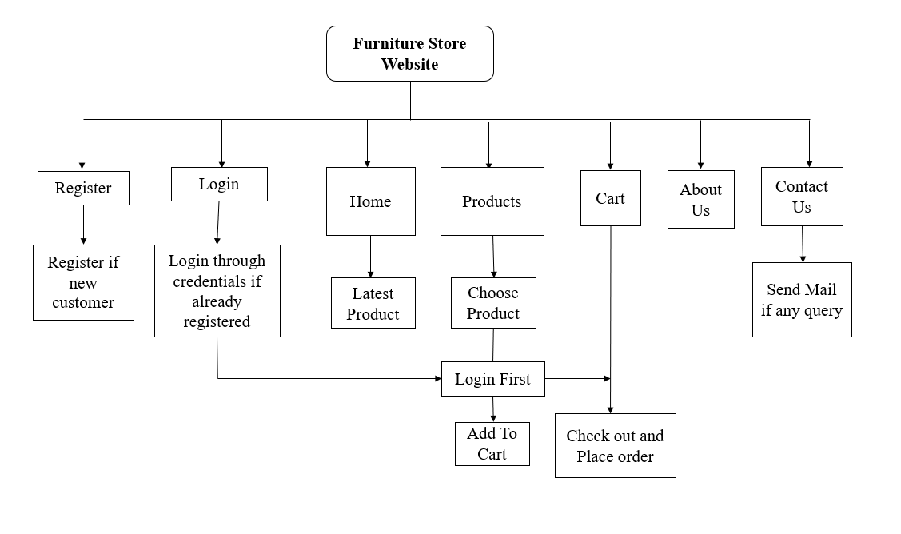
System Design
2023 - 2024
22-Mar-2024
Department of CSE, Vemana IT
6

Slide 8
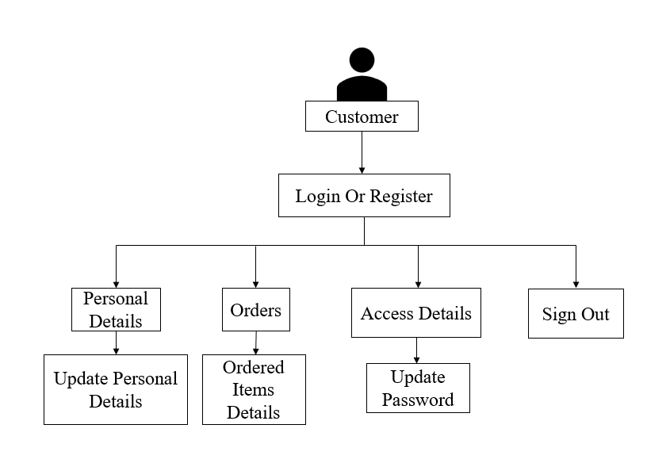
2023 - 2024
Customer Account
22-Mar-2024
Department of CSE, Vemana IT
7

Slide 9
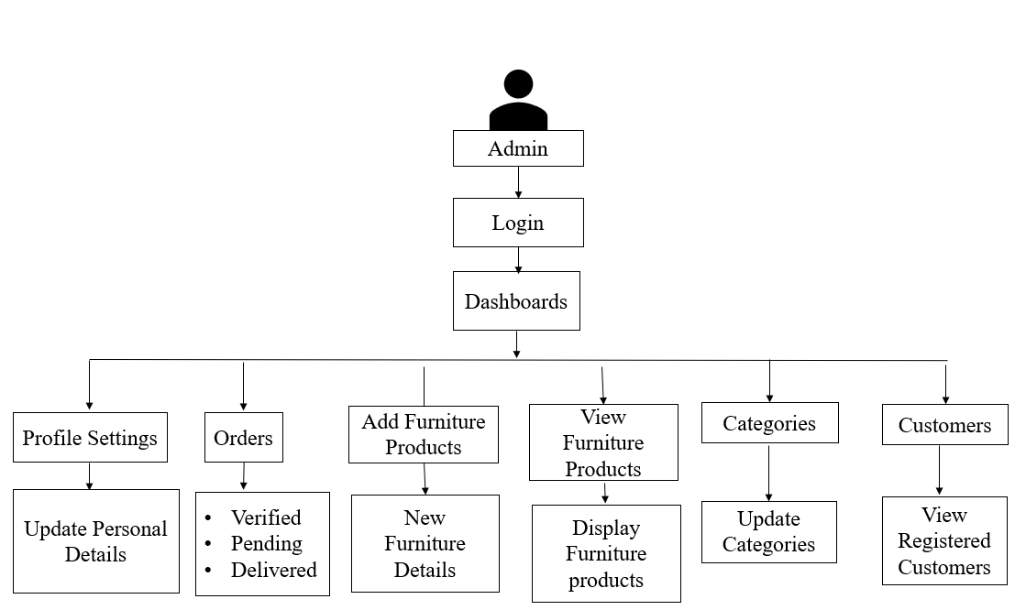
Admin Account
Department of ECE, Vemana IT

Slide 10
Implementation
2023 - 2024
HTML: The foundation of the Online Furniture Shop, HTML structures the web pages, displaying our vast catalog of furniture including beds, dining sets, and sofas with clarity and organization. It enables easy navigation and browsing for customers.
CSS: CSS brings the Online Furniture Shop to life, styling the webpage elements for a visually appealing and consistent user experience. It ensures the site is responsive and looks great on any device, enhancing customer engagement.
PHP: bolstered by the PHP Mailer library, is integral to the Online Furniture Shop's backend operations. It enables secure and efficient email communication for user registrations, order confirmations, and customer inquiries, ensuring data safety and streamlining interactions.
22-Mar-2024
Department of CSE, Vemana IT
8

Slide 11
2023 - 2024
FUNCTIONAL MODULES
The functional modules included in the project are listed below:
INSERT MODULE: This module is essential for capturing and storing all new inputs into the system. It handles data from various sources such as new user registrations, product additions by admins, customer orders, and feedback submissions.
UPDATE MODULE: Facilitates modifications to existing data within the system, catering to the dynamic nature of user and inventory information.
22-Mar-2024
Department of CSE, Vemana IT
9

Slide 12
2023 - 2024
FUNCTIONAL MODULES
RETRIEVE MODULE: Acts as the central information retrieval mechanism, pulling data from the database to be displayed to the users.
TRIGGER MODULE: Implements automated actions within the database, enhancing the system's responsiveness and security.
22-Mar-2024
Department of CSE, Vemana IT
10

Slide 13
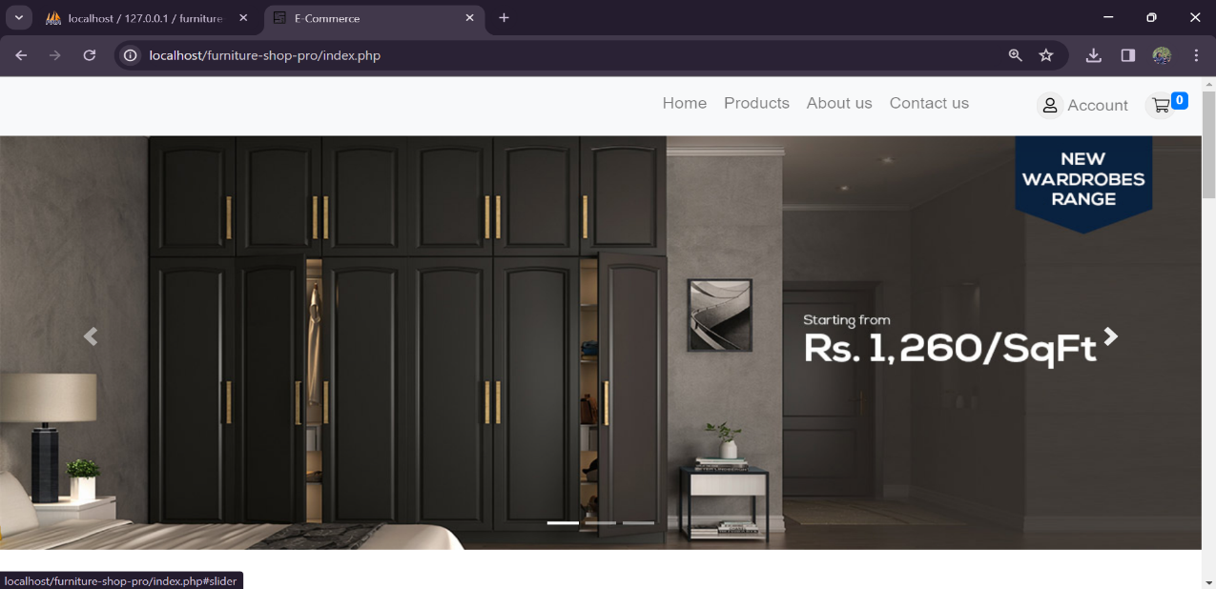
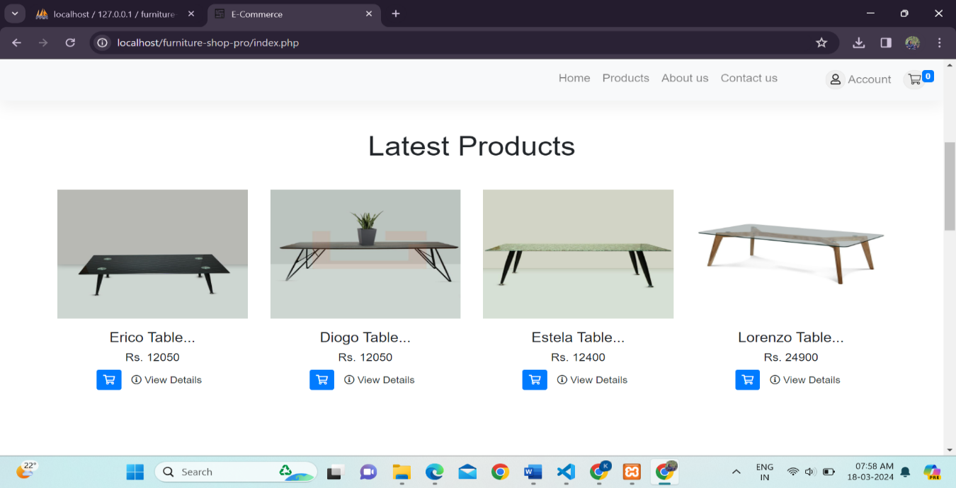
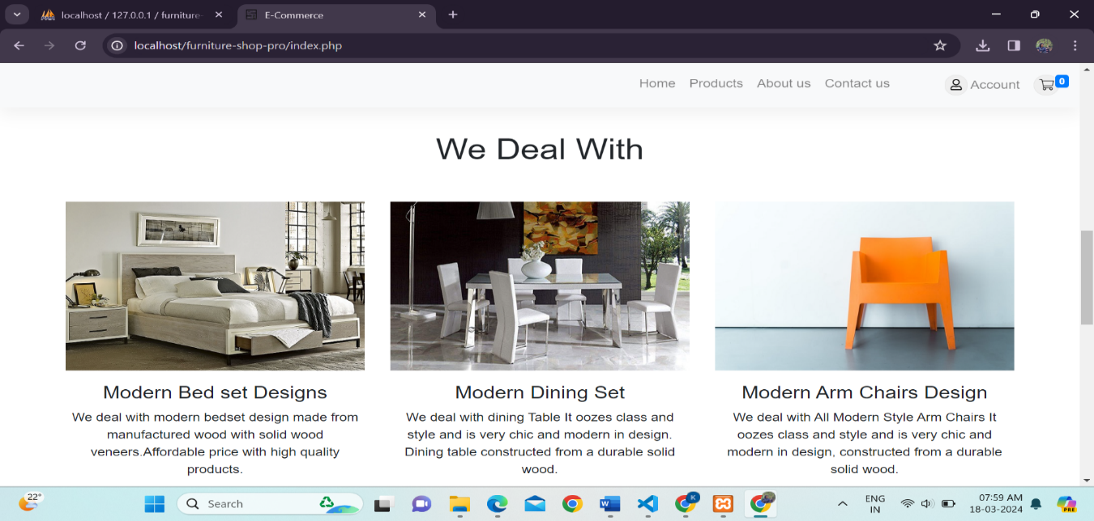
Results
2023 - 2024
Welcome Page
22-Mar-2024
Department of CSE, Vemana IT
11

Slide 14
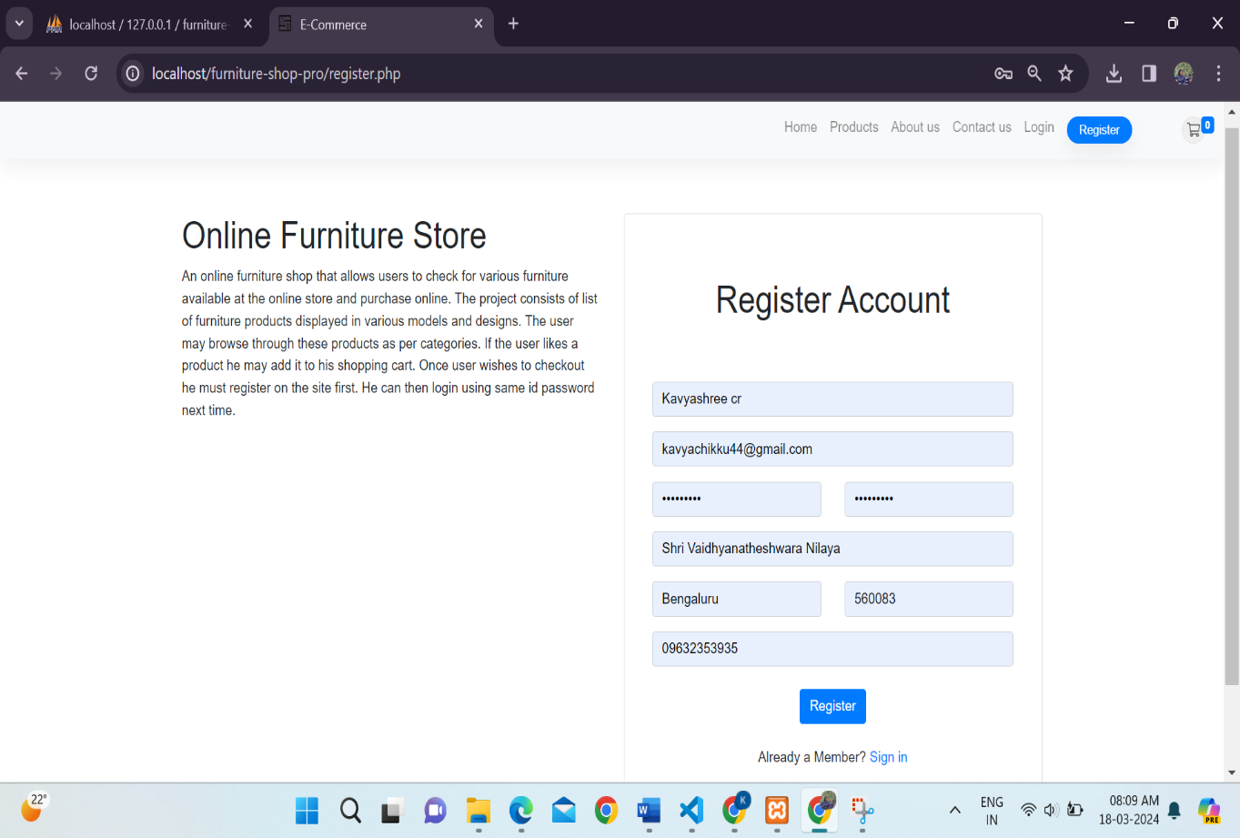
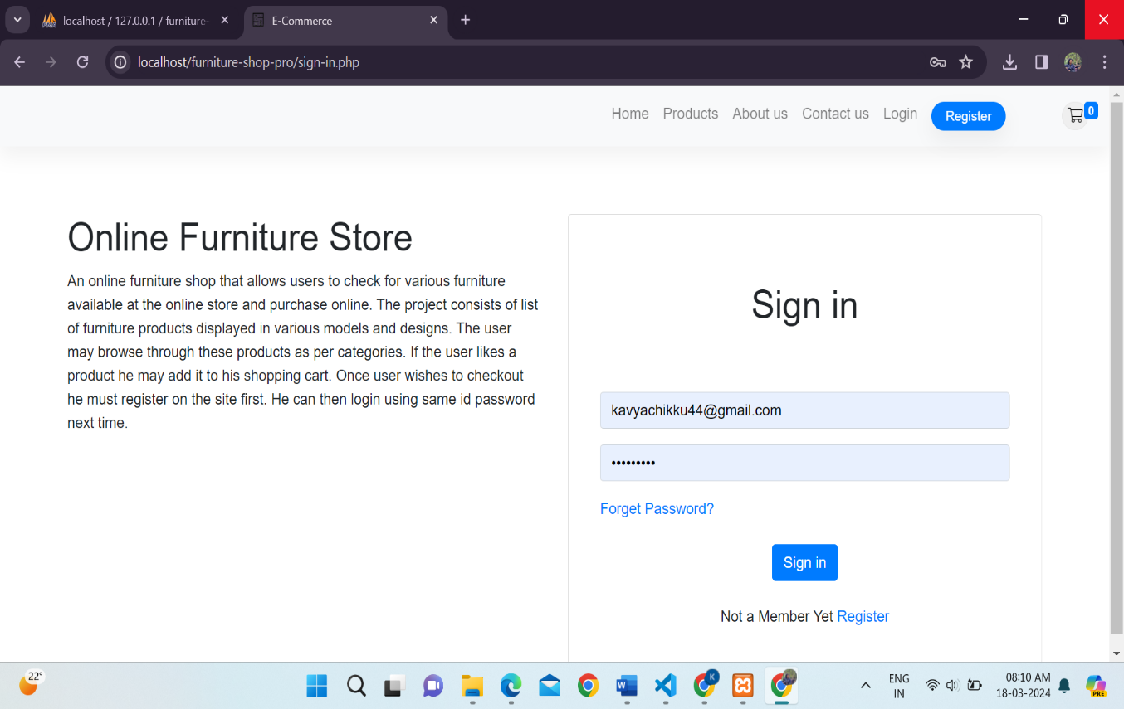
2023 - 2024
Register Page
22-Mar-2024
Department of CSE, Vemana IT
12

Slide 15
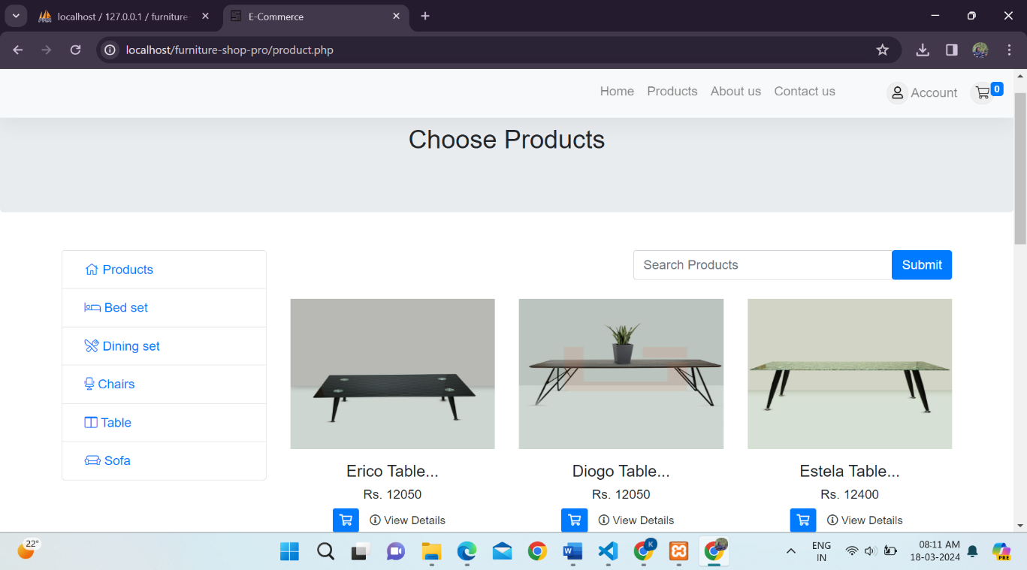
2023 - 2024
Products Dashboard
22-Mar-2024
Department of CSE, Vemana IT
14

Slide 16
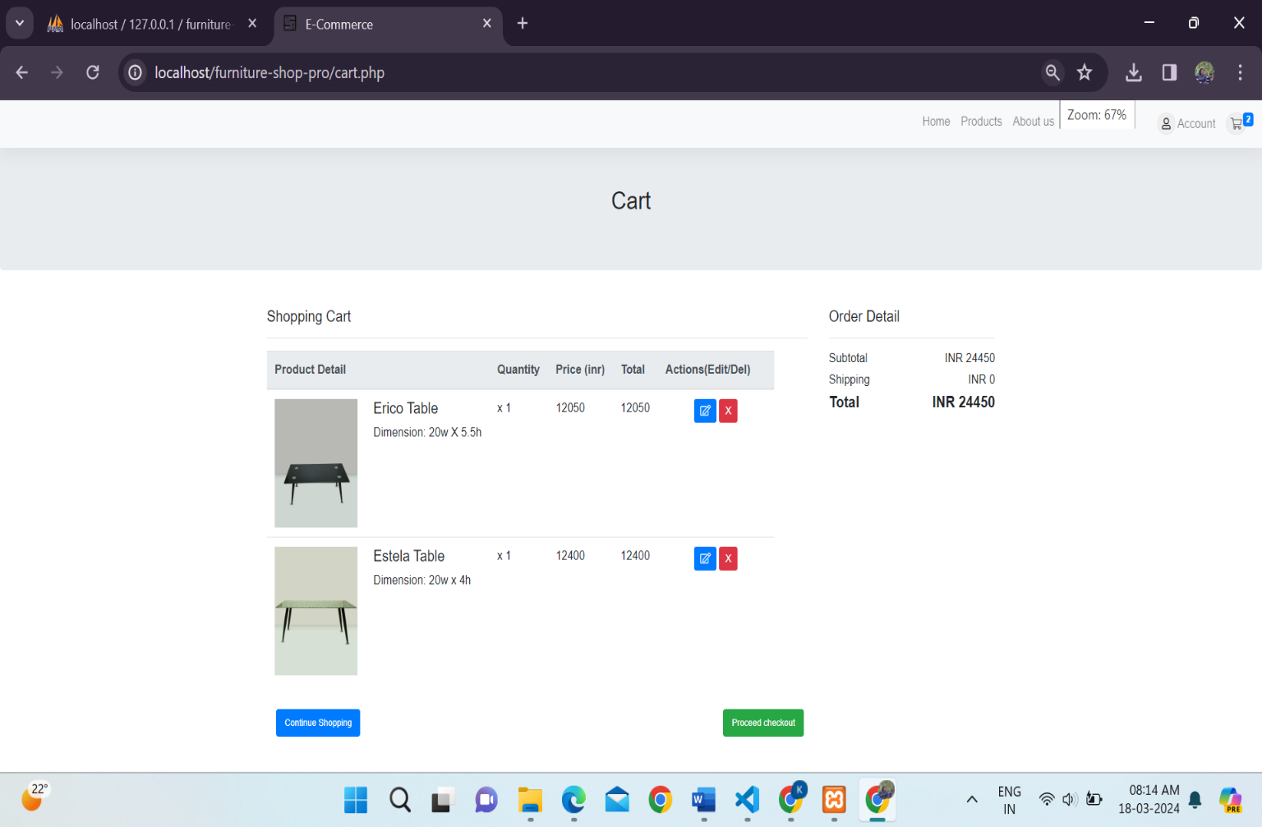
2023 - 2024
Cart Page
22-Mar-2024
Department of CSE, Vemana IT
15

Slide 17
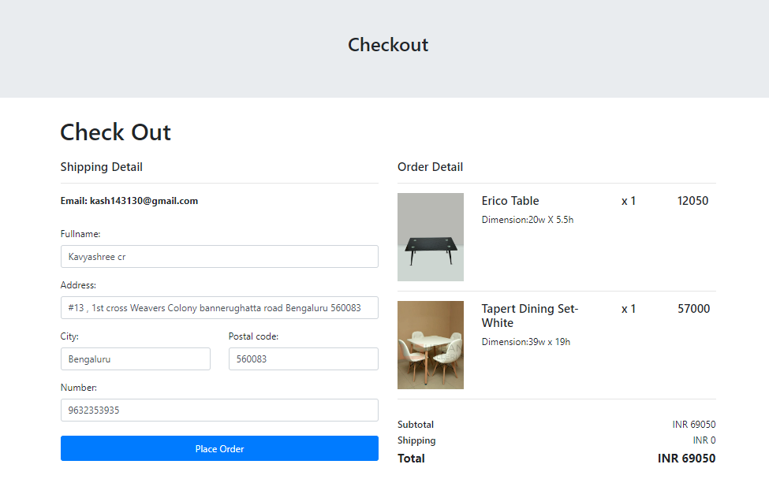
Checkout Page
Department of ECE, Vemana IT
16

Slide 18
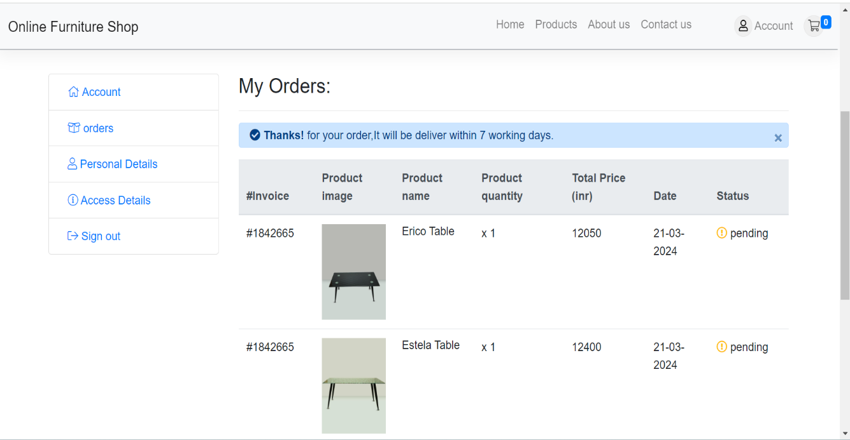
Customer Order tracking Page
Department of ECE, Vemana IT
17

Slide 19
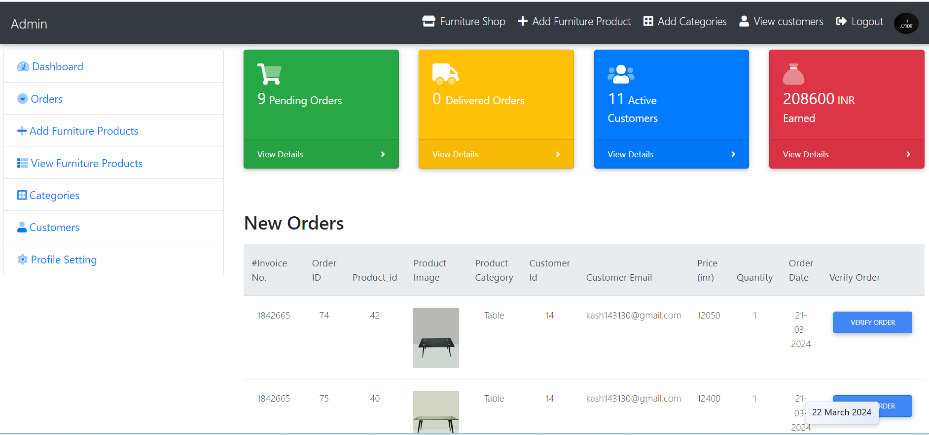
Admin Dashboard
Department of ECE, Vemana IT

Slide 20
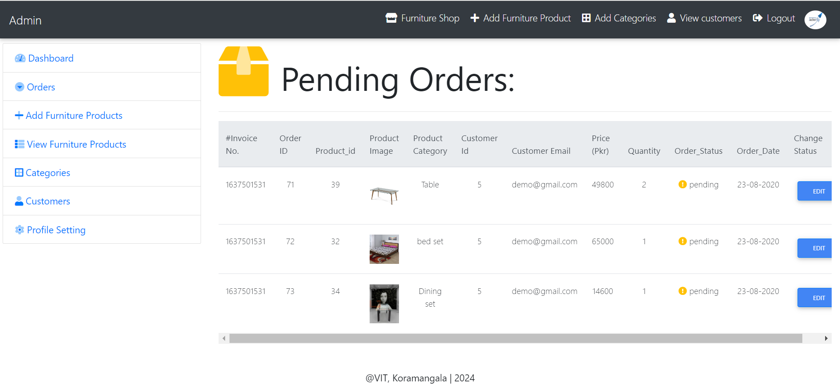
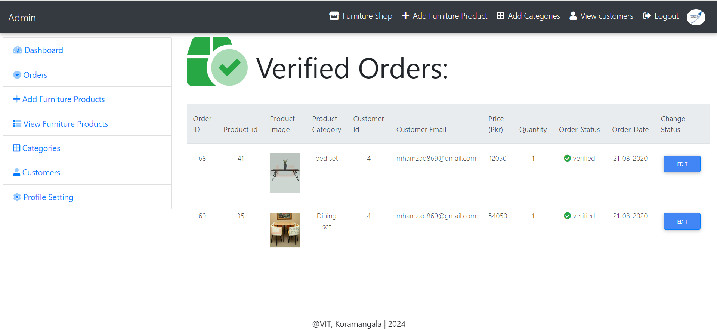
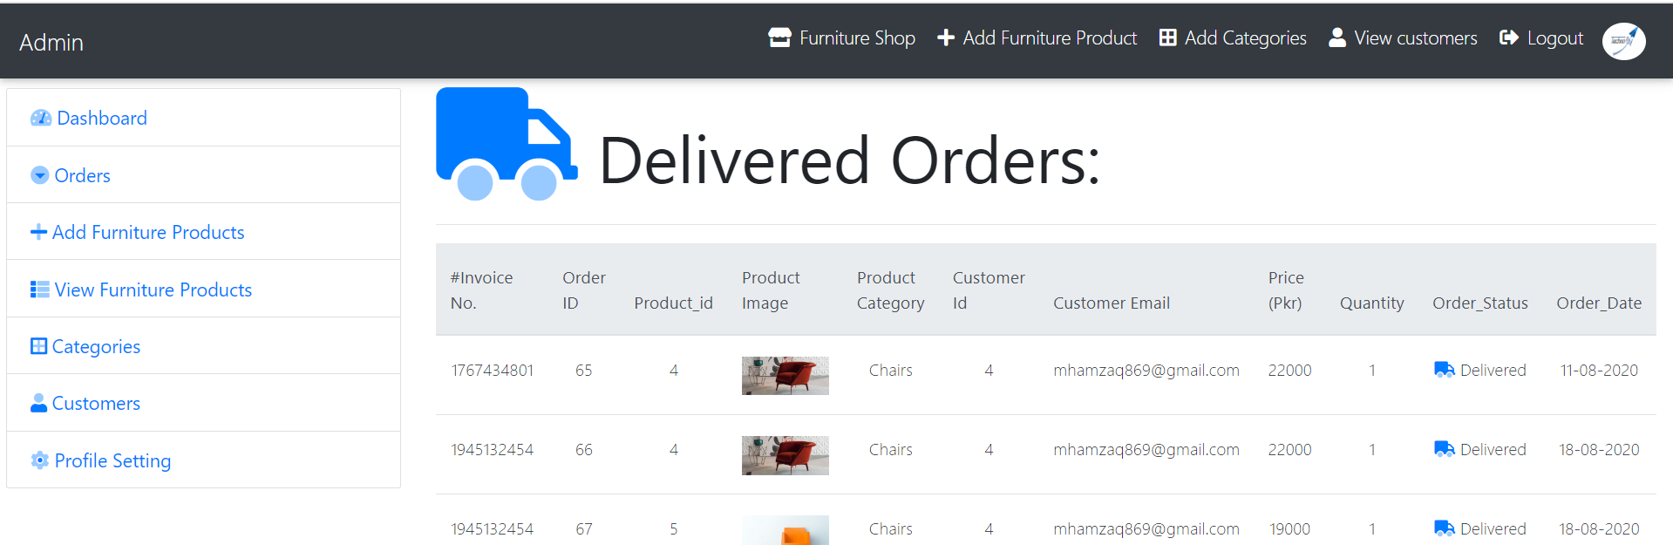
Orders
Department of ECE, Vemana IT

Slide 21
Future Work
2023 - 2024
Real Time Order Tracking.
Enabling Online Transactions.
Hosting the application (globally or organization wide).
22-Mar-2024
Department of CSE, Vemana IT
20

Slide 22
Conclusion
2023 - 2024
Revolutionizes furniture retail with integrated management of customers, transactions, and orders, boosting efficiency and engagement.
Simplifies buying with features like an intuitive catalog and real-time tracking, enhancing customer service.
Sets the stage for future growth with potential for global expansion and improved customer interactions.
22-Mar-2024
Department of CSE, Vemana IT
21

Slide 23
Organization overview
2023 - 2024
Technofly solution & Consulting was found in year 2017 by 14+ years’ experience team in software application domain and embedded systems domain . Technofly solution focused on software development and maintenance , automotive embedded technologies , VLSI Design, Corporate Training & Consulting Globally .Till now we have delivered 15+ Corporate Training’s for Various Programming Languages ,Software Project module solutions and embedded automotive Technologies companies in India. Involved in the Development of OBD2 (on Board Diagnose Product for Passenger cars) for Clients in India.
The team is associated with R&D in Wireless Communication Technologies department in the company. The team is currently working on 4G-5G technologies associated with Cognitive Devices such as WLAN, Bluetooth, Zigbee, other Mobile networks etc,for better achievable network efficiencies
22-Mar-2024
Department of CSE, Vemana IT
22
Notes:
25-10-2017
Department of CSE, Vemana IT
Title

Slide 24
THANK YOU
2023 - 2024
Notes:
Title
25-10-2017
Department of CSE, Vemana IT

