Slide 1


Sentimental Analysis of women safety in India on Instagram data using machine learning
Dr G Shankar Government Women’s First Grade College & PG Study Centre
Ajjarkadu Udupi
Team No: 3
Apoorva
Pavithra
Kavyashri
Rumana
Project Guide: Sushma s

Slide 2
Table of Contents
Introduction
Problem Statement
Scope of the study
Literature review
Research Methodology
Proposed Model
Data set used
Performance Evaluation Metrics
Designing AND Implementation
Performance Evaluation
Research Methodology
Conclusion
Contribution of this Work
Future Scope
References

Slide 3
Sentimental Analysis of women safety in India on Instagram data using machine learning
Implemented sentiment analysis on Instagram data from India concerning women's safety, focusing on keywords(rape, stalking, gender discrimination and sexual abuse).
Machine learning algorithms to preprocess polarity scores.
Implemented visualization techniques.
Analyzed safety concerns in the country.

Slide 4
Problem Statement
When women face online bullying or harassment, it can make them feel scared and unsure about using the internet.
They might worry about their personal information being shared without their permission, which can make them feel even more anxious.
This fear can make women less likely to share their thoughts or interact with others online, which can make them feel lonely and isolated.
Cybercrime can make women feel less confident about themselves

Slide 5
Scope of the study
Helping combat online abuse: Understanding Instagram data helps in fighting harassment and violence against women online.
Utilizing machine learning for analysis: Using machine learning on Instagram data aids in researching digital safety methods.
focus on Instagram data: The project examines Instagram information to uncover online abuse patterns.
Not covered: Offline harassment like staring or inappropriate comments in public is not part of this project's investigation.
Emojis from analysis: Emojis are not considered in this project's analysis; only text comments are examined.

Slide 6
Literature review
The project referred to two papers.
To review existing studies on sentiment analysis and machine learning in Twitter data for various applications.
To detect unsafe areas for women based on negative sentiments expressed in social media posts.

Slide 7
Literature review #Paper 1
Title: Leveraging Social Media for Women's Safety in Indian Cities: A Twitter Analysis
Authors: Salla Anisha and Srinidhi Ghankot
Publication Name: Journal of Social Media Studies
Published Year: 2022
The paper explores how Twitter can contribute to addressing women's safety issues in Indian urban areas.
It underscores the widespread instances of harassment and violence encountered by women in public settings.
It advocates for a societal shift towards taking responsibility for ensuring the safety of women, leveraging platforms like Twitter for advocacy and support.

Slide 8
Literature review #Paper 2
Title:“Women’s Safety Analysis on Social Media Using Machine Learning”
Authors: : Mrs. B Ganga Bhavani, Ms. V Bhavani, Boddu Pavan Ganesh, Bonthu Sai Kiran, Bonthu Venkata Naveen, and Kallakuri Baladitya
Published Year: 2022
Bhavani et al.'s (2022) study analyzes women's safety perceptions on Twitter using sentiment analysis tools like TWEEPY, NLTK, TextBlob and Decision Trees.
Foundational research by Agarwal et al. (2009) and others supports sentiment analysis in noisy Twitter environments.
The study shows sentiment analysis can provide insights into women's safety, using social media data for public safety and urban planning.

Slide 9
Proposed Model
The model consists of:
Reading and displaying Instagram comments based on selected categories (Rape, Stalking, Sexual abuse, Gender discrimination).
Cleaning the comments by removing stopwords, punctuation, and converting to lowercase.
Applying TextBlob for sentiment analysis, classifying comments as positive, negative, or neutral based on polarity scores.
Displaying sentiment analysis results and percentages.
Visualizing sentiment distribution using a pie chart.
Important components:
- Combobox for category selection.
- Buttons for actions like loading images, reading comments, cleaning comments, running ML algorithms, and displaying graphs.
- Text widget for displaying comments and results

Slide 10
Schematic diagram of the model
upload instagram comments dataset
Comments cleaning
Run machine learning algorithem
Read comments
women safety graph

Slide 11
Specification
Software
Microsoft Excel
Pyhon based environment - IDLE
programming language
python
libraries
TextBlob
Matplotlib
pandas
nltk
PIL
Tkinter

Slide 12
Data set used
https://www.kaggle.com/hollyhetherington/metootweets?select=MeToo_tweets.csv
Based on “MeToo Tweets.csv” dataset we created 4 dummy dataset
Size of the data set is 186 KB. 1000 records are there.
Important column header within the data set are comments, user name, created at, source, like, replies count and lang.

Slide 13
SL.NO | COLUMN | DATATYPE | DESCRIPTION
1 | comments | String | Textual content of the comment posted on Instagram.
2 | user name | String | Username or handle of the Instagram user who posted the comment.
3 | created at | Date/Time | Timestamp indicating when the comment was posted on Instagram.
4 | source | String | Source platform or application from which the comment was posted on Instagram (e.g., "Instagram for Android").
5 | likes | Integer | Number of likes or reactions received by the comment on Instagram.
6 | replies count | Integer | Count of replies or responses to the comment on Instagram.
7 | lang | String | Language code indicating the language in which the comment is written on Instagram (e.g., 'en' for English).

Slide 14
Performance Evaluation Metrics
The polarity score represents the sentiment of the text, ranging from
<0.2 (negative) , >0.5 (positive), and >0.2 &<0.5(neutral).
To calculate the percentage of each sentiment category:
(count of a sentiment category / total number of comments) * 100
Count of a Sentiment Category: Count the pos,neg, and neu
Total Number of Comments: The total count of all comments
Multiplication by 100: To converts the proportion into a percentage.

Slide 15
proposed system
Sentiment Analysis on Instagram Data: - Analyze sentiments on keywords like rape, stalking, gender discrimination, and sexual abuse to measure public sentiment and online harassment impact.
Machine Learning for Comment Classification: - Automatically classify comments as positive, negative, or neutral to efficiently process data and detect harmful or supportive comments.
Data Visualization for Better Insights: - Use graphs and charts to represent analyzed data, aiding policymakers, journalists, and the public in understanding women's safety concerns.

Slide 16
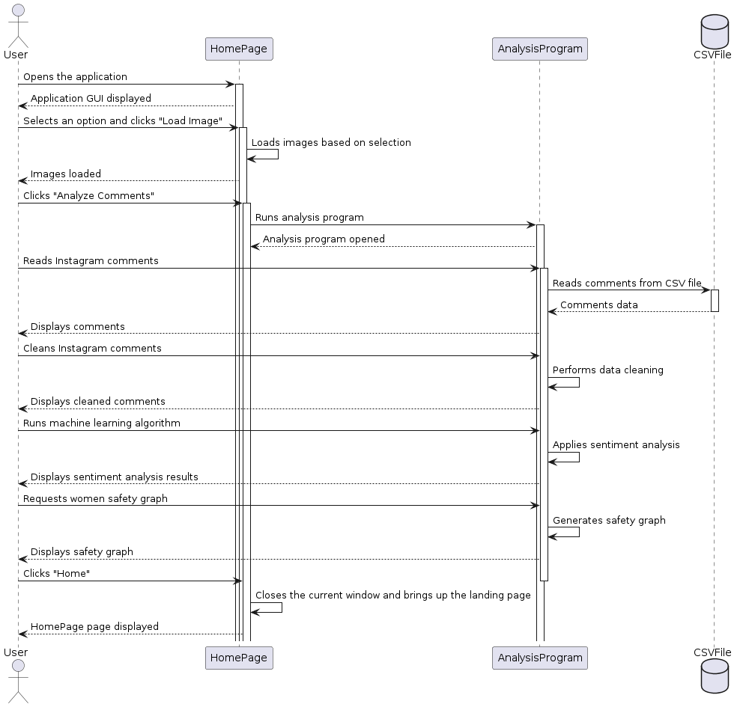
System Design

Slide 17
Implementation
Algorithm
Start
Import Required Libraries
Create an instance of the homePage class, which serves as the main interface for the application
Enter the main loop to handle user interactions and events.
selecting a category from the combobox and clicking buttons to load images or comments.
Display a loading message while the images are loading.
Based on the selected category, load and display corresponding images in a grid layout.
When the user clicks the "Analyze Comment" button, open the analysis program window.
Create an instance of the AnalysisProgram class, passing the selected category and associated CSV file path.
Enter the main loop of the analysis program window.
The user interacts with the analysis program by clicking buttons to read comments, clean comments, run machine learning algorithms, and generate graphs.
Close the analysis program window when the user clicks the "Home" button to return to the Home page.
End Main Loop
stop

Slide 18
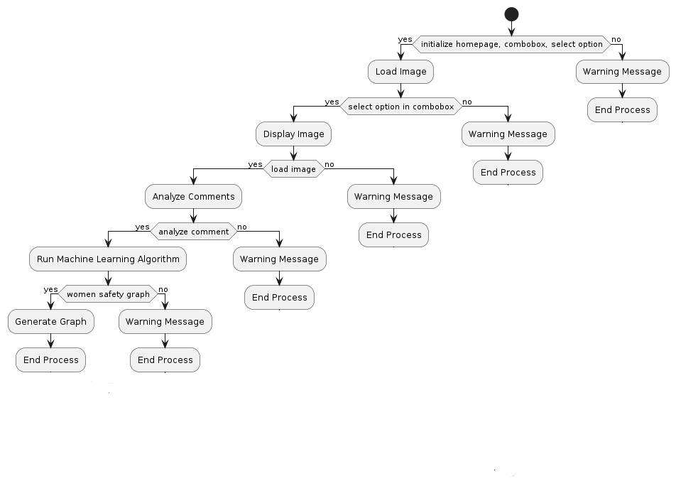
Flowchart

Slide 19
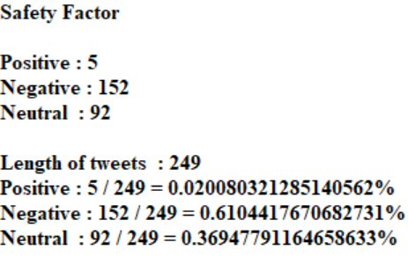
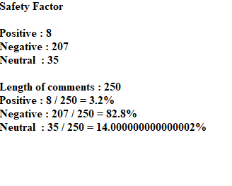
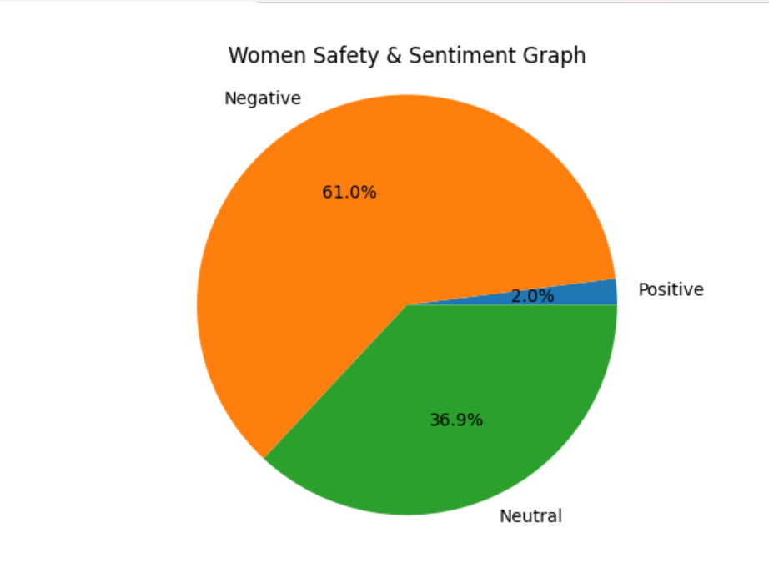
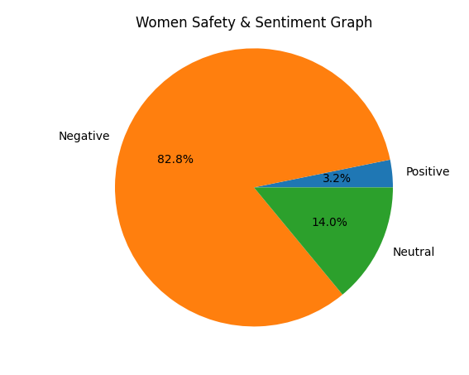
Rape
Stalking

Slide 20
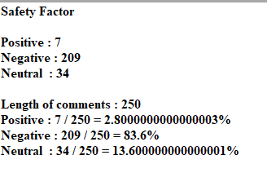
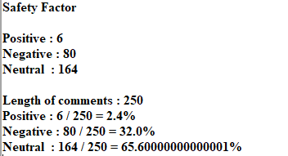
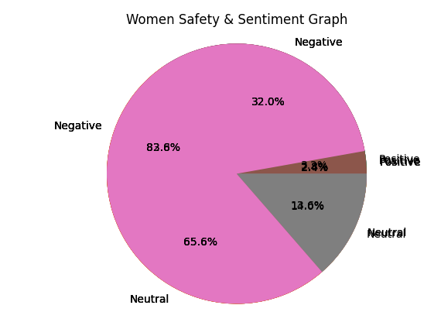
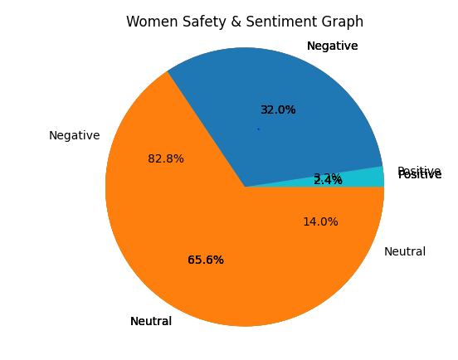
Sexual abuse
Gender discrimination

Slide 21
Conclusion
Prevalence of Online Harassment: Online harassment against women on Instagram is a big problem, with lots of hurtful comments and threats being made.
Impact on Women's Well-being: Women feel really bad when they're harassed online. It makes them scared and anxious, and they might stop using Instagram because of it.
Underreporting and Silent Suffering: Many times, women don't tell anyone when they're harassed online because they're worried about what might happen if they do. This means the problem often goes unnoticed and keeps happening.
Need for Empowerment and Support: We need to help women feel stronger and give them places online where they feel safe. Providing things like helplines and support groups can make a big difference.
Importance of Education and Awareness: It's super important to teach women and girls how to stay safe online. They need to know about their rights, how to keep their information private, and how to deal with mean people online.

Slide 22
Contribution of your work
Visualizing data through charts enhances communication, engaging policymakers, journalists, and the public in discussions about women's safety and the need for action.
Data analysis raises awareness about gender-based violence, crucial for promoting zero tolerance and gender equality.
Data-driven insights empower decision-makers to allocate resources effectively and formulate policies for improving women's safety, contributing to meaningful change in communities.

Slide 23
Future Scope
Analyzing women's safety in India using Instagram data, focusing on issues like rape, stalking, sexual abuse, gender discrimination, and other related concerns..
Future development includes expanding data analysis to incorporate platforms like Twitter, Facebook, and news articles for a more comprehensive understanding of women's safety concerns.
Advancing sentiment analysis through sophisticated NLP techniques and machine learning algorithms to enhance comment classification and trend identification.
Creating a system that constantly checks social media for signs of safety problems as they happen. This helps us react quickly to keep people safe..
Using maps and location-based information to understand safety issues in different regions or cities. This helps authorities focus efforts where they're needed most and distribute resources effectively.
Apply the system to analyze other societal issues like child abuse and animal abuse, helping to identify and address various forms of abuse and violence.

Slide 24
References
The books that we have referred for this project are,
Arun Pujari. K. (2012). Data mining techniques (4th ed.). Universities Press.
Han, Jiawei and Micheline Kamber. Data Mining: Concepts and Techniques (2nd ed.). University of Illinois at Urbana-Champaign.
Nageswara Rao, R. (2019). Core Python Programming (3rd ed.). Dreamtech Press.
Online resources that we have referred for this project are,
https://www.geeksforgeeks.org/pandas-tutorial/
https://www.pythontutorial.net/python-basics/python-read-csv-file/

Slide 25
Thank You
Dr G Shankar Government Women’s First Grade College & PG Study Centre
Ajjarkadu Udupi
Team No:3

