Slide 1
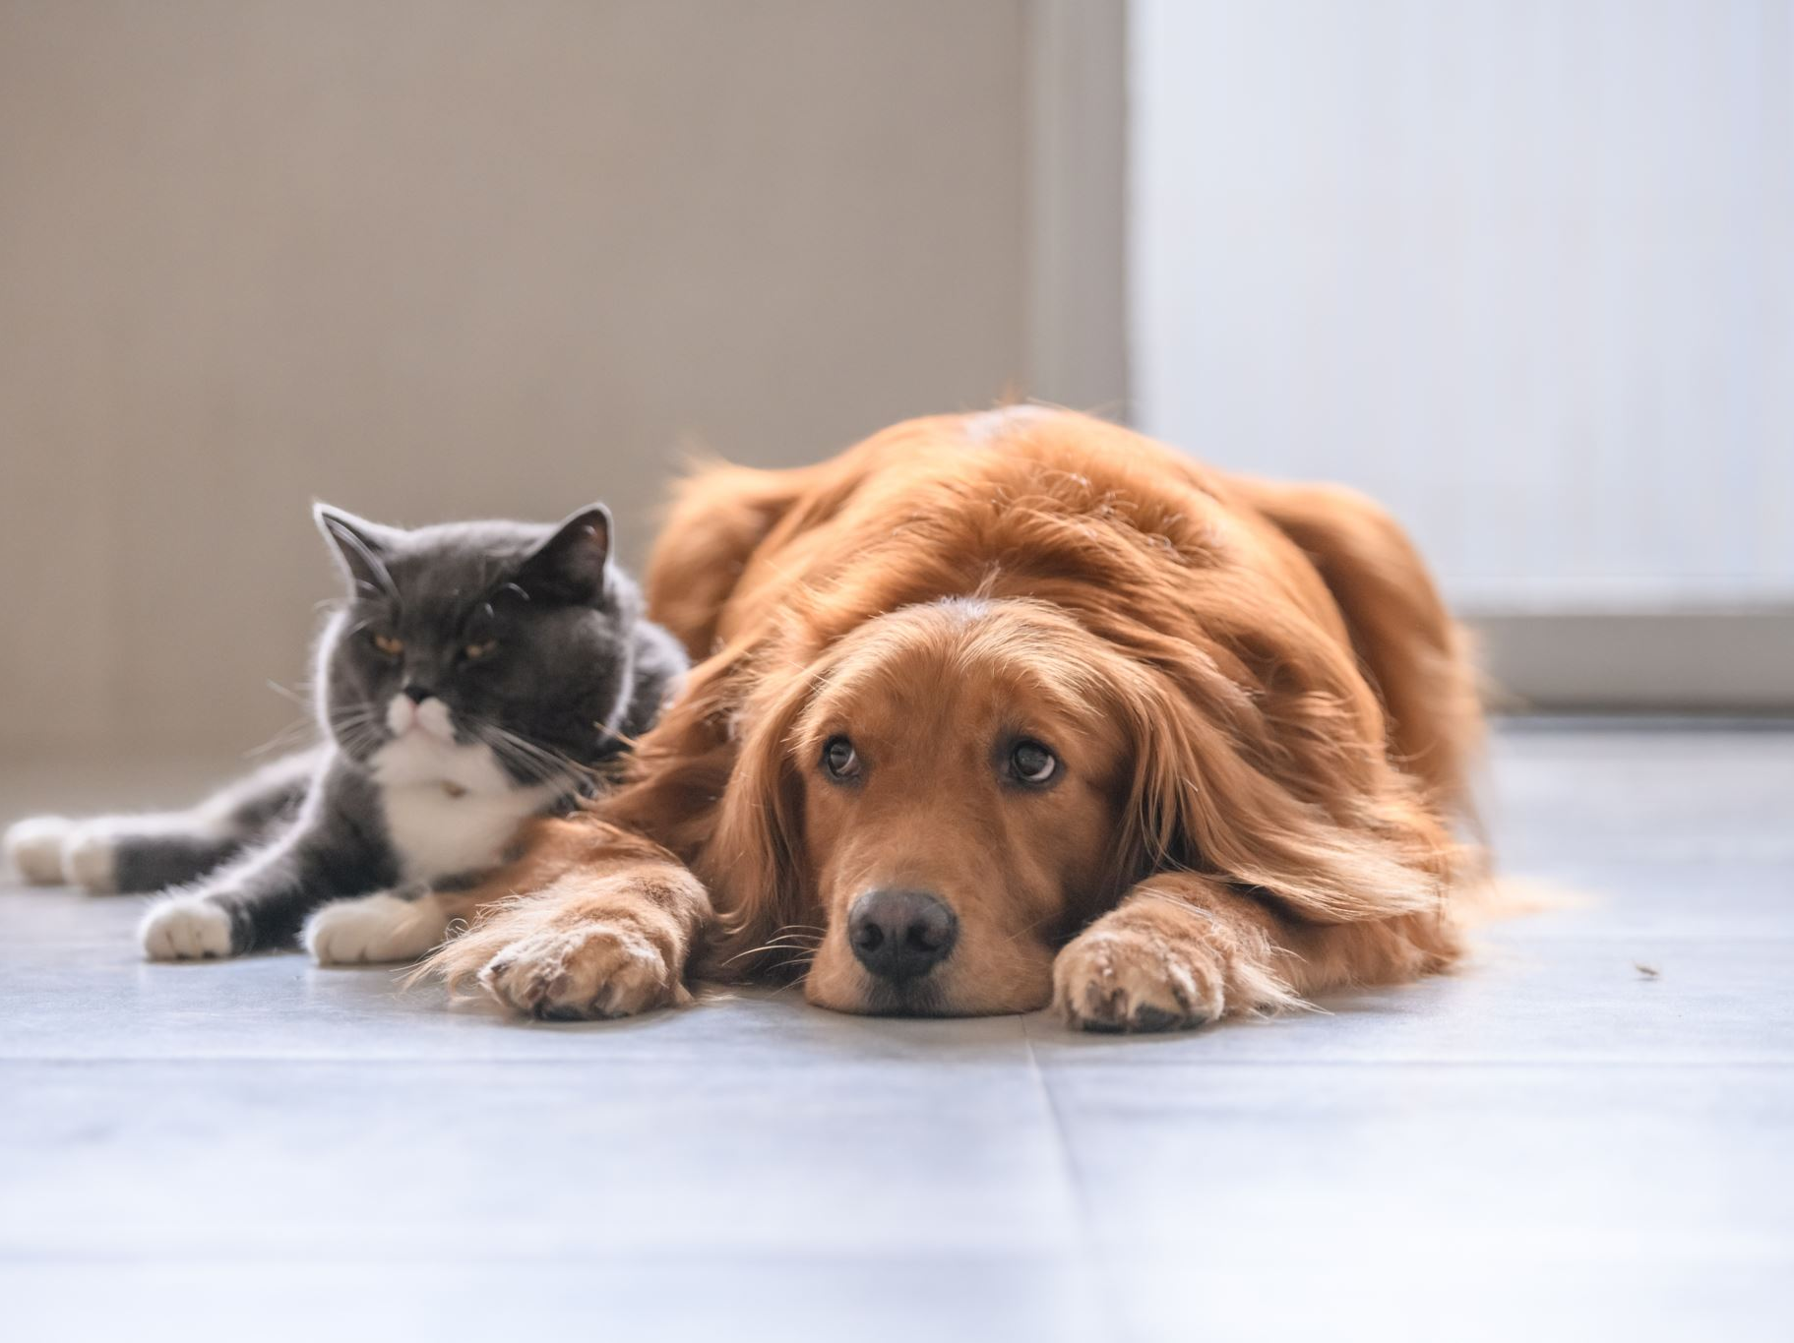
PawMatch: Pet Adoption Website
Human Interface Computing Class Presentation

Slide 2
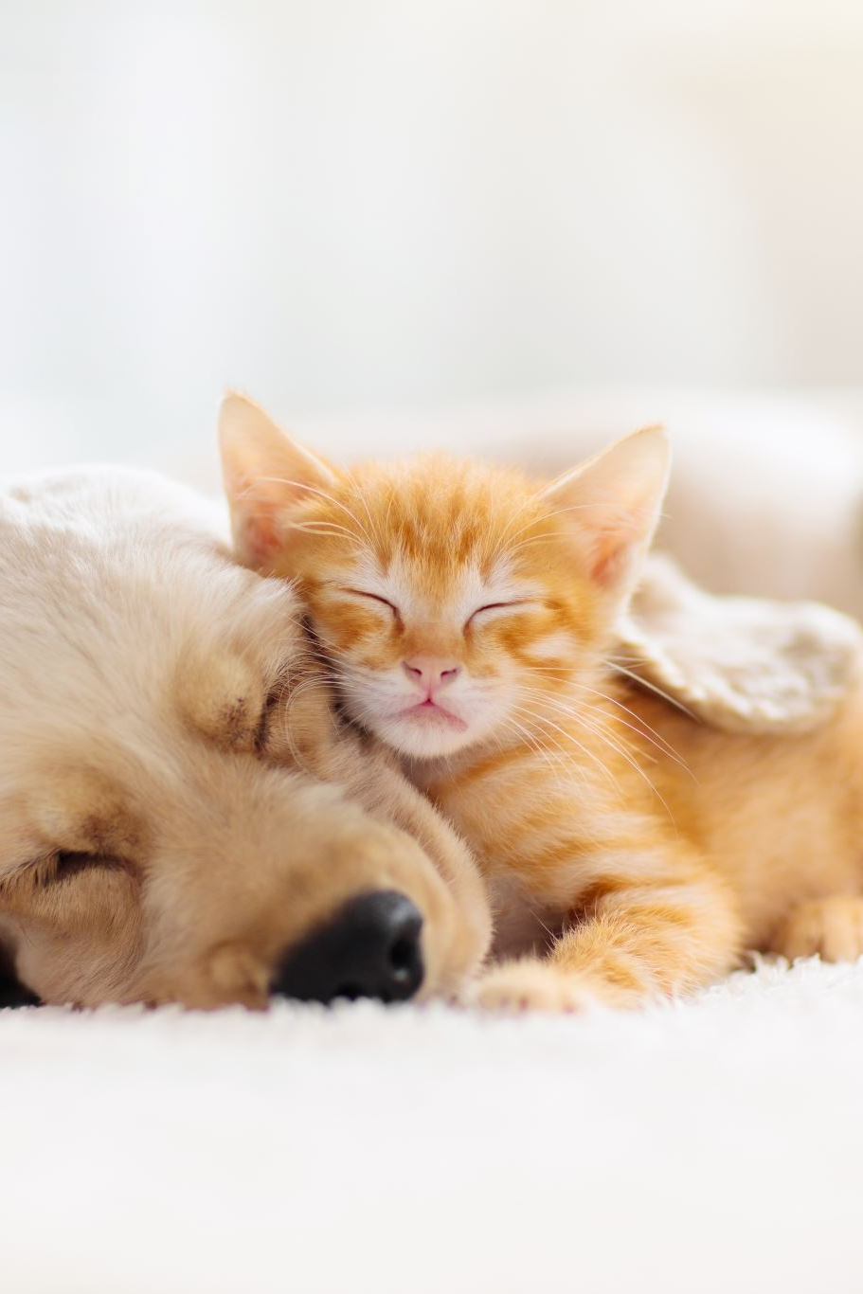
Introduction
PawMatch is a website created to connect pets with loving homes. The site is designed to be user-friendly and support both adopters and those looking to rehome pets.

Slide 3
Website Features
• A visually appealing homepage with pet profiles.
• Detailed pet information pages with images, descriptions, and adoption buttons.
• Adoption form to express interest in a pet.
• A section for posting pets for adoption.

Slide 4

Main Page Design
• Features pet profiles displayed in card format.
• Provides essential information at a glance, such as the pet's name and location.
• Users can click on a pet card for more details.

Slide 5
Pet Detail Page
• Displays detailed information about the pet, including breed, age, and health status.
• Includes a call-to-action button to adopt the pet.

Slide 6
Adoption Form
• A simple and user-friendly form to submit adoption requests.
• Collects basic information such as name, email, phone number, and reason for adoption.

Slide 7
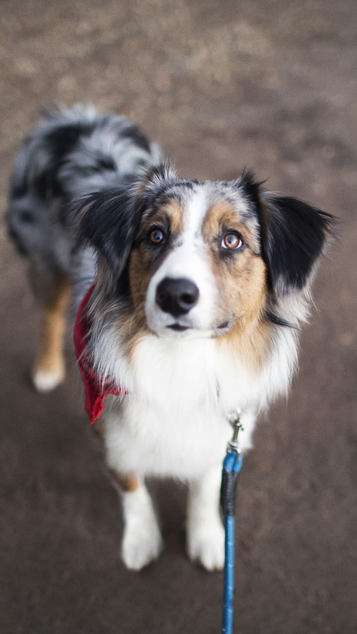
Post a Pet for Adoption
Allows users to post pets they wish to rehome.
Form fields include pet name, type, breed, age, and additional details.

Slide 8
Applying Schneiderman's Rules
• Consistency: Uniform design and navigation across all pages.
• Error Prevention: Clear and labeled fields in forms.
• User Control: Simple navigation and intuitive actions.

Slide 9
Conclusion
PawMatch combines functionality and design to provide a seamless adoption experience.
Future improvements include additional user feedback features and error handling.

