Slide 1
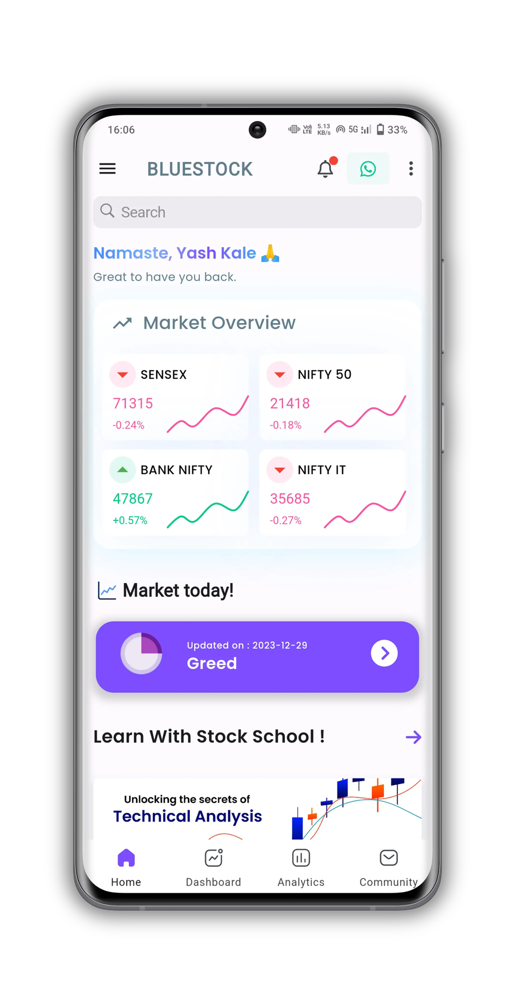


BLUESTOCKS FINTECH
Mutual Fund Analytics
Capstone Project I - Final Report
Prepared by : Narayan Handsah
Gmail: hansdahnarayan987@gmail.com
Github repository: https://github.com/KawaiiLolly/bluestock-mf-capstone
Notes:
1

Slide 2
Problem & Objective
Why does this analysis matter?
With more than 1,900 mutual fund schemes available in the Indian market, there is a growing need for a centralized analytics platform that transforms raw fund data into meaningful insights. Retail investors lack data-driven tools to compare performance, risk, and suitability.
Problem
The primary objective of this project is to develop a production-ready mutual fund analytics system capable of ingesting of AMFI data, clean it, analyzing and computing risk metrics, and visualizing large-scale mutual fund data. The final outcome is a comprehensive analytics platform that supports data-driven mutual fund evaluation and investment decision-making with interactive dashboard.
Objective
40 Mutual Fund Schemes | 10 Major Fund Houses | Jan 2022 – Dec 2025 | 19,798 Historical NAV Records | 32,778 investor transactions | Multiple Benchmark Indices | Portfolio Holdings and Sector Allocations | SIP and AUM Industry Statistics
This scope enables both fund-level and industry-level analysis across performance, risk, investor behavior, and market trends.
Scope
Python · Pandas · NumPy · SciPy · Matplotlib · Seaborn · Plotly · SQLite · Streamlit
Stack
Bluestock Fintech | Capstone Project I - Mutual Fund Analytics
2 / 12
Notes:
2

Slide 3
Data Sources
10 raw datasets from AMFI, NSE & mfapi.in
Dataset
Rows
Key Columns
fund_master.csv
40
amfi_code, scheme_name, fund_house, category
nav_history.csv
46,000
amfi_code, date, nav, daily_return_pct
investor_transactions.csv
13,048
investor_id, transaction_type, amount_inr, state
scheme_performance.csv
40
sharpe_ratio, beta, alpha, expense_ratio_pct
aum_by_fund_house.csv
90
fund_house, year, aum_lakh_crore
monthly_sip_inflows.csv
48
month, sip_inflow_crore, active_sip_accounts_crore
category_inflows.csv
144
month, category, net_inflow_crore
portfolio_holdings.csv
322
amfi_code, stock_symbol, weight_pct, sector
benchmark_indices.csv
8050
Date, index_name, close_value
industry_folio_count.csv
21
month, total_folios_crore
Bluestock Fintech | Capstone Project I - Mutual Fund Analytics
3 / 12
Notes:
3

Slide 4
Project Architecture
7-day end-to-end analytics pipeline
Project Setup + Data Ingestion
Exploratory Data Analysis (EDA)
Dashboard Development
Final Report + Presentation
Compiled all findings into a detailed PDF report and a professional presentation deck. Finalized documentation, code repository, and deployment-ready deliverables for project submission.
Collected mutual fund data from mfapi.in and multiple CSV sources, including NAV history, AUM, SIP inflows, investor transactions, and benchmark data. Performed initial data validation and established the project structure for downstream analytics.
Created 17+ visualizations to analyze fund performance, investor behavior, industry growth, and market trends. Generated key insights using Matplotlib, Seaborn, and Plotly.
Built a multi-page Streamlit dashboard with interactive charts, KPI cards, rankings, and filters. Enabled users to explore performance, risk, and industry analytics dynamically.
Day 2
Day 4
Day 6
Day 1
Day 3
Day 5
Day 7
Data Cleaning + SQL Database Design
Fund Performance Analytics
Advanced Analytics + Risk Metrics
Cleaned and standardized all datasets by handling missing values, correcting inconsistencies, and ensuring data quality. Designed a SQLite database to store and manage the processed data efficiently.
Calculated performance and risk metrics such as CAGR, Sharpe Ratio, Sortino Ratio, Alpha, Beta, VaR, and Maximum Drawdown. Developed a fund ranking scorecard for objective scheme comparison.
Implemented Monte Carlo simulations, portfolio optimization, Efficient Frontier analysis, cohort analysis, and sector concentration (HHI) metrics. These models provided deeper insights into future returns, portfolio risk, and diversification.
Bluestock Fintech | Capstone Project I - Mutual Fund Analytics
4 / 12
Notes:
4

Slide 5
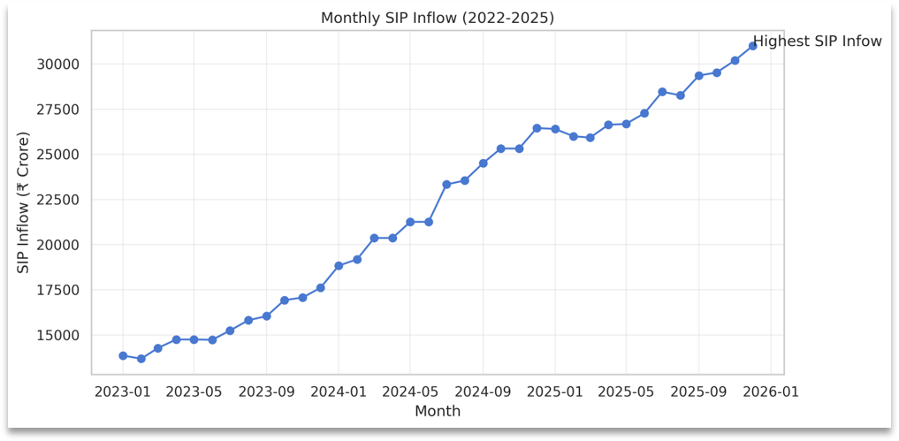
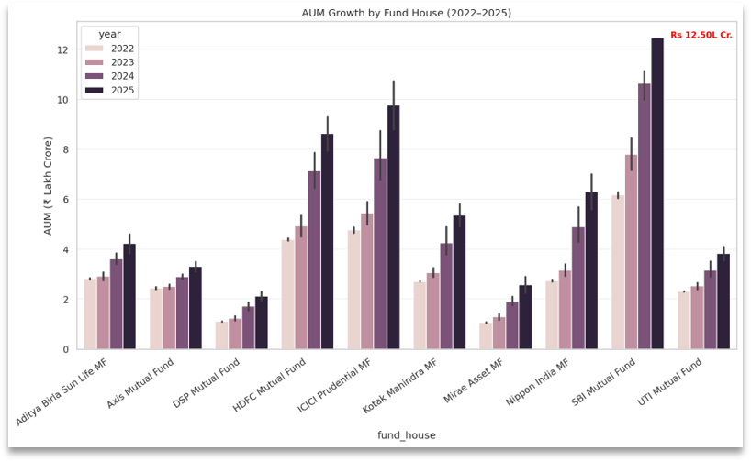
EDA Highlights — Industry Overview
SIP growth, AUM trends & folio expansion
Rs.31,002 Cr
Rs.117L Cr
26.12 Cr
2.2x Growth
SIP All-Time High (Dec 2025)
Industry AUM (FY 2025)
Total Folios (Jan 2022 → Dec 2025)
SIP inflow 2022 → 2025
Figure 1: Monthly SIP inflow trend (Jan 2023 - Jan 2026). All-time high of Rs.31,002 Crore annotated.
Figure 2: Grouped bar chart of AUM by fund house (2022-2025). SBI Funds leads at Rs.12.5 Lakh Crore in 2025.
Bluestock Fintech | Capstone Project I - Mutual Fund Analytics
5 / 12
Notes:
5

Slide 6
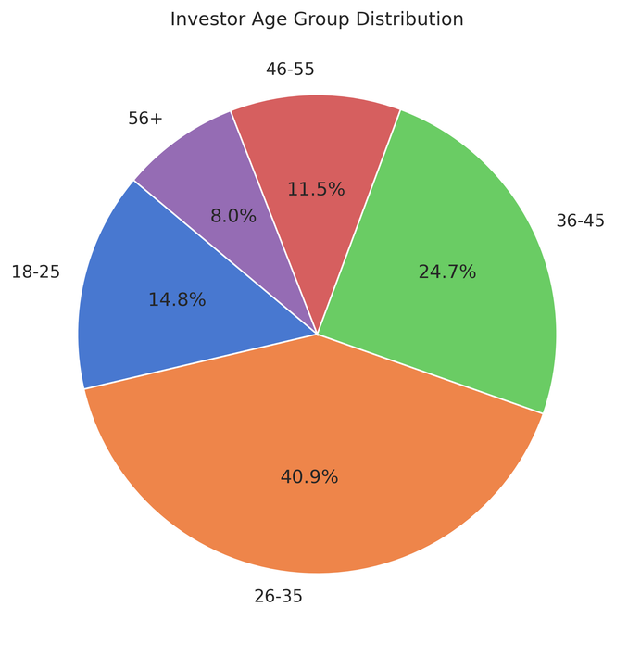
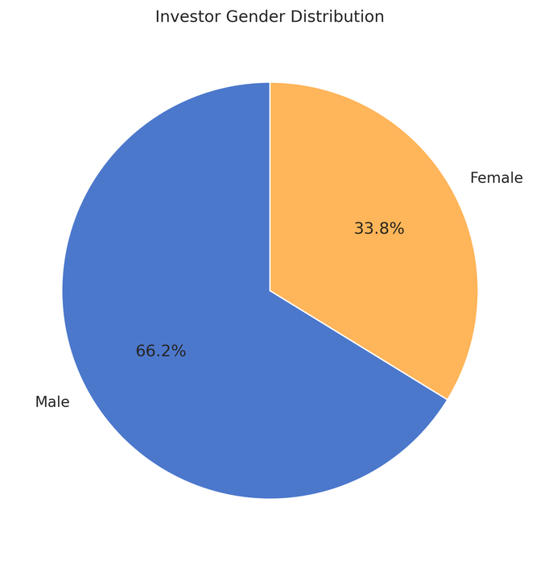
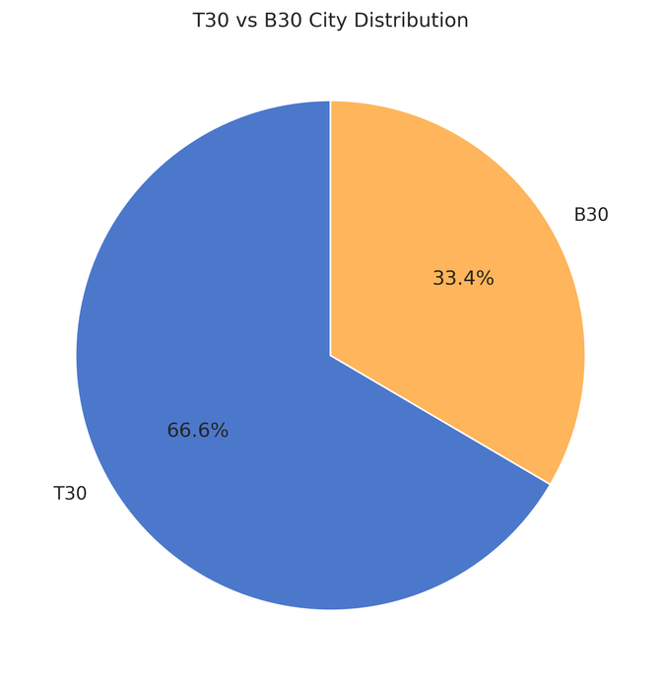
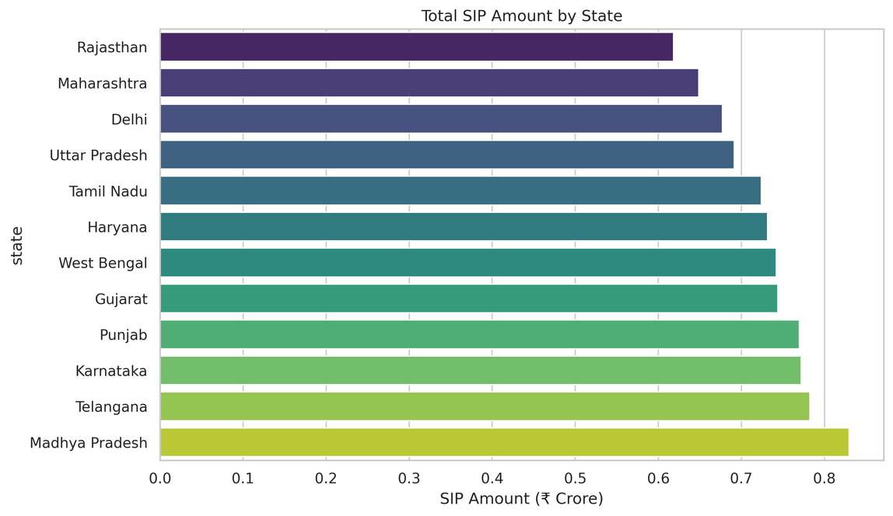
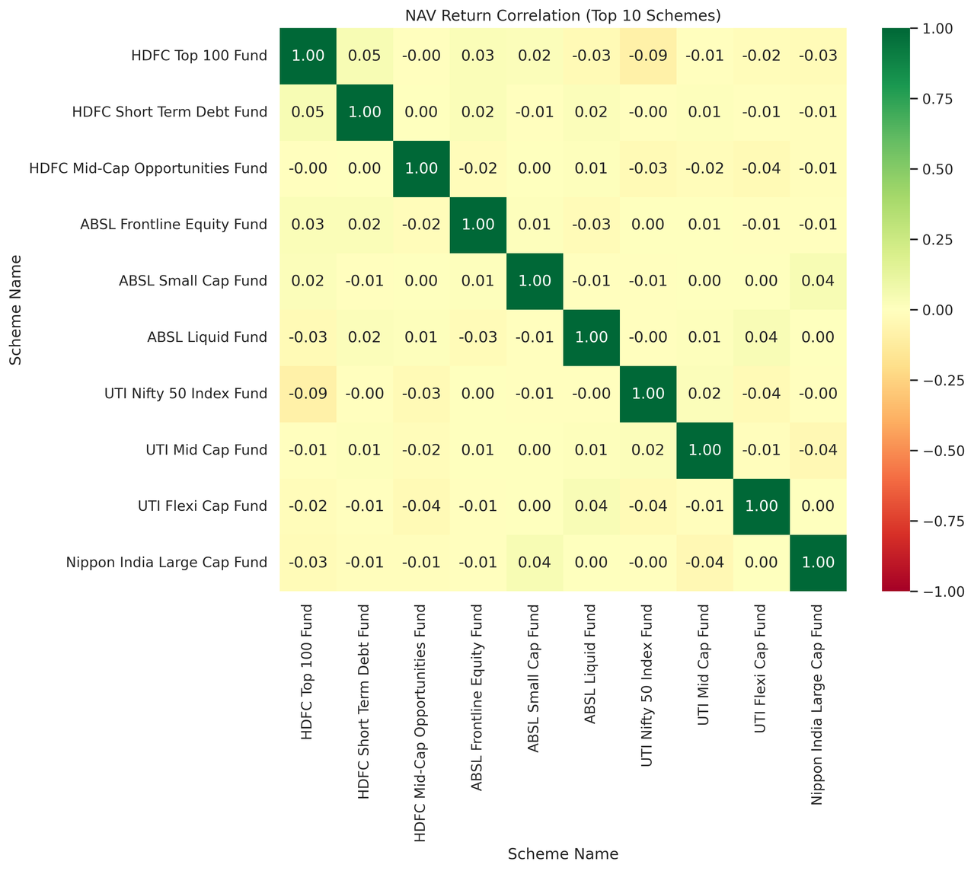
EDA Highlights — Investor Demographics
Who invests, from where, and how
Figure 4: Investor gender distribuition
Figure 5: T30 vs B30 distribuition
Figure 3: Investor age group distribuition
Figure 6: Total SIP amount by state
Figure 7: NAV return correlation (Top 10 Scheme)
Bluestock Fintech | Capstone Project I - Mutual Fund Analytics
6 / 12
Notes:
6

Slide 7
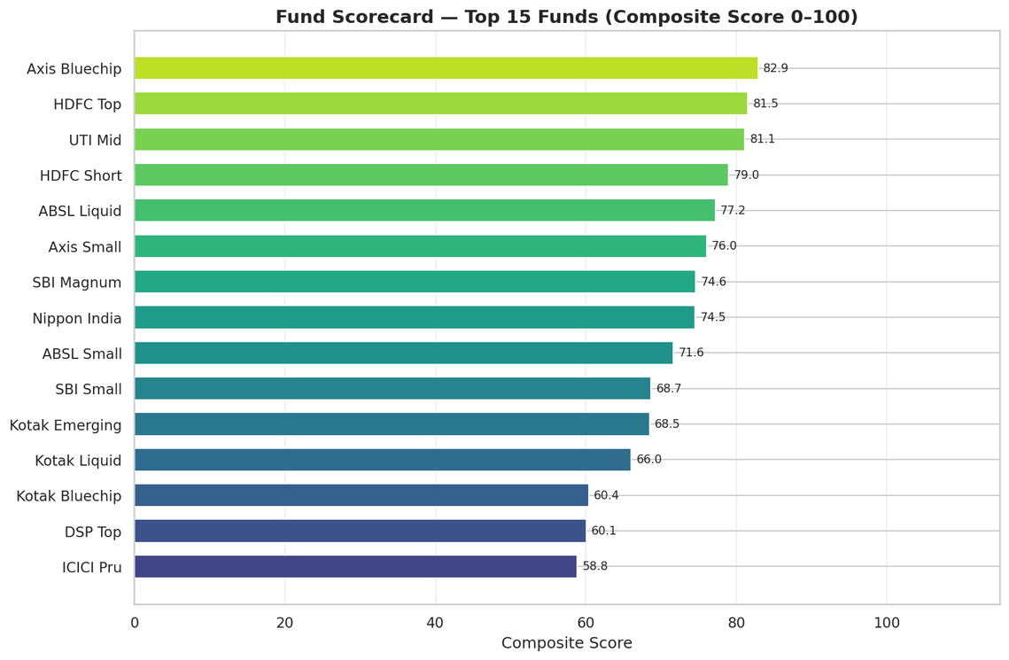
Performance Metrics — Fund Scorecard
Composite 0–100 ranking (30% CAGR + 25% Sharpe + 20% Alpha + 15% ER + 10% DD)
Rank
Scheme
Compostite Score
CAGR_3Yr
Sharpe
1
Axis Bluechip Fund
82.88
0.5064
0.0483
2
HDFC Top 100 Fund
81.54
1.2446
-0.1971
3
UTI Mid Cap Fund
81.09
-0.7392
-0.2037
1
4
HDFC Short Term Debt Fund
78.97
3.7690
-0.5433
5
ABSL Liquid Fund
77.18
6.0755
-0.4438
6
Axis Small Cap Fund
76.03
-11.2988
-0.0717
7
SBI Magnum Gilt Fund
74.62
5.6187
-0.1865
8
Nippon India Gilt Securities
Fund
74.49
3.9092
-0.3239
9
ABSL Small Cap Fund
71.60
-4.0021
0.1855
Figure 8: Fund Scorecard
10
SBI Small Cap Fund
68.65
-1.2883
-0.0520
Bluestock Fintech | Capstone Project I - Mutual Fund Analytics
7 / 12
Notes:
7

Slide 8
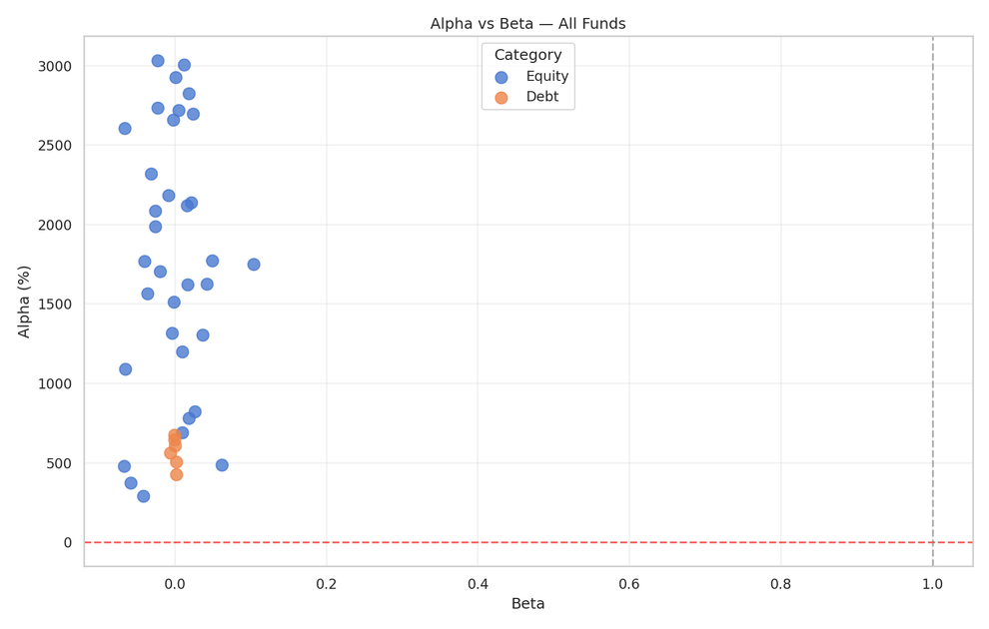
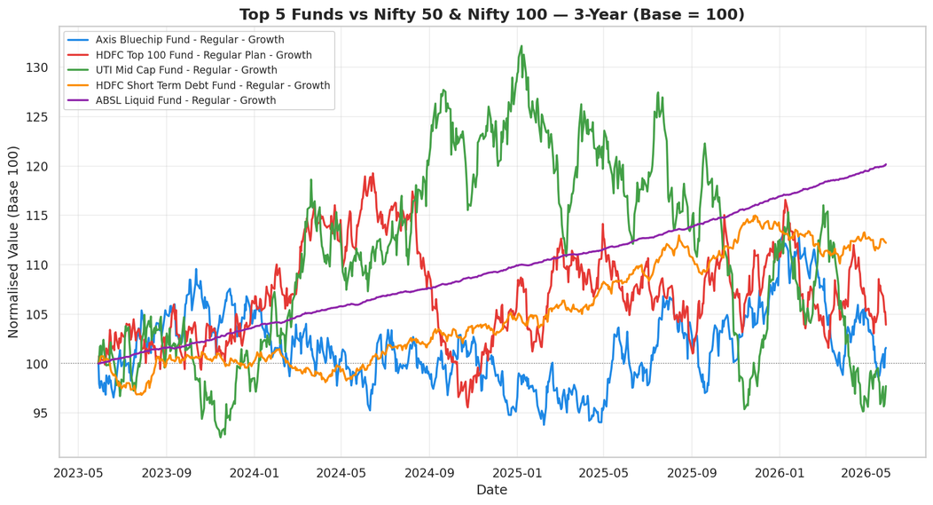
Performance Metrics — Risk Analysis
Sharpe · Sortino · Alpha/Beta · Max Drawdown · VaR
Figure 9: Alpha vs Beta scatter.
Figure 10: Top 5 funds vs Nifty 50 and Nifty 100 (3-year, base=100). .
Metrics
Formula
Key Finding
Metric
Formula
Sharpe
(Rp−Rf)/(σ × √252)
Best: 1.7298 | Rf=6.5%
Sortino
(Rp−Rf)/σ_down × √252
Uses downside std only
Alpha
OLS intercept × 252
Best: +20% annualised
VaR 95%
5th pct of daily returns
Range: −1.9% to −1.7%
Max DD
min(NAV/cummax−1)
Worst: −45% (small-cap)
Bluestock Fintech | Capstone Project I - Mutual Fund Analytics
8 / 12
Notes:
8

Slide 9
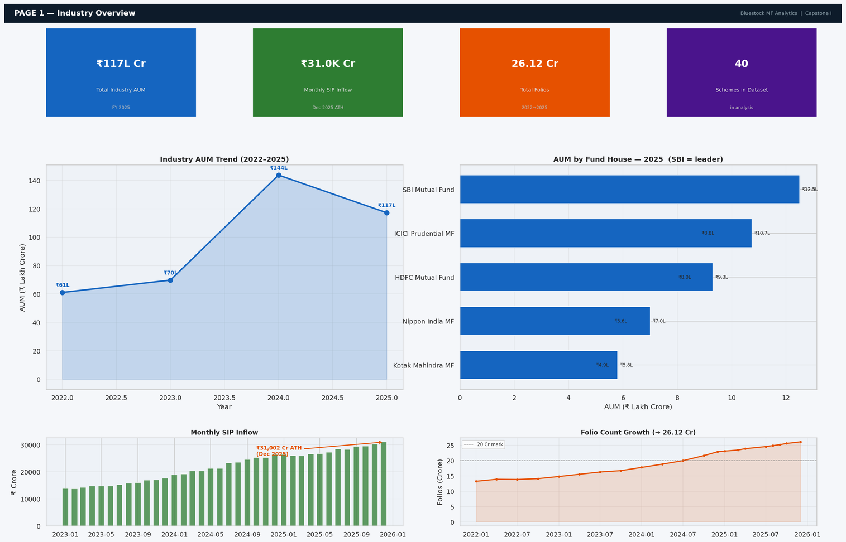
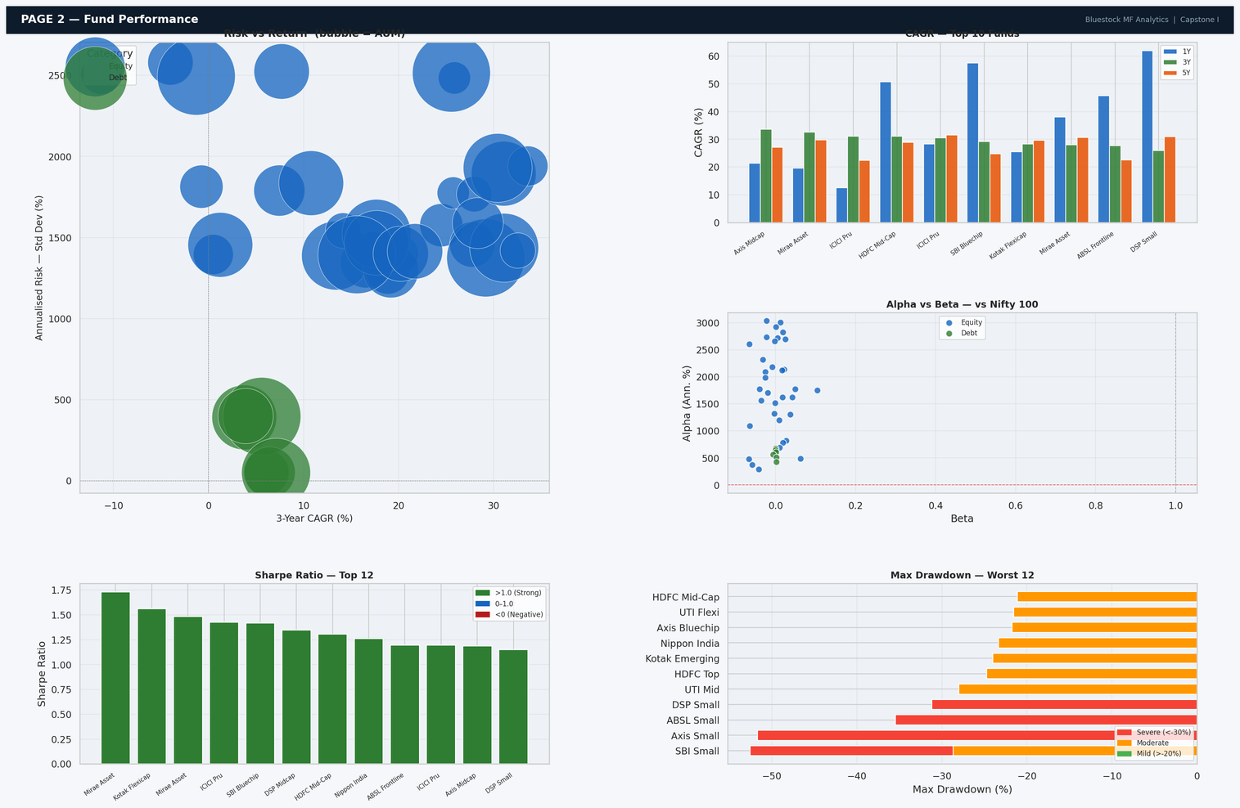
Interactive Dashboard — Pages 1 & 2
Built with Streamlit + Plotly | streamlit run dashboard/dashboard.py
Figure 11: Page 1 — KPI cards, AUM trend, SIP bar chart, folio growth..
Figure 12: Page 2 — Risk-return scatter (bubble=AUM), sortable scorecard, NAV vs benchmark, alpha bar chart.
Bluestock Fintech | Capstone Project I - Mutual Fund Analytics
9 / 12
Notes:
9

Slide 10
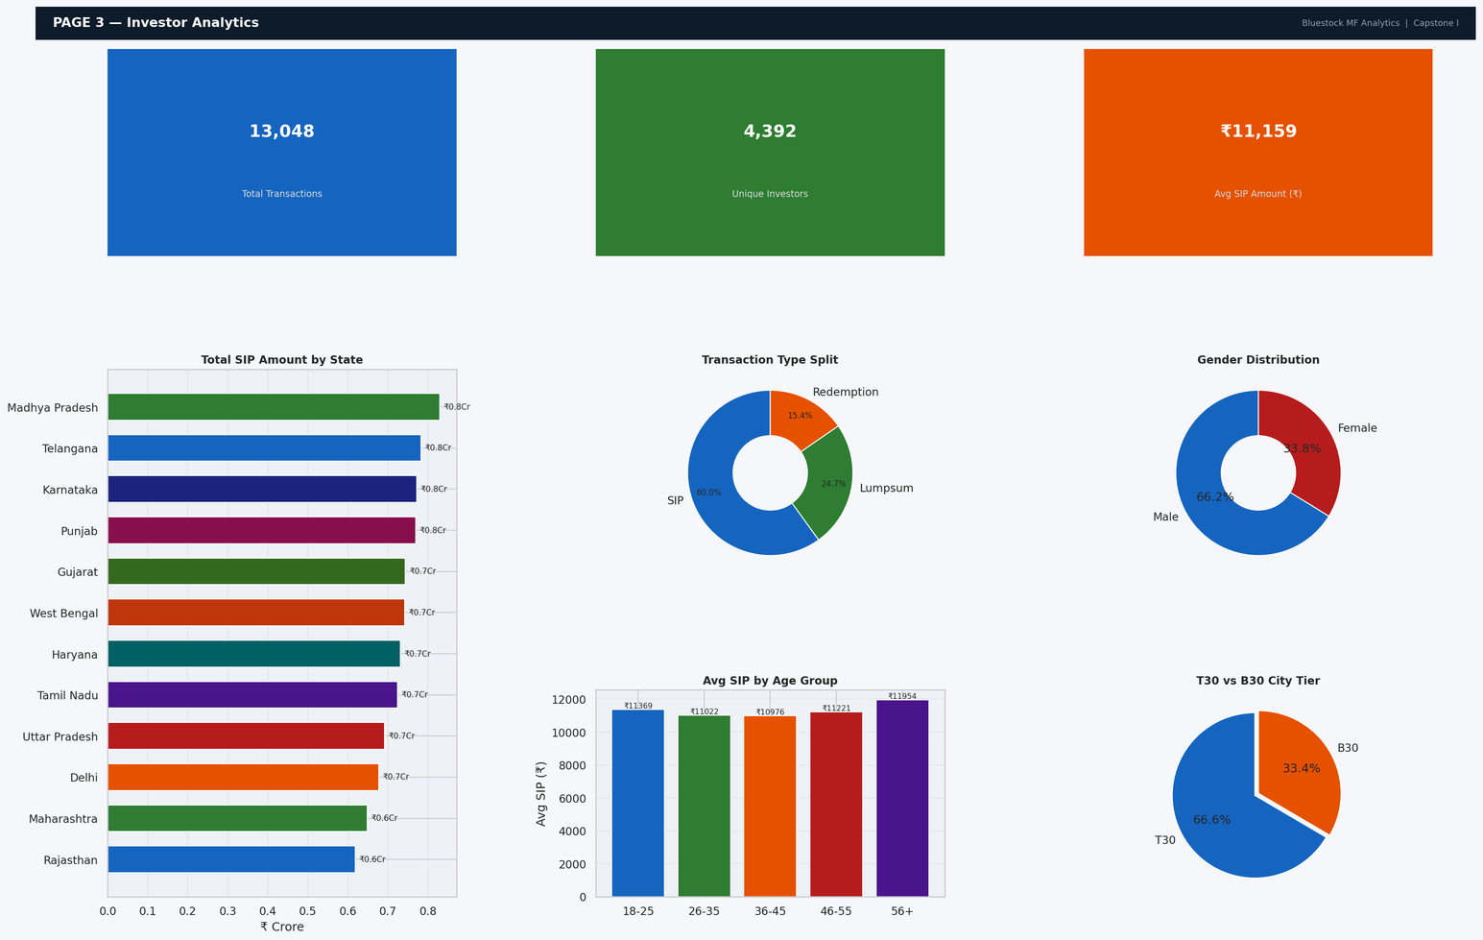
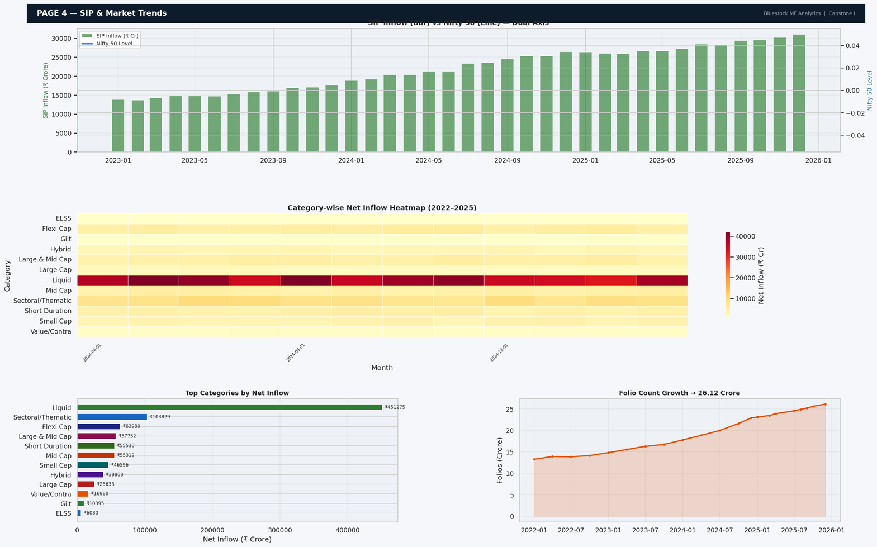
Interactive Dashboard — Pages 3 & 4
Slicers: State | Age Group | City Tier | Year Range | Benchmark Index
Figure 13: Page 3 — SIP by state, transaction type donut, age group bar, gender pie, T30 vs B30, monthly volume
Figure 14: Page 4 — Dual-axis SIP+Nifty50, category heatmap, top categories bar, folio growth.
Bluestock Fintech | Capstone Project I - Mutual Fund Analytics
10 / 12
Notes:
10

Slide 11
Key Findings & Recommendations
Data-driven insights for investors, managers and regulators
SIP Growth
Industry Expansion
Top Performer
Monthly SIP inflows reached ₹31,002 Cr (Dec 2025), up 2.2× from ₹13,856 Cr in Jan 2023, highlighting strong retail participation and confidence in systematic investing.
Recommendation:
AMCs should continue expanding digital SIP onboarding, financial literacy campaigns, and goal-based investing tools to sustain growth momentum.
Industry AUM reached ₹62.74 Lakh Cr, while folios doubled from 13.26 Cr to 26.12 Cr (18% CAGR), indicating broadening mutual fund adoption.
Recommendation:
Fund houses should focus on investor retention and personalized engagement strategies to convert first-time investors into long-term wealth creators.
Axis Midcap Fund delivered the highest 3-year CAGR (33.6%), while Mirae Asset Large Cap Fund achieved the best Sharpe Ratio (1.73), demonstrating that superior returns can be achieved without excessive risk.
Recommendation:
Investors should evaluate both return and risk-adjusted performance metrics rather than relying solely on historical returns.
Monte Carlo Outlook
At-Risk SIPs
Diversification Gap
Monte Carlo simulations project 25–32% median 5-year CAGR for leading equity funds, with ICICI Pru Midcap, SBI Small Cap, and DSP Small Cap leading projections.
Recommendation:
Long-term investors should maintain disciplined SIPs in diversified equity portfolios to benefit from compounding and future market growth.
Approximately 90% of investors with multiple SIPs exhibit gaps exceeding 90 days, indicating weak SIP continuity and a high probability of churn.
Recommendation:
AMCs should implement automated SIP reminder nudges, missed-payment alerts, and retention campaigns before debit dates.
All analyzed equity funds show HHI > 0.25, reflecting significant sector concentration driven by large-cap and NIFTY 50 exposure.
Recommendation:
Investors should diversify across market capitalizations, sectors, and asset classes instead of relying on a single equity category.
Bluestock Fintech | Capstone Project I - Mutual Fund Analytics
11 / 12
Notes:
11

Slide 12
Rs. 117L Cr
Total Industry AUM FY 2025
15 Scripts
Python
Rs. 31,002 Cr
THANK YOU
Monthy SIP Inflow Dec 2025 ATH
6 Notebooks
Bluestock Fintech — Mutual Fund Analytics Capstone Project I
Jupyter
Rs. 26.12 Cr
Total Folios Jan 2022 – Dec 2025
30+ Charts
PNG/HTML
40
Schemes In dataset analyzed
Notes:
12

