Slide 1
Phishing: Navigating the Waters of Cybersecurity Threats

Slide 2




Introduction to Phishing
Phishing is one of the most prevalent and dangerous forms of cyber attacks today. It involves the use of deceptive tactics to trick individuals into divulging sensitive information, such as login credentials, credit card numbers, or personal details. These attacks often come in the form of emails, text messages, or fake websites that appear to be from legitimate organizations, but are designed to exploit human psychology and trust.

Slide 3
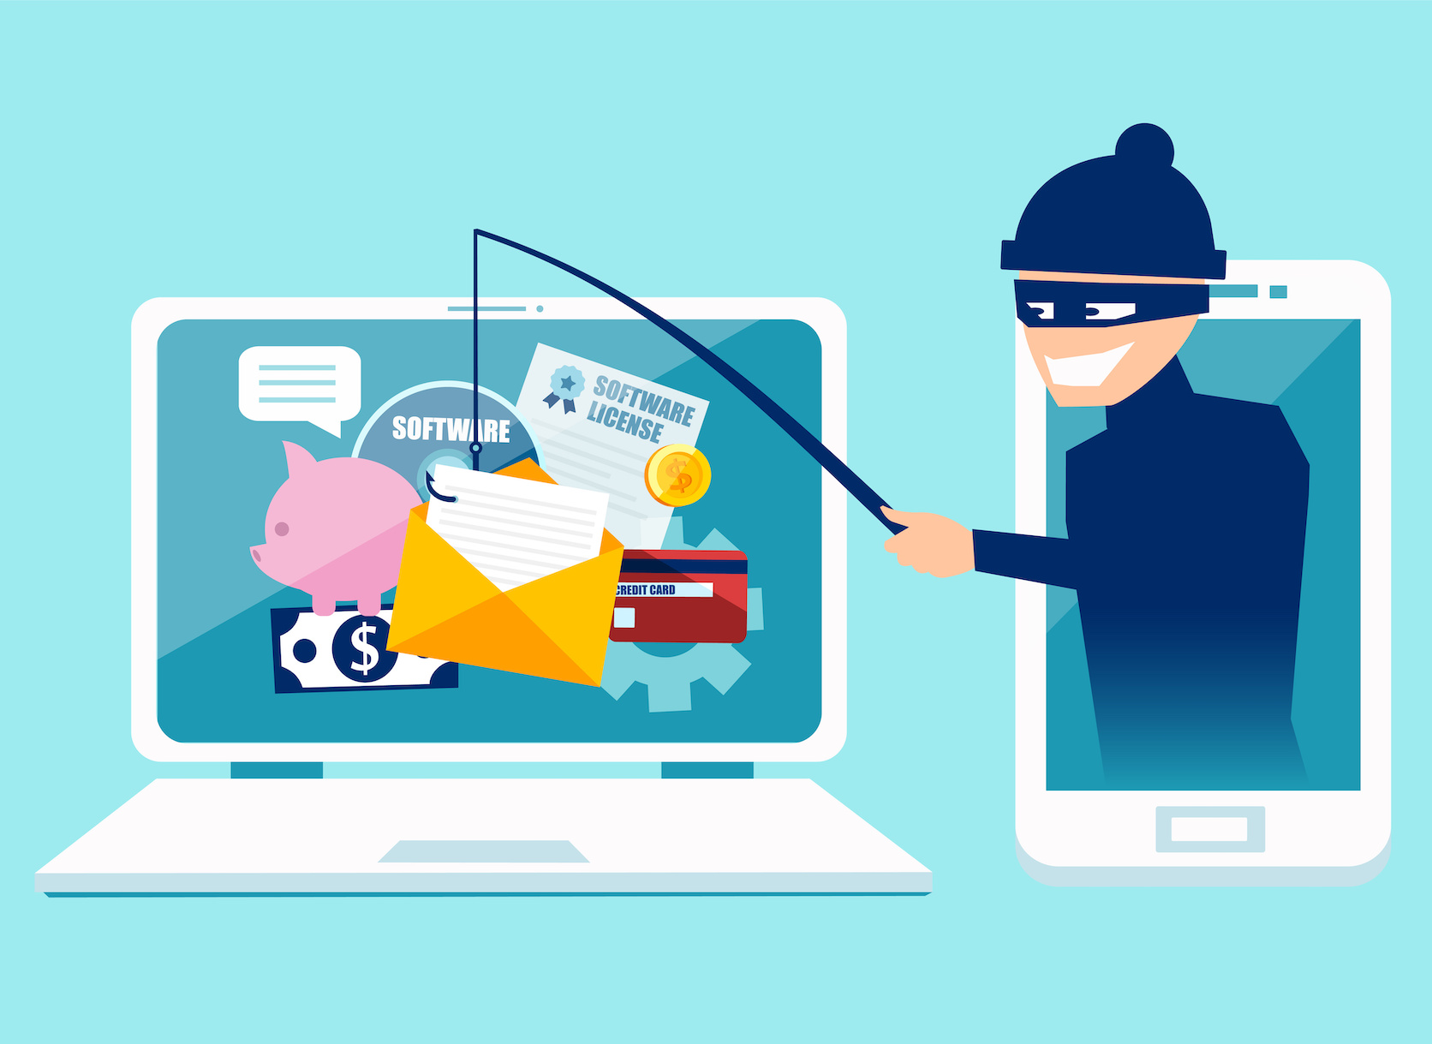


What is Phishing?
Phishing is a type of cyber attack where attackers attempt to deceive individuals into providing sensitive information, such as passwords, credit card numbers, or personal details, by pretending to be a trustworthy entity. These attacks are typically carried out through fraudulent emails, text messages, phone calls, or fake websites designed to look like legitimate organizations or services.

Slide 4
Types of Phishing Attacks
Email Phishing
Vishing
Smishing
Whaling
Spear Phishing
Email phishing is the most common type of phishing. Hackers send these emails to any email addresses they can obtain. The email usually informs you that there has been a compromise to your account and that you need to respond immediately by clicking on a provided link.
A common vishing attack includes a call from someone claiming to be a representative from Microsoft. This person informs you that they’ve detected a virus on your computer. You’re then asked to provide credit card details so the attacker can install an updated version of anti-virus software on your computer.
Smishing is an attack that uses text messaging or short message service (SMS) to execute the attack. A common smishing technique is to deliver a message to a cell phone through SMS that contains a clickable link or a return phone number.
Whaling is an even more targeted type of phishing that goes after the whales – a marine animal even bigger than a fish. These attacks typically target a CEO, CFO, within an industry. A whaling email might state that the company is facing legal consequences and that you need to click on the link to get more information.
Spear phishing targets a specific group or type of individual such as a company’s system administrator. Below is an example of a spear phishing email. Note the attention paid to the industry in which the recipient works, the download link the victim is asked to click, and the immediate response the request requires.

Slide 5

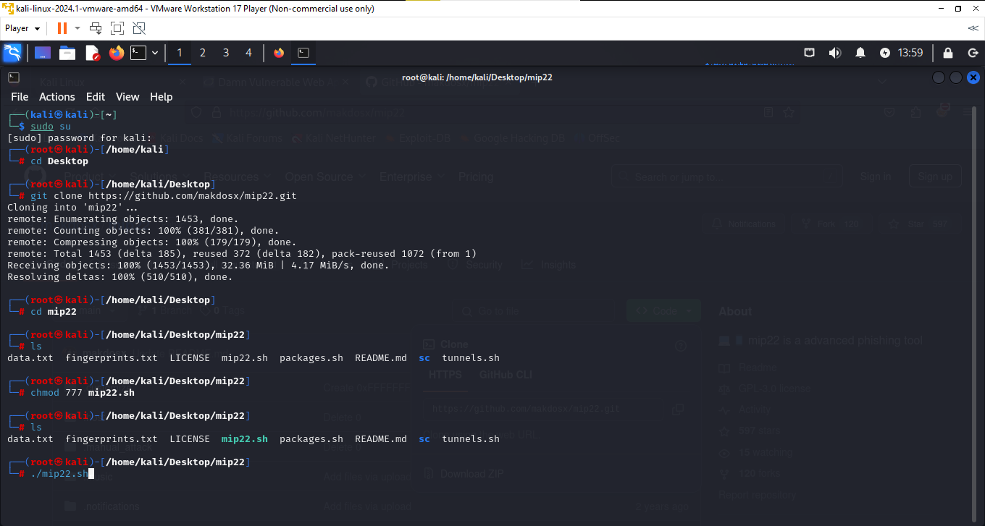

PRACTICAL

Slide 6

PRACTICAL

Slide 7
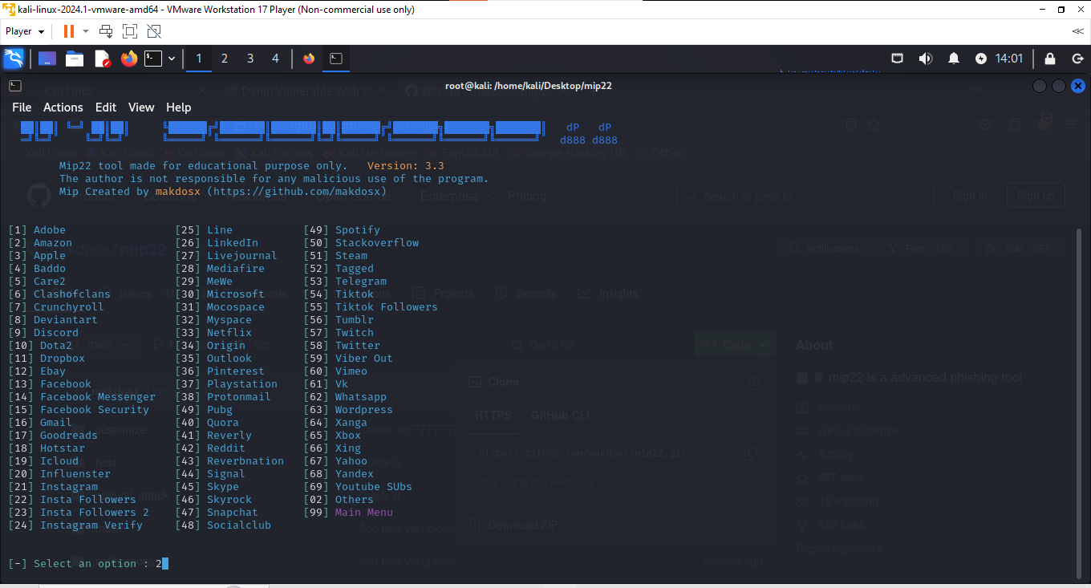
PRACTICAL

Slide 8
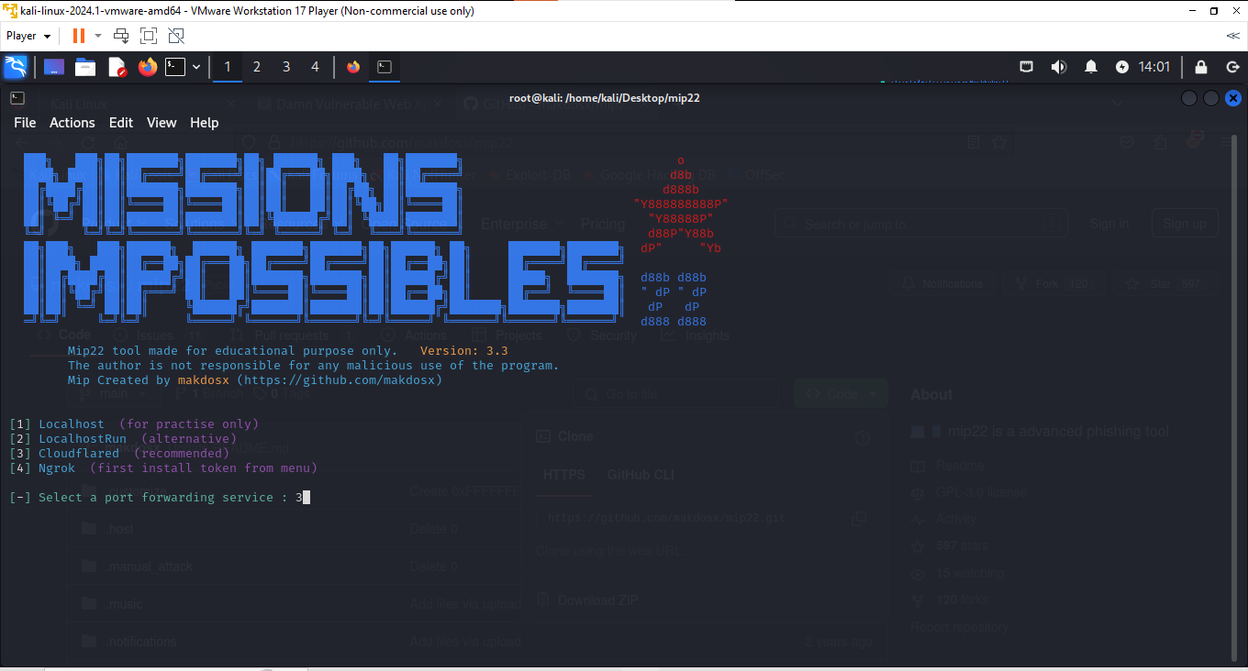
PRACTICAL

Slide 9
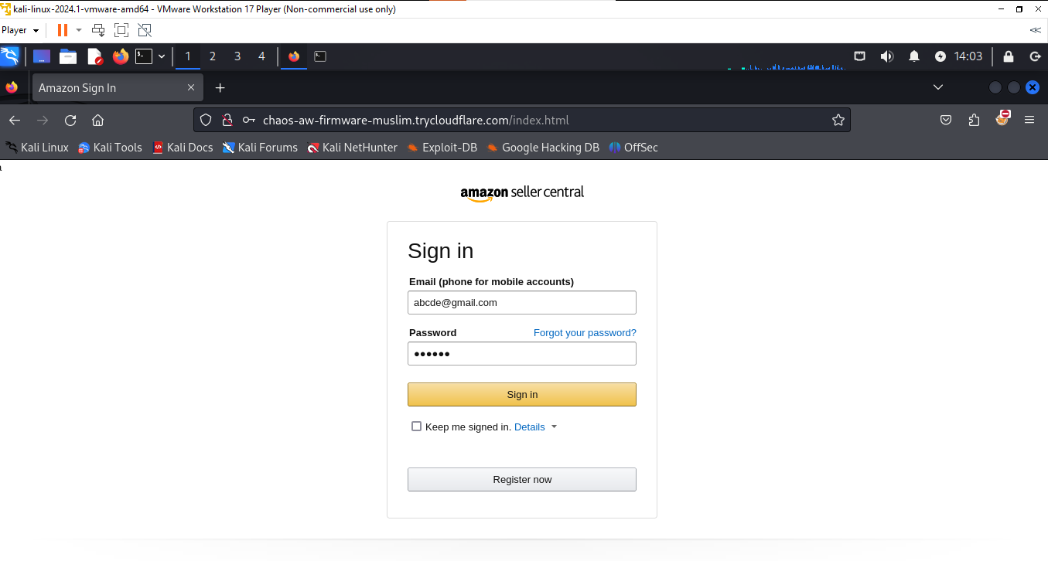
PRACTICAL

Slide 10
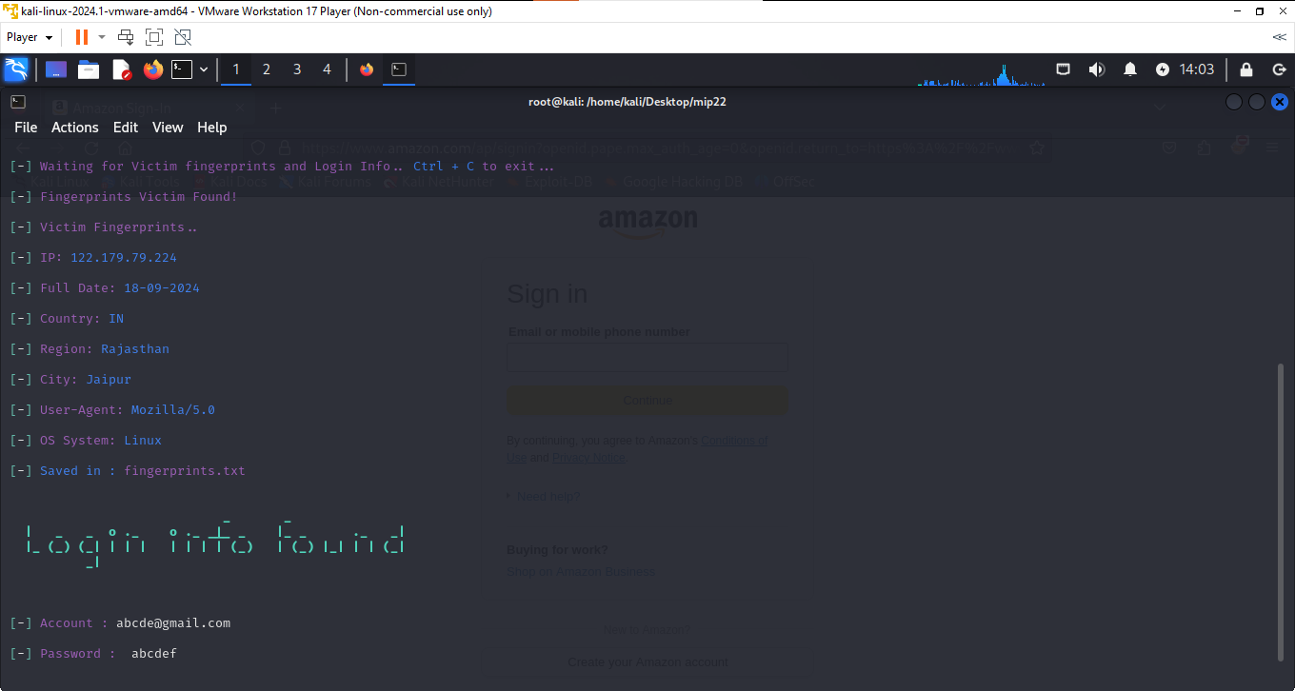
PRACTICAL

Slide 11



Preventing Phishing Attacks
Implementing security measures can significantly reduce the risk of falling victim to phishing. Use strong passwords, enable two-factor authentication, and educate yourself and others about phishing techniques. Awareness and proactive strategies are key to enhancing your cybersecurity posture.

Slide 12


Conclusion: Stay Vigilant
In conclusion, being aware of phishing tactics and employing preventive measures are essential for online safety. As cyber threats evolve, continuous education and vigilance are necessary. Protect yourself and your organization by staying informed and cautious.

Slide 13


Thanks!

