Slide 1
Photosynthesis Overview
Plants convert light into chemical energy.

Slide 2

Chloroplast Structure Diagram
The thylakoid membrane stacks form grana.

Slide 3
Water Cycle Stages
Evaporation, condensation, precipitation, collection.

Slide 4
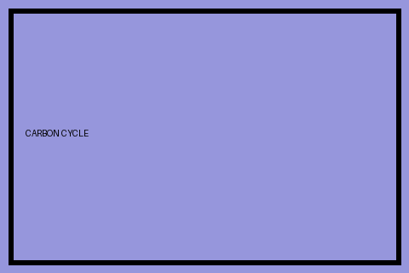
Carbon Cycle Diagram
Carbon moves between atmosphere, biosphere and oceans.

