Slide 1
IBM University Engagement Project Submission
Smart Travel Planner Agent
“AI-Powered Multi-Agent Travel Planning System using IBM watsonx.ai, LangFlow, RAG and Machine Learning”

Slide 2

Project Tile – [Smart Travel Planner Agent]
Domain of Project – [Travel & Tourism ]
Student Name | Recent Passport Photo | Email ID | Mobile number [WhatsApp]
Goldi Kumari |  | amisha6828@gmail.com | 8088186828

Slide 3
Problem Statement - Travel Planner Agent
The Challenge
Travel planning often requires users to visit multiple websites for destination research, weather forecasting, budgeting, accommodation, transportation, and itinerary preparation. This process is time-consuming and lacks personalization.
Users face challenges such as:
Information overload
Budget uncertainty
Lack of personalized recommendations
Difficulty planning day-wise itineraries
Limited access to reliable destination knowledge
Objective
Build an AI-powered Smart Travel Planner Agent capable of:
Recommending destinations based on user preferences
Providing weather intelligence
Predicting trip costs using Machine Learning
Retrieving destination knowledge using RAG
Generating personalized travel itineraries
Delivering a seamless travel planning experience

Slide 4







Technology Used
Frontend
HTML5
CSS3
JavaScript
AI & Agentic AI
IBM watsonx.ai
Llama 3.3 70B Instruct
LangFlow
RAG
ChromaDB
Sentence Transformers
Deployment
Render Cloud Platform
Backend
Flask
REST APIs
Machine Learning
Random Forest Regressor
External APIs
OpenWeather API

Slide 5
Proposed Solution -
The Smart Travel Planner Agent is an intelligent travel assistant that combines Agentic AI, Retrieval-Augmented Generation (RAG), Machine Learning, and real-time weather intelligence to generate personalized travel plans.
The system analyzes traveler preferences, budget, destination interests, and trip duration to provide intelligent travel recommendations.
Key Features
Destination Recommendation
Weather Forecast Analysis
Trip Cost Prediction
Travel Knowledge Retrieval
Personalized Itinerary Generation
Interactive User Dashboard
The solution leverages IBM watsonx.ai and LangFlow to orchestrate multiple specialized AI agents that collaborate to create an end-to-end travel planning experience.

Slide 6
Langflow component Used -
1. Chat Input
Receives traveler preferences and trip requirements.
2. Input Parser Agent
Processes and understands user travel requirements.
3. Destination Recommendation Agent
Analyzes user preferences and recommends suitable destinations.
4. Weather Intelligence Agent
Fetches and analyzes weather conditions using OpenWeather API.
5. Cost Prediction Agent
Uses Machine Learning (Random Forest) to estimate travel expenses.
6. Travel Knowledge Agent (RAG)
Retrieves destination information using ChromaDB.
7. Travel Concierge Agent
Generates personalized travel itineraries using IBM watsonx.ai.
8. Chat Output
Displays the final travel plan.

Slide 7
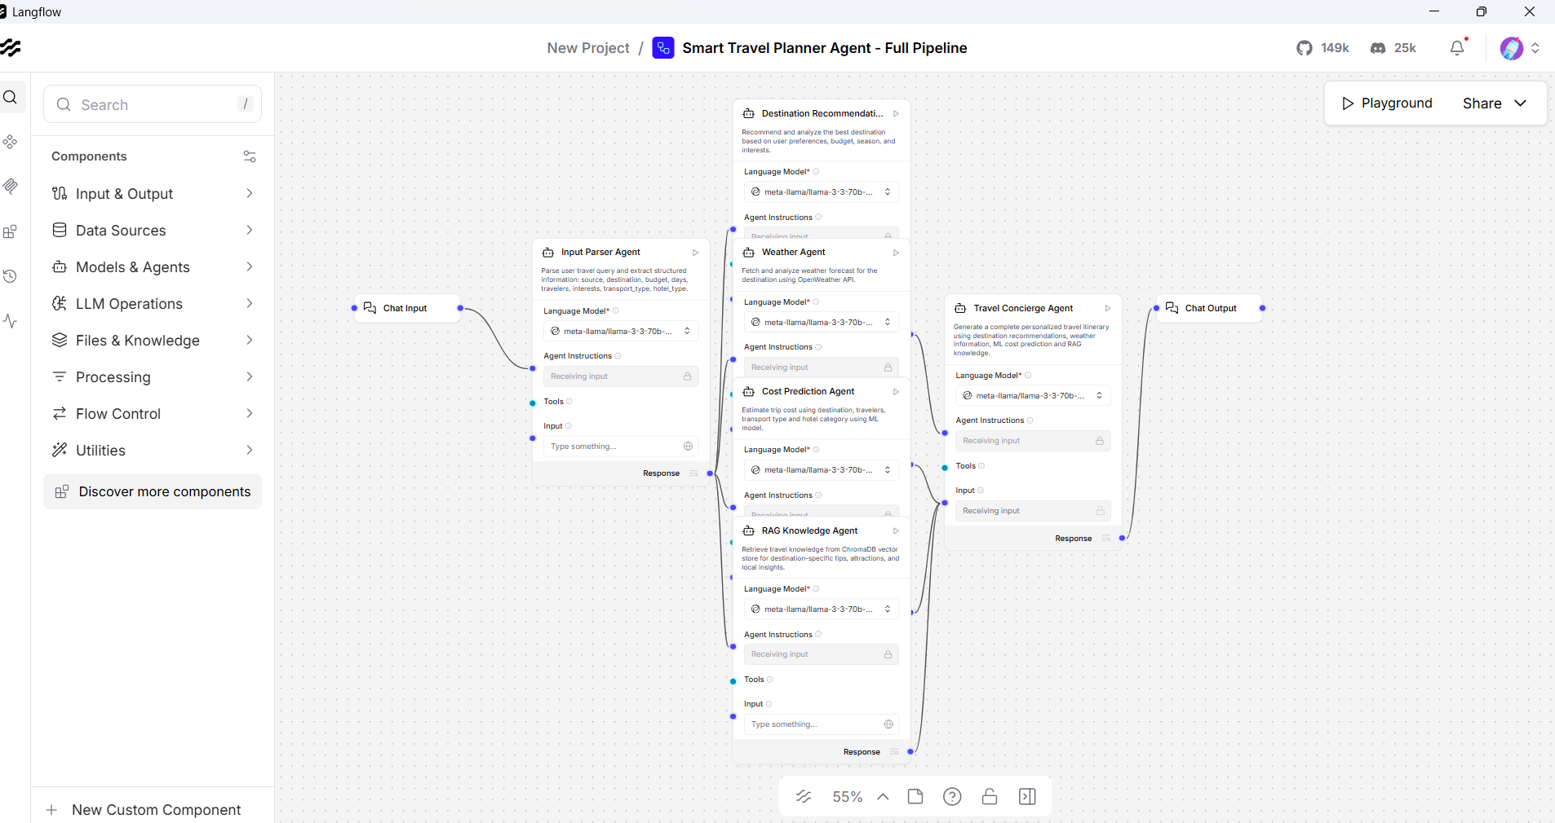
Langflow workflow -

Slide 8
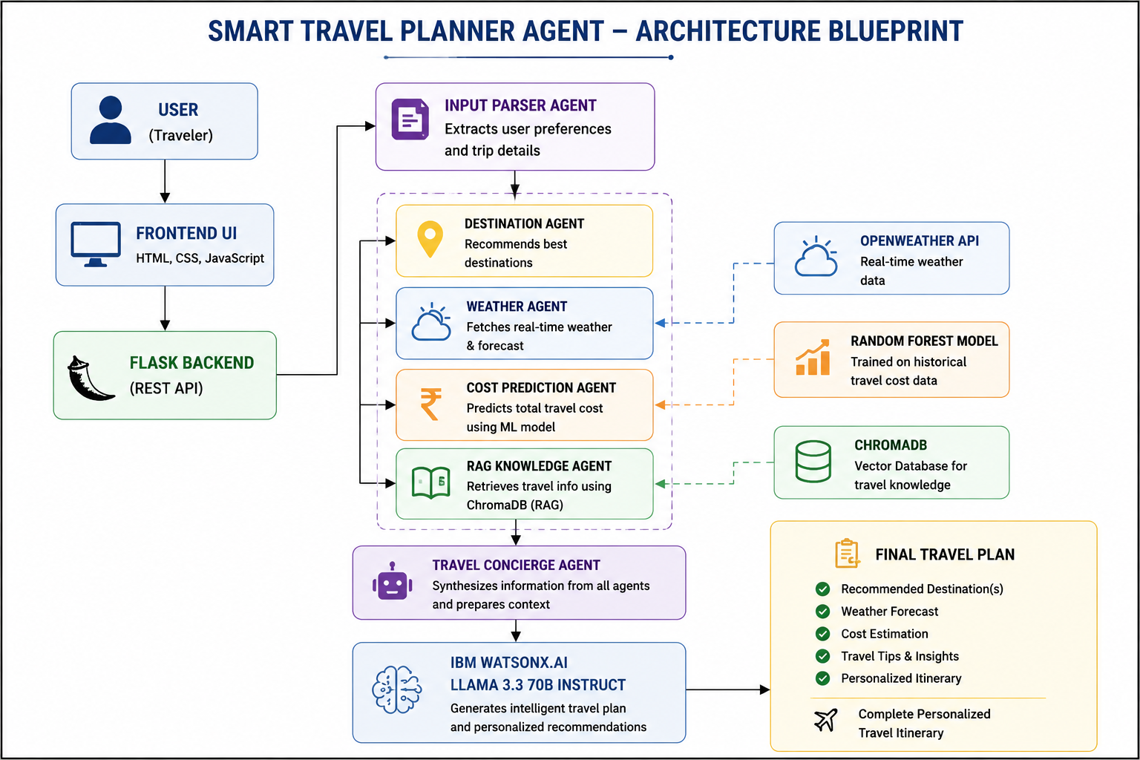
Architecture blueprint

Slide 9

Role of Agentic AI in the solution
Agentic AI enables multiple specialized AI agents to work collaboratively instead of relying on a single AI model.
Destination Agent
Provides destination recommendations.
Weather Agent
Analyzes weather conditions.
Cost Prediction Agent
Estimates travel expenses.
Travel Knowledge Agent
Retrieves contextual travel information.
Travel Concierge Agent
Generates personalized travel itineraries.
Benefits:
Better personalization
Context-aware recommendations
Improved decision-making
Real-time adaptability
Enhanced user experience

Slide 10
Technology Used
IBM watsonx.ai
Used for deploying and accessing foundation models.
Llama 3.3 70B Instruct
Used for itinerary generation, reasoning,
and travel recommendations.
LangFlow
Used to design and orchestrate the multi-agent workflow.
IBM Cloud
Provides infrastructure and deployment support.
Technology Stack
Flask
Backend API development.
ChromaDB
Vector database for Retrieval-Augmented Generation.
OpenWeather API
Real-time weather forecasting.
Random Forest Machine Learning
Travel cost prediction.
Render
Cloud deployment platform.

Slide 11
Novelty and Uniqueness
Multi-Agent Architecture
Instead of relying on a single AI model, the Smart Travel Planner Agent uses multiple specialized AI agents that collaborate to perform different tasks such as destination recommendation, weather analysis, cost prediction, knowledge retrieval, and itinerary generation. This improves efficiency, accuracy, and personalization.
Machine Learning Integration
The solution incorporates a Random Forest Machine Learning model to estimate travel expenses based on destination, trip duration, number of travelers, transport mode, and accommodation preferences. This helps users make better budget decisions before planning their trips.
Retrieval-Augmented Generation (RAG)
The system utilizes ChromaDB-based RAG to retrieve destination-specific information, attractions, travel tips, and local insights from a knowledge base. This ensures more accurate and context-aware responses compared to traditional AI systems.
Personalized Travel Planning
Travel recommendations and itineraries are generated according to user preferences, budget, duration, and interests, ensuring a customized travel experience for every user.
Real-Time Intelligence
By integrating OpenWeather API, the system provides weather-aware travel recommendations and activity suggestions, helping users plan trips more effectively.
Enterprise AI Stack
Built using IBM watsonx.ai, LangFlow, ChromaDB, Machine Learning, and modern web technologies, the solution demonstrates a scalable and intelligent travel planning platform capable of solving real-world travel challenges.

Slide 12
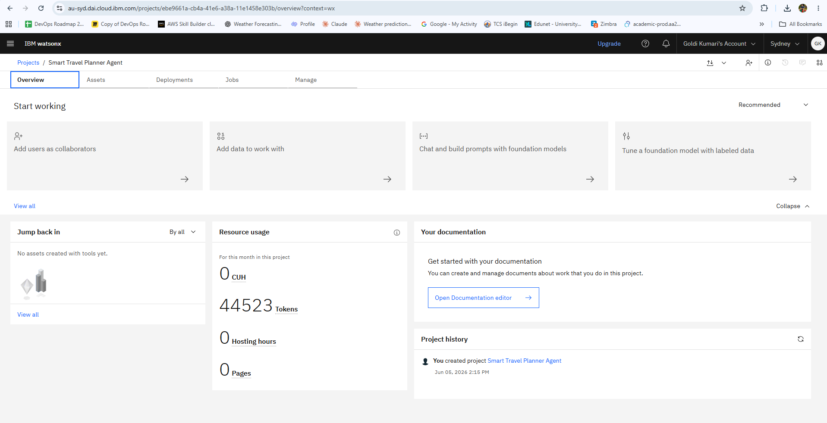
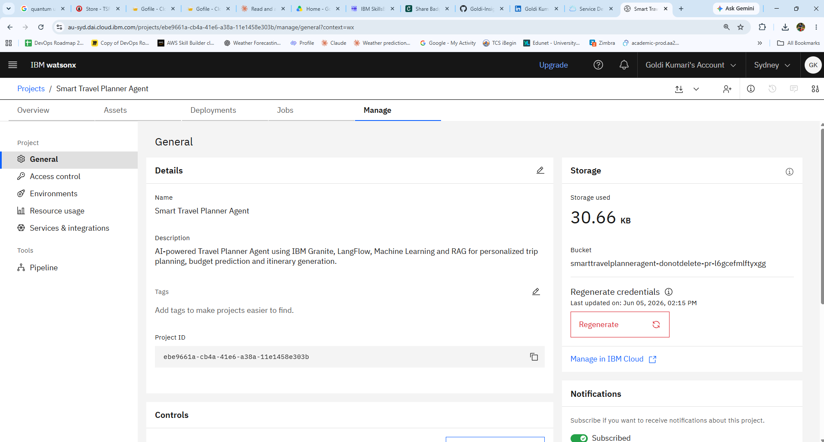
Token Usage & Project Configuration & Storage
IBM watsonx.ai Project Setup
Successfully created and configured the Smart Travel Planner Agent project in IBM watsonx.ai.
Managed project metadata, storage resources, and cloud environment settings.
Established the foundation for integrating AI models, LangFlow workflows, and travel planning services.
Ensured proper project configuration for seamless development and deployment.
Foundation Model Resource Usage
Monitored AI resource utilization through IBM watsonx.ai dashboard.
Consumed 44,523 tokens while generating travel recommendations, itineraries, and AI responses.
Demonstrated successful interaction with the Llama 3.3 70B Instruct foundation model.
Validated efficient token usage and system performance during project execution.
·
·

Slide 13
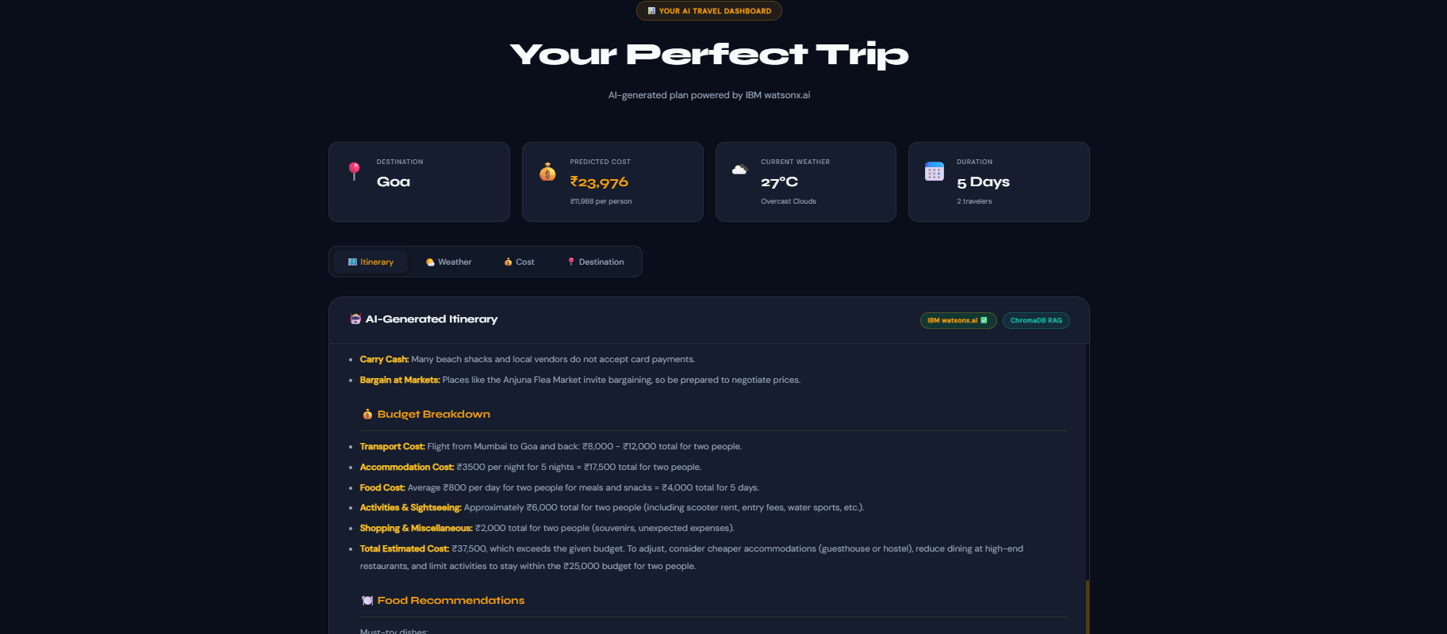
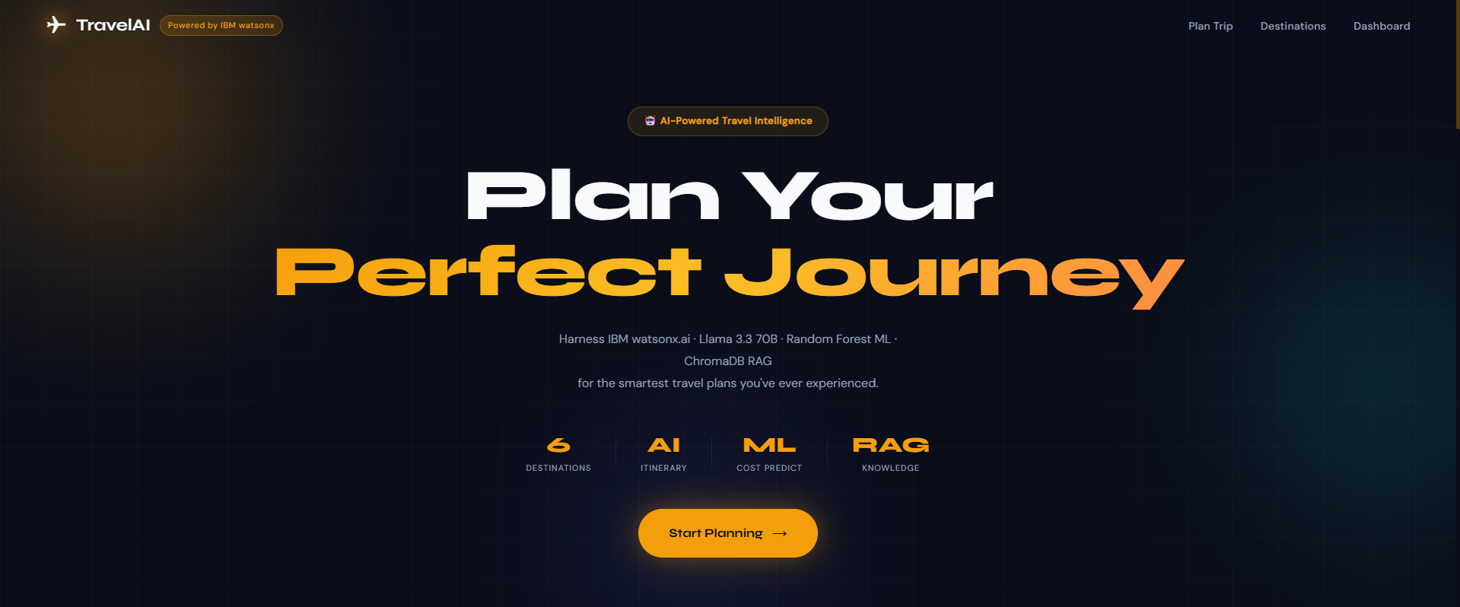
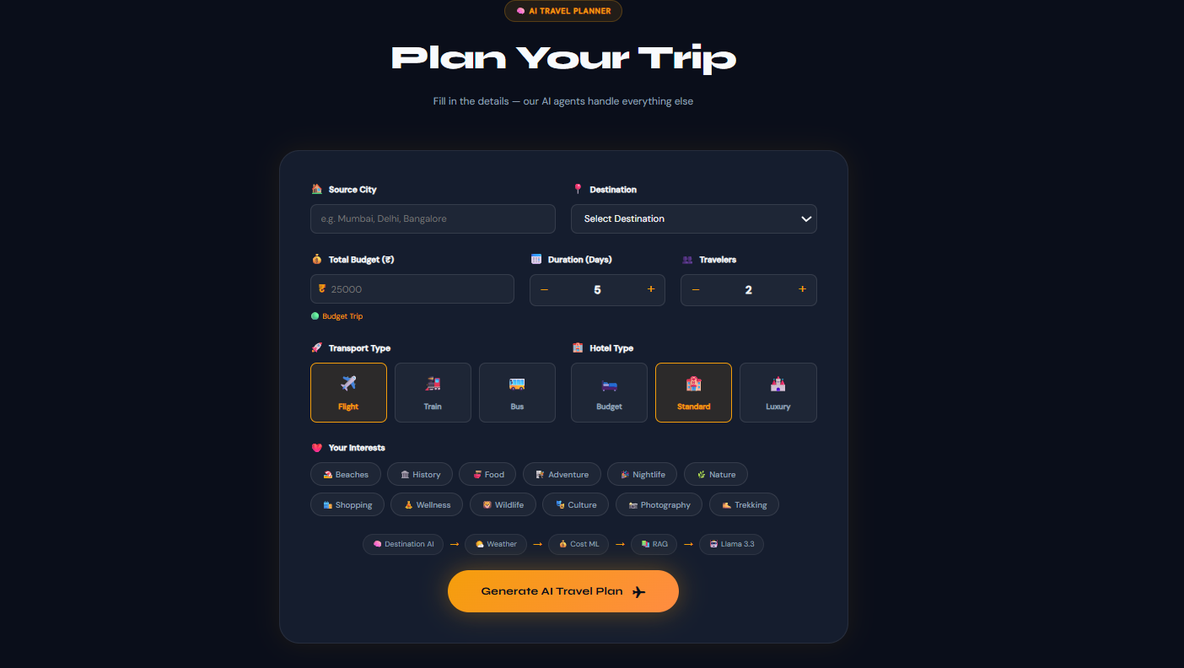
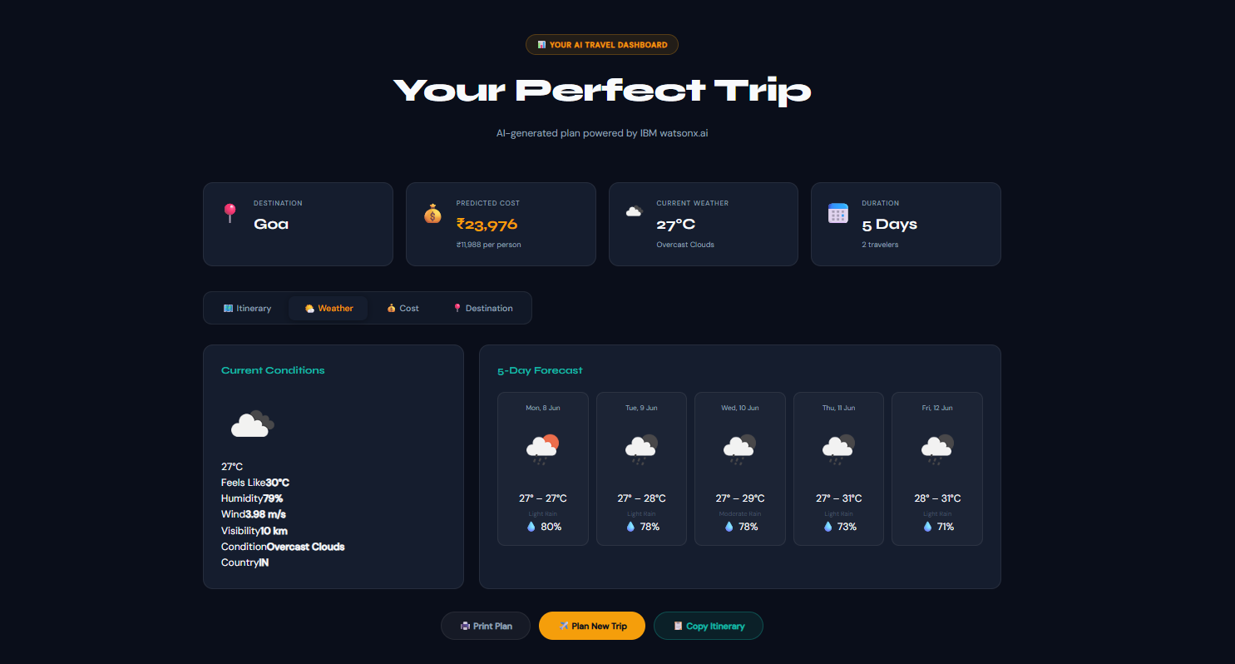
Results and Demonstration
Home Dashboard
Trip Planning Interface
·
·
·
AI-Generated Travel Itinerary
Real-Time Weather Insights

Slide 14
Github Link , Project Resources & Deployment
🌐 Live Application
https://smart-travel-planner-agent.onrender.com
💻 GitHub Repository
https://github.com/Goldi-Insights/Smart-Travel-Planner-Agent
🔗 LinkedIn Project Showcase
https://www.linkedin.com/posts/amisha6828_ibm-ibmskillsbuild-edunetfoundation-ugcPost-7469710786639130624-_gRG/
·
·
·

Slide 15
Future Scope
The Smart Travel Planner Agent can be further enhanced by integrating advanced travel and tourism services to provide a more comprehensive user experience.
Integration with hotel booking platforms for real-time accommodation recommendations and reservations.
Flight and transportation booking support with dynamic fare comparison.
Google Maps integration for route planning, navigation, and nearby attraction discovery.
Voice-enabled travel assistant for hands-free interaction and trip planning.
Multi-language support to serve users from different regions and countries.
Mobile application development for Android and iOS platforms.
Dynamic pricing intelligence for real-time budget optimization and travel cost tracking.
Personalized recommendation engine based on user travel history and preferences.
AI-powered travel companion capable of providing on-trip assistance and real-time travel alerts.
·
·
·

Slide 16
Conclusion
The Smart Travel Planner Agent successfully demonstrates the practical application of Agentic AI, Machine Learning, Retrieval-Augmented Generation (RAG), and IBM watsonx.ai in solving real-world travel planning challenges.
The system intelligently combines destination recommendations, weather forecasting, travel cost prediction, and knowledge retrieval to generate personalized travel itineraries tailored to user preferences. By leveraging LangFlow for multi-agent orchestration, ChromaDB for contextual information retrieval, and Machine Learning for cost estimation, the solution provides an efficient, scalable, and user-centric travel planning experience.
This project highlights how modern AI technologies can transform traditional travel planning into an intelligent, personalized, and data-driven digital experience.
·
·
·

Slide 17
Thank You
"Every great journey begins with a smart plan, and every smart plan begins with AI."
– Goldi Kumari

