Slide 1



Student Management System Securing Academic Success Presented by: kazi kawchar Ahammed ID:MUH2101020M Sajedul Karim ID:ASH2101027M

Slide 2





EduValt Student Management System
User Management
Attendance Tracking
Admins Faculty Students
Manage Attendance Auto Calculation
EduValt Student Management System
Assessment Tracking
Reporting
Grade Entry Performance Analysis
Progress Reports Performance Summaries

Slide 3




Components of EduVault Student Management System
JavaFX
Used for creating the desktop application's user interface
Students
Accesses grades
,Attendace Track and
Receive Email
MS SQL
Serves as the database for storing academic data
Faculty
Assessment Mark , Manages attendance and Send Email
Java
The programming language used for system logic and functionality
Admin
Manages system settings and user access

Slide 4





Planning for EduVault Student Management System
Problem Statement
Stakeholder Analysis
Project Scope
Timeline
Resource Planning
Development Tools
Database
Testing Environment

Slide 5


Requirement Gathering Methods for EduVault Student Management System
Stakeholder Interviews
Use Case Analysis
Admins Faculty Students
Add New Faculty
Enroll Student in Course Generate Attendance Report
Requirement Gathering Methods
System Requirement Documentation
Functional Requirements
Non-Functional Requirements

Slide 6





EduVault Student Management System: Functional Requirements
Report Generation and Analytics
User Authentication and Authorization
Assessment Report Attendance Summaries Performance Analytics
Secure Login
Role-Based Access
Faculty Dashboard
Student Management and Enrollment
Send Email Assessment Mark
Add Student Update Student Delete Student Enroll in Courses
Pushpo Academic Management System
Assessment Management
Attendance Management
Assessment and Attendance
Tracking
Admin Dashboard
Create Assessments Manage Assessments Record Attendance Calculate Grades
User Management Course Creation Report Generation

Slide 7


Non-Functional Requirements
Performance
Ensures quick response times for all operations
Scalability
Supports a large number of users without performance
issues
Security
Protects sensitive data with role-based access control
Reliability
Guarantees high system uptime
Usability
Provides an intuitive and consistent user interface

Slide 8

MVC Architecture
Controller
Handles user input and updates Model/View
View
Responsible for presentation layer
Model
Represents data and business logic

Slide 9

Core Design Principles
Separation of Concerns
Separating the presentation, business logic, and data access layers to improve code
organization.
Database Abstraction
Using DAOs to abstract the database implementation, allowing for easier switching.
Modular Architecture
Dividing the system into independent modules for easier maintenance
and scalability.
Responsive UI Design
Designing the user interface to be responsive and adapt to different screen sizes.
EduVault System Design

Slide 10



Database Schema for EduVault Student Management System
Faculty Table
Assessment Table
Users Table
Courses Table
Students Table
Attendance Table
Relationships:
One-to-many: One faculty member can teach multiple courses (Faculty-Courses)
Many-to-many: Students can enroll in multiple courses, and courses can have multiple students (Students-Courses).
This is typically implemented using a junction table (e.g., Enrollment Table).

Slide 11


Dashboard Features
1
2
3
4
Customized dashboards for different user roles.
Tables adapt to screen sizes with sorting.
User-friendly forms for data input.
Displaying current information to users.
Role-based Dashboards
Responsive Table Views
Interactive Forms
Real-time Updates

Slide 12

Testing Framework
User Acceptance
Testing
Allowing stakeholders to test and provide feedback before
deployment.
Unit Testing
Testing individual components in isolation using JUnit.
System Testing
Testing the entire system to meet all requirements.
Integration Testing
Testing interactions between modules to ensure they work together.

Slide 13


Testing Strategies
JUnit Testing
Automated unit testing for code components
Cross-Platform
Testing
Ensuring compatibility across different OS
Manual Testing
Hands-on testing of UI and system functionality
Database Testing
Verifying database connectivity and operations

Slide 14



Continuous Software Development Cycle
Integrate Code Changes
Frequent integration to avoid issues
Test Incrementally
Testing in small increments
Develop Incrementally
Small increments for quality
Use Version Control
Git for collaboration and tracking

Slide 15
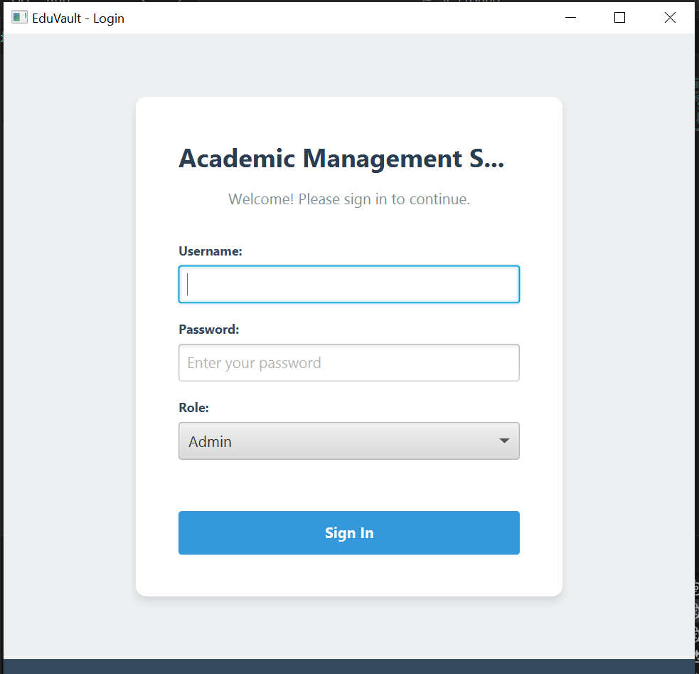

Slide 16
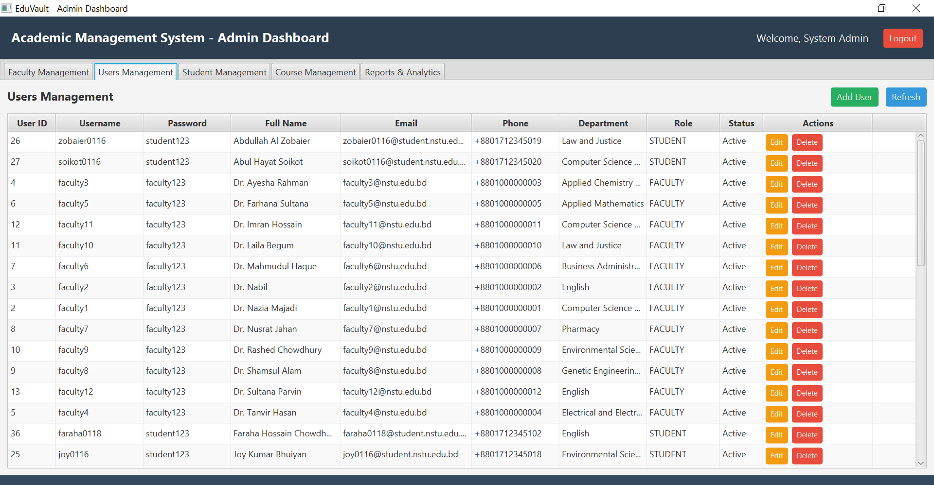

Slide 17
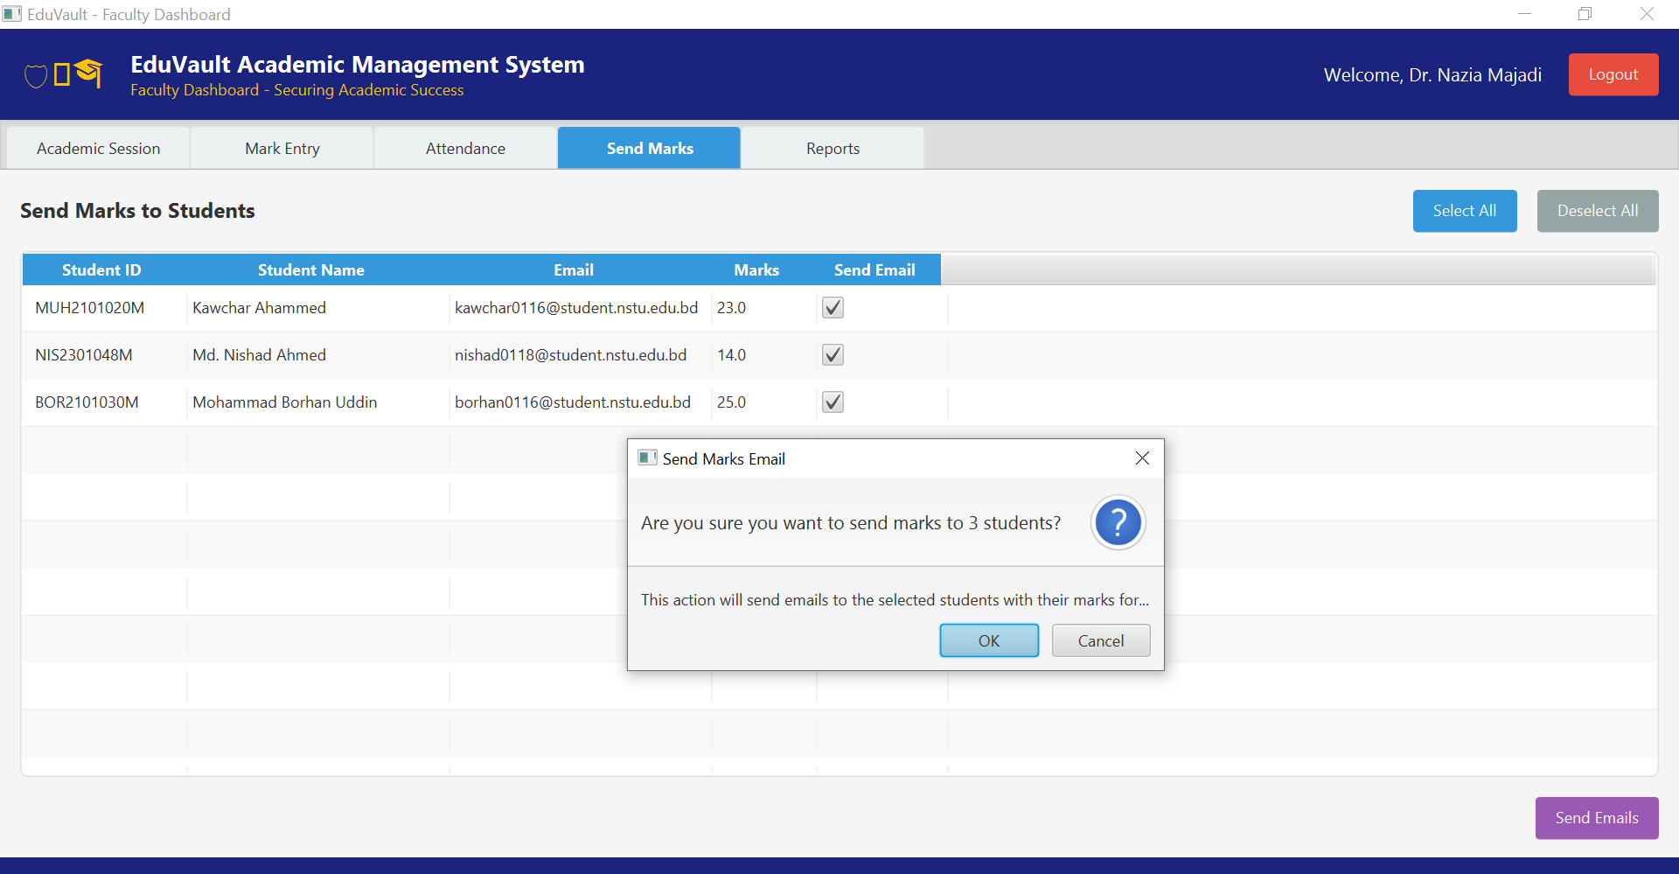

Slide 18
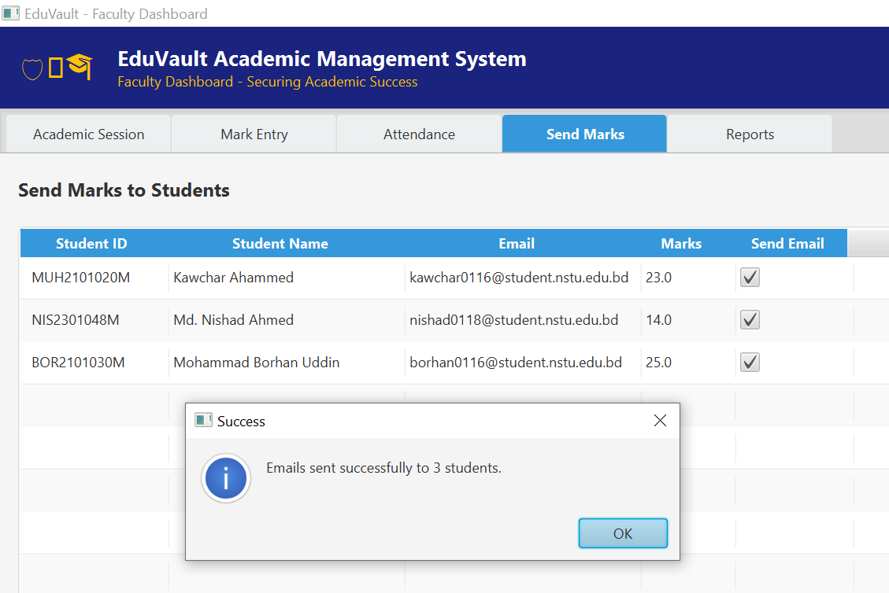
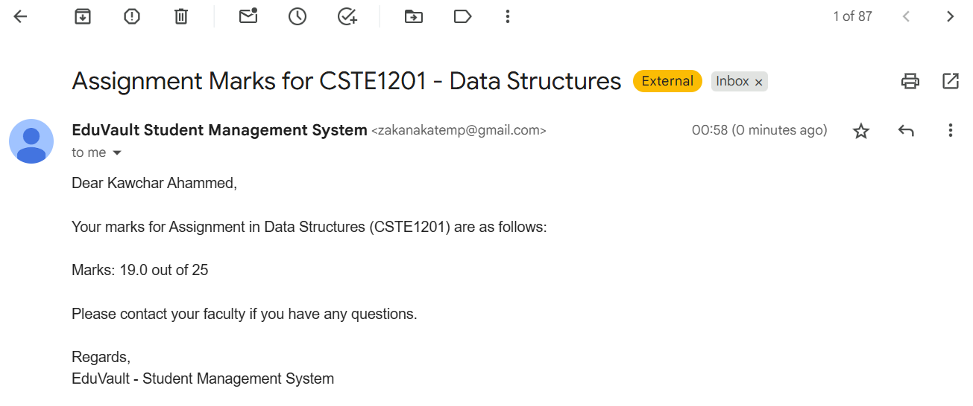

Slide 19
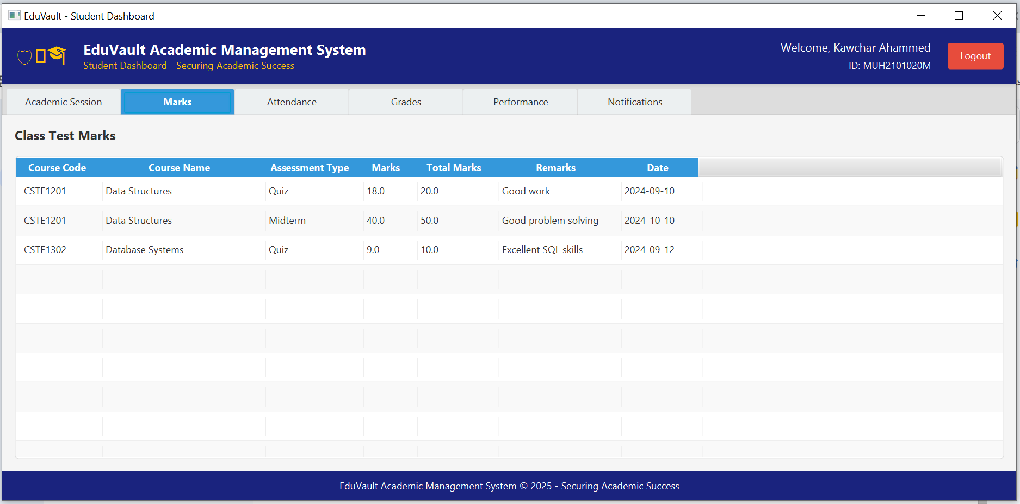

Slide 20
Future Enhancements
Potential Improvements:
Web-based version for remote access.
Mobile application development.
Advanced analytics and reporting.
Integration with external systems.
Real-time notifications and messaging.
Conclusion
Successfully developed a comprehensive academic management system
Implemented modern

Slide 21


