Slide 1
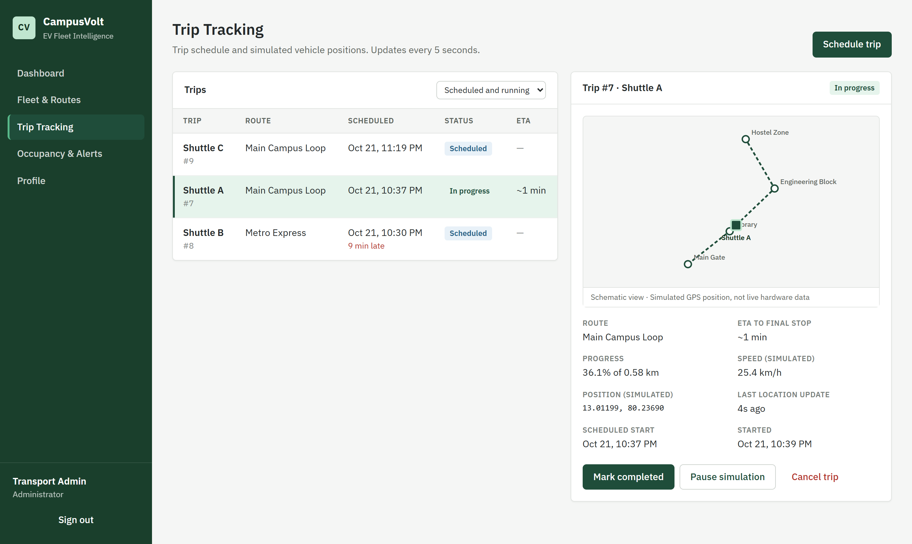
MINI PROJECT · MICROSERVICES WEB APPLICATION
CampusVolt
Smart Campus EV Fleet Intelligence System
Know where every campus shuttle is, how full it is, and when it will arrive.
TEAM
Kawin A N 2024115018
Shankararam S U 2024115020
Live trip tracking screen from the working application
Rohan Beniel E 2024115124

Slide 2
THE PROBLEM
Campus shuttles run without visibility
Students wait at stops without knowing where the electric shuttle is, when it will arrive, or whether it has room. The transport office tracks vehicles, routes and passenger loads through spreadsheets and phone calls, so problems are noticed late.
01
02
No position or ETA
Unknown crowding
Students cannot see where a shuttle is or how long it will take to arrive.
Overloaded shuttles are unsafe and drain the battery faster. Nobody knows until boarding.
03
04
Scattered fleet records
Late reaction
Capacity, battery level, status and route assignments are kept in separate sheets.
Delays and lost tracking are found only after students complain.

Slide 3
THE SOLUTION
One dashboard backed by four Spring Boot services
CampusVolt splits the work into three business services and one shared authentication service. Each owns its own PostgreSQL database. The React website calls them directly over REST.
BUSINESS SERVICE
BUSINESS SERVICE
BUSINESS SERVICE
SHARED
SHARED
Fleet & Route Service
Trip & Tracking Service
Occupancy & Alert Service
Auth Service (shared)
React Website (shared)
Kawin A N
Shankararam S U
Rohan Beniel E
Kawin A N (lead)
Kawin A N
Port :8082
Port :8083
Port :8084
Port :8081
Port :5173
Vehicles, capacity, battery, status, routes, stops and vehicle-to-route assignment.
Trip scheduling and status, simulated GPS movement, delay detection and ETA.
Passenger counts, occupancy %, overcrowding, and alerts for delays and stale tracking.
Registration, login, BCrypt password hashing, JWT tokens, ADMIN and STUDENT roles.
Login, dashboard, fleet, trips, occupancy and profile pages. Calls all four services.

Slide 4
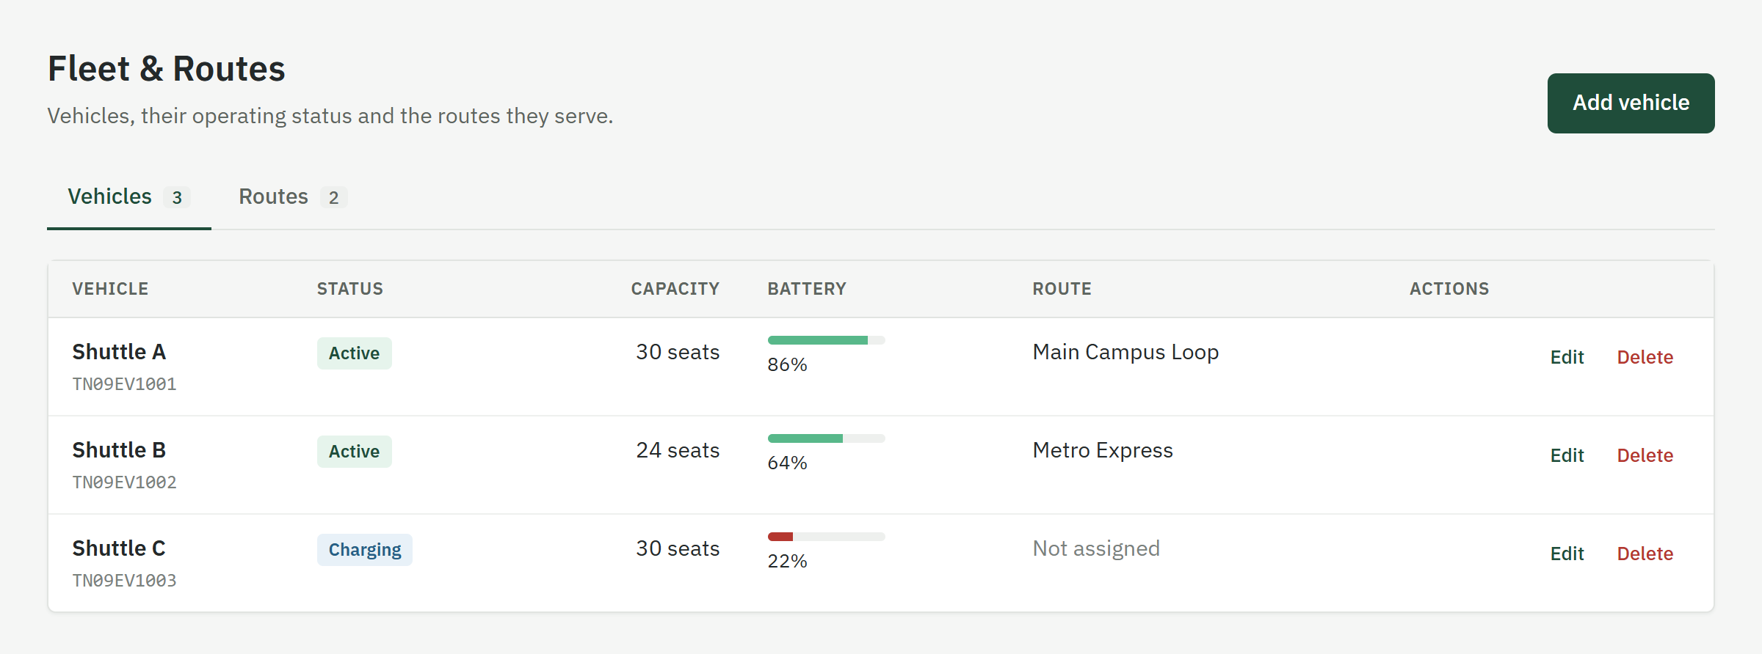
SERVICE 1 · FLEET & ROUTE
Fleet and Route Service
Owner: Kawin A N · 2024115018 | Database: campusvolt_fleet_db | Port 8082
Work done
File | What it does
VehicleController.java | REST endpoints for /api/vehicles. Anyone signed in can read; only ADMIN can create, edit or delete.
RouteController.java | REST endpoints for /api/routes, including the list of stops for each route.
VehicleService.java | Checks the registration number is unique, links the vehicle to its route, builds the response.
RouteService.java | Saves stops in travel order. Estimates distance from stop coordinates if none is given. Unassigns vehicles when a route is deleted.
Vehicle / Route / RouteStop.java | JPA entities mapped to the vehicles, routes and route_stops tables.
FleetDtos.java | Request rules: capacity 1–120, battery 0–100, valid latitude and longitude.
FleetRouteServiceApplication.java | Starts the service and adds 2 sample routes and 3 shuttles on first run.
Vehicle CRUD with capacity, battery level and operating status
Routes with ordered stops and GPS coordinates
Assigning vehicles to routes
Input validation, 404 and 409 errors, admin-only changes

Slide 5
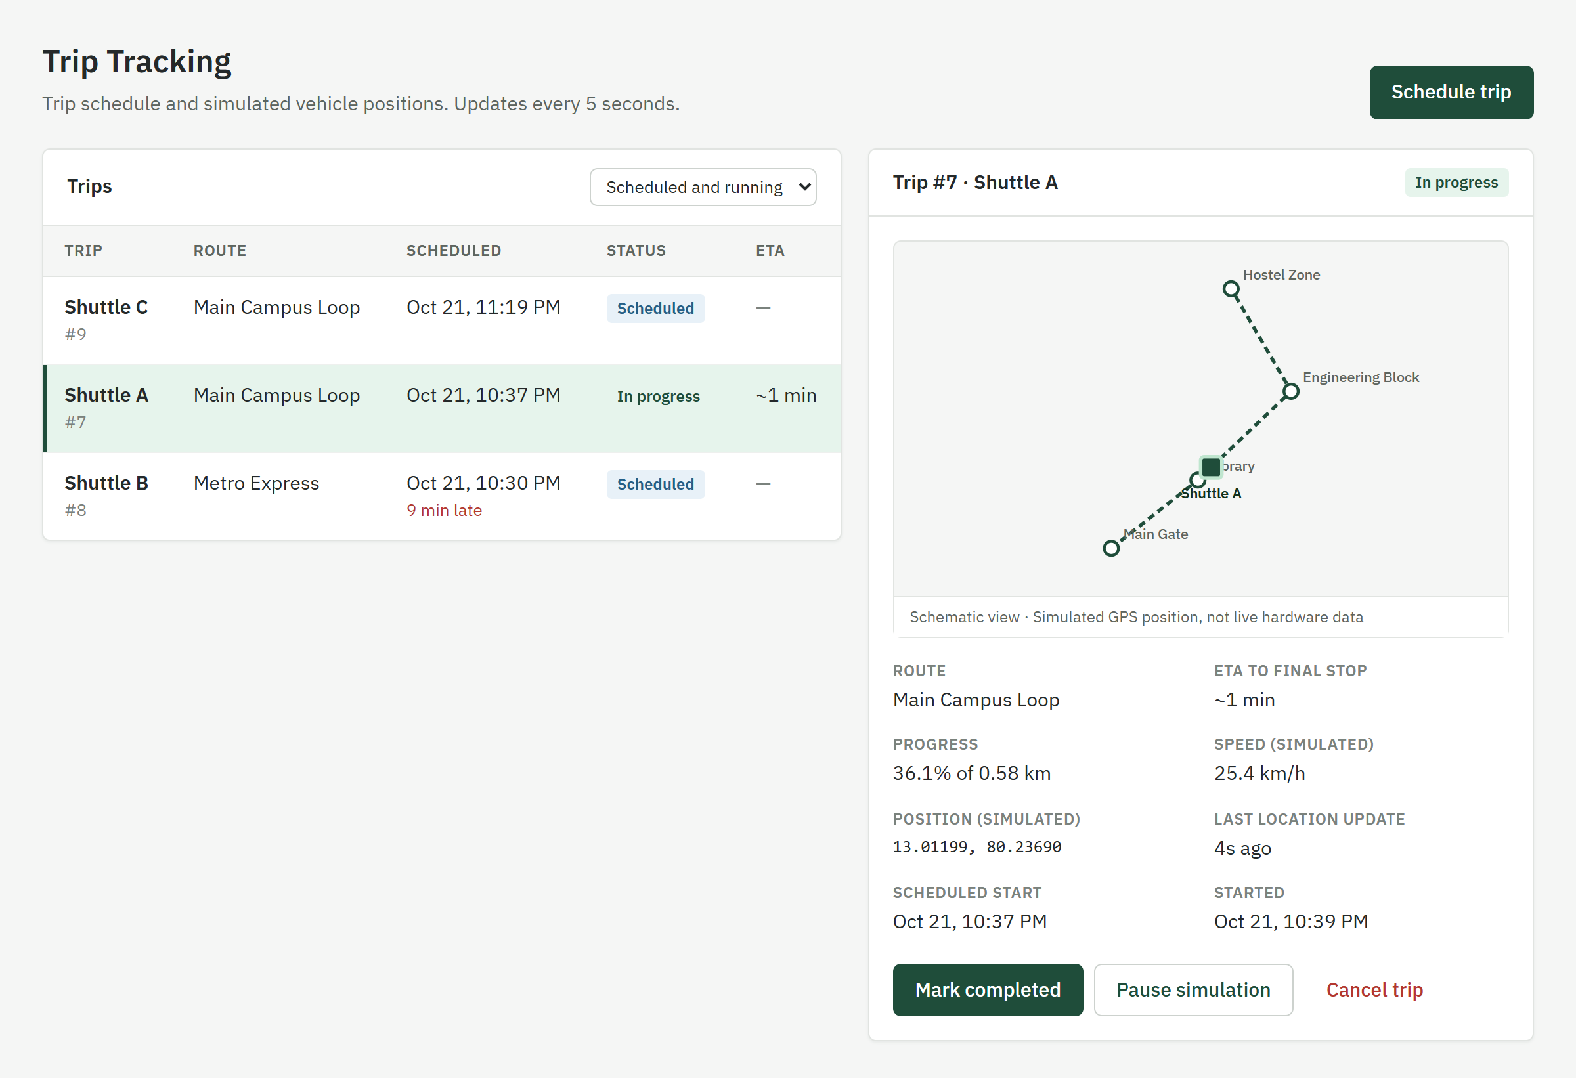
SERVICE 2 · TRIP & TRACKING
Trip and Tracking Service
Owner: Shankararam S U · 2024115020 | Database: campusvolt_tracking_db | Port 8083
Work done
File | What it does
TripController.java | REST endpoints for /api/trips and /api/tracking/vehicles (trips currently running).
TripService.java | Checks the vehicle and route with the fleet service, enforces status rules and one trip per vehicle, works out delay, stale location and ETA.
TrackingSimulator.java | Runs every 5 seconds. Moves each running trip along its stops at 18–32 km/h and completes it at the final stop.
FleetClient.java | Calls the Fleet service REST API, passing on the user's JWT.
Trip.java / TripStatus.java | Trip entity: schedule, route snapshot, simulated position and speed.
TripDtos.java | Request and response records, including etaMinutes and etaNote (why there is no ETA).
Scheduling trips and assigning vehicles to them
Trip status: Scheduled → In progress → Completed or Cancelled
Simulated vehicle movement and last-updated location
ETA only when distance and speed are known

Slide 6
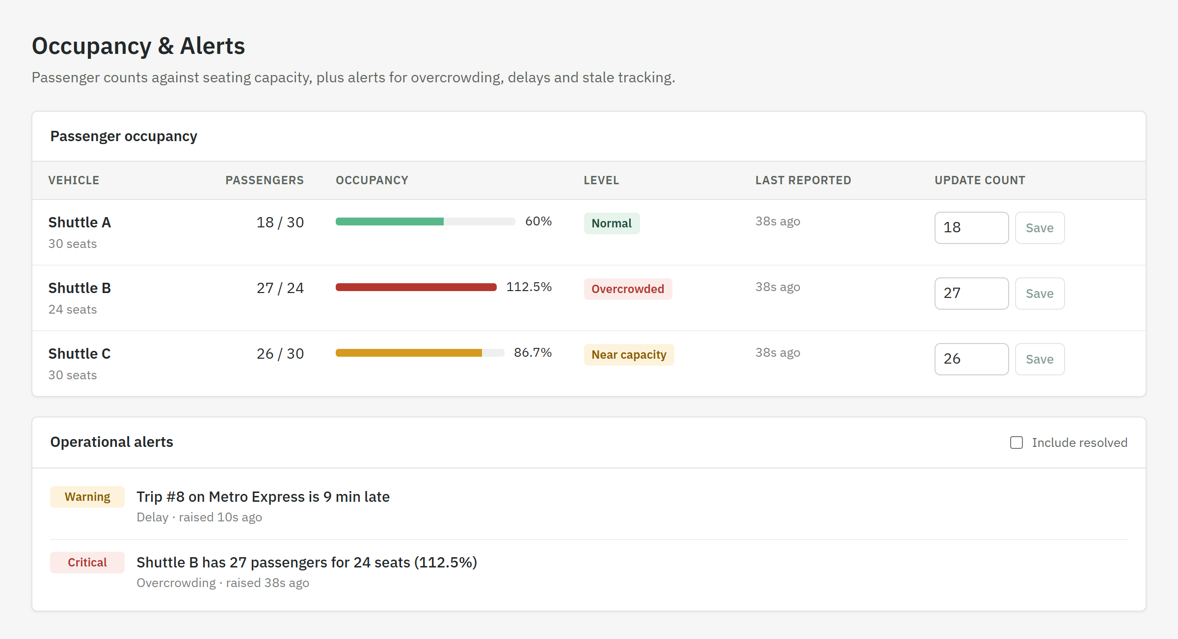
SERVICE 3 · OCCUPANCY & ALERT
Occupancy and Alert Service
Owner: Rohan Beniel E · 2024115124 | Database: campusvolt_occupancy_db | Port 8084
Work done
File | What it does
OccupancyController.java | REST endpoints: GET /api/occupancy, PUT /api/occupancy/{vehicleId}, GET /api/alerts.
OccupancyService.java | Gets capacity from the fleet service, rejects negative counts or more than 2× capacity, calculates passengers ÷ capacity.
AlertService.java | Opens, updates and resolves alerts: over capacity, trip more than 5 min late (critical from 15), no location update for 2 min.
ServiceClients.java | REST calls to the Fleet and Trip services, passing on the user's JWT.
VehicleOccupancy.java / Alert.java | Entities for the latest count per vehicle and for alert history.
AlertType / AlertSeverity.java | OVERCROWDING, DELAY, STALE_TRACKING · WARNING, CRITICAL.
Passenger counts checked against vehicle capacity
Occupancy % with Normal, Near capacity and Overcrowded levels
Automatic alerts for overcrowding, delays and stale tracking
APIs for current occupancy and alerts

Slide 7
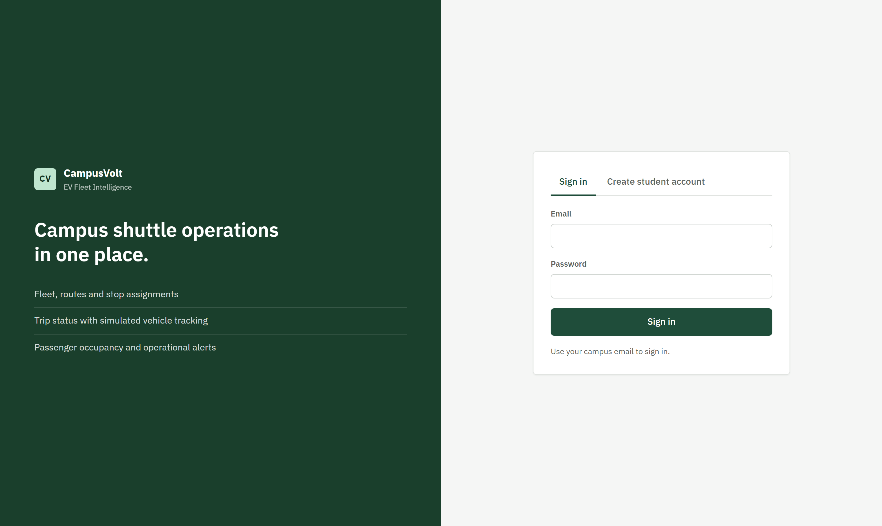
SHARED · AUTHENTICATION & AUTHORIZATION
Auth Service and security in every service
Coordinated by Kawin A N · each owner protects their own endpoints | Database: campusvolt_auth_db | Port 8081
Work done
File | What it does
AuthController.java | POST /api/auth/register, POST /api/auth/login, GET /api/auth/me.
AuthService.java | Hashes and checks passwords with BCrypt. New accounts are always STUDENT.
JwtService.java | Signs a JWT (HMAC-SHA256) holding email, name and role. Expires after 8 hours.
JwtAuthFilter.java | In every service: reads the Bearer token, verifies its signature, sets the user's role.
SecurityConfig.java | In every service: no server sessions, CORS, public login/register only, ADMIN rules via @PreAuthorize.
User.java / Role.java | Users table with a unique email, password hash and ADMIN | STUDENT role.
AuthServiceApplication.java | Defines the BCrypt encoder and creates the first admin from environment variables.
Registration and login with BCrypt-hashed passwords
JWT issued at login and checked by every service
ADMIN and STUDENT roles enforced on the backend
CORS set up for the React website

Slide 8
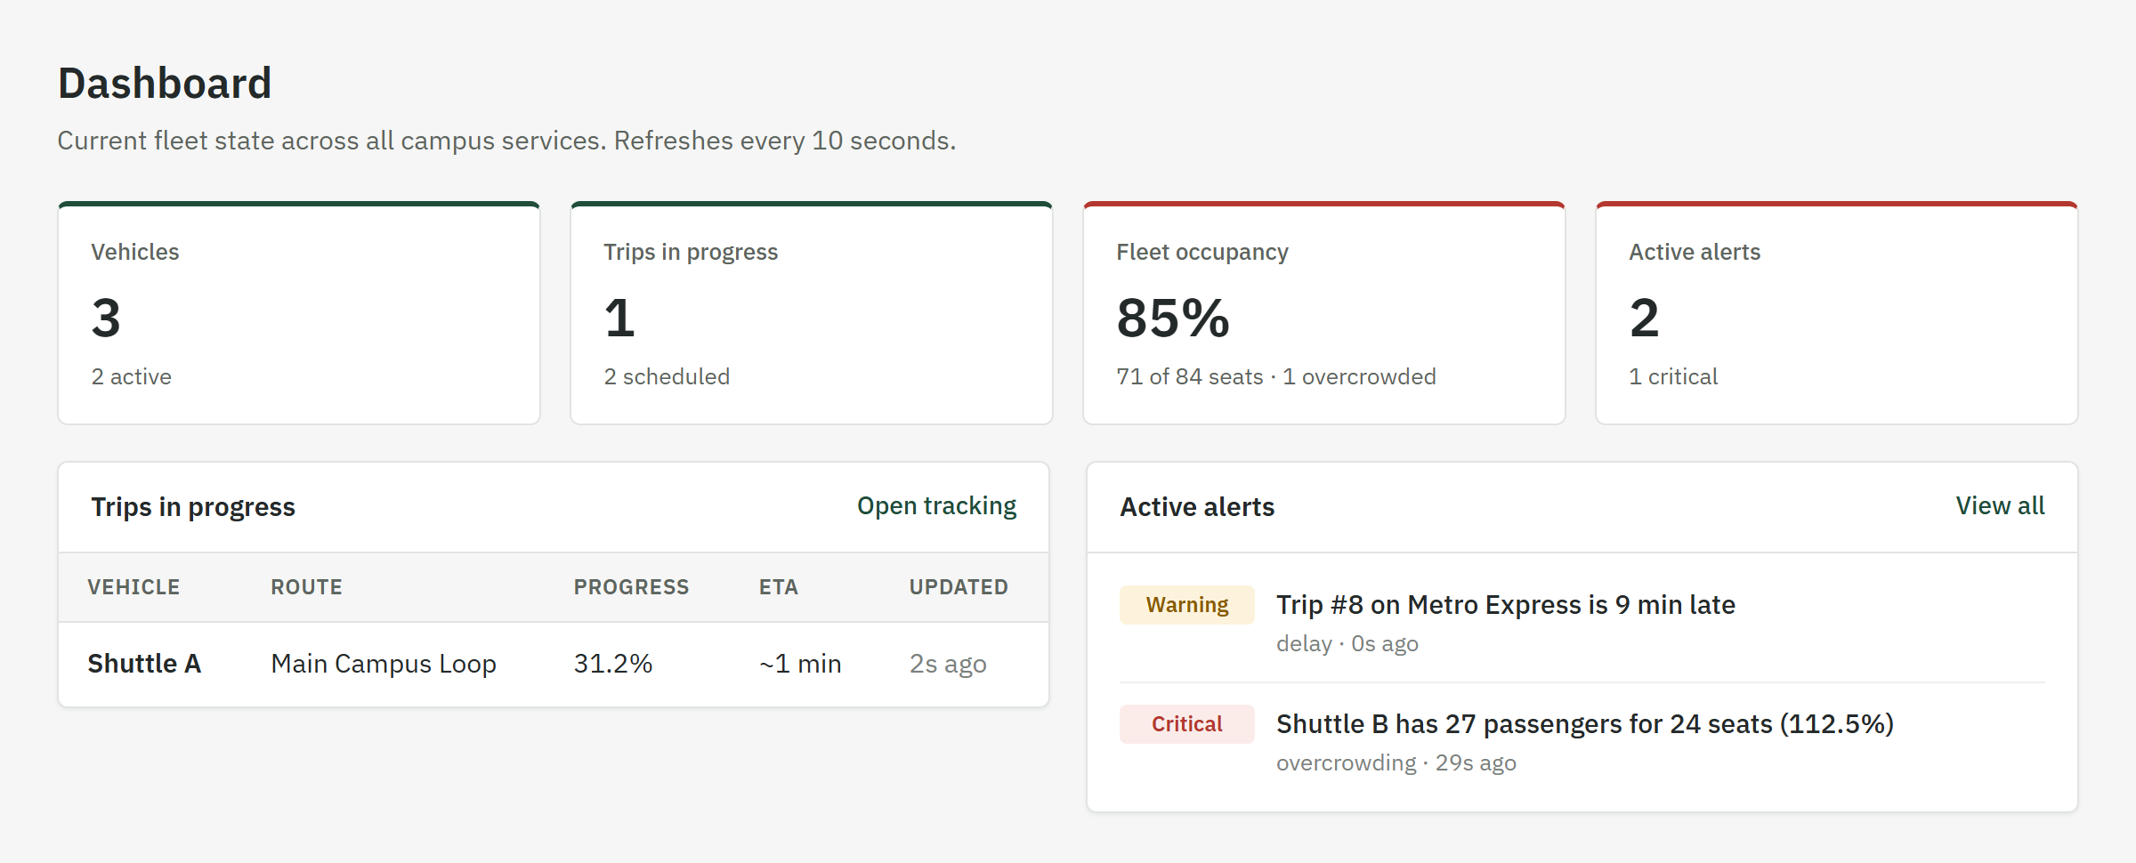
SHARED · REACT WEBSITE
React Frontend
Owner: Kawin A N · 2024115018 | React + Vite | Port 5173
Work done
File | What it does
services/api.js | The four service URLs in one place. Adds the JWT to every request and turns errors into readable messages.
context/AuthContext.jsx | Session state: login, register, logout. Signs the user out automatically when a token expires.
components/Layout.jsx | Sidebar navigation and signed-in user panel.
components/ui.jsx | Shared pieces: Panel, Badge, Modal, Field, Meter, Loading, EmptyState.
components/RouteMap.jsx | SVG drawing of route stops and the simulated vehicle position.
pages/DashboardPage.jsx | Totals from all three business services, refreshed every 10 seconds.
pages/Fleet, Trips, Occupancy, Login, Profile | One page per feature, with create and edit forms for admins.
Login, dashboard, fleet, trips, occupancy and profile pages
Connected to all four backend services
Form validation, loading, empty and error states
Responsive layout that works on phones

Slide 9
ENTITIES · 1 OF 2
Users, vehicles and routes
User
Vehicle
Route
RouteStop
Auth service · users
Fleet service · vehicles
Fleet service · routes
Fleet service · route_stops
Attribute | Data type
id | Long (PK)
fullName | String
email | String (unique)
passwordHash | String (BCrypt)
role | Role
createdAt | Instant
Attribute | Data type
id | Long (PK)
registrationNumber | String (unique)
name | String
capacity | Integer
status | VehicleStatus
batteryLevel | Integer
route | Route (FK)
Attribute | Data type
id | Long (PK)
name | String (unique)
description | String
distanceKm | Double
stops | List<RouteStop>
Attribute | Data type
id | Long (PK)
name | String
sequence | Integer
latitude | Double
longitude | Double
route | Route (FK)
Enums Role: ADMIN, STUDENT · VehicleStatus: ACTIVE, CHARGING, MAINTENANCE, OUT_OF_SERVICE
A Route has many RouteStops (one-to-many, kept in travel order). A Vehicle belongs to at most one Route (many-to-one).

Slide 10
ENTITIES · 2 OF 2
Trips, occupancy and alerts
Trip
VehicleOccupancy
Alert
Trip service · trips
continued
Occupancy service · vehicle_occupancy
Occupancy service · alerts
Attribute | Data type
id | Long (PK)
vehicleId | Long
vehicleName | String
routeId | Long
routeName | String
routeDistanceKm | Double
routePath | String (text)
status | TripStatus
scheduledStart | Instant
Attribute | Data type
startedAt | Instant
completedAt | Instant
progressKm | double
latitude | Double
longitude | Double
speedKmh | Double
lastLocationUpdate | Instant
simulationPaused | boolean
Attribute | Data type
vehicleId | Long (PK)
vehicleName | String
capacity | Integer
passengerCount | Integer
updatedAt | Instant
updatedBy | String
Attribute | Data type
id | Long (PK)
type | AlertType
severity | AlertSeverity
conditionKey | String
vehicleId | Long
vehicleName | String
message | String
active | boolean
createdAt | Instant
resolvedAt | Instant
Enums TripStatus: SCHEDULED, IN_PROGRESS, COMPLETED, CANCELLED · AlertType: OVERCROWDING, DELAY, STALE_TRACKING
AlertSeverity: WARNING, CRITICAL
Trip and occupancy keep a copy of vehicle and route names, because a service never reads another service's database.

Slide 11
TECH STACK
What we used and why
Layer | Technology | Why we used it
Frontend | React 18 | Pages built from reusable components such as tables, forms and badges.
Frontend | Vite | Fast development server and a simple production build.
Frontend | React Router + Fetch API | Page navigation without reloads. Fetch is built into the browser, so no extra HTTP library.
Backend | Java 21 + Spring Boot 3.5 | Mature framework for REST services. Each service starts on its own with little setup.
Backend | Spring Web + Validation | REST controllers, JSON handling, and request checks with @NotNull, @Min, @Max.
Data | Spring Data JPA + Hibernate | Maps entities to tables. Repositories give CRUD without hand-written SQL.
Data | PostgreSQL | Reliable relational database. One server holds four separate databases, one per service.
Security | Spring Security + JWT (jjwt) | Stateless login. Every service verifies the token itself, with no session store.
Security | BCrypt | Salted, deliberately slow password hashing. Plain-text passwords are never stored.
Build | Maven · npm | One Maven build per service and one npm build for the website.

Slide 12
ARCHITECTURE
How the pieces connect
Auth Service :8081
JPA
campusvolt_auth_db
Login, register, issues JWT
PostgreSQL · users
REST + JWT
React website :5173
Fleet & Route :8082
campusvolt_fleet_db
Browser. Stores the JWT and sends it on every request.
Vehicles, routes, stops
PostgreSQL · vehicles, routes, route_stops
Trip & Tracking :8083
campusvolt_tracking_db
Trips, simulator, ETA. Calls Fleet API
PostgreSQL · trips
Occupancy & Alert :8084
campusvolt_occupancy_db
Counts, alerts. Calls Fleet + Trip APIs
PostgreSQL · vehicle_occupancy, alerts
Every service checks the JWT signature with the same shared secret. A service only reads its own database; it gets other data through REST calls.

Slide 13
END-TO-END FLOW
From login to an alert on the dashboard
1
Sign in
2
Set up the fleet
3
Schedule a trip
Auth Service
Fleet & Route
Trip & Tracking
The user logs in. The password is checked with BCrypt and a JWT holding the role is returned.
An admin adds vehicles and routes with stops, then assigns each vehicle to a route.
The trip service checks the vehicle and route with the Fleet API before saving the trip.
4
Track the shuttle
5
Report passengers
6
See alerts
Trip & Tracking
Occupancy & Alert
Occupancy & Alert
Once started, the simulator moves the shuttle every 5 s. ETA = remaining distance ÷ speed.
An admin enters a count. The service gets capacity from Fleet, calculates the % and flags overcrowding.
The service reads trips for delay and stale tracking. Alerts close by themselves when the problem clears.

