Slide 1




Banking Made Simple
Project Report
Presentation by
Sharon Mungania

Slide 2


Implementation and responsibility
Full-stack Developer;
Sharon Mungania

Slide 3





Introduction
Simple User Interface
01
The application will make use of UX/ UI best design practices to ensure a seamless user experience for the users.
02
Secure sign up and authentication
Application will make use of the password reset flow to ensure unauthorized access of customer accounts is prevented. More than 4 failed login attempts will result in the locking of the account.
Real-Time Transaction Update
03
The app will aim to give a break down of the various transaction types and their descriptions, namely Processing(Pending), Successful, Failed(Declined)

Slide 4
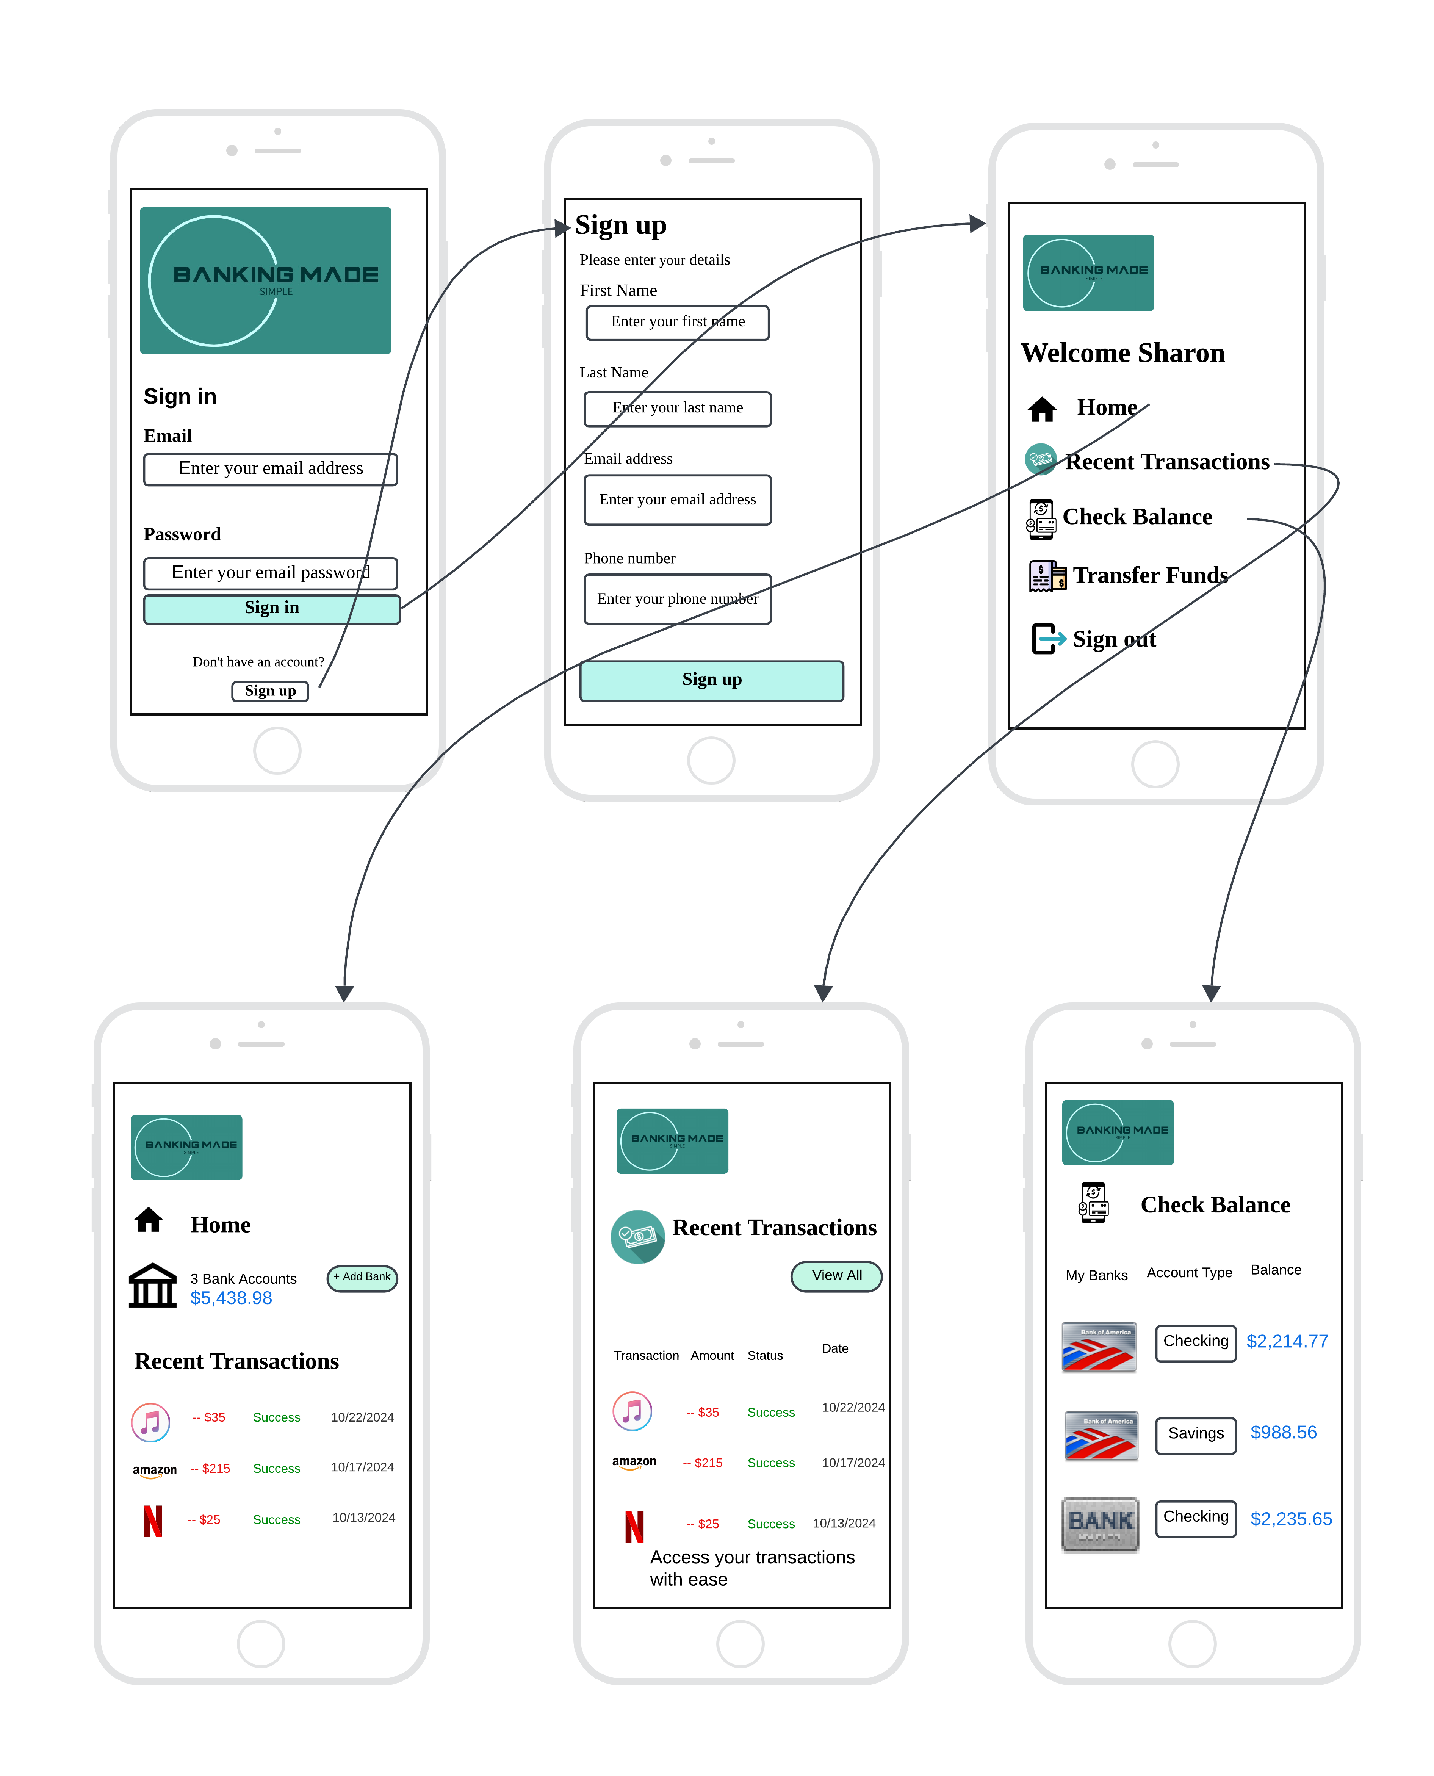
User
Interface
Wireframe Overview

Slide 5
Project Management Tool
Gantt chart
Project is small and scalable.
Project follows a systemic approach; project scope is clearly defined.
Milestones and deadlines are clearly set.
Task progress is linear and dependent on each other’s completion.

Slide 7
References
Systems Analysis and Design: An Object-Oriented Approach with UML By: Alan Dennis; Barbara Wixom on the Waterfall model and Gantt charts for project management
Lucid App for customizing wireframe
Slide Geeks and Slide Geeks AI for slide template
ChatGPT AI
Microsoft Excel for Gantt chart

Slide 8
Thank you!

