Slide 1
Bus Ticket Booking System
Mdmkdmkmdmmd
Md. Kawser Talukder
Id: 22203221

Slide 2
Introduction
Overview: Web-based system to manage bus ticket reservations.
Purpose: Easy and secure intercity ticket booking.
Technologies: C#, ASP.NET MVC, SQL Server, Visual Studio.

Slide 3
System Architecture
MVC Pattern Overview:
- Model: Data and business logic
- View: UI and presentation
- Controller: User input handling
Architecture Diagram: (Insert diagram here)

Slide 4
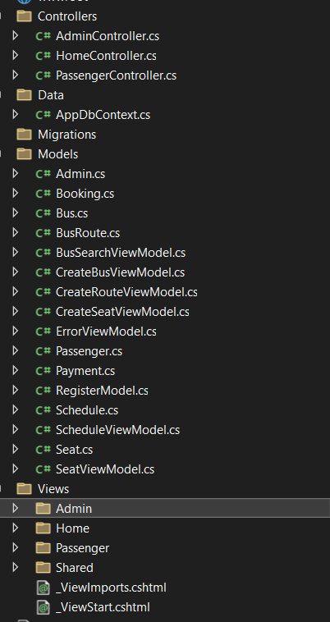
System Architecture

Slide 5
Key Features
User Login and Registration
CRUD operations: Routes, Tickets, Buses
Ticket Booking: Search and reserve seats
Admin Reporting Module

Slide 6
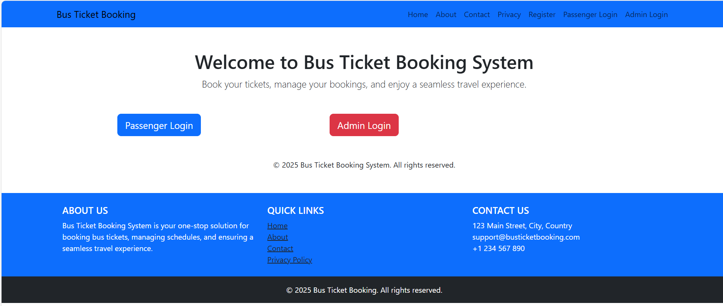
Home page

Slide 7
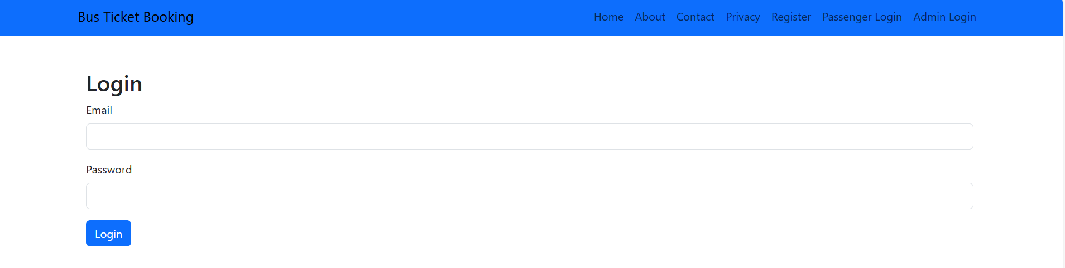
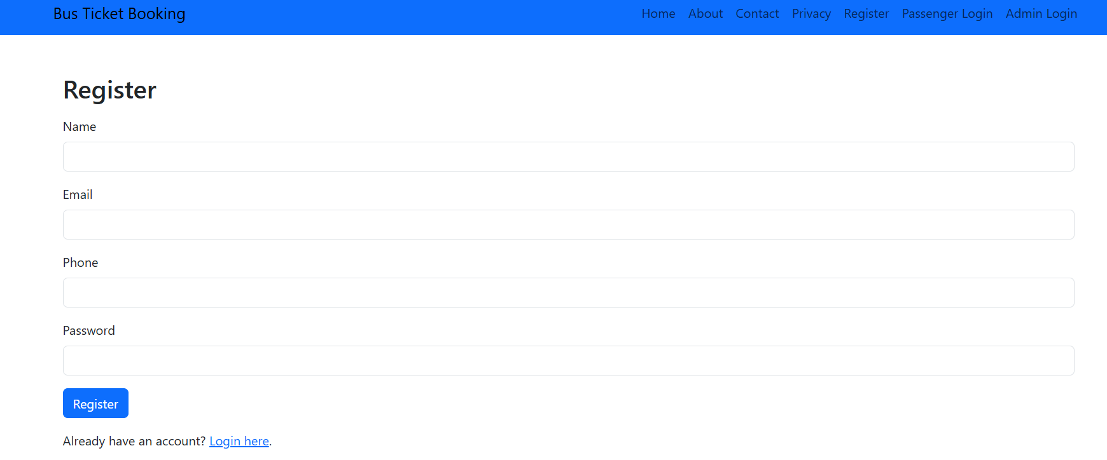
Login And Registration Page

Slide 8
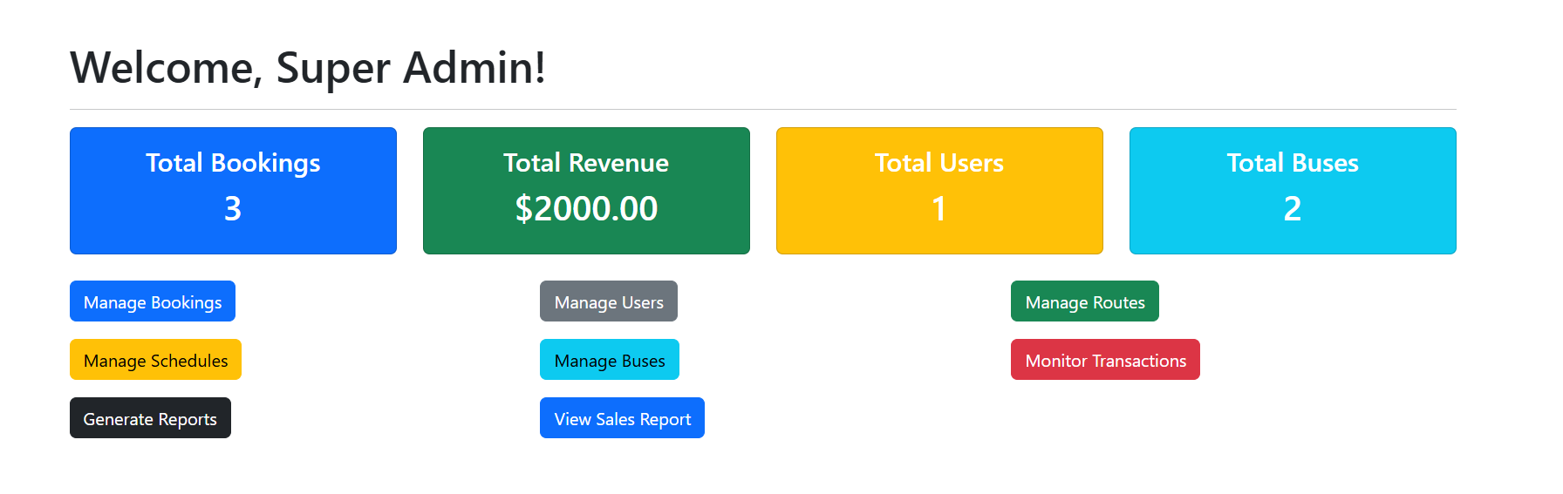
Admin Dashboard

Slide 9
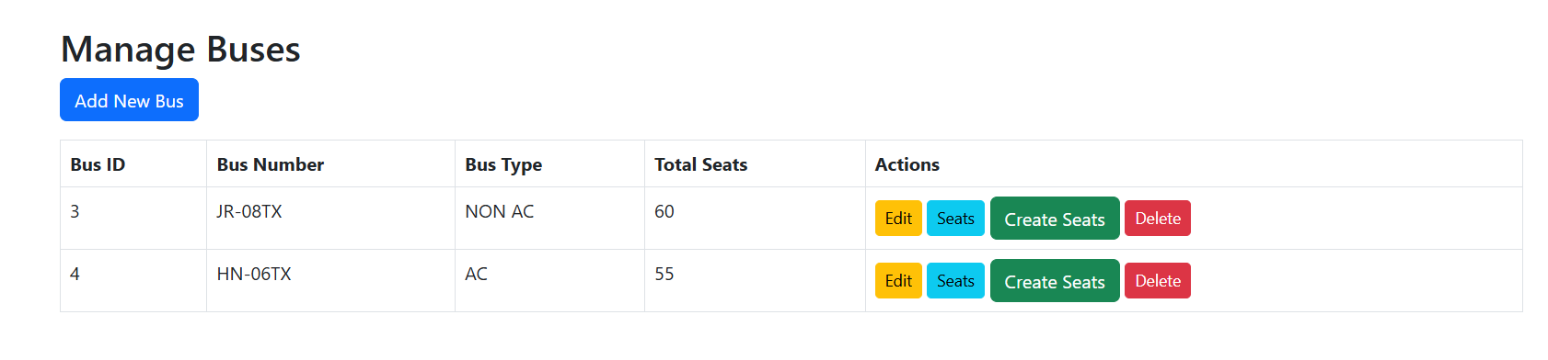
Manage Buses

Slide 10
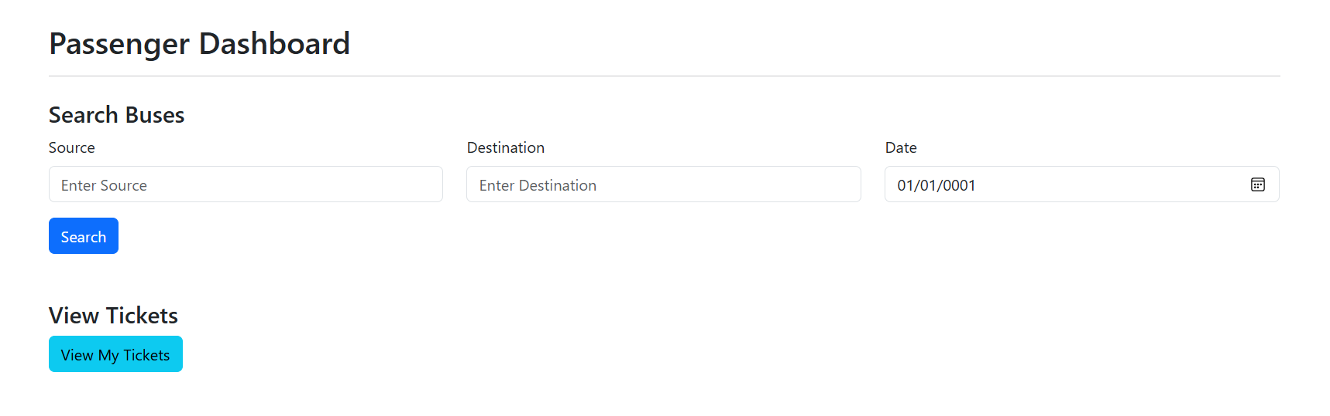
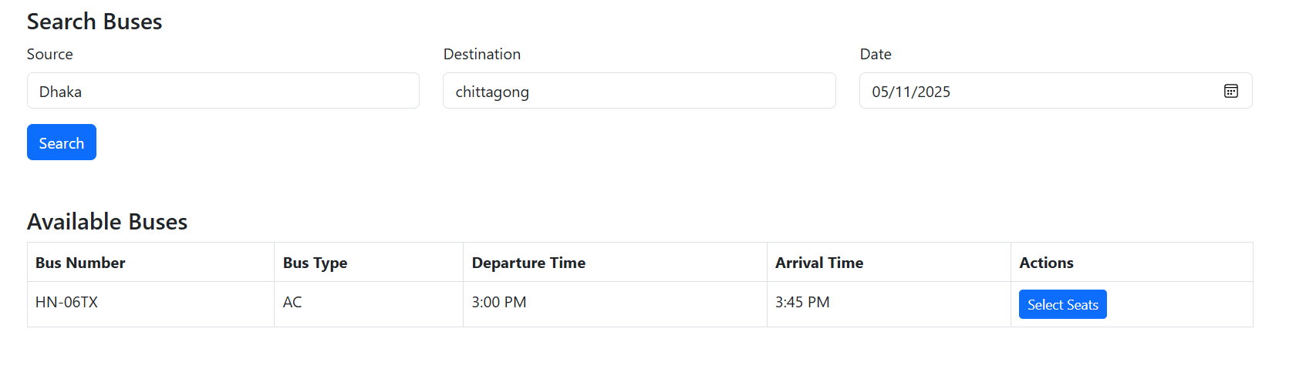
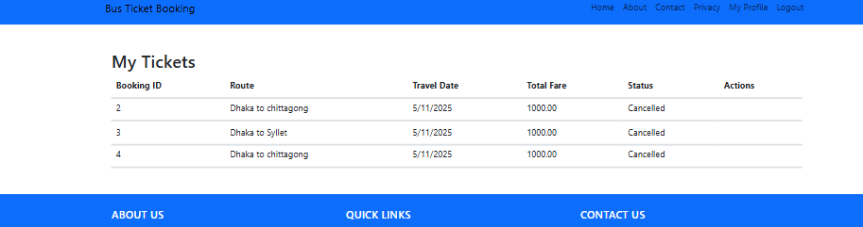
User Dashboard

Slide 11
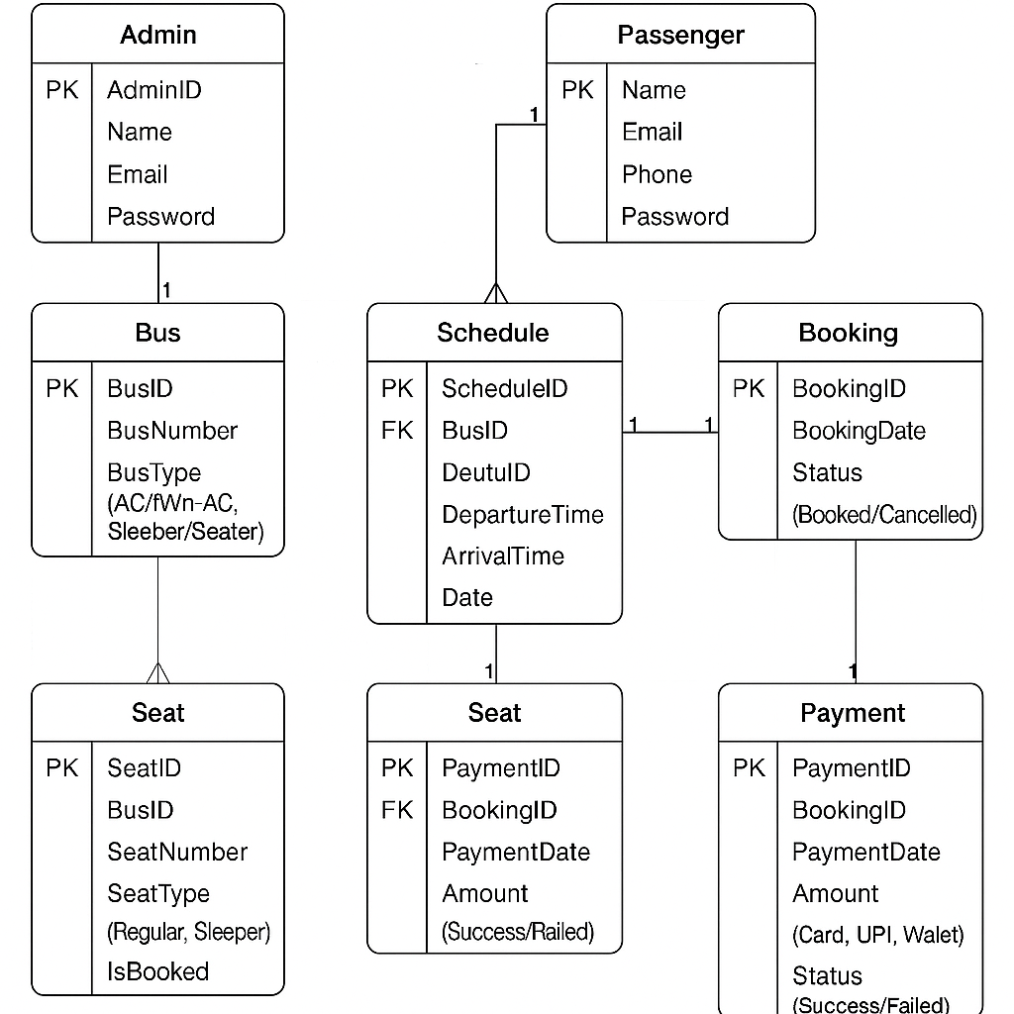
Database Design
ER Diagram

Slide 12

Tables and Relationships
Database Schema
Users: UserID, Name, Email, Password
Buses: BusID, BusNumber, Capacity
Routes: RouteID, Start, Destination, Distance
Seats: SeatID, BusID, SeatNumber, Status
Bookings: BookingID, UserID, RouteID, BusID, BookingDate, TotalAmount
BookingDetails: BookingID, SeatID (to support multiple seat selection)
🔗 Relationships:
One-to-Many: User → Bookings
One-to-Many: Bus → Seats
One-to-Many: Route → Bookings
Many-to-Many: Bookings ↔ Seats (via BookingDetails)

Slide 13
Example Data

Slide 14
Important Code Snippets
Model: Data Annotations for validation
public class Booking
{
public int BookingID { get; set; }
[Required]
public int UserID { get; set; }
[Required]
public int RouteID { get; set; }
[Required]
public int BusID { get; set; }
[DataType(DataType.Date)]
public DateTime BookingDate { get; set; }
[Range(1, 10000)]
public decimal TotalAmount { get; set; }
}
public class BookingController : Controller
{
// GET: Booking
public IActionResult Index()
{
var bookings = _context.Bookings.ToList();
return View(bookings);
}
// GET: Booking/Create
public IActionResult Create()
{
return View();
}
// POST: Booking/Create
[HttpPost]
[ValidateAntiForgeryToken]
public IActionResult Create(Booking booking)
{
if (ModelState.IsValid)
{
_context.Add(booking);
_context.SaveChanges();
return RedirectToAction(nameof(Index));
}
return View(booking);
}
}

Slide 15
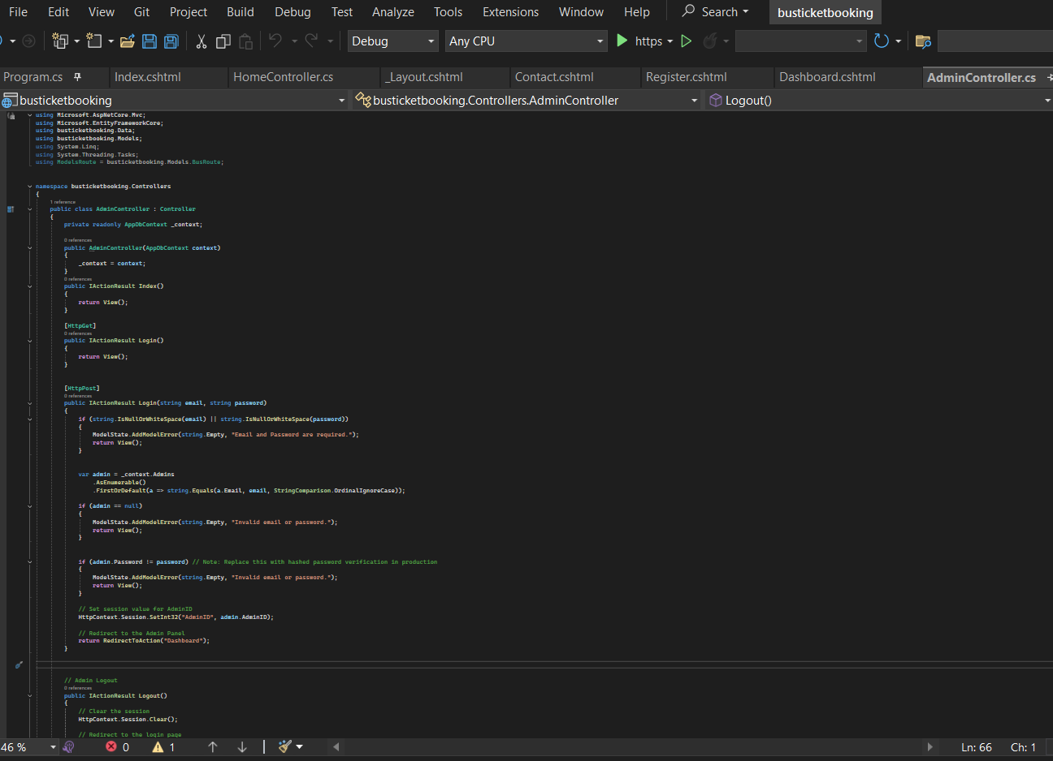
Admin Controller

Slide 16
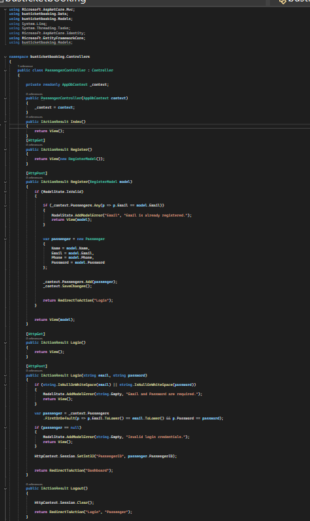
Passenger Controller

Slide 17
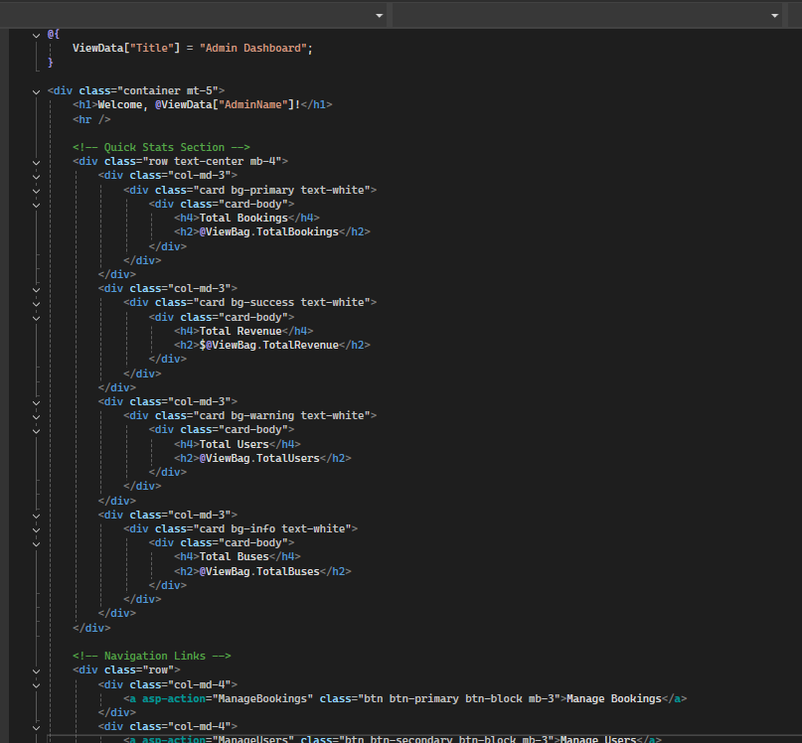
View Page

Slide 18
Challenges and Solutions
Challenge: Entity Framework Migration
Solution: Used Fluent API and manual migrations
Challenge: Form Validation
Solution: Used Data Annotations

Slide 19
Conclusion
Learned: MVC pattern, full-stack web dev, DB integration
Future Improvements:
- Payment Gateway
- Mobile Responsive Design
- Role-based Access Control

Slide 20

Q&A
Any Questions?

