Slide 1
Hostel Management System
Supervised by:
Md.Nahid Anwar
Lecturer ,
Dept. of CSE, BUBT
Presented by :
Md. Kawsher Mahbub ID:16172103282
Amit Das ID:16172103297
Sikder Md. Saiful Islam ID: 16172103316

Slide 2

It is a system for managing the hostel activities
It helps the admin to manage
Students record
Mess bill
Allocating room
Deallocating room
Payment
Search student information
Add new room

Slide 3
Users:
Admin User:-
Add student
Remove student
Search student
Payment
Add room
Add meal
Student User:-
See student information
See payment information
See Room mate Information
Search Student
See Meal Information

Slide 4
Advantage of Proposed System:
User Friendliness
Easier and Flexible.
Centralized database.
Good security for user information

Slide 5
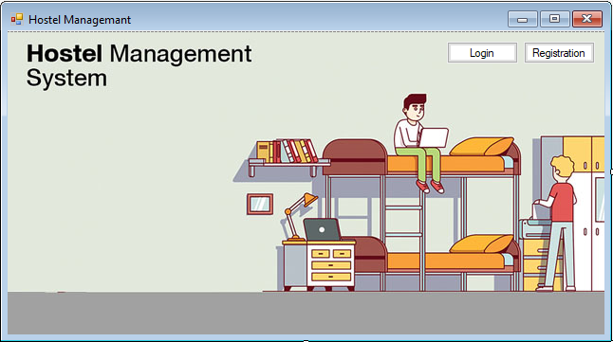
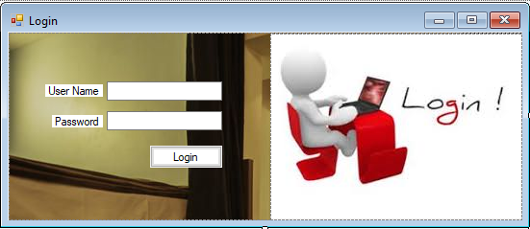
Login & Registration

Slide 6
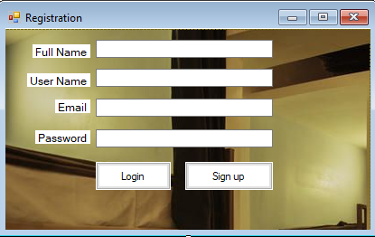
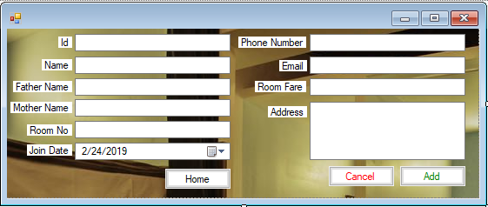
Add Student Record

Slide 7
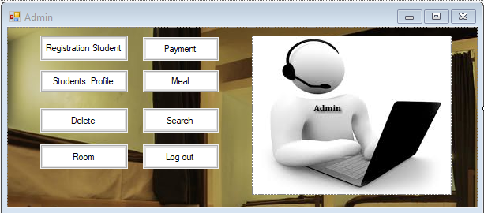
Admin User

Slide 8
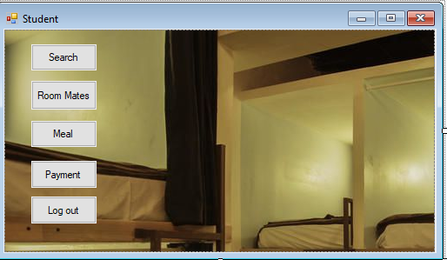
Student Users

Slide 9
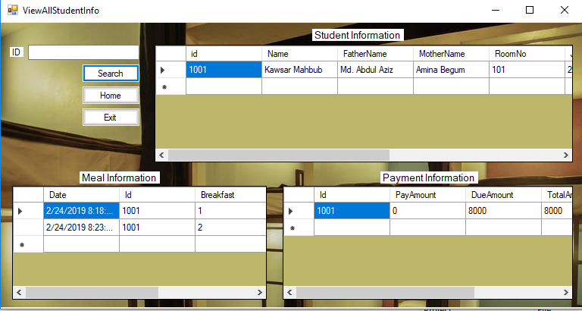
View Search Student Information

Slide 10
Methodology Use
Hardware Requirements:-
Processor: 2.5GHz
RAM: 4GB
Hard Disk: 512GB Space Required
Software Requirements:-
Visual Studio, Microsoft Sql Server
Operating System:- windows XP Professional,7,8,8.1,10 etc.
Language:- C#,Sql

Slide 11
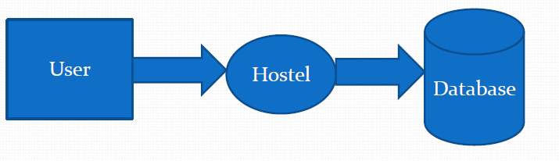
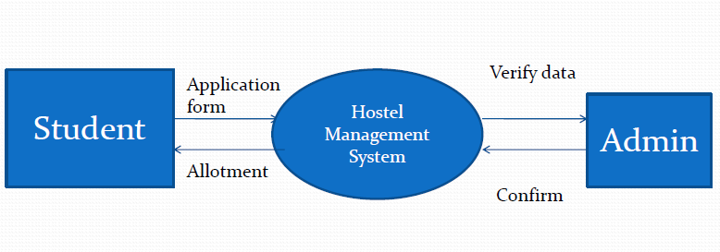
Data Flow Diagram

Slide 12
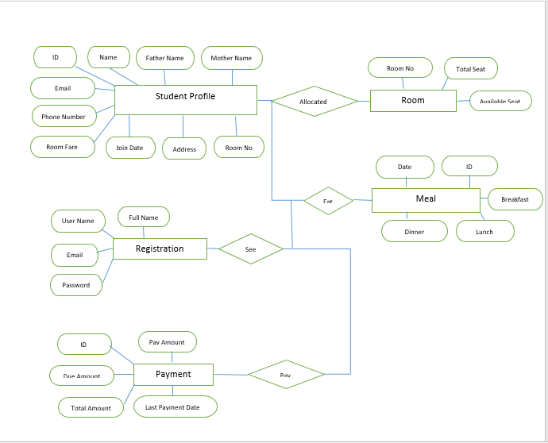
ER Diagram

Slide 13

User is provided the option of only view the records he entered earlier.
Data storage and retrieval will become faster and easier to maintain
This project offers user to enter the data through simple and interactive manner.

Slide 14




