Slide 1

A Survey on Predicting Player’s Performance and Team Recommendation in Game of Cricket Using Machine Learning

Slide 2
Supervised by

Slide 3
Milon Biswas
Assistant Professor
Department of CSE
Bangladesh University of Business and Technology (BUBT)

Slide 4

Presented by
Md. Kawsher Mahbub
Sikder Md. Saiful Islam
Sadia Sorna
Limitations
Proposed Method
Motivation
User Interface
Existing System
Objectives
Safety Measure
Introduction
Future Plan
Applications

Slide 5
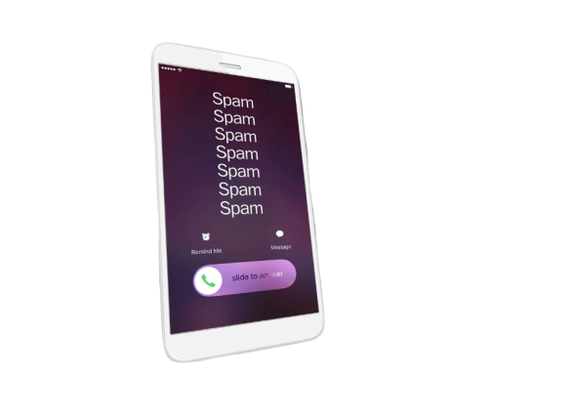

Worldwide, the number of spam calls is increasing every day.
To restrict these spam calls ,
we are presenting a new concept in which spam callers will be
recognized through their vocals .
Presented by
OBONEE KUSHUM
SAYMA YOUSUF
SANJANA RAHMAN
Limitations
Proposed Method
Precautions
Motivation
User Interface
Existing System
Objectives
Safety Measure
Introduction
Future Plan
Applications

Slide 6


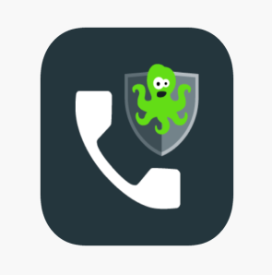




7 Best Spam Call Blocker Apps For Smartphones
Worldwide, the number of spam calls is increasing every day.
To restrict these spam calls ,
we are presenting a new concept in which spam callers will be
recognized through their vocals .
01
02
03
04
Presented by
OBONEE KUSHUM
SAYMA YOUSUF
SANJANA RAHMAN
True Caller
Hiya
Should I answer?
Call Control
Limitations
Proposed Method
Precautions
Motivation
User Interface
Safety Measure
Objectives
Precautions
Existing System
Future Plan
Introduction
Applications
05
06
07
Call Blacklist
Norton Mobile Security
CallApp Crawler

Slide 7
7 Best Spam Call Blocker Apps For Smartphones
Worldwide, the number of spam calls is increasing every day.
To restrict these spam calls ,
we are presenting a new concept in which spam callers will be
recognized through their vocals .
02
Synced
Personal Information
01
03
04
Switching
SIM Card’s
Shows
Old Owner’s Name
Presented by
OBONEE KUSHUM
SAYMA YOUSUF
SANJANA RAHMAN
True Caller
Hiya
Should I answer?
Call Control
Limitations
Proposed Method
Precautions
Safety Measure
Motivation
User Interface
Precautions
Objectives
Precautions
Introduction
Future Plan
Existing System
Applications
05
06
07
Tracking
phone numbers is pointless
Leads to
security Problems
Causes
unnecessary harassment
Call Blacklist
Norton Mobile Security
CallApp Crawler

Slide 8




7 Best Spam Call Blocker Apps For Smartphones
Worldwide, the number of spam calls is increasing every day.
To restrict these spam calls ,
we are presenting a new concept in which spam callers will be
recognized through their vocals .
Spammer will be caught in the first place
02
Synced
Personal Information
01
03
04
Switching
SIM Card’s
Shows
Old Owner’s Name
Suspect can be recognized even after changing the SIM card’s number
Presented by
OBONEE KUSHUM
SAYMA YOUSUF
SANJANA RAHMAN
True Caller
Hiya
Should I answer?
Call Control
Limitations
Proposed Method
Precautions
Safety Measure
Motivation
User Interface
Precautions
Precautions
Objectives
Introduction
Future Plan
Existing System
Applications
Identify the speaker with a few seconds of speech
05
06
07
Recognizing suspect’s vocal even in a noisy environment
Tracking
phone numbers is pointless
Leads to
security Problems
Causes
unnecessary harassment
Call Blacklist
Norton Mobile Security
CallApp Crawler

Slide 9










7 Best Spam Call Blocker Apps For Smartphones
1. MFCC
2. GMM
Sending Notification
Worldwide, the number of spam calls is increasing every day.
To restrict these spam calls ,
we are presenting a new concept in which spam callers will be
recognized through their vocals .
Spammer will be caught in the first place
02
Synced
Personal Information
01
03
04
Switching
SIM Card’s
Shows
Old Owner’s Name
Suspect can be recognized even after changing the SIM card’s number
Voice exits in database
Creating spam report
Presented by
OBONEE KUSHUM
SAYMA YOUSUF
SANJANA RAHMAN
True Caller
Incoming threat call
Hiya
Should I answer?
Call Control
Limitations
Precautions
Precautions
Safety Measure
Motivation
User Interface
Precautions
Precautions
Objectives
Introduction
Existing System
Future Plan
Proposed Method
Applications
Identify the speaker with a few seconds of speech
Multiple Vocals
05
06
07
Spam Caller
Extracting Vocals from Noise
User
Call recording
Recognizing suspect’s vocal even in a noisy environment
Spam caller
Causes
unnecessary harassment
Tracking
phone numbers is pointless
Leads to
security Problems
Noise
Call Blacklist
Norton Mobile Security
CallApp Crawler
Database

Slide 10
Start
7 Best Spam Call Blocker Apps For Smartphones
Worldwide, the number of spam calls is increasing every day.
To restrict these spam calls ,
we are presenting a new concept in which spam callers will be
recognized through their vocals .
Is it an incoming call?
Spammer will be caught in the first place
02
Synced
Personal Information
01
03
04
Switching
SIM Card’s
Yes
Shows
Old Owner’s Name
Unknown number?
Suspect can be recognized even after changing the SIM card’s number
Yes
Presented by
OBONEE KUSHUM
SAYMA YOUSUF
SANJANA RAHMAN
Have more than 5 reports?
Does this voice exist in the database?
True Caller
Hiya
Yes
Should I answer?
Call Control
Limitations
Precautions
Precautions
Safety Measure
Motivation
User Interface
Precautions
Precautions
Objectives
Introduction
Existing System
Future Plan
Proposed Method
Applications
Identify the speaker with a few seconds of speech
No
Yes
No
05
06
07
Send a notification
Was it threatened?
Recognizing suspect’s vocal even in a noisy environment
Yes
Tracking
phone numbers is pointless
Leads to
security Problems
Causes
unnecessary harassment
No
Report against this spam caller
Call Blacklist
Norton Mobile Security
CallApp Crawler
END
No
No

Slide 11
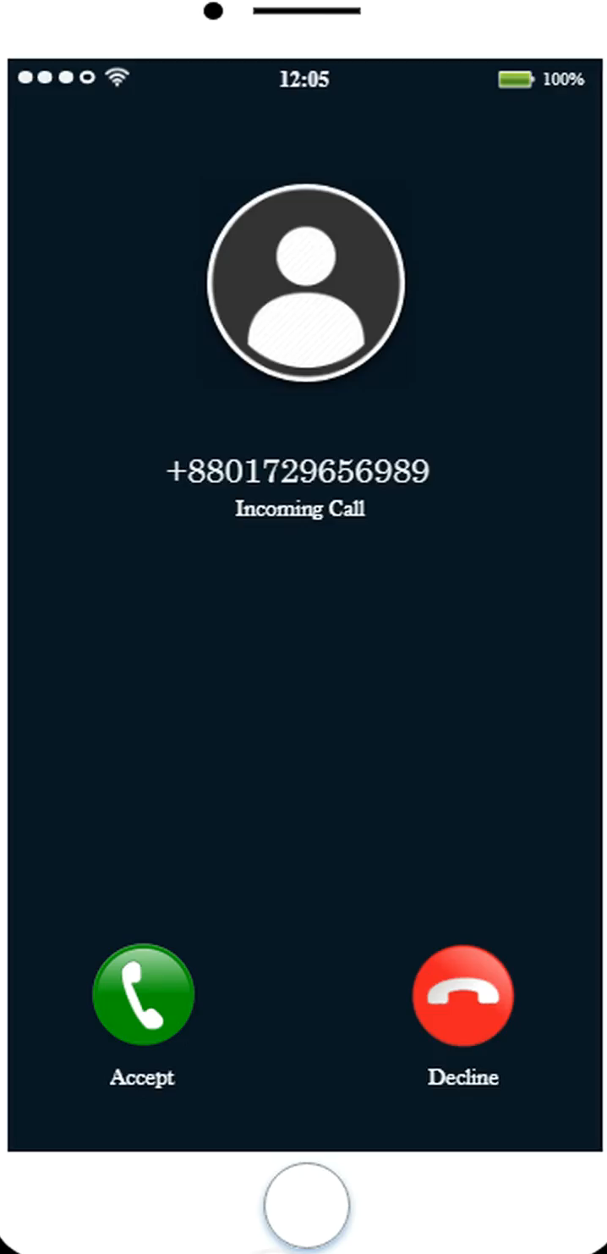
Start
7 Best Spam Call Blocker Apps For Smartphones
Worldwide, the number of spam calls is increasing every day.
To restrict these spam calls ,
we are presenting a new concept in which spam callers will be
recognized through their vocals .
Is it an incoming call?
Spammer will be caught in the first place
02
Synced
Personal Information
01
03
04
Switching
SIM Card’s
Yes
Shows
Old Owner’s Name
Unknown number?
Suspect can be recognized even after changing the SIM card’s number
Yes
Presented by
OBONEE KUSHUM
SAYMA YOUSUF
SANJANA RAHMAN
Have more than 5 reports?
Does this voice exist in the database?
True Caller
Hiya
Yes
Should I answer?
Call Control
Limitations
Precautions
Precautions
Safety Measure
Motivation
Precautions
Precautions
Safety Measure
User Interface
Objectives
Introduction
Existing System
Future Plan
Proposed Method
Applications
Identify the speaker with a few seconds of speech
No
Yes
No
05
06
07
Send a notification
Was it threatened?
Recognizing suspect’s vocal even in a noisy environment
Yes
Tracking
phone numbers is pointless
Leads to
security Problems
Causes
unnecessary harassment
No
Report against this spam caller
Call Blacklist
Norton Mobile Security
CallApp Crawler
END
No
No

Slide 12



7 Best Spam Call Blocker Apps For Smartphones
Worldwide, the number of spam calls is increasing every day.
To restrict these spam calls ,
we are presenting a new concept in which spam callers will be
recognized through their vocals .
Spammer will be caught in the first place
02
Synced
Personal Information
01
03
04
Switching
SIM Card’s
Shows
Old Owner’s Name
Suspect can be recognized even after changing the SIM card’s number
Presented by
OBONEE KUSHUM
SAYMA YOUSUF
SANJANA RAHMAN
True Caller
Threshold of Spam Reports
Storing
IMEI number
Incoming Call
Hiya
Should I answer?
Call Control
Limitations
Precautions
Precautions
Motivation
Precautions
Precautions
Objectives
Introduction
Existing System
Future Plan
Proposed Method
Applications
User Interface
Identify the speaker with a few seconds of speech
Safety Measure
It only works for unknown numbers, which helps to prevent anyone, from
complaining against an innocent
for no reason
Prevents more
than one complaint from the
same user
If the number of spam reports
exceed the threshold everyone will be notified. Otherwise, notification will be sent to those users who complained before.
07
05
06
Recognizing suspect’s vocal even in a noisy environment
Tracking
phone numbers is pointless
Leads to
security Problems
Causes
unnecessary harassment
Call Blacklist
Norton Mobile Security
CallApp Crawler

Slide 13
7 Best Spam Call Blocker Apps For Smartphones
Worldwide, the number of spam calls is increasing every day.
To restrict these spam calls ,
we are presenting a new concept in which spam callers will be
recognized through their vocals .
Spammer will be caught in the first place
02
Synced
Personal Information
01
03
04
Switching
SIM Card’s
Shows
Old Owner’s Name
Suspect can be recognized even after changing the SIM card’s number
Presented by
OBONEE KUSHUM
SAYMA YOUSUF
SANJANA RAHMAN
True Caller
Threshold of Spam Reports
Storing
IMEI number
Incoming Call
Hiya
Should I answer?
Call Control
Precautions
Limitations
Precautions
Motivation
Precautions
Precautions
Objectives
Introduction
Existing System
Future Plan
Proposed Method
Applications
User Interface
Identify the speaker with a few seconds of speech
Safety Measure
It only works for unknown numbers, which helps to prevent anyone, from
complaining against an innocent
for no reason
Prevents more
than one complaint from the
same user
If the number of spam reports
exceed the threshold everyone will be notified. Otherwise, notification will be sent to those users who complained before.
07
05
06
Recognizing suspect’s vocal even in a noisy environment
Processing Time
Tracking
phone numbers is pointless
Leads to
security Problems
Causes
unnecessary harassment
Since many methods are used to find specific voices,
So it might take a while.
Call Blacklist
Norton Mobile Security
CallApp Crawler

Slide 14


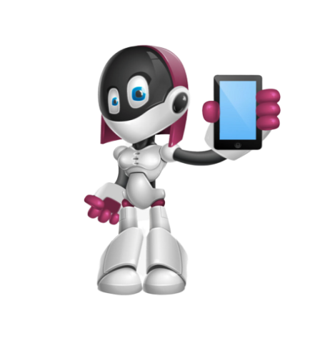

7 Best Spam Call Blocker Apps For Smartphones
Worldwide, the number of spam calls is increasing every day.
To restrict these spam calls ,
we are presenting a new concept in which spam callers will be
recognized through their vocals .
Spammer will be caught in the first place
02
Synced
Personal Information
01
03
04
Switching
SIM Card’s
Shows
Old Owner’s Name
Using voice recognition system to protect Bank Account
Suspect can be recognized even after changing the SIM card’s number
Presented by
OBONEE KUSHUM
SAYMA YOUSUF
SANJANA RAHMAN
True Caller
Threshold of Spam Reports
Storing
IMEI number
Incoming Call
Hiya
Should I answer?
Call Control
Precautions
Limitations
Precautions
Motivation
Precautions
Precautions
Objectives
Introduction
Existing System
Future Plan
Proposed Method
User Interface
Applications
Identify the speaker with a few seconds of speech
Safety Measure
It only works for unknown numbers, which helps to prevent anyone, from
complaining against an innocent
for no reason
Prevents more
than one complaint from the
same user
If the number of spam reports
exceed the threshold everyone will be notified. Otherwise, notification will be sent to those users who complained before.
07
05
06
A Hands free AI Assistant
that Knows Who is its
actual user
Solving Crimes With Voice Recognition
Recognizing suspect’s vocal even in a noisy environment
Processing Time
Tracking
phone numbers is pointless
Leads to
security Problems
Causes
unnecessary harassment
Since many methods are used to find specific voices,
So it might take a while.
Call Blacklist
Norton Mobile Security
CallApp Crawler

Slide 15



7 Best Spam Call Blocker Apps For Smartphones
Worldwide, the number of spam calls is increasing every day.
To restrict these spam calls ,
we are presenting a new concept in which spam callers will be
recognized through their vocals .
Spammer will be caught in the first place
02
Synced
Personal Information
01
03
04
Switching
SIM Card’s
Shows
Old Owner’s Name
Using voice recognition system to protect Bank Account
Suspect can be recognized even after changing the SIM card’s number
Presented by
OBONEE KUSHUM
SAYMA YOUSUF
SANJANA RAHMAN
True Caller
Threshold of Spam Reports
Storing
IMEI number
Incoming Call
Hiya
Should I answer?
Call Control
Precautions
Limitations
Precautions
Motivation
Precautions
Precautions
Objectives
Introduction
Existing System
Proposed Method
User Interface
Applications
Future Plan
Identify the speaker with a few seconds of speech
Safety Measure
It only works for unknown numbers, which helps to prevent anyone, from
complaining against an innocent
for no reason
Prevents more
than one complaint from the
same user
If the number of spam reports
exceed the threshold everyone will be notified. Otherwise, notification will be sent to those users who complained before.
07
05
06
A Hands free AI Assistant
that Knows Who is its
actual user
Solving Crimes With Voice Recognition
Recognizing suspect’s vocal even in a noisy environment
Processing Time
Tracking
phone numbers is pointless
Leads to
security Problems
Causes
unnecessary harassment
Since many methods are used to find specific voices,
So it might take a while.
To assist the police or some government law enforcement authority to track spam callers through their voice clips which are stored in our database
Call Blacklist
Norton Mobile Security
CallApp Crawler

Slide 16



