Slide 1

Welcome
To
presentation

Slide 2

Presented By….
Youth challengers
Name | Roll
Kawsher mahbub | 282
Sajjad hossain | 294
Al amin Hossain | 315
Arindom kisor biswas | 311

Slide 3
Our subject
Scientific advancement in the last decade

Slide 4

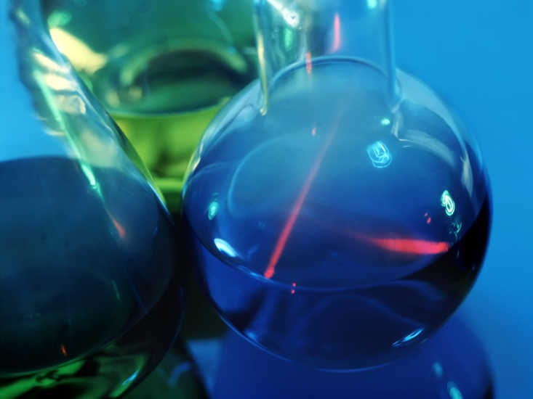
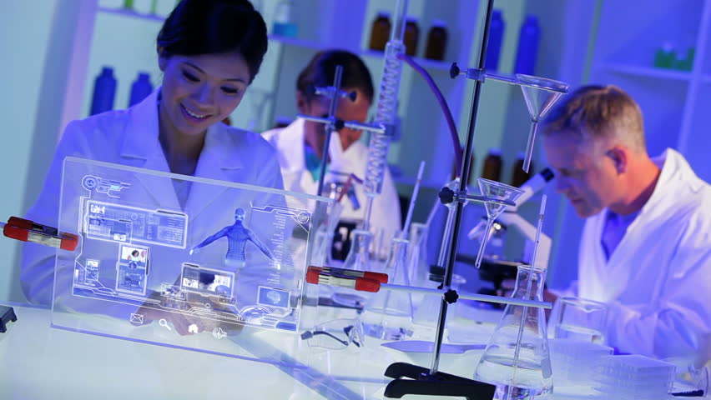
What is science?...
Science is new
inventing things.

Slide 5
So let’s go to see some thing about…
Scientific
advancement by
invention

Slide 6
At first we should to know…..
what type of
invention was
changed the world?..

Slide 7
We know that…..
Computer
Mobile Phone
Radio
Television
Electric light bulb
Rocketry
The Automobile
Airplane
Nuclear Power
Calculator
refrigerator

Slide 8
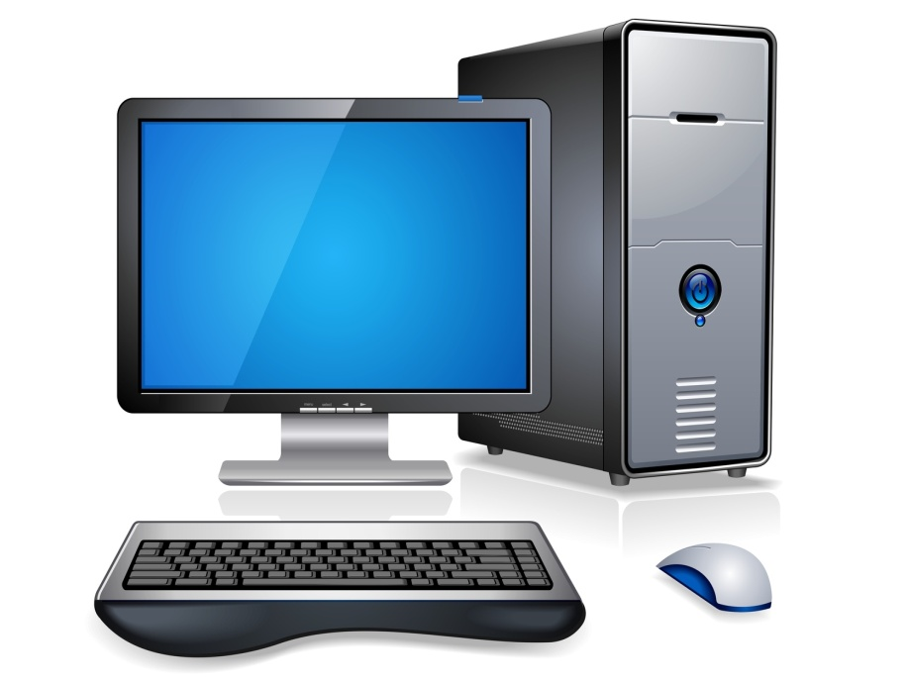
computer
The first personal computer
named the programmer
101 was launched in 1964.
The SCAMP IBM computer was the beginning
of the modern personal computer.
Today, everyone owns a device that has
its roots in the personal computer.
From tablets to cell phones.

Slide 9
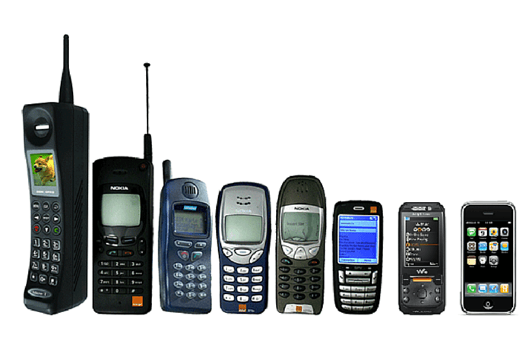
Mobile phone
Martin cooper is an American pioneer and
he conceived the first handler mobile in 1970.
Nothing more than a Mobile Phone comes
to great help in emergency.
Companies find it yet another medium to advertise their products;
so another medium to reach the consumers.

Slide 10
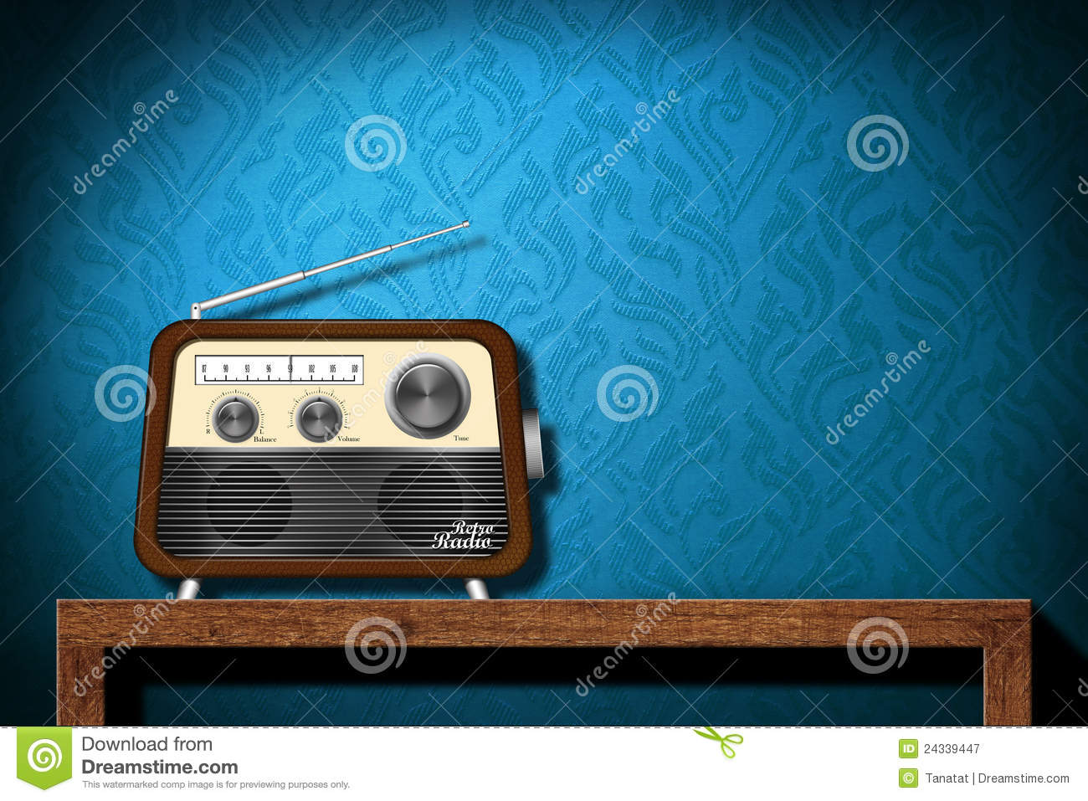
Radio
Marconi made the first successful
transatlantic transmissions of
radio waves in 1901 and 1902
Early developments in radio were
called ‘wireless telegraphy’,
which is why the radio
used to be called the wireless.
.Radios are being combined with
computers to connect the computer
to the Internet via satellites.

Slide 11
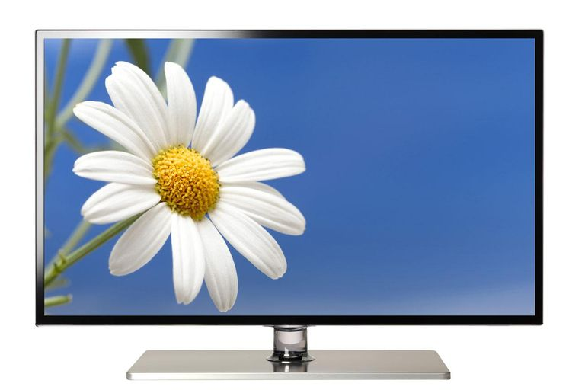
television
John logie was the first person in the world to demonstrate
a working television system in january 1926.
It is society’s baby-sitter, news source,
teacher, entertainer, and story-teller.
it fills our days with vapidity and all manner
of inane and obnoxious commercials.

Slide 12

Electric light bulb
Thomas Edison first invented
electric light bulb.
One of the invention
that brightness millions
of houses and buildings.
The bulb itself works by transmitting
electricity through a wire with high resistance Known as a filament .The waste energy created by the resistance is expelled as heat and light

Slide 13
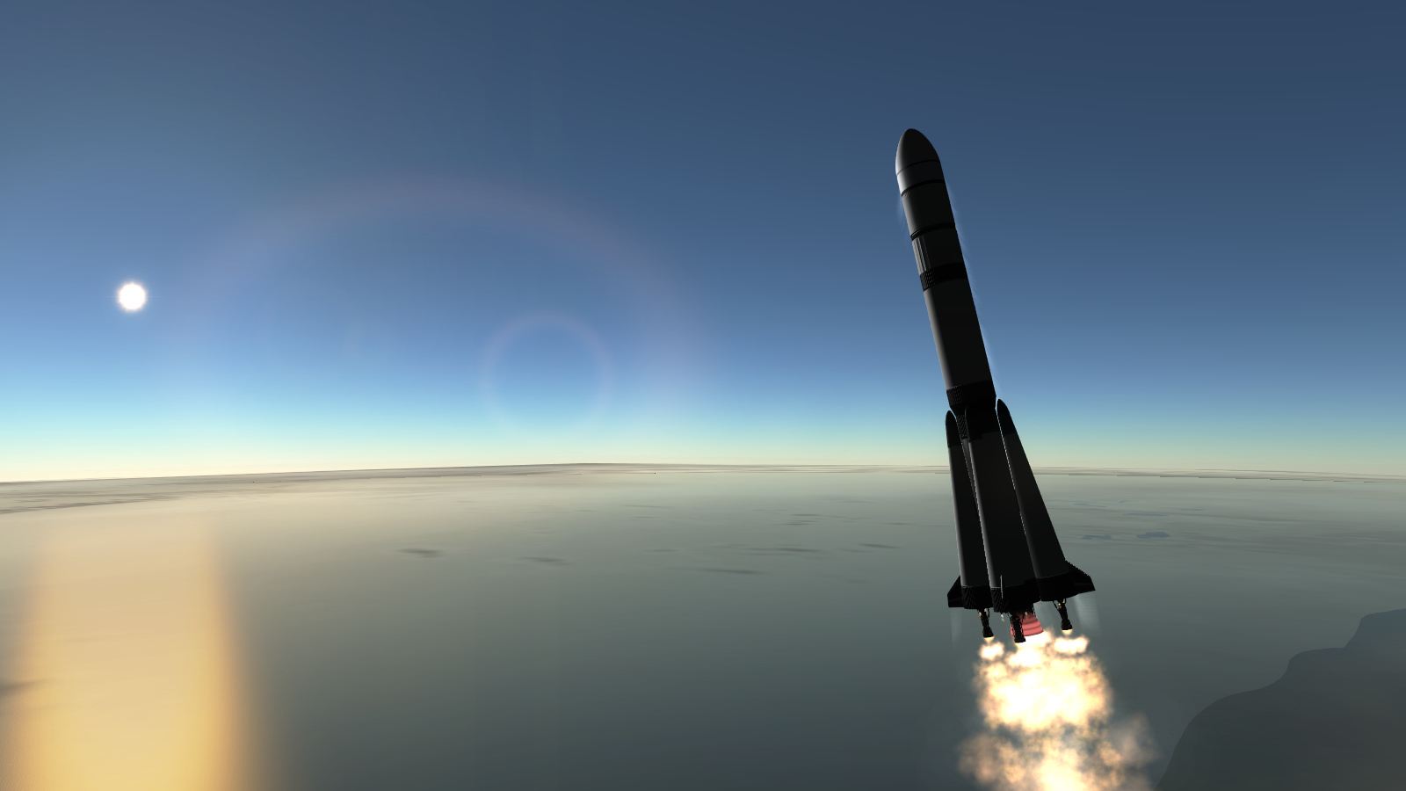
rocketry
The first modern rocket was
created in 1926 by Robert
Godard.
The Germany Army used a V-2
rocket during world war-2. At
The time the most advanced
rocket ever made.
Today are the basis for space
exploration.

Slide 14
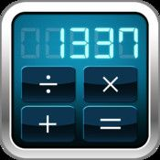
calculator
1960’s is the first start of the electronic calculator
They make it easier to do math problems.

Slide 15
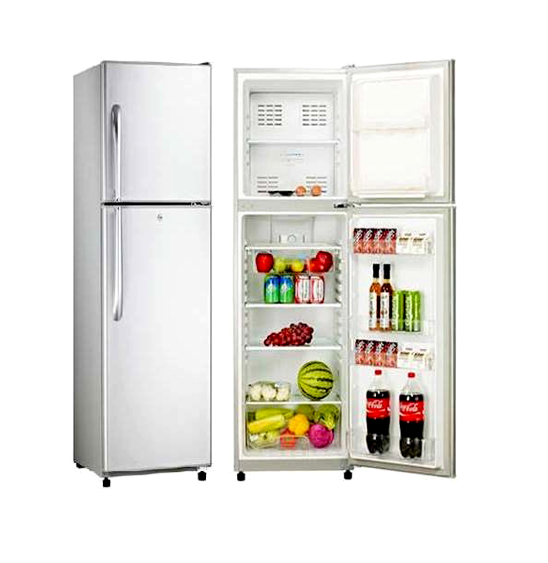
refrigerator
Developed for home use in 1913.
The very first ones had to be put
together by the customer.
Refrigerator today are in almost
every household in the United
States

Slide 16
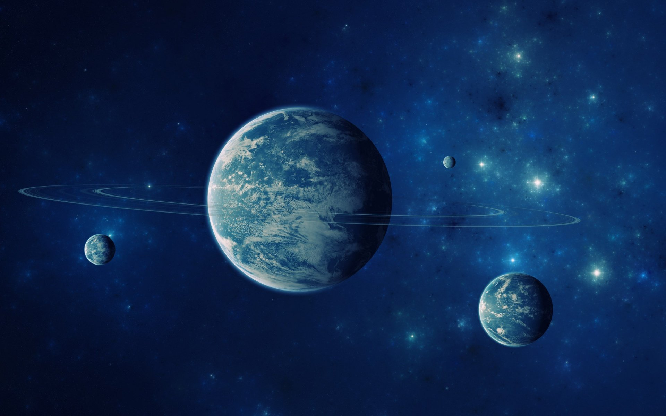
Conclusion
After all , we can say that science
is the most wonderful thing
Of modern era. It makes our
life easy and developed.
Without science we can’t
imagine our modern civilization.

Slide 17
Thank you

