Slide 1

Bangladesh University OF Business And Technology
Subject: Technological Advancement
Presented by
Group: Youth Challenger
Department of CSE

Slide 2
OUTLINE
INTRODUCTION
TECHNOLOGICAL ADVANCEMENT IN
DIFFERENT SECTORS
IMPORTANCE OF TECHNOLOGICAL ADVANCEMENT
CONCLUSION

Slide 3
INTRODUCTION
What is Technology?
The word "technology" can be used to refer to a collection of techniques. In this context, it is the current state of humanity's knowledge of how to combine resources to produce desired products, to solve problems, fulfil needs, or satisfy wants.

Slide 4
Technological advancement in different sectors
Space technology.
Information technology.
Leaser technology
Bio-technology.
Nano technology.

Slide 5
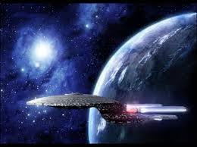
What is Space technology?
Space technology is that technology which is related to entering space, maintaining and using system in space and retuning people and things from space.

Slide 6
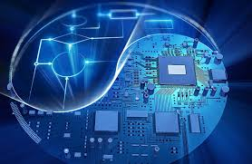
What is Information technology?
Information technology (IT) as defined by the information technology association of America (ITAA) is any study design , development , implementation , support or management of computer hardware . It deals with the use of electronic computers and computer software to convert store project process transmit and securely retrieve information .
Use an application of information technology.
Business
Mobile phone
Education
Publication
Media
Defense service
Manufacturing

Slide 7
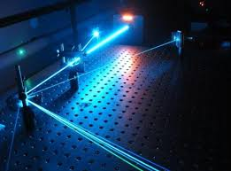
What is laser technology?
A laser is an electronic optical device that’s emits coherent light radiation the term laser is an acronym for light amplification by stimulated emission of radiation .
Use an application of laser technology.
Medicines
Commercial use.
Industrial use.
Military use.
Optical communication
Distance and velocity measurement.

Slide 8
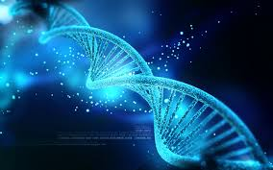
What is Bio-technology?
Bio technology is technology based on biology . Especially when use in agriculture , food science and medicine . Bio technology is the field in which living organisms or their product are used to
Use an application of Bio-technology.
Medicine
Pharmacogenomics
Pharmaceutics product
Gene testing
Gene therapy
Cloning
Agriculture
Environment
Industry

Slide 9
What is Nano technology?
Nano technology refers to field of applied science and technology whose theme is the control of matter on atomic and molecular scale generally 100 Nano meters or smaller and the fabrication of devise of material that lie within that the size range.
One Nano meter is on billionth or 10^-9 of a meter to put that scale in context , the comparative size 0 Nano meter to a meter is same as that a marble to the size of Earth.

Slide 10
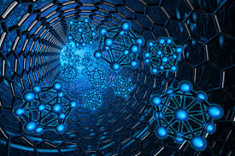
Use an application of Nano technology.
Electronics
Energy
Automobiles
The Space and defence
Medical fields
Environment
Sports and toys

Slide 11
CONCLUSION
Our personal life is highly dependent on the technology that people have developed. Technology has advanced with years and it has changed the way we purchase products , the way we live , the way we communicate , the way we travel , the way we learn and so many changes have been brought about by these continuous technological advancements. As people’s demands and life style change, the demand for advancing the type of technology we use is high.

Slide 12
Thank You

