Slide 1

Transcom Group

Slide 2
Challengers
Supervised by:
Md.Mahin Chowdhury Bipu
Lecturer ,
Dept. of CSE, BUBT
Presented by :
Md. Kawsher Mahbub ID:16172103282
Asif Rakib Khan ID:16172103279
Sikder Md. Saiful Islam ID: 16172103316
Naim Mia h ID: 16172103335

Slide 3
About transcom limited
Originated with tea plantations in 1885, TRANSCOM today is one of the leading and fastest growing diversified business houses in the country employing over 14000+ people. Not many industrial groups in Bangladesh can claim a history of continuous business pursuits stretching back over 125 years!.
Location:
Corporate Head Office:
Gulshan Tower
Plot # 31, Road # 53, Gulshan North C/A,
Gulshan-2, Dhaka-1212, Bangladesh

Slide 4
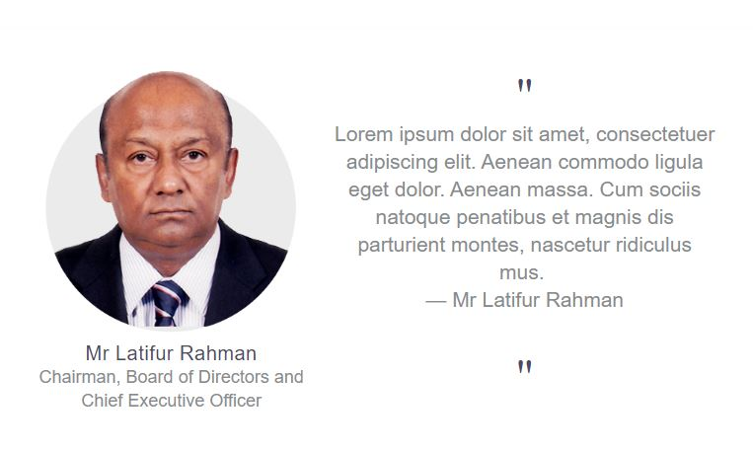

Slide 5
Holding companies of Transcom Group:
Transcom Electronics Limited (TEL):
Transcom Beverages Ltd.
Eskayef (SK+F) Bangladesh Ltd.
Media Star Ltd.
Media World Ltd.
Transcraft Ltd.
Tea Holdings Ltd.
Reliance Insurance Ltd.
Transcom Distribution Co. Ltd.
Transcom Foods Ltd.
Transcom Consumer Product Ltd.
Bangladesh Lamps Ltd.
Bangladesh Electrical Industry Ltd.

Slide 6
What Transcom do?
1.Manufacture Product Initially tea and later jute formed the backbone of the family business. Although these are still part of the activities and contributing marginally to the overall group turnover.
2.Distrubute Product
Transcom distribution company Limited (TDCL) has the largest independent distribution setup in Bangladesh with full infrastructural facilities provided by a countrywide network of 23 branch offices along with one main office, warehouses and delivery vans, directly servicing over 8000 outlets throughout the whole country.

Slide 7
Contact
Phone: 58814663, 9848501, 58814701, 9848502.
Fax: 880-2-9887373 (Gulshan), 9561350 (Motijheel)
E-mail: transcom@transcombd.com
fhn@transcombd.com
el@transcombd.com
info@transcombd.com
Website: www.transcombd.com
https://en.wikipedia.org/wiki/Transcom_Group

Slide 8
Literature review :
We analyze some company like as Transcom such as Intl Foodservice, Distributors Assn, Waffle House Inc., Roark Capital Group, Dinex Group. Many the company manufacture their own product and they also distribute other company’s product. Every company has a supply chain and distribute management.
Supply chain Management and distribution Management has assumed a significant role in the company’s performance. Every company has its own strategy for production and distribution. Most of the company try to make a better product to keep their customer. Also, they give Alluring offers to the customer to buy a product.

Slide 9
Basically transcom group manufactured the product and distribute this product

Slide 10
Advantage :
They distribute their product every zilla and big town all over the country.
Provide free Home delivery service
Longevity
Reasonable price

Slide 11
Resource :
They collect their raw materials from -
China
Japan
Thailand

Slide 12

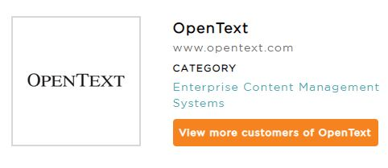
Software
Transcom utilizes these 2 vendors

Slide 13
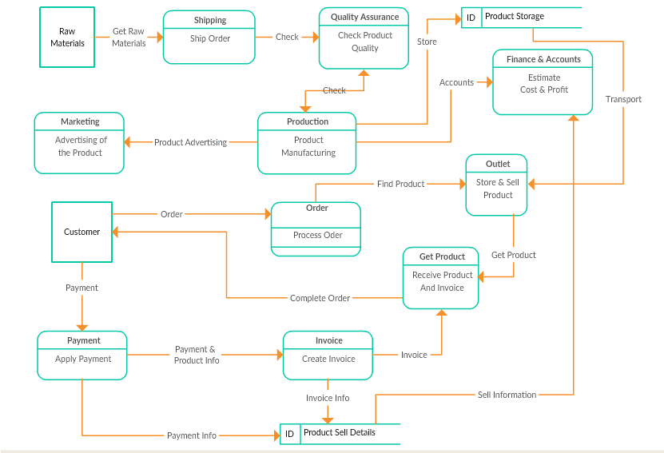
Data Flow Diagram

Slide 14
Loopholes
They Maintenance Supply chain that’s why if one of the damage then the whole production will be damage.
Production cost is high because of the raw materials imported from abroad.
Sometimes Product didn’t reach the exact time to the consumer .
Lower class people can’t buy their product easily.
Village side & small town people cannot properly enjoy the facilities of product maintenance.
They cannot distribute their product whole country.
Labor wages are low.
The HR department is too strict that’s why many employees feel uneasy.

Slide 15
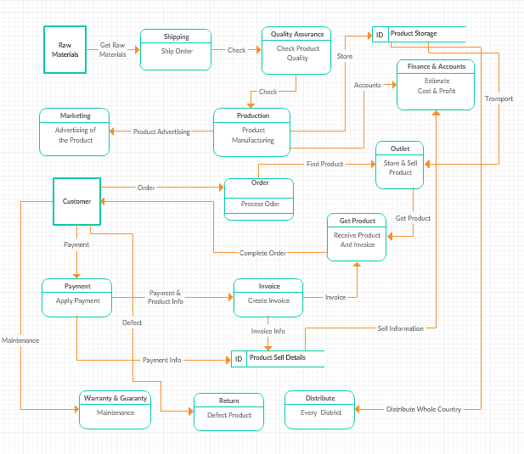
Revised Data Flow Diagram

Slide 16
Solution
Now the village side & small town people now can properly enjoy the facilities of product maintenance.
Now they can distribute their product whole country.
Now the customer can exchange or return defect product.
Now they can reach the product an exact time.

Slide 17
Reference
1.http://website.tclwebapps.com/
2. https://www.transcombd.com/
3.https://www.featuredcustomers.com/customer/transcom/reviews?fbclid=IwAR0CPfc2GPjXqqMTcWkJc_dGIS-NdL_AtiBc80bo7K3UhRTHTdrFwKAbOfw
4. https://en.wikipedia.org/wiki/Transcom_Group

Slide 18
Any Questions?

Slide 19

Thanks to all

