Slide 1
Online book store
Supervised by:
Arunavo Dey
Assistant Professor ,
Dept. of CSE, BUBT
Presented by :
Md. Kawsher Mahbub ID:16172103282
Md. Sajjad Hossain ID:16172103294
Intake:35
Section:06
Dept. of CSE, BUBT

Slide 2
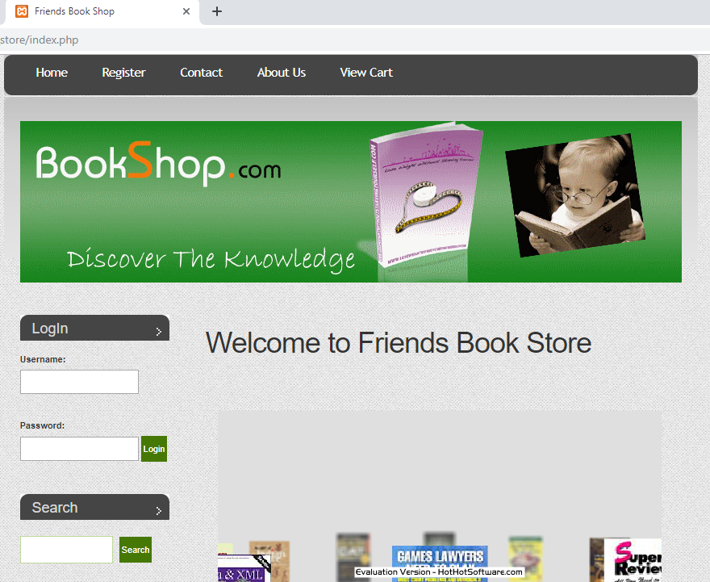
Home page

Slide 3
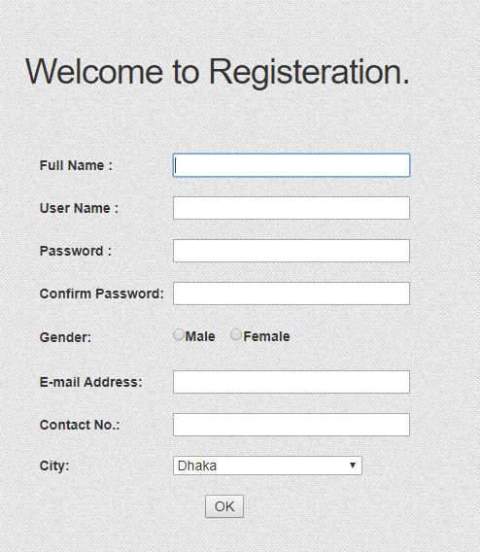
Registration

Slide 4
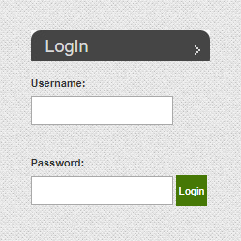
Login

Slide 5
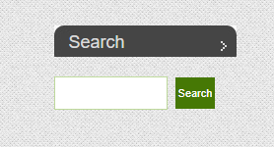
Search Book

Slide 6
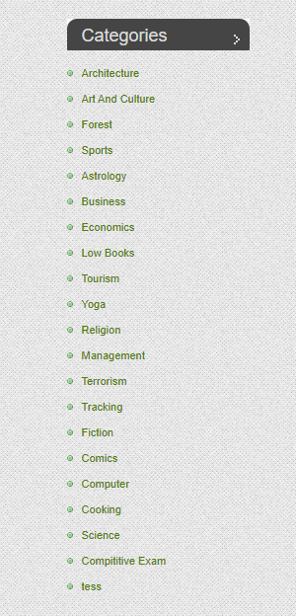
Book Categories

Slide 7
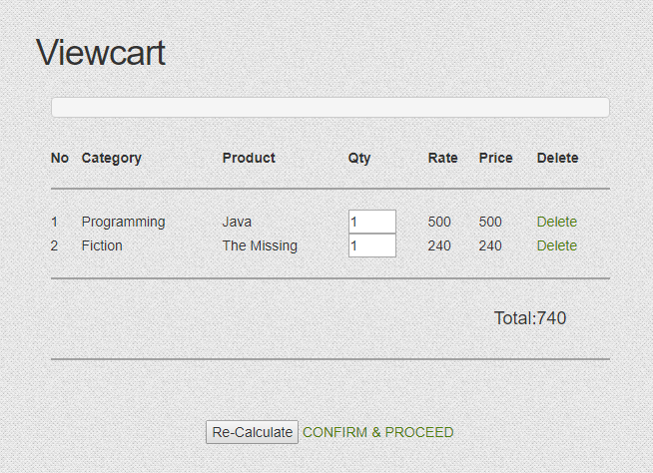
Shopping Cart

Slide 8
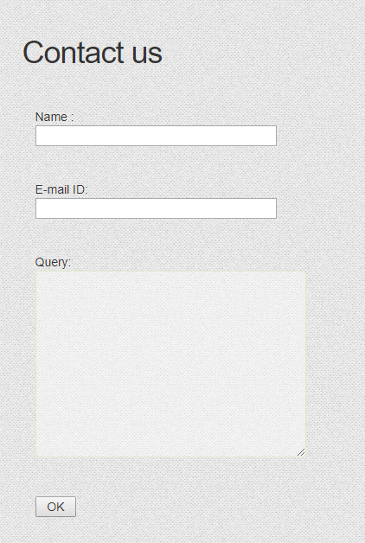
Contact For Query

