Slide 1

Amy Xiao, Li Ting Wong, Timothy Chan
SVC presentation | 2015
Notes:
Good evening everyone, we are EXO control.
We are a group of ambitious University student that is aming to help people with physical disabilities.
We develop devices to assist these people, providing them opportunities to use the newest technology out there.

Slide 2
Problem ID
“A great piece of technology I see making an impact in our community.”
Rep from Tetra Society of North America
“This is really convenient!”
A beneficiary from Tetra Society of North America
Introduction
Analysis
Recommendation
Implementation
Conclusion
Notes:
touch screens
timo
-Defines a significant social problem and articulates importance of problem to society
-Outlines scope and magnitude of problem both qualitatively and quantitatively

Slide 3
Value Proposition
Empowering people with physical disabilities by allowing them the freedom to enjoy the full benefits of modern technology.
Using our device, users can control a wide array of devices with minimal energy and money investment.
Introduction
Analysis
Recommendation
Implementation
Conclusion
Notes:
timo
-Defines a significant social problem and articulates importance of problem to society
-Outlines scope and magnitude of problem both qualitatively and quantitatively

Slide 4
Vision
Everyone in the world regardless of their physical capabilities will have equal opportunities to realize their ambitions for the world.
Introduction
Analysis
Recommendation
Implementation
Conclusion
Notes:
timo
-Defines a significant social problem and articulates importance of problem to society
-Outlines scope and magnitude of problem both qualitatively and quantitatively
Thats why EXO exists to provide opportunities for people with disabilities. Be assist them to be more productive and achieve their personal goals without the barriers of their physical disadvantages.

Slide 5
Market Analysis
Price
Main competitors:
Sip ‘n’ puff’ remote control
Headmouse Extreme
Misc. access methods
3.8 million in Canada with disabilities
Total annual earnings: $45B
Growth: 2.21 % YoY
Head-
mouse Extreme
Sip n’ puff
EXO
Misc.
Quality
Introduction
Analysis
Recommendation
Implementation
Conclusion
Notes:
timo
-Defines a significant social problem and articulates importance of problem to society
-Outlines scope and magnitude of problem both qualitatively and quantitatively

Slide 6
Financial Analysis
EOY1 Revenue: $1 680 000
EOY2 Revenue: $3 712 800
EOY3 Revenue: $8 205 000
Net Income: $194 290
Y0 Y1 Y2 Y3
Introduction
Analysis
Recommendation
Implementation
Conclusion
Notes:
timo
-Defines a significant social problem and articulates importance of problem to society
-Outlines scope and magnitude of problem both qualitatively and quantitatively
PROJECTED 5% market penatration. First year 200, 000

Slide 7
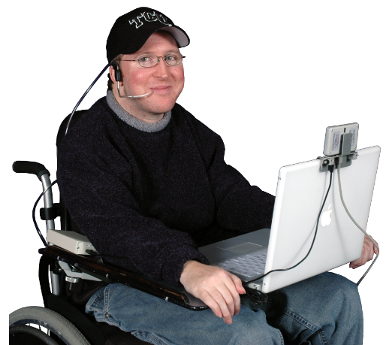
Existing Solutions
Alternative computer controllers
Mouthstick
Sip and Puff switch
Trackball mouse
Eyes tracking system
Introduction
Analysis
Recommendation
Implementation
Conclusion
Notes:
Li
Identifies competitive/alliance environment & organization’s competitive advantage

Slide 8
Problems
System not adaptable
Unfriendly user interface
Energy Consuming
Cost inefficient
Introduction
Analysis
Recommendation
Implementation
Conclusion
Notes:
Li
Describes root causes of problem and why current solutions are not effective
no further development - limited to one device (only computer)
Electronic pointing devices—used to control the cursor on the screen without use of hands. (cursor->unfriendly)
sip & puff, hard to use

Slide 9
Compatible
Beautiful Design
Potential for more
Universal
Ergonomics
Enhances quality of life
Amazing Usability
Cost Efficient
Realistic
Feasible
Notes:
Li
universal- device is compatible with a wide range of electronics, for example, tv, phones, or even home appliances
usability - since device can be used on many, user can regain control over their lives and the sense of independence
feasible - design is realistic, feasible, can be done by current tech

Slide 10
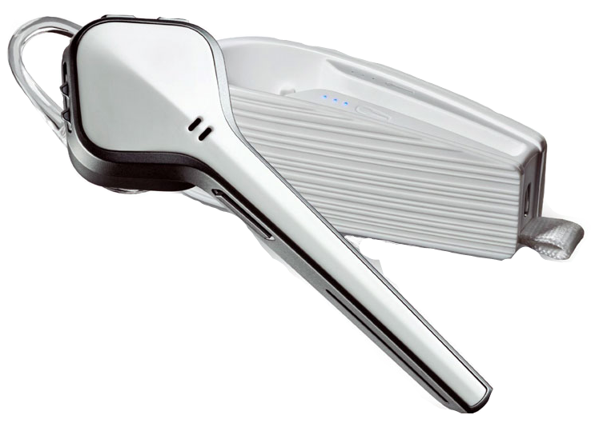

Our Innovation
EXO CONTROL
Notes:
Timo
One Piece headset, register head movement.
This is our major product… exo control and it is a device that ,,,, allows disabled people to have the opportunities to access the household electronics more easily.

Slide 11
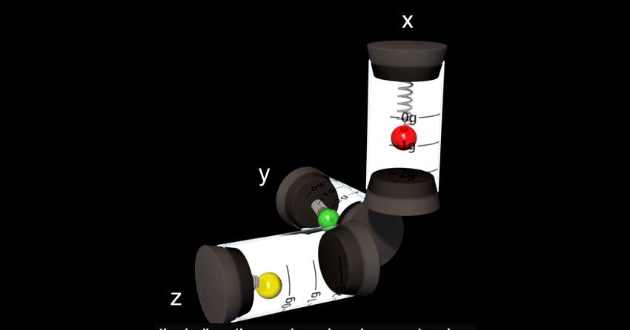
Accelerometer
Introduction
Analysis
Recommendation
Implementation
Conclusion
Notes:
Timo
special feature. Integrate accelerometer, allow them to use head motion as a command

Slide 12
Key Technologies
Voice/noise recognition
Bluetooth integration
Infrared control
Dynamic motion detection
Haptic feedback
Introduction
Analysis
Recommendation
Implementation
Conclusion
Notes:
Li

Slide 13
User Experience Walkthrough

Slide 14
*3 seconds puff* Turning on EXO...
[ON beep]
Connecting devices… connected
Welcome to EXO!
“TV On”
Turn on TV? *Puff to confirm*

Slide 15
E X O in TV Remote Mode
“Channels”
Channel mode? *Puff to confirm*
*Rotate head to change channels*
“Volume”
Volume mode? *Puff to confirm*
*Rotate head to change volumes*

Slide 16
*Double puff to main menu*
Main Menu
Please select TV or phone
“Phone”

Slide 17
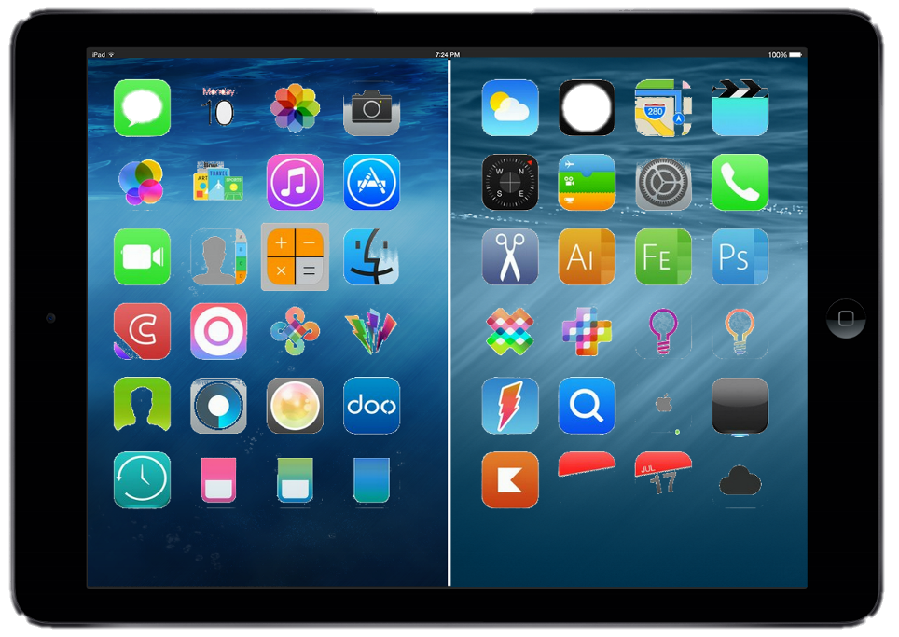
Notes:
Li

Slide 18
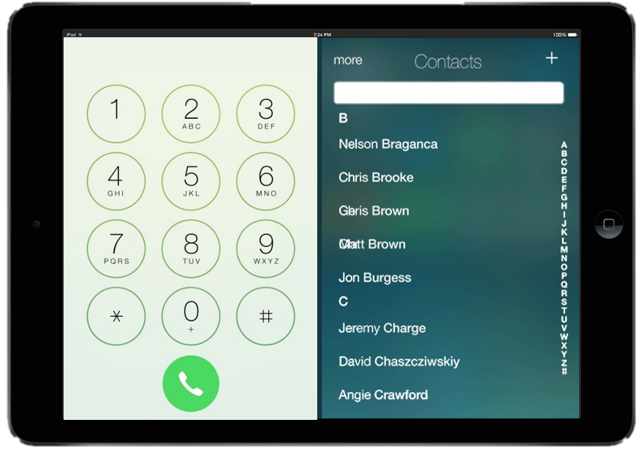
Notes:
Li

Slide 19
Accessibility Features
Personalized experience through calibration and customization
App store for developers = endless potential
Introduction
Analysis
Recommendation
Implementation
Conclusion
Notes:
Indicates why approach is fundable/attractive for investors/donors

Slide 20
Costs
Marketing: $30 000
Product manufacturing: $100
Bluetooth headset: $50 CAD
Accelerometer: $30 CAD
Other electronic materials: $20
Product development/servicing: In house -> Free!
Introduction
Analysis
Recommendation
Implementation
Conclusion
Notes:
Provides a detailed overview of start‐up costs

Slide 21
Income Streams
Sales profits
Donations
App commissions
Developer Kits
Introduction
Analysis
Recommendation
Implementation
Conclusion
Notes:
Demonstrates how donations/investments and/or revenues will sustain organization

Slide 22
Anticipated Challenges
Universal Adoption
Marketing
Introduction
Analysis
Recommendation
Implementation
Conclusion
Notes:
Describes barriers to success and solutions to anticipated challenges (funding,
-funding: production
-marketing: social media not effective, general public attention

Slide 23

Key Partnerships
Government
Funding for development
Subsidies
Healthcare facilities
Hackathons
Non-profit organizations
Introduction
Analysis
Recommendation
Implementation
Conclusion
Notes:
Describes how the intervention can be replicated & scaled
Describes barriers to success and solutions to anticipated challenges (funding,

Slide 24
KPIs
# of devices sold
# of Cities expanded to
# of government and non-profit partnerships
# of applications developed/compatible
# of applications downloaded
Introduction
Analysis
Recommendation
Implementation
Conclusion
Notes:
Outlines metrics that will be used to track the impact of the intervention

Slide 25
Team
Business
Design
Engineering
CEO
Amy Xiao, 20
CompSci | 1T7
CMO
Timothy Chan, 20
ECE | 1T7
CTO
Li Ting Wong, 20
ECE | 1T7
Introduction
Analysis
Recommendation
Implementation
Conclusion

Slide 26
Questions?

Slide 27
Appendix
280 000 | Persons with physical disabilities in Toronto (working age)
5% | EOY Market Penetration
$120 | Cost per device
$1 680 000 | EOY1 Revenue
$3 712 800 | EOY2 Revenue
$8 205 000 | EOY3 Revenue
$30 000 | Marketing costs
$1 400 000 | Manufacturing costs ($100/device)
$5000 | Licensing, patenting
$50 000 | Partnerships
$1 480 708 | Total Expenses
$194 290 | Net Income
Introduction
Analysis
Recommendation
Implementation
Conclusion

