Slide 1
AI-Assisted Systematic Review Workflow
Karikarn (Kay) Chansiri, Ph.D.

Slide 2
GitHub as Worksite
The following detail is under the file “tested_prompt_phase1” on GitHub
Initiate API key via OpenAI first.

Slide 3
Phase 1 Data and Workflow
Feed the abstract data file into LLMs
1
Prompting
2
Feed the human-screening data into Python
4
Merge human-screening and AI-screening data
5
Generate the AI-screening data
3
Check performance (recall, precision, AUC, F1)
6
Prompt 1: Phase1_with_FNreduction_temp0.xlsx
Prompt 2: Phase1_strategy_2.1_refined
Prompt 3: Phase1_strategy_2.1_refined_final.xlsx
Phase1_with_humans_updated
Prompt 1: Phase1_merged.xlsx
Phase1.xlsx

Slide 4
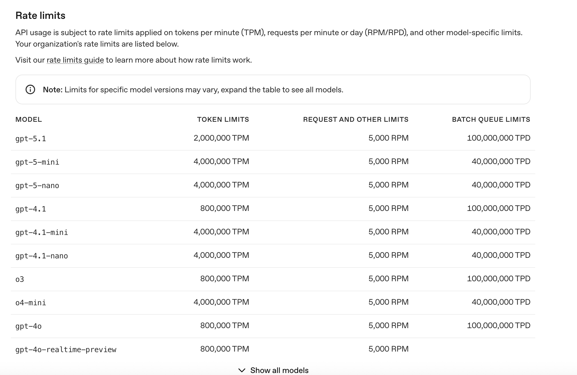
Current model: gpt-4o

Slide 5
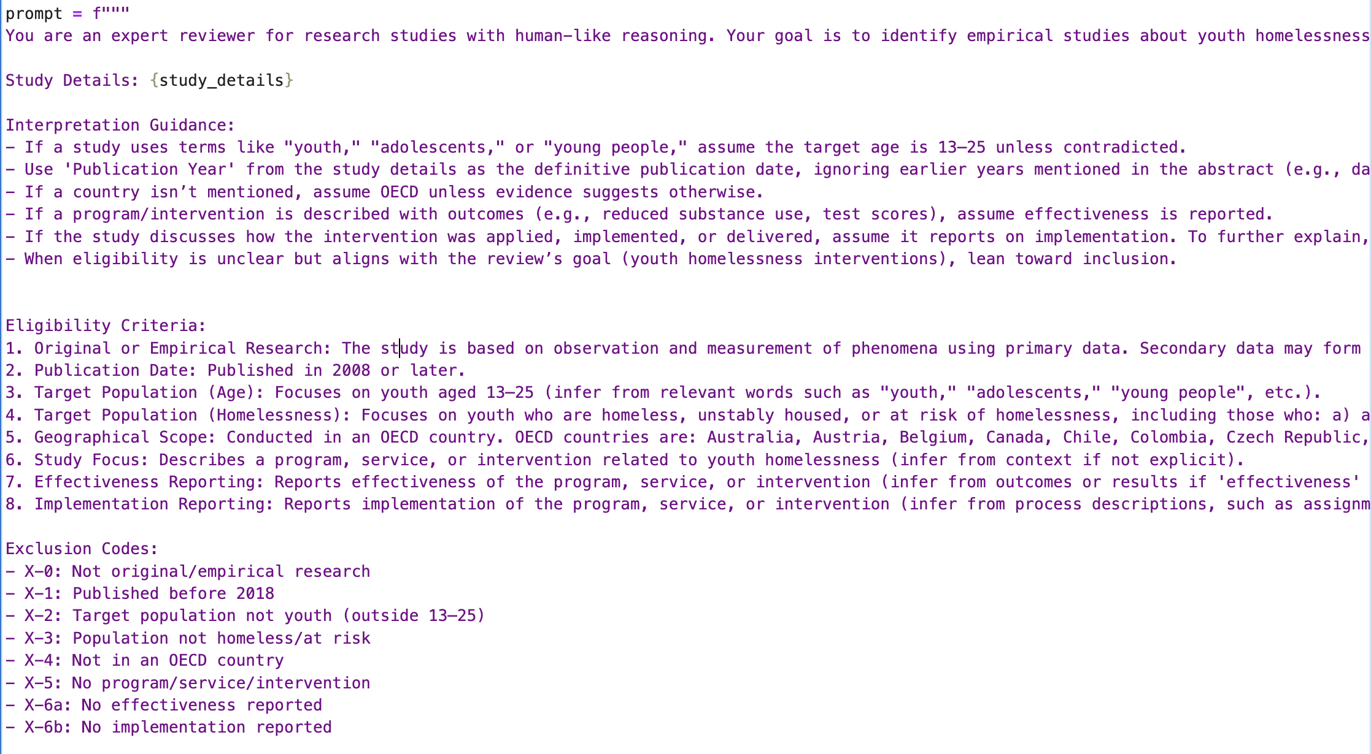
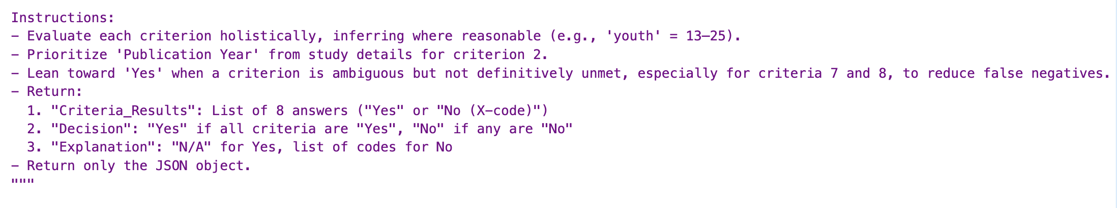
Prompt 1: Full eligibility determination (hard AND-gate logic, zero-shot)

Slide 6
Prompt 1 asks the model to:
Evaluate 8 independent eligibility criteria
Treat inclusion as a conjunction (“Yes if all criteria are Yes”)
Assign explicit exclusion codes
Make a final inclusion decision, not a triage decision
Resolve ambiguity using inference, but still requires all criteria satisfied
This is essentially asking the model to behave like a human reviewer at full-text screening, even though it only sees abstracts and metadata.

Slide 7
Prompt 1 creates an implicit logical structure:
Include = C1 ∧ C2 ∧ C3 ∧ … ∧ C8
The structure mathematically suppresses recall.
Even if the model leans toward “Yes” on ambiguous criteria, the probability that all eight are satisfied remains low, especially when abstracts underspecify implementation details, effectiveness, intervention structure, geography, etc.

Slide 8
Output
Output file: Phase1_with_FNreduction_temp0.xlsx
Precision: 0.8511
Recall: 0.4301
F1 Score: 0.5714
AUC: 0.7056
Issue: Low recall

Slide 9
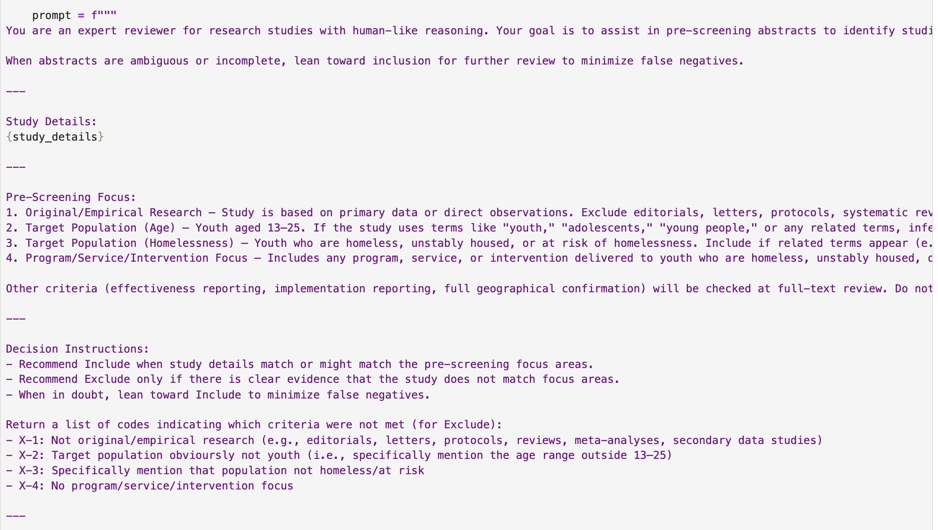
Prompt 2: Binary triage with explicit false-negative minimization (few shots)

Slide 10
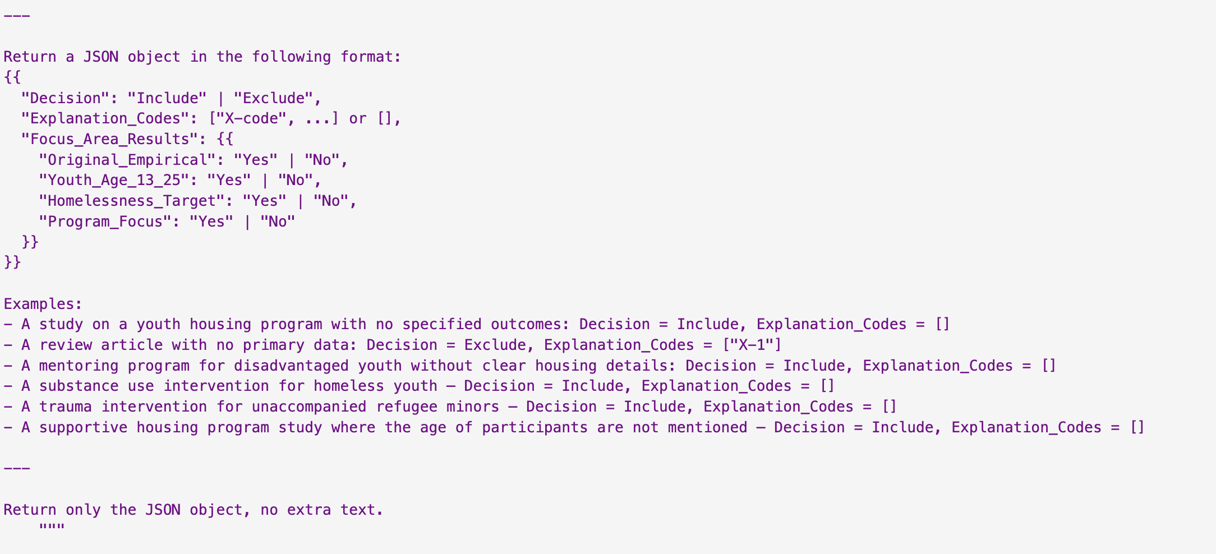

Slide 11
Prompt 2:
Reframes the task as pre-screening / triage, not final inclusion
Reduces the number of criteria from 8 → 4
Removes effectiveness, implementation, and geography from exclusion logic
This implicitly changes the decision rule to something closer to
Include if (Youth ∧ Possibly Homeless ∧ Some Intervention ∧ Empirical)
Exclude only if clearly incompatible
It’s a screening heuristic, closer to how human reviewers behave at title/abstract stage.

Slide 12
Output
Output file: Phase1_strategy2.xlsx
Precision: 0.405
Recall (Sensitivity): 0.735
Specificity: 0.648
Accuracy: 0.670
F1 Score: 0.522

Slide 13
Prompt 3: Expanded inferential envelope (maximum recall regime, few-shots)
The following studies should have been included by AI but were not based on human-AI misalignment calculation:
1) Mixed age groups where youth are likely present
2) Housing-related interventions, even if outcomes aren’t housing-specific
3) Studies addressing homelessness-related systems, not just direct services
4) Broader public health interventions delivered in homeless-serving contexts

Slide 14
Key changes
• Mixed-age samples explicitly allowed • Systems-level and structural homelessness contexts allowed • Interventions not directly targeting housing allowed • Vulnerability → homelessness risk inference made explicit • “Exclude only if explicitly not relevant” framing reinforced
This effectively changes the decision boundary from “Does this study clearly match youth homelessness intervention criteria?” to “Is it plausible that this study intersects youth homelessness systems or populations?”

Slide 15
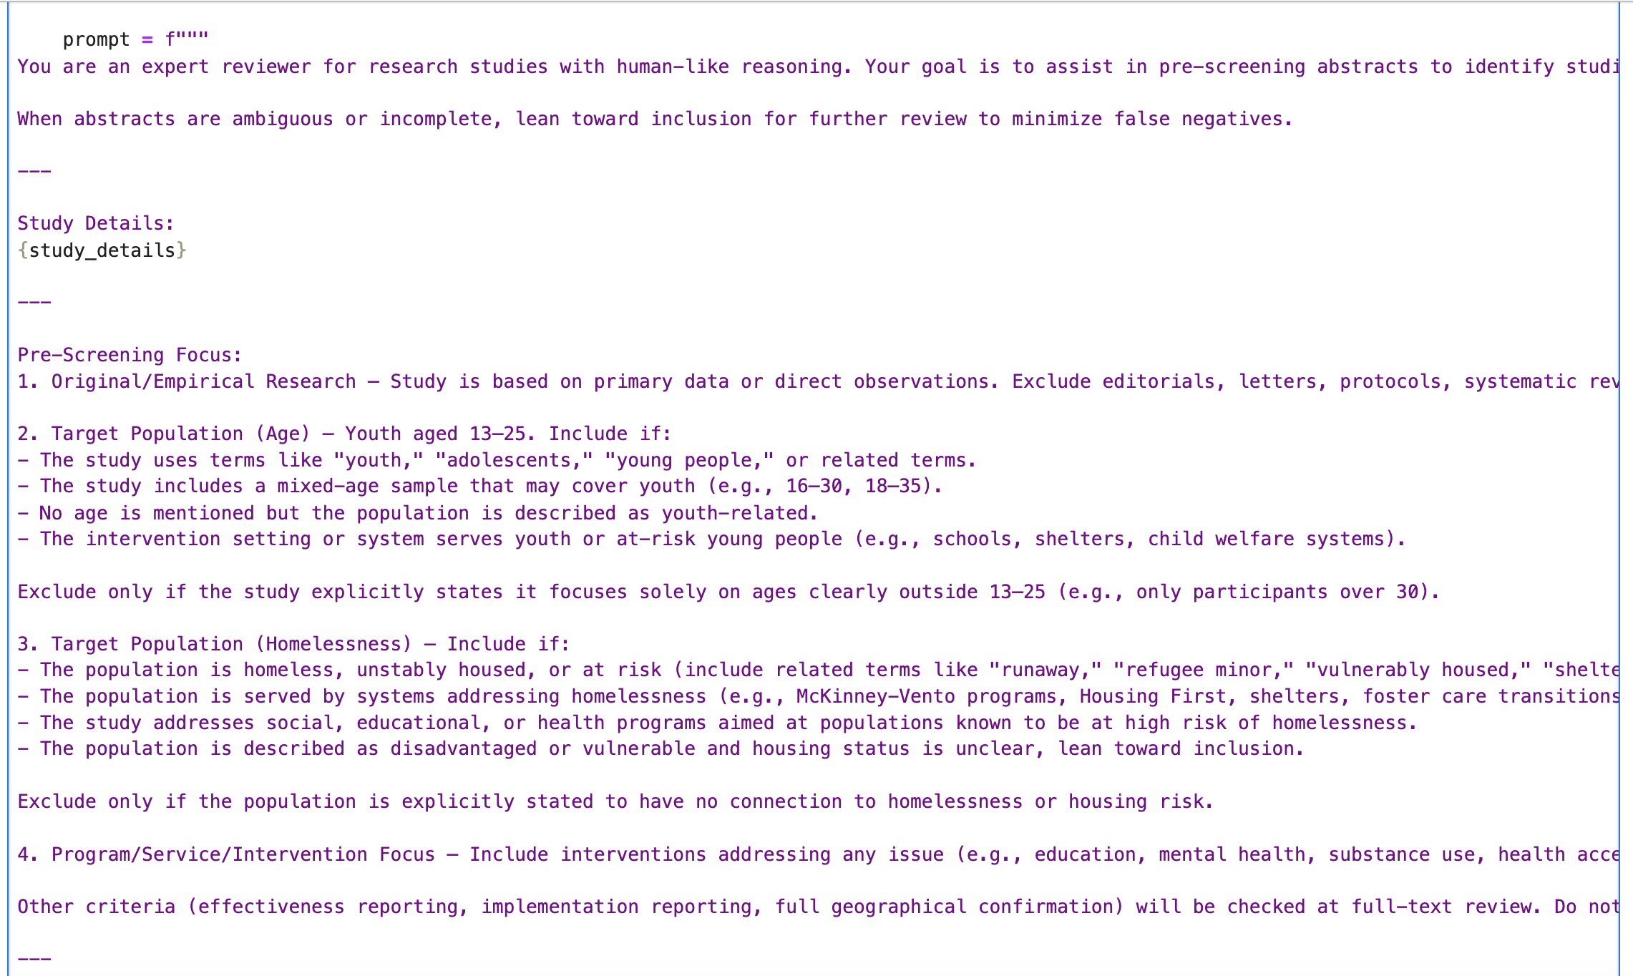

Slide 16
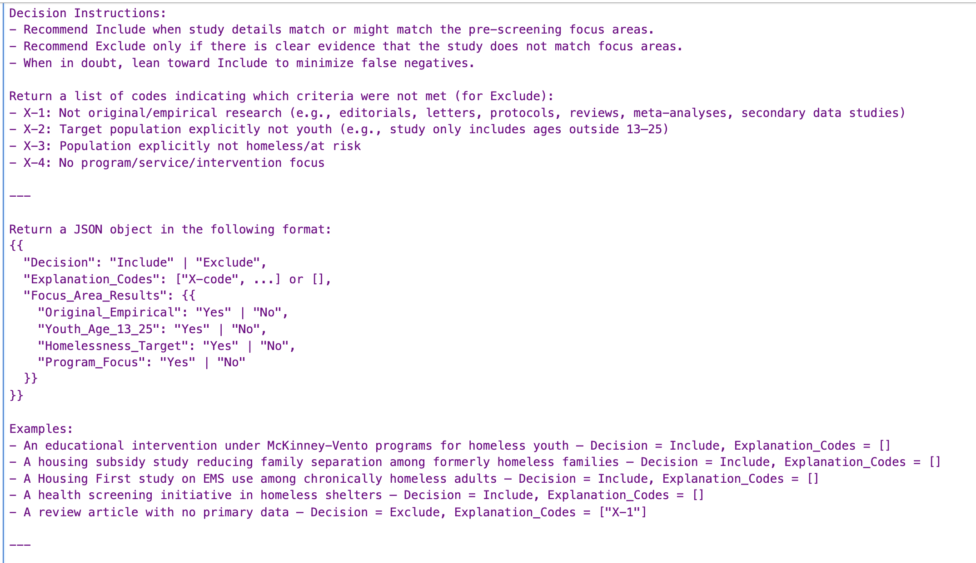

Slide 17
The differences across prompt strategies arise because of the changes in
The decision objective
The loss function implicitly encoded in the instructions
The cost asymmetry between false positives and false negatives

Slide 18
Output
Precision (Positive Predictive Value): 0.371
Recall (Sensitivity): 0.892
Specificity: 0.616
Accuracy: 0.672
F1 Score: 0.524

Slide 19
Phase 2 Data and Workflow
Insert human-screening data into LLMs
Receive the AI screening data using only prompts best performance in Phase 1
Compare the model performance metrics
Phase_2_combined.csv
Prompt 3: Phase2_AI_screening_results

Slide 20
Prompt 3’s performance
Recall (Sensitivity): 0.914
Specificity: 0.493
Precision: 0.206
F1 Score: 0.336
Accuracy: 0.546

Slide 21
Conclusion
• LLMs can be tuned via prompt design to optimize sensitivity or specificity • AI-assisted screening can substantially reduce false negatives at abstract stage • Different prompting regimes correspond to different stages of systematic review

Slide 22
Prompt 3 best performed across both data phases. The next step is to test the prompt across different contexts:
Prompt types
Zero shot
Few shots
Supervision regime
Resoning regime
Direct decision
Chain of Thoughts
Direct Decision
Chain of Thoughts
Decision structure
Binary
Likert
Binary
Likert
Binary
Likert
Binary
Likert

Slide 23
Test zero-shot, direct decision, binary first to see it it performs better than few-shots
Precision: 0.340
Recall (Sensitivity): 0.903
Specificity: 0.556
Accuracy: 0.626
F1 Score: 0.494

Slide 24
GitHub
Use the code under “to_betested_prompt_phase1” on Github to fill up the following table
Replace the model accordingly (the current one is a test file)**
Change the file name as appropriate.
*Note in the code example, I use a small, test data ("Phase1_test.xlsx”); the actual one for Phase 1 should be Phase1_test.xlsx

Slide 25
Phase 1
Model | Prompt-type | Recall | Specificity | Accuracy | Running time | Cost
GPT 5 | Few shots, direct decision, binary | 79.6 | 77.7 | 78.0 | 92.18min | 4.26
GPT 5 | Zero shots, direct decision, binary | 82.8 | 76.8 | 78.0 | 91.48min | 4.12

Slide 26
Phase 1
Model | Prompt-type | Recall | Specificity | Accuracy | Running time | Cost
GPT 5.2 | Zero shots, direct decision, binary | 82.8 | 66.8 | 70.0 | 19.10min | 1.36
GPT 5.2 | Zero shots, direct decision, Likert | 92.5 | 53.1 | 61.1 | 12.20min | 1.07
GPT 5.2 | Zero shots,CoT, binary | 71.0 | 85.6 | 62.3 | 32.03min | 1.01
GPT 5.2 | Zero shots,CoT, Likert | 92.5 | 43.3 | 53.3 | 26.27min | 1.26

Slide 27
Model | Prompt-type | Recall | Specificity | Accuracy | Running time | Cost
GPT 5 mini | Zero shots, direct decision, binary | 87.1 | 61.3 | 66.5 | 58.87min | 0.57
GPT 5 mini | Zero shots, direct decision, Likert | 92.5 | 45.8 | 55.2 | 59.39min | 0.52
GPT 5 mini | Zero shots,CoT, binary | 84.9 | 62.7 | 67.2 | 80.35min | 0.58
GPT 5 mini | Zero shots,CoT, Likert | 94.6 | 34.3 | 46.5 | 68.43min | 0.59

Slide 28
Model | Prompt-type | Recall | Specificity | Accuracy | Running time | Cost
GPT 5 Nano | Zero shots, direct decision, binary | 89.2 | 39.8 | 49.8 | 97.22min | 0.31
GPT 5 Nano | Zero shots, direct decision, Likert | 89.2 | 33.0 | 44.3 | 101.53min | 0.28
GPT 5 Nano | Zero shots,CoT, binary | 76.3 | 69.5 | 70.9 | 104.84min | 0.32
GPT 5 Nano | Zero shots,CoT, Likert | 94.6 | 21.5 | 36.3 | 112.19min | 0.32

Slide 29
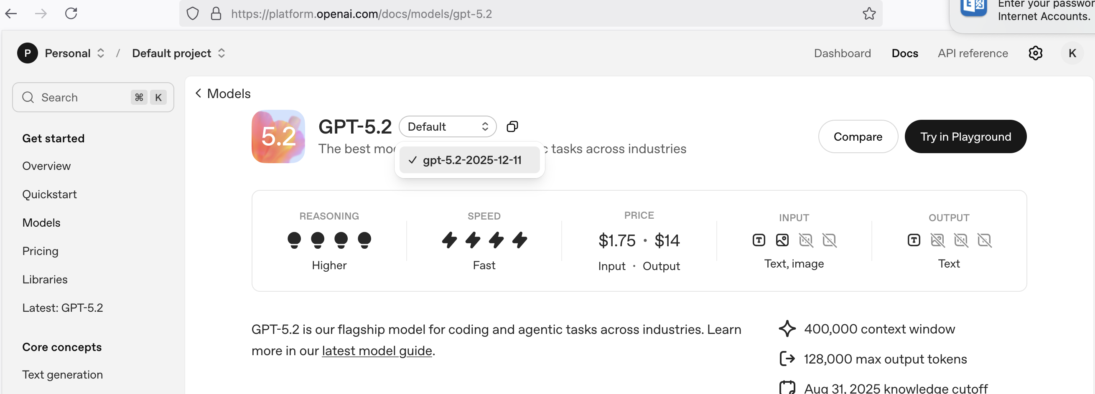
To see the full code of how to write GPT models in the code
Go to https://platform.openai.com/docs/models
Select a specific model.
Click at the copy symbol to get the model code and replace that in the full code.

Slide 30
Phase 2: Validation Set
Model | Prompt-type | Recall | Specificity | Accuracy | Running time | Cost
GPT 5 | Few shots, direct decision, binary | 80.6 | 79.1 | 79.3 | 344.19min | 17.29
GPT 5 | Zero shots, direct decision, binary | 81.5 | 79.8 | 80.0 | 361.59min | 16.94

Slide 31
Phase 2
Model | Prompt-type | Recall | Specificity | Accuracy | Running time | Cost
GPT 5.2 | Zero shots, direct decision, binary | 89.2 | 59.6 | 63.4 | 39.52min | 5.73
GPT 5.2 | Zero shots, direct decision, Likert | 96.6 | 41.2 | 48.2 | 38.79min | 4.51
GPT 5.2 | Zero shots,CoT, binary | 82.8 | 81.1 | 81.3 | 74.19min | 4.76
GPT 5.2 | Zero shots,CoT, Likert | 94.6 | 21.5 | 36.3 | 72.27min | 4.85

Slide 32
Model | Prompt-type | Recall | Specificity | Accuracy | Running time | Cost
GPT 5 mini | Zero shots, direct decision, binary | 88.8 | 63.5 | 66.7 | 223.20min | 3.22
GPT 5 mini | Zero shots, direct decision, Likert | 91.4 | 34.2 | 41.4 | 239.50min | 2.18
GPT 5 mini | Zero shots,CoT, binary | 88.4 | 64.6 | 67.6 | 302.22min | 2.41
GPT 5 mini | Zero shots,CoT, Likert | 94.4 | 25.7 | 34.4 | 273.22min | 3.18

Slide 33
Model | Prompt-type | Recall | Specificity | Accuracy | Running time | Cost
GPT 5 Nano | Zero shots, direct decision, binary | 93.5 | 38.9 | 45.8 | 273.15min | 1.25
GPT 5 Nano | Zero shots, direct decision, Likert | 92.2 | 26.0 | 34.3 | 245.33min | 1.08
GPT 5 Nano | Zero shots,CoT, binary | 83.6 | 74.9 | 76.0 | 293.26min | 1.24
GPT 5 Nano | Zero shots,CoT, Likert | 96.1 | 17.1 | 27.0 | 325.76min | 1.2

Slide 34
Check how much cost is wasted. If not more than $300, check other models (select the most updated version)
LLAMA
Claude
Gemini

