Slide 1
LLM Foundations I: From Natural Language Processing to Transformers

Slide 2
Course Website
https://kaychansiri.github.io/research-methods-in-the-age-of-ai/
The website is for accessing code used in class, lecture slides, and other supplementary materials.
Blackboard is still the main course platform for checking the class schedule, assignments, announcements, and other course information.

Slide 3
Readings
Readings will be posted on Blackboard before each course block.

Slide 4
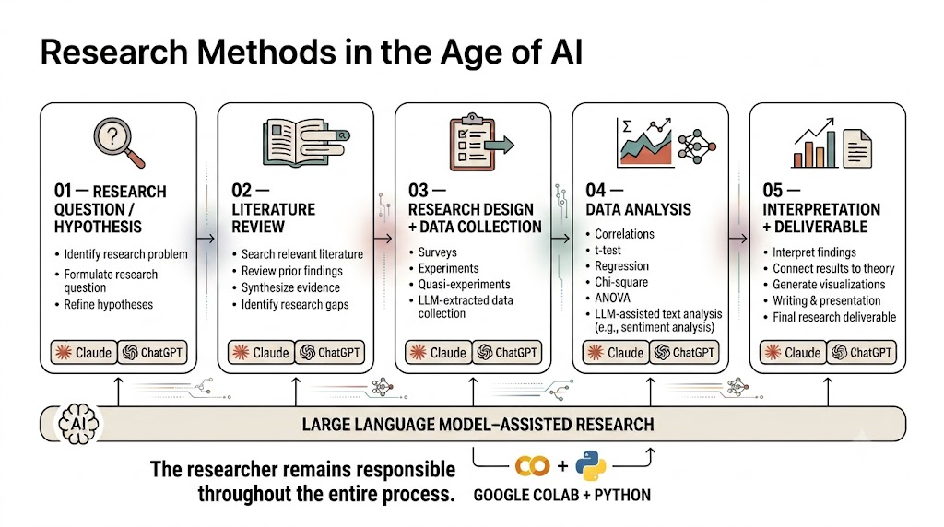
Last Class: What Did We Learn?
Research is a process, not just data analysis.
AI can support the entire research process.
LLMs are one type of AI tool we can use in research.
Python + Colab help us work with data and AI.
You are still the researcher — AI does not replace your judgment.

Slide 5
What Is AI?

Slide 6
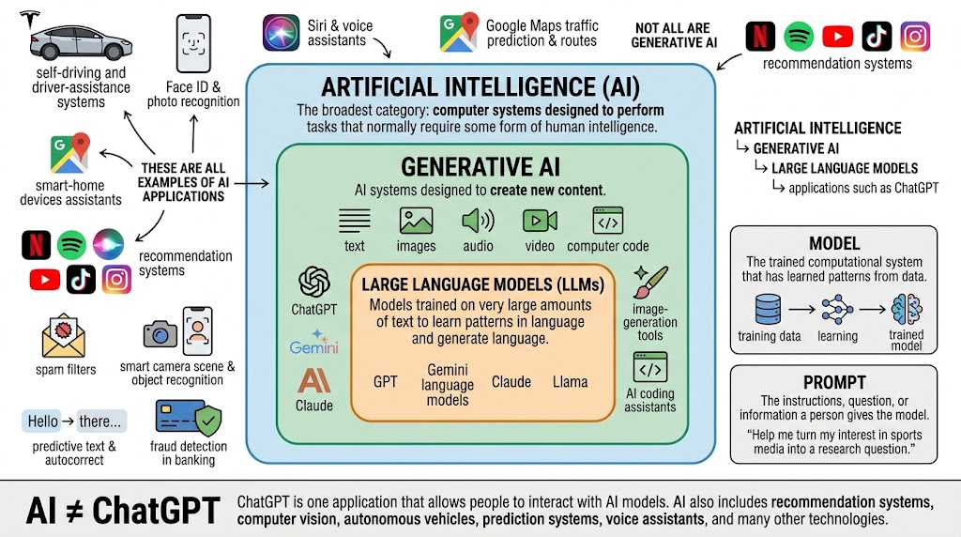

Slide 7
Why Study LLMs?
1. Potential research tool across the process
2. **Knowing the structure reveals the limitations**
3. Can help with text analysis

Slide 8
Let’s Use an LLM to Develop a Research Question
1. Think What are you curious about?
2. Ask ChatGPT Help me turn this idea into a research question.

Slide 9
From Natural Language (NLP) Processing to LLMs
What is NLP?
NLP is the part of AI that helps computers understand and work with human language in text or speech

Slide 10
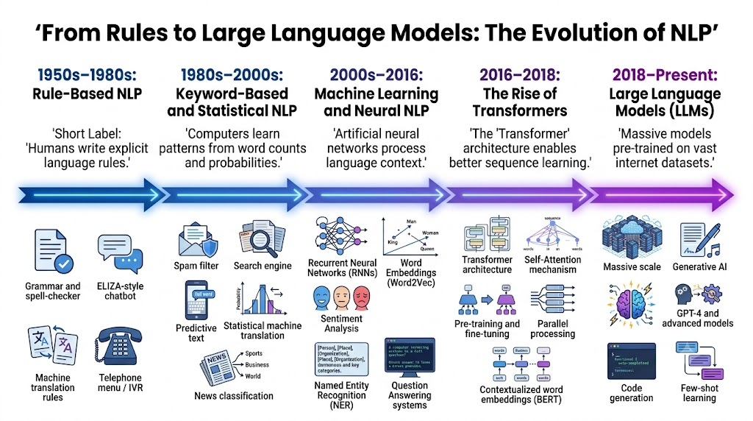

Slide 11
From NLP to LLMs
 | NLP (earlier) | LLMs (current)
Goal | Understand, interpret, generate language | Same goal, much broader scope
Examples | Sentiment analysis, named entity recognition, machine translation | GPT, Claude, LLaMA
Training | Task-specific | Massive, general-purpose
Flexibility | One task per model | Many tasks, minimal retraining
Speed | Slow, process one word at a time, bad at long-range processing | Process all words simultaneously

Slide 12
Vocabulary You'll Need Before We Go Further
Term | Very simple meaning
AI | The broad idea of computers doing tasks that seem “smart”
Generative AI | AI that creates something new, such as text, images, audio, or video
LLM | A type of generative AI that works mainly with language
Model | The trained AI system doing the work
Transformer | The basic technology behind many modern LLMs
Training data | The information the model learns from
Token | A small piece of text the model works with
Model size | Roughly, how big the model is based on how much it has learned internally

Slide 13
How LLMs Work: Training Time vs. User Time
Training time: the model learns language patterns from large collections of text.
User time: you type a prompt, and the model uses learned patterns to generate a response.
The model does not “look up” one answer. It predicts likely language based on patterns.

Slide 14
1. Training Time: Learning From Text
Text from many sources is broken into smaller pieces called tokens.
The model learns which tokens tend to appear near each other.
It also learns broader patterns: topics, writing styles, arguments, examples, and associations.
These patterns are stored as numbers inside the model.

Slide 15
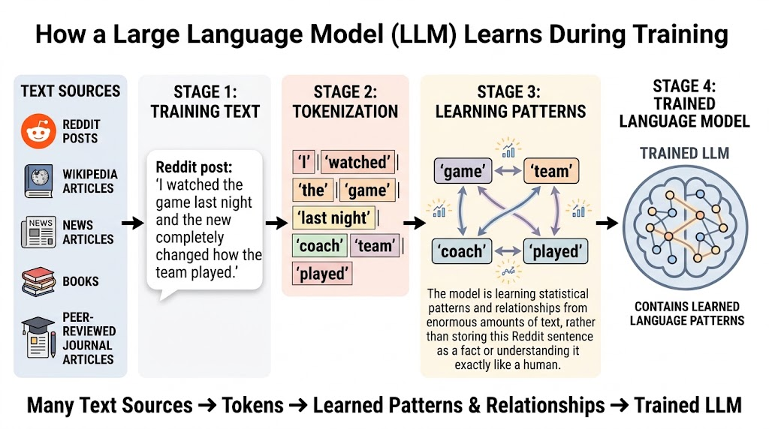

Slide 16
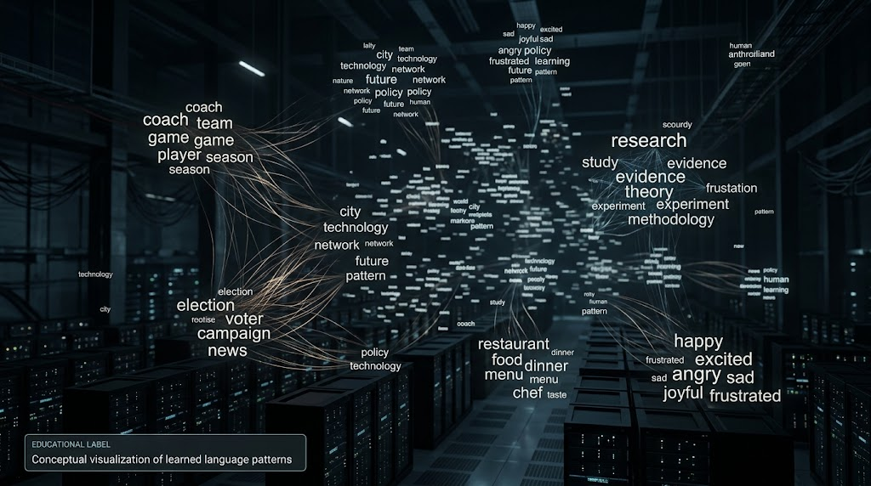
Trained LLM

Slide 17
2. User Time: From Prompt to Response
You enter a prompt.
The prompt is also broken into tokens.
The model processes those tokens using the patterns and relationships it learned during training.
It generates a response one token at a time.

Slide 18
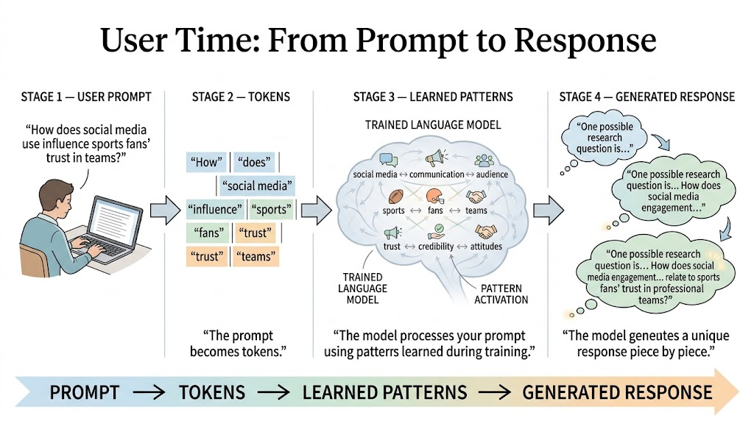

Slide 19
Why Different Prompts Give Different Outputs
Changing words changes the pattern the model follows.
More specific prompts usually guide the model better.
Different users may receive different outputs because they provide different context.
This is why researchers must evaluate the output.

Slide 20
What We Learned
AI can help turn a broad interest into a researchable question.
But the human researcher decides whether the question is clear, meaningful, and feasible.
Better input usually leads to better output.
AI assistance is useful, but not the same as methodological judgment.

Slide 21
What We Are Not Memorizing Today
You do not need to memorize equations.
You do not need to become an AI engineer.
You only need to understand the basic logic: text → tokens → patterns → generated response

Slide 22
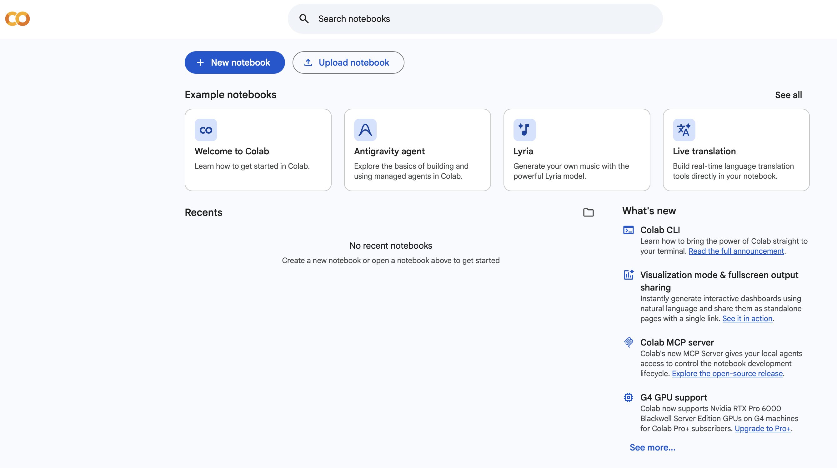
Assignment 1 (Due Next Tuesday)
Go to colab.research.google.com
Sign in with your Google account
Click "New Notebook"
You'll see an empty gray box — that's a code cell
Take a screenshot of your Colab window
Upload the screenshot to BlackBoard

Slide 23
Next: Inside the Transformer

