Slide 1
Fundamental Research Design:
Research Questions, Hypotheses, Variables, and Surveys
BLOCK 2 • DAY 1 • STARTING FROM THE BASICS
JOUR 701 • Block 2 • Fundamental Research Design

Slide 2
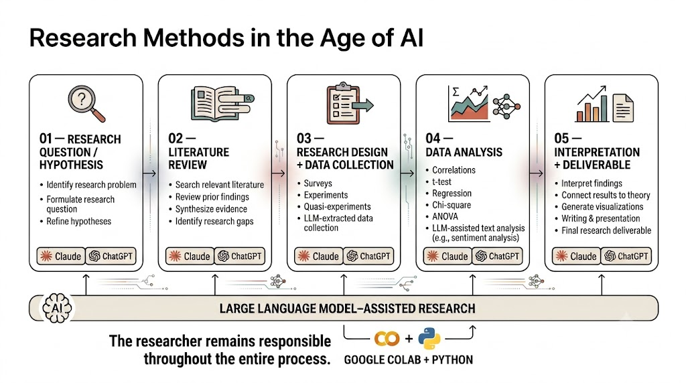

Slide 3
What is a research question?
A research question states exactly what the study wants to find out.
It should be specific enough that you can imagine collecting evidence for it.
It usually tells us WHO or WHAT we care about.
It often identifies something we want to describe, compare, or connect.
A good research question is answerable with data.
JOUR 701 • Block 2 • Fundamental Research Design

Slide 4
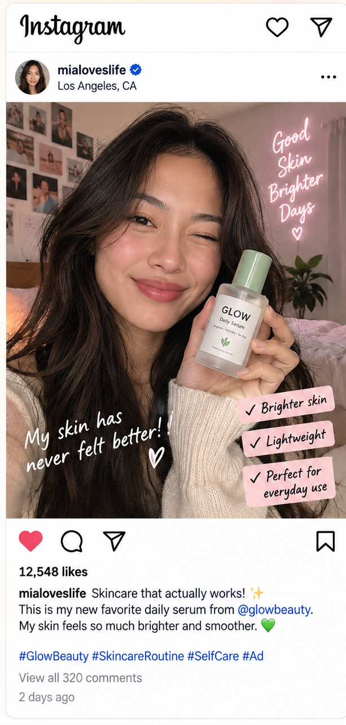
A skincare brand paid for this post.
What might the brand want to KNOW?
Think → pair → share
What would you want to know? What evidence could answer it?
JOUR 701 • Block 2 • Fundamental Research Design

Slide 5
A topic is not yet a research question
Topic: Influencer marketing
RQ: Does seeing an #Ad disclosure change how credible an influencer seems?
Topic: Sports journalism
RQ: Do fans perceive athlete-written posts as more authentic than team-written posts?
Topic: Crisis PR
RQ: Is a CEO video apology associated with greater company trust than a written apology?
Topic: Advertising
RQ: How does humor in a social-media ad relate to purchase intention?
JOUR 701 • Block 2 • Fundamental Research Design

Slide 6
Quick check: topic or research question?
Call out TOPIC or RESEARCH QUESTION.
1. Instagram influencers
2. Does influencer expertise relate to followers’ trust in a sponsored post?
3. Sports media
4. How often do college sports fans get game updates from social media?
5. Crisis communication
JOUR 701 • Block 2 • Fundamental Research Design

Slide 7
Three beginner-friendly kinds of research questions
DESCRIBE
How often do college students use TikTok for news?
RELATE
Is TikTok news use related to perceived news credibility?
COMPARE
Do people rate video apologies as more sincere than text apologies?
JOUR 701 • Block 2 • Fundamental Research Design

Slide 8
What is a hypothesis?
A hypothesis is a specific prediction about what you expect to find.
It usually predicts a relationship or a difference.
It should be testable with the data you plan to collect.
A hypothesis comes from prior research, theory, or a reasoned expectation—not just a random guess.
Research question = asks. Hypothesis = predicts.
JOUR 701 • Block 2 • Fundamental Research Design

Slide 9
Same study: research question vs. hypothesis
RQ
Do people rate influencer posts with #Ad as less authentic than posts without #Ad?
H1
People who see the #Ad version will report lower authenticity than people who see the no-#Ad version.
RQ
Is social-media sports use related to fan engagement?
H1
More frequent social-media sports use will be associated with higher fan engagement.
JOUR 701 • Block 2 • Fundamental Research Design

Slide 10
Research Question vs. Hypothesis
 | Research Question | Hypothesis
Purpose | Asks what we want to know | Predicts what we expect to find
Form | Usually a question | Usually a statement
Direction? | May be open-ended | Often predicts direction/difference
Example | Does message tone relate to trust? | A warmer tone will be associated with greater trust.
Always needed? | Yes: every study needs a clear question | No: not every study needs a hypothesis
JOUR 701 • Block 2 • Fundamental Research Design

Slide 11
When should I use an RQ? When should I use a hypothesis?
Use an RQ when you are asking what happens, how often, whether things are related, or whether groups differ.
Use a hypothesis when you have a reasonable basis to predict the direction of the result.
Descriptive studies often use RQs without hypotheses.
Exploratory studies may use RQs because the expected pattern is not yet clear.
A study can have BOTH: an RQ states the question; a hypothesis states the predicted answer.
Do not invent a hypothesis just because you think every paper needs one.
JOUR 701 • Block 2 • Fundamental Research Design

Slide 12
RQ or hypothesis?
For each statement, decide: RQ or HYPOTHESIS?
1. Does an AI-generated label affect perceived ad credibility?
2. Ads labeled AI-generated will receive lower credibility ratings than unlabeled ads.
3. How often do students follow sports journalists on social media?
4. Fans who follow more sports journalists will report greater knowledge of team news.
JOUR 701 • Block 2 • Fundamental Research Design

Slide 13
What makes RQs and hypotheses researchable? VARIABLES
Look at: “Is seeing an #Ad label related to how authentic an influencer seems?”
Two things can differ:
#Ad disclosure: #Ad label present. #Ad label not present
Perceived authenticity: People may perceive the influencer as more or less authentic. We could measure this with an authenticity rating
These changing characteristics are called variables.
Variable 1: #Ad disclosure
Variable 2: Perceived authenticity
Variables are the building blocks that turn a research question into something we can measure and study.
If nothing can vary, there is nothing to measure or compare.
JOUR 701 • Block 2 • Fundamental Research Design

Slide 14
What is a variable?
A variable is a characteristic that can take different values across people, posts, messages, organizations, or situations.
For example, Platform can be Instagram, TikTok, YouTube, or X.
Number of likes can be 0, 10, 500, or 50,000.
Trust can be low, medium, or high—or measured on a rating scale.
#Ad disclosure can be present or absent.
Variable = something that can vary.
JOUR 701 • Block 2 • Fundamental Research Design

Slide 15
Find the variables
RQ: “Do fans perceive player-created sports posts as more authentic than team-created posts?”
1. What is the first thing that varies?
2. What is the outcome that varies?
3. What values could each variable take?
4. Could we record those values in a dataset?
JOUR 701 • Block 2 • Fundamental Research Design

Slide 16
Types of Variables: categorical vs. numeric
CATEGORICAL
Values tell us which group/category. Example: platform = Instagram / TikTok / YouTube.
NUMERIC / QUANTITATIVE
Values represent an amount or quantity. Example: number of comments = 0, 12, 245.
JOUR 701 • Block 2 • Fundamental Research Design

Slide 17
Types of Variables
CATEGORICAL
Categories / labels
NUMERIC
Amounts / quantities
Nominal
Categories with NO natural order
Ordinal
Categories with a meaningful order
Interval
Numbers have equal spacing, but zero does not mean “none.”
Ratio
Numbers have equal spacing AND a true zero—zero means none of that quantity.
JOUR 701 • Block 2 • Fundamental Research Design

Slide 18
1. Nominal variables: categories with no natural order
The values are names or labels.
There is no meaningful “higher” or “lower” category.
Social platform: Instagram / TikTok / YouTube / X
Content format: video / image / carousel
Sports beat: football / basketball / baseball
#Ad disclosure: yes / no
Nominal asks: WHICH category?
JOUR 701 • Block 2 • Fundamental Research Design

Slide 19
2. Ordinal variables: categories with an order
The values can be ranked from lower to higher.
But the distance between categories is not guaranteed to be equal.
Brand reputation: Poor / Fair / Good / Excellent
Frequency category: Never / Rarely / Sometimes / Often / Always
Agreement item: Strongly disagree → Strongly agree
Ordinal asks: WHICH level or rank?
JOUR 701 • Block 2 • Fundamental Research Design

Slide 20
3. Interval variables: equal numerical intervals, but no true zero
The difference between 10 and 20 represents the same amount as the difference between 20 and 30.
But zero does NOT mean the complete absence of the thing.
Classic example: temperature in °F or °C.
Interval variables are less common in everyday communication examples than nominal, ordinal, or ratio variables.
Interval = equal spacing; zero is not “none.”
JOUR 701 • Block 2 • Fundamental Research Design

Slide 21
4. Ratio variables: equal intervals + a true zero
Zero means none of the quantity is present.
Number of Instagram comments: 0 really means no comments.
Video viewing time: 0 seconds means no viewing time.
Number of followers: 0 means no followers.
Number of articles shared: 0 means none shared.
Ratio = equal spacing + meaningful zero.
JOUR 701 • Block 2 • Fundamental Research Design

Slide 22
Put the four levels together
Level | Broad family | Easy question | Communication example | Example values
Nominal | Categorical | Which category? | Primary social platform | Instagram / TikTok / YouTube
Ordinal | Categorical | Which ordered level? | Frequency of checking sports news | Never / Rarely / Sometimes / Often / Always
Interval | Numeric | How much, equal spacing, no true zero? | Temperature at outdoor PR event | 50°F / 60°F / 70°F
Ratio | Numeric | How much, with a true zero? | Number of comments | 0 / 5 / 200
JOUR 701 • Block 2 • Fundamental Research Design

Slide 23
What about 1–5 or 1–7 ratings?
Example: “How credible is this post?” 1 = Not at all credible → 7 = Extremely credible.
A single Likert-type item is technically ORDINAL: the response options have an order.
The numbers are labels for ordered response categories; we should not automatically assume equal psychological distance between every point.
Researchers often combine multiple related items into a scale and may analyze the resulting score as approximately continuous.
For this class: first identify what the response options actually mean.
A number printed beside a response option does not automatically make the variable ratio or interval.
JOUR 701 • Block 2 • Fundamental Research Design

Slide 24
Variable classification challenge
Classify each as nominal, ordinal, interval, or ratio.
1. Platform used most: Instagram / TikTok / YouTube
2. Agreement: Strongly disagree → Strongly agree
3. Number of likes on a post
4. Seconds spent watching a TikTok
5. Temperature during an outdoor football press conference
JOUR 701 • Block 2 • Fundamental Research Design

Slide 25
A variable name is not enough: make it measurable
Variable: “engagement” — what exactly does that mean?
Could mean number of likes.
Could mean number of comments or shares.
Could mean click-through rate.
Could mean seconds spent viewing.
Could mean a self-report rating of attention or involvement.
Measurement = deciding exactly how an idea will be represented by observable data.
JOUR 701 • Block 2 • Fundamental Research Design

Slide 26
What is Measurement?
Measurement = deciding how we will turn a variable into data we can actually record.
VARIABLE
Trust in an influencer
“Trust” is an idea.
We cannot put the idea itself directly into a dataset.
MEASURE IT
“I trust this influencer.”
1 = Strongly disagree
↓
7 = Strongly agree
DATA
2 5 6
4 7 3
Now each participant has a recorded value.
JOUR 701 • Block 2 • Fundamental Research Design

Slide 27
One concept can be measured in different ways
TRUST
Single 1–7 rating • multiple survey items • willingness to rely on source
ENGAGEMENT
Likes • comments • shares • viewing time • self-reported involvement
PURCHASE INTENTION
1–7 likelihood rating • click on “Shop Now” • choice between products
NEWS USE
Minutes per day • days per week • platform frequency categories
JOUR 701 • Block 2 • Fundamental Research Design

Slide 28
Common measurements in communication research
Category choice
Which platform do you use most? Instagram / TikTok / YouTube / Other
Yes / No
Did you notice the #Ad disclosure? Yes / No
Likert-type agreement
“I trust this influencer.” Strongly disagree → Strongly agree
Rating scale
How credible is this story? 1 = Not at all → 7 = Extremely
Frequency
Never / Rarely / Sometimes / Often / Always
Behavioral / digital measure
Clicks • shares • comments • viewing time
JOUR 701 • Block 2 • Fundamental Research Design

Slide 29
Measurement choices create variable types
Question / measure | Recorded values | Variable level
Which platform do you use most? | Instagram / TikTok / YouTube | Nominal
How often do you check team news? | Never → Always | Ordinal
How credible is this post? | 1–7 ordered rating | Ordinal (single item)
How many comments did the post receive? | 0, 1, 2, 3... | Ratio
How long did the person watch? | 0.0, 3.4, 18.7 sec | Ratio
JOUR 701 • Block 2 • Fundamental Research Design

Slide 30
You have a research question and measurement. Now what?

Slide 31
For example:
RQ: Does seeing an #Ad disclosure change how credible an influencer seems?
• Has someone already studied this?
• What did previous studies find?
• What do we still NOT know?
• Does our question add something new?
Literature review = finding, reading, and synthesizing previous research related to your research question.
JOUR 701 • Block 2 • Fundamental Research Design

Slide 32
What Does a Literature Review Actually Do?
1. Shows what we already know
What have researchers already found about #Ad disclosures, credibility, authenticity, or purchase intention?
2. Shows how others studied it
Who did they study? What questions or measures did they use? Instagram, TikTok, or another platform?
3. Finds the gap
Maybe prior work studied adults but not college students, Instagram but not TikTok, or found conflicting results.
4. Helps design our study
The literature helps refine the RQ, identify variables, develop hypotheses, choose measures, and select a design.
A literature review connects YOUR question to what researchers already know.
JOUR 701 • Block 2 • Fundamental Research Design

Slide 33
From Research Question → Literature → Study
1. RESEARCH QUESTION
Does #Ad disclosure affect influencer credibility?
2. SEARCH LITERATURE
influencer marketing • #Ad • disclosure • credibility
3. WHAT DO WE KNOW?
What has been found? What measures were used? What is missing?
4. REFINE STUDY
Variables + hypothesis
5. DESIGN
Survey? Experiment? Another design?
RQ → Literature Review → Variables & Hypothesis → Measurement → Research Design → Data
JOUR 701 • Block 2 • Fundamental Research Design

Slide 34


Slide 36
Research design helps us to think about how to collect variables
What does “research design” mean?
Research starts with a question. We decide what evidence would help answer the question.
We decide what information must be collected.
We decide who or what we will collect it from.
Research design is the PLAN connecting the question to the evidence.
Question → evidence needed → plan to collect evidence (RESEAECH DESIGN) → answer
JOUR 701 • Block 2 • Fundamental Research Design

Slide 37
Survey is a research design; it’s one way to collect variables
A survey asks people a standardized set of questions.
Surveys are especially useful for attitudes, beliefs, perceptions, intentions, self-reported behaviors, and demographics.
A survey can include nominal, ordinal, and numeric variables in the same questionnaire.
Survey is a RESEARCH DESIGN AND A DATA-COLLECTION METHOD; what you can conclude depends on the overall design.
Survey question → response → variable value → dataset
JOUR 701 • Block 2 • Fundamental Research Design

Slide 38
Example: A tiny social-media survey
Platform — nominal
Which platform do you use most? Instagram / TikTok / YouTube / X / Other
Frequency — ordinal
How often do you get news from social media? Never → Always
Credibility — ordinal item
This news post is credible. Strongly disagree → Strongly agree
Behavior — ratio
How many news posts did you share in the past 7 days? ___
Exposure — nominal
Have you seen this campaign before? Yes / No
Viewing time — ratio
How many minutes per day do you estimate using TikTok? ___
JOUR 701 • Block 2 • Fundamental Research Design

Slide 39
Good survey questions are boring—in a good way
Clear: Participants should interpret the question similarly.
Specific: define the time period when needed.
Neutral: do not push respondents toward an answer.
One idea at a time: avoid double-barreled questions.
Response options should match the question and cover reasonable answers.
Good measurement is more important than clever wording.
JOUR 701 • Block 2 • Fundamental Research Design

Slide 40
Bad question → better question
BAD: “How amazing was this ad?”
BETTER: “How favorable is your overall evaluation of this ad?” 1 = Very unfavorable → 7 = Very favorable
BAD: “How trustworthy and likable is this influencer?”
BETTER: Ask trust and likability as separate items.
BAD: “Do you use TikTok a lot?”
BETTER: “On a typical day, about how many minutes do you spend on TikTok?”
BAD: “Don’t you agree the CEO gave a sincere apology?”
BETTER: “The CEO’s apology seemed sincere.” Strongly disagree → Strongly agree
JOUR 701 • Block 2 • Fundamental Research Design

Slide 41
Activity: build a study from this post
1. Write ONE research question about this post.
2. Identify the variable(s) in your RQ.
3. Classify each variable: nominal / ordinal / interval / ratio.
4. Decide exactly how each variable will be measured.
5. If appropriate, write a hypothesis.
6. Write TWO survey questions that would collect the data.
JOUR 701 • Block 2 • Fundamental Research Design

Slide 42
The fundamental research-design chain
RQ
What do we want to know?
H
What do we expect?
VARIABLES
What can vary?
MEASUREMENT
How does each become data?
SURVEY
How can we collect the values?
JOUR 701 • Block 2 • Fundamental Research Design

