Slide 1
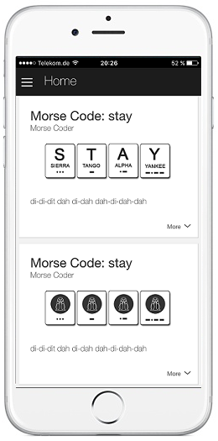

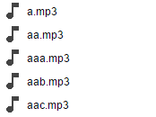
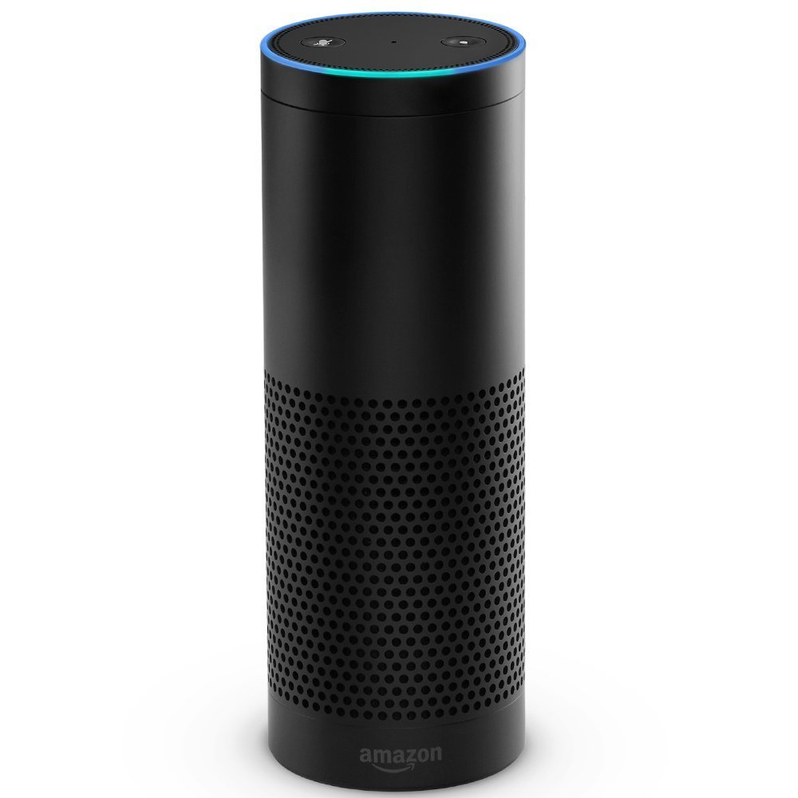



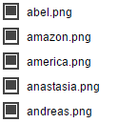
6
S3 Bucket
Audio-Files
1
2
3
6
5
4
Morse
Coder Skill
AWS
Lambda
AWS
S3
S3 Bucket
Image-Files

