Slide 1
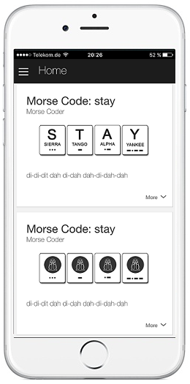



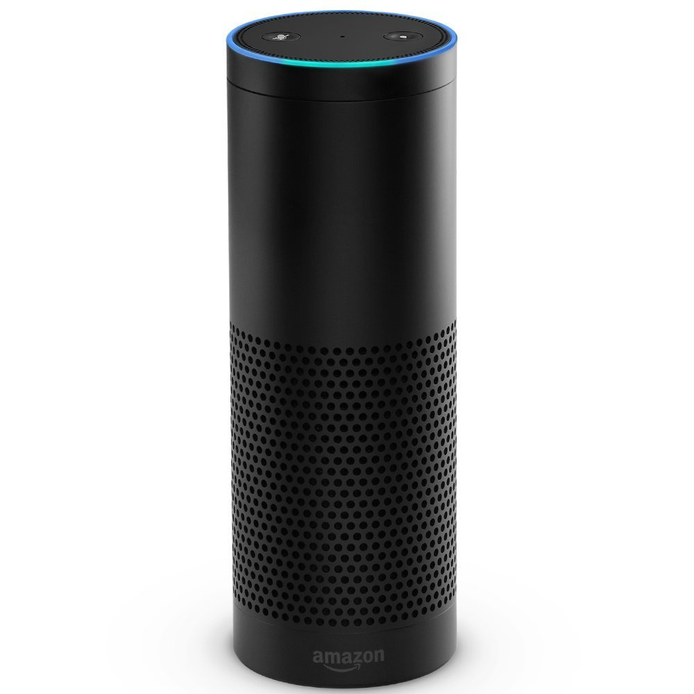




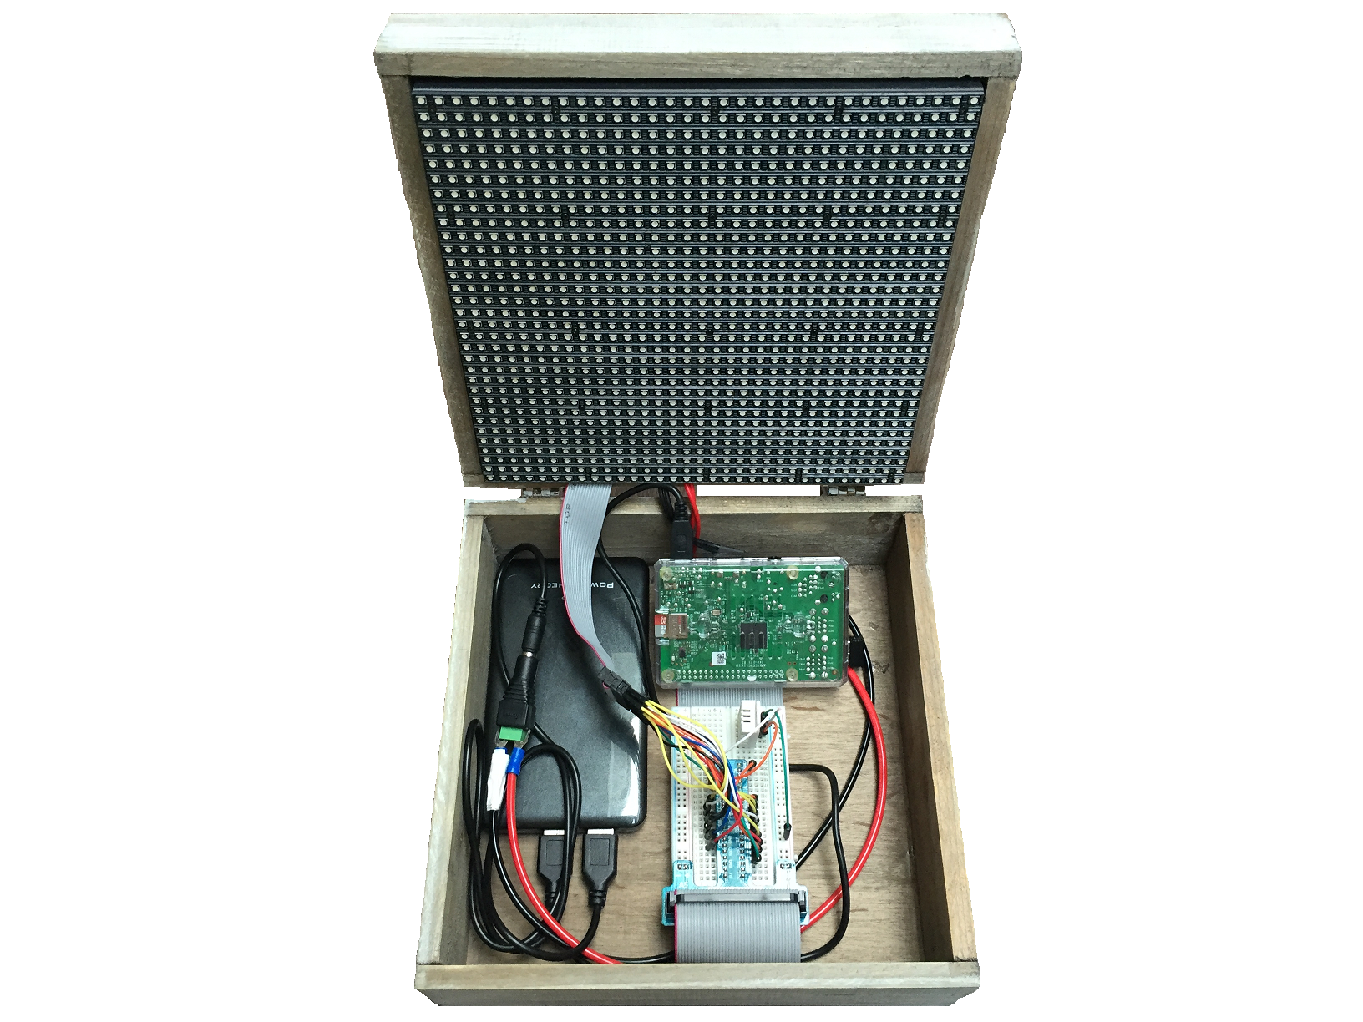


9
User Data
AWS
DynamoDB
S3 Bucket
Audio-Files
1
2
3
4
9
8
6
5
Morse
Coder Skill
AWS
Lambda
AWS
EC2
AWS
S3
S3 Bucket
Image-Files
7
MQTT
Topic
AWS
IoT

