Slide 1
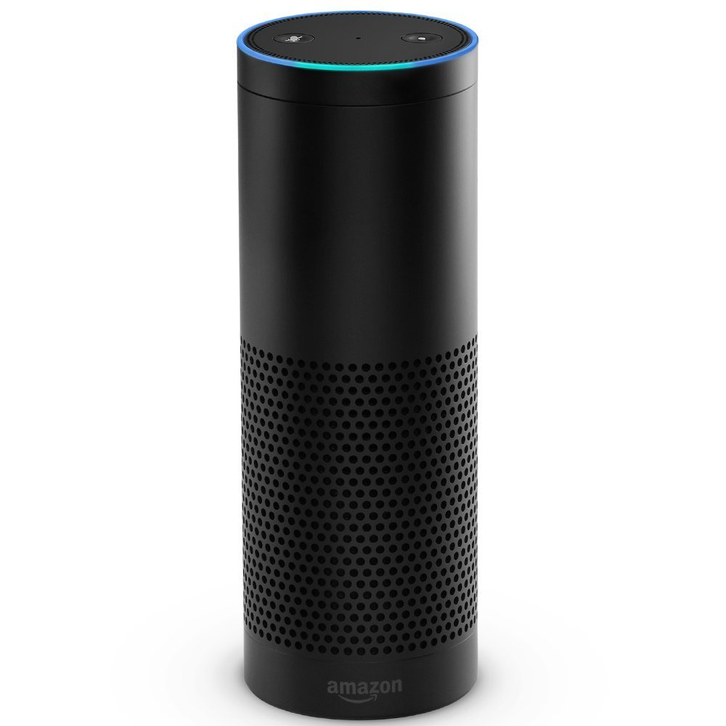



1
2
3
9
8
Rockets
“My rockets” Alexa skill
AWS
Lambda
AWS
IoT
7
4
5
6
Raspberry Pi
RF Transmitter
Remote Firing System

