Slide 1
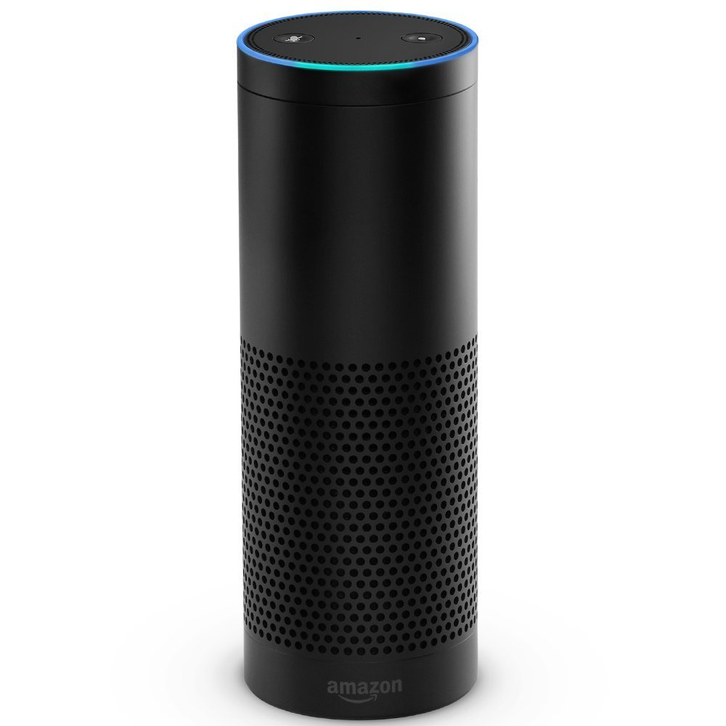




3
1
6
4
5
Your Alexa Skill
Your Skill Lambda
Test Lambda
AWS CloudWatch
AWS SNS Subscription
2
AWS
S3
S3 Bucket
Test-Scripts

