Slide 1
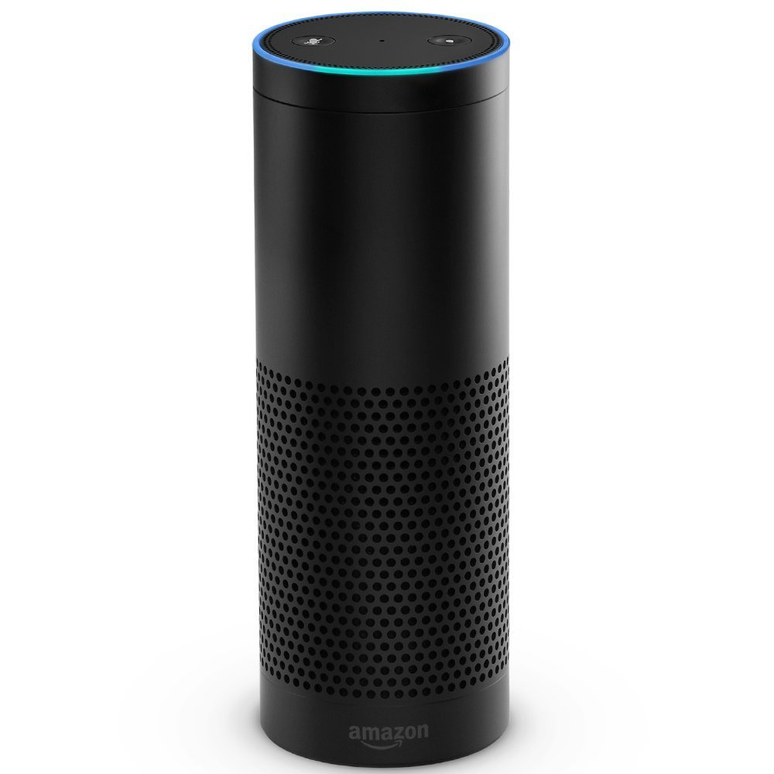




3
1
6
4
5
Your Alexa Skill
Skill Lambda
Test Lambda
AWS CloudWatch
AWS SNS Subscription
2
Amazon
S3
Amazon S3 Bucket w/
Test Scripts

