Slide 1
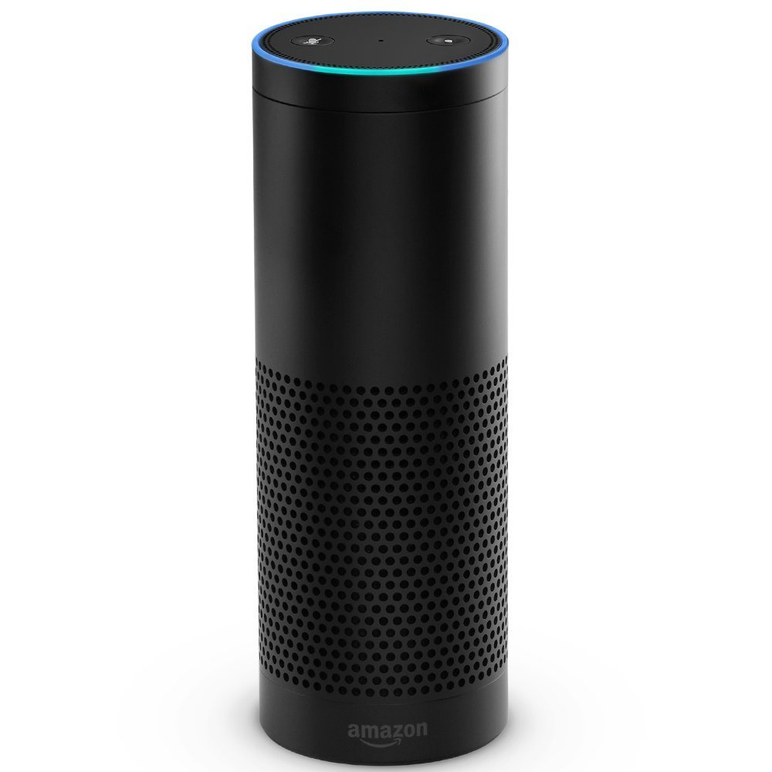




4
1
Alexa
Skill
2
3
II
I
E
C
A
Play wait loop
Direct
wait loop
Alexa Skill Handler
Transaction State Tracking
Long-Running Service
Audio Player
B
D
Business Domain

