Slide 1
KayaKanban

Slide 2
Contents
What the software is about
How is it different from other similar softwares
Goals
How it works
Future Plans

Slide 3
What is KayaKanban?
Kanban board
Project Management Tooling
Integrates Github & Basecamp

Slide 4
Difference from traditional Kanbans
Automation
No knowledge of Git or basecamp.
Issue/Task management

Slide 5
Goals
Integration with different softwares
Gitlab
Jira
Asana
Bitbucket etc..

Slide 6
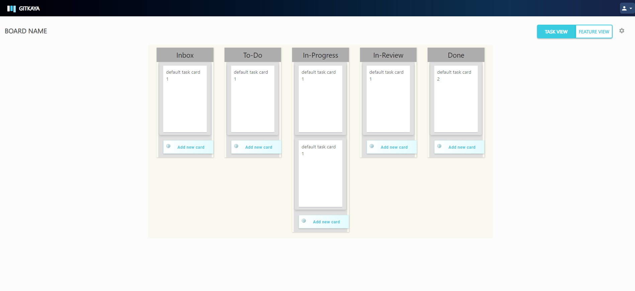

Slide 7
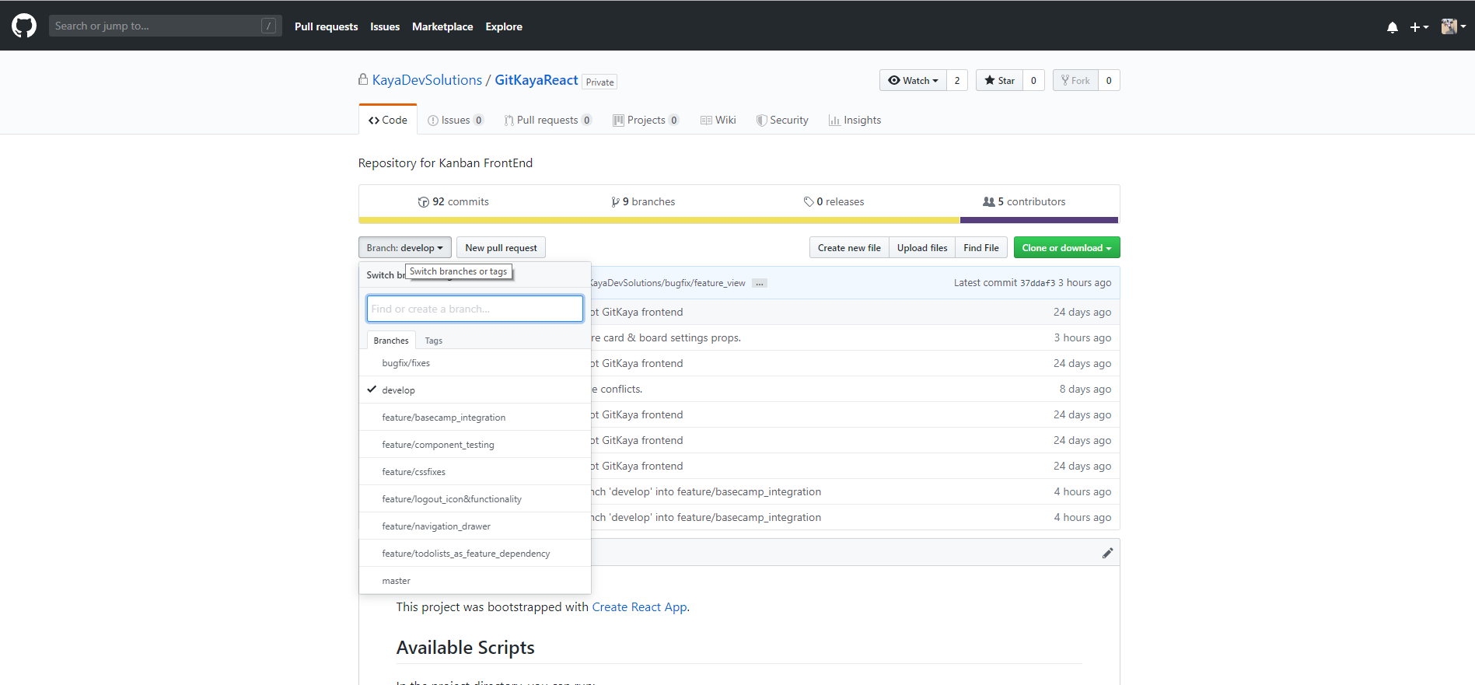
Tech Stack

Slide 8
How KayaKanban works.
Board View/Project View
  Boards Created by User (role: Admin)
Card View
  Swimlanes
  Inbox, To Do, In Progress, In Review, Done
  Invite to Project

Slide 9
Users
Two types of users
Admin
  Create Boards/Cards
  Add/Update Cards
Member
  Create/Move/Update Cards

Slide 10
Kanban View
Swimlanes divided into
  Inbox
  To Do
  In Progress
  In Review
  Done

Slide 11
Inbox Swimlane
  Moves to on card creation
  Assignees : null
  Can create issue/ branch from swimlane

Slide 12
To Do Swimlane
  Moves to on status : open
  Assignees: null/NA
  Can create issue/ branch

Slide 13
In Progress Swimlane
  Moves to when issue/branch created
  Status: open
  Assignees: Assigned

Slide 14
In Review
  Moves to on Pull Request: Opened
  Different possible outcome
    Might move to In Progress
    Done

Slide 15
Done
  When Pull Request: merged
  Further division
    Production Lane
    Testing Lane

Slide 16
Automation
Github issue creation -> Reflects in Kanban
Card creation -> Reflects in Github

Slide 17
The End

