Slide 1
CT-81-Seg for Windows 11
User guidance
Yi Gu
2025/12/16

Slide 2
Requirements
Windows 11 (installation would fail for other Windows)
Administrative user
Network connection
Latest Windows GPU driver

Slide 3
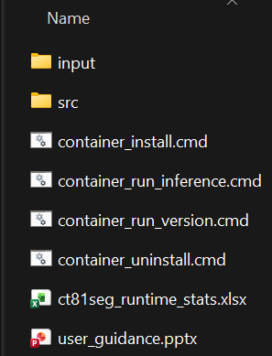
1. File explanation
Example input CT
Script for installation
Source code
Script for inference
Script for checking version
Script for uninstallation
Runtime performance report
This guidance

Slide 4
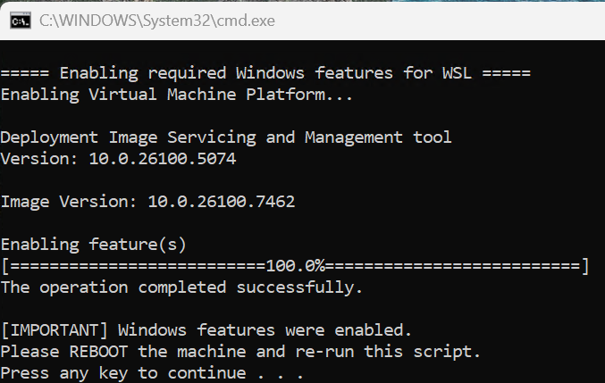
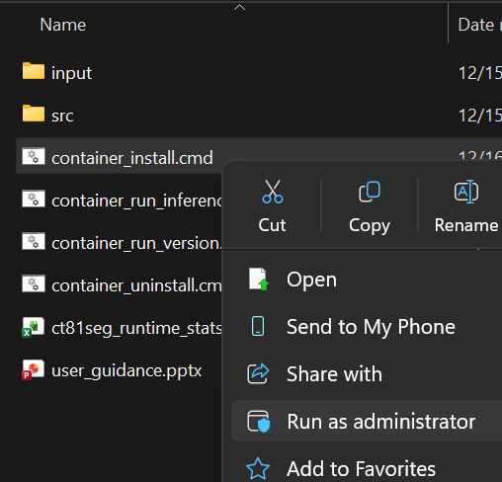
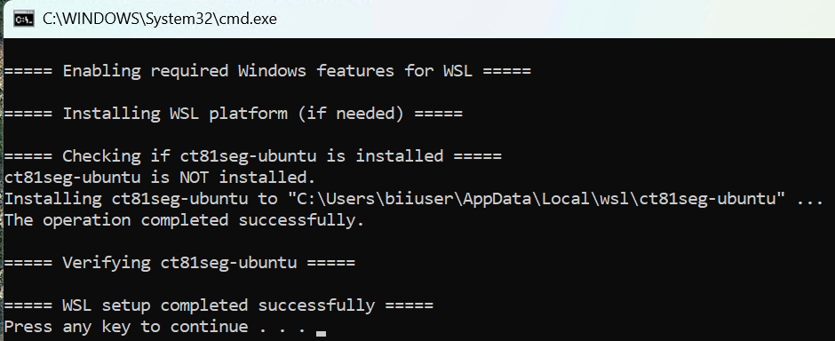
2. Installation
(3) If it is the first time of installing WSL,
machine restart may be required.
(1) Right-click container_install.cmd.
(4) After restarting, go to (1) to run container_install.cmd again.
(2) Click Run as administrator.

Slide 5
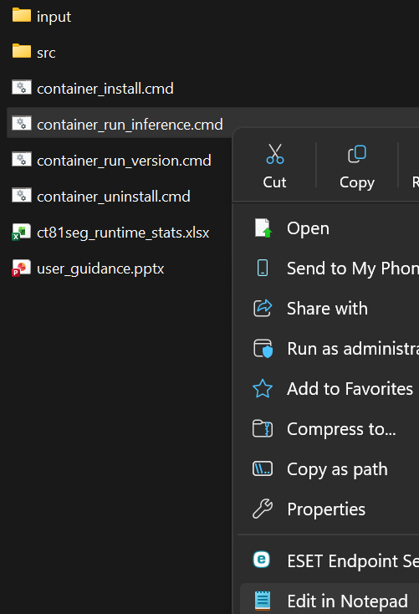
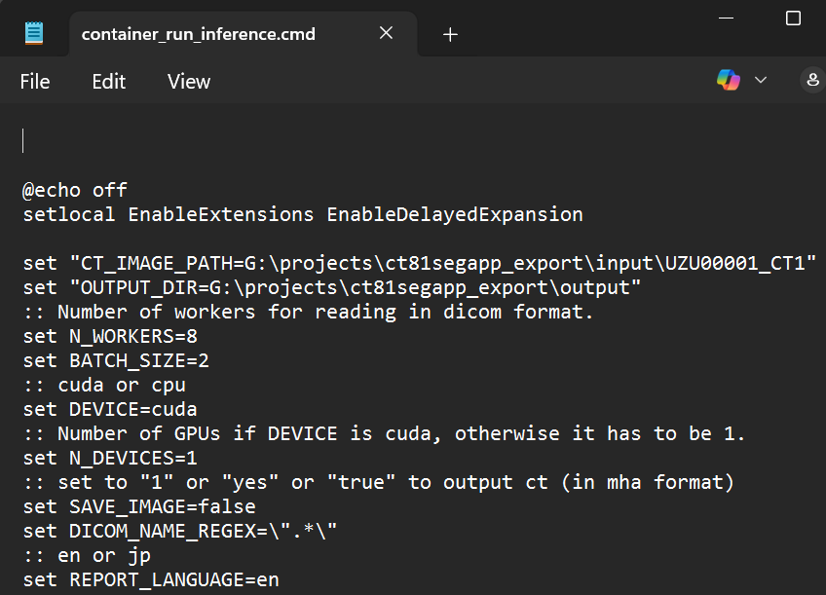
3. Inference example: 3.1 Setting input and output
(1) Right-click container_run_inference.cmd
(3) Set CT_IMAGE_PATH (can be a MHD/A file or a folder of DICOM)
(for example, G:\projects\ct81segapp_export\input\UZU00001_CT1)
(4) Set OUTPUT_DIR (must be a valid folder)
(for example, G:\projects\ ct81segapp_export \output)
(2) Click Edit in Notepad
(5) Save changes

Slide 6
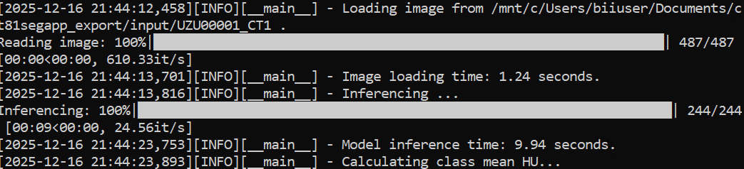
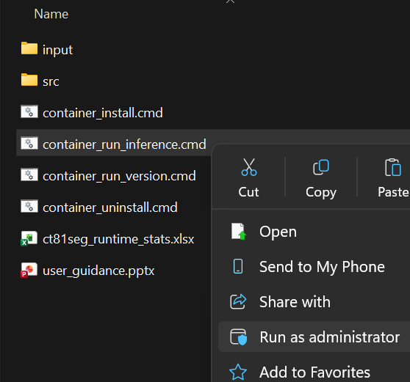
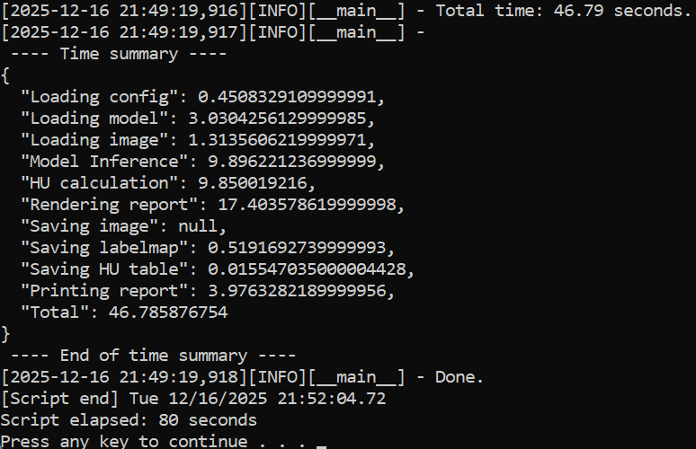
3. Inference example: 3.2 Running script
(3) Wait for the result
(1) Right-click container_run_inference.cmd
(2) Click Run as administrator

Slide 7
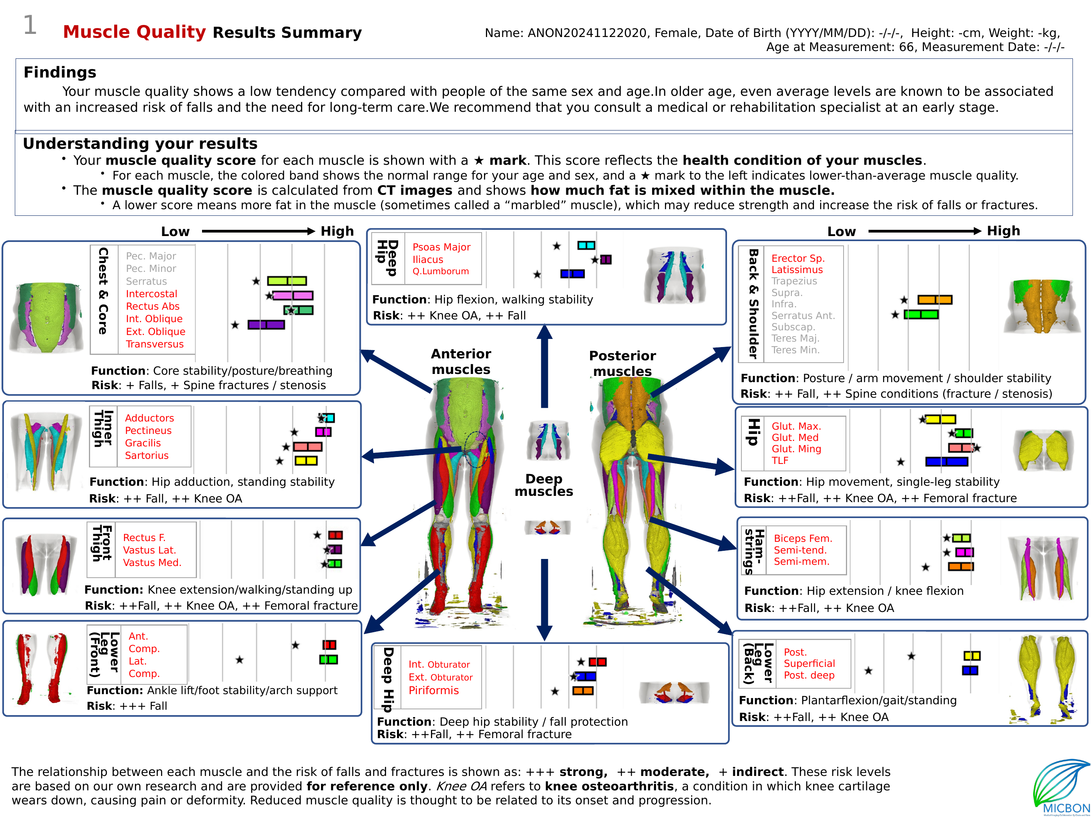
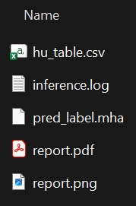
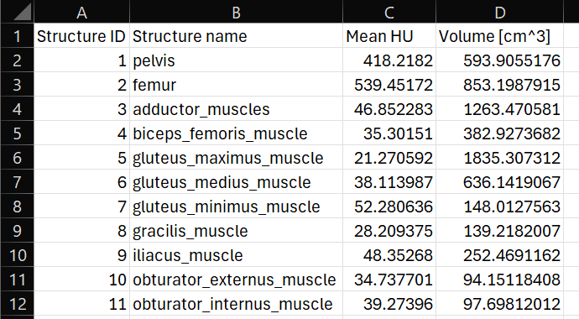
3. Inference example: 3.3 Checking results
Log
Predicted labelmap
Calculated mean HU table

Slide 8
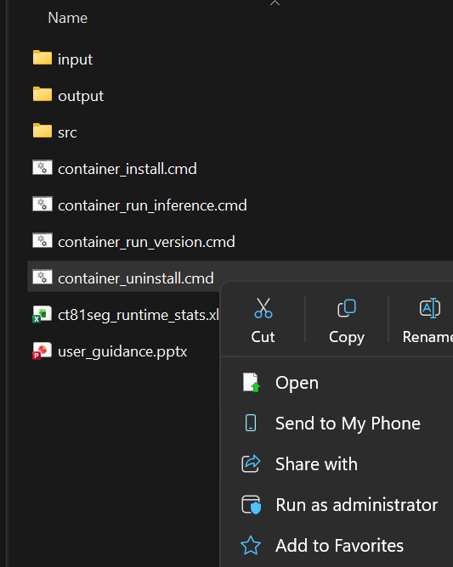
4 Uninstallation
(1) Right-click container_uninstall.cmd.
(3) Wait until the uninstallation finished.
(2) Click Run as administrator.

