Slide 1




AGENTIC AI PROCUREMENT AGENT
ON BECKN PROTOCOL
Autonomous enterprise procurement over an open commerce network
Project Details
Team & Faculty
Project: Agentic AI Procurement Agent on Beckn Protocol
Team: Team AI1
Department: CSE
Team Leader: Kavala Durga Eswar (A23126510147)
Team Members: Kinthala Samuel Sampath Kumar (A23126510150)
Korukonda Jahnavi (A23126510214)
Kittali Krishna Vamsi (A23126510035)
Yindula Vaishnavi (A23126510248)
Faculty Guide: Dr. Ch. Lakshmi Narayana
USER REQUEST
AI AGENT
BECKN NETWORK
SUPPLIERS

Slide 2
Enterprise Procurement is Fragmented
The problem is not simply finding a product. The problem is coordinating the entire procurement decision.
01
02
03
REQUEST
SEARCH
COMPARE
04
05
06
NEGOTIATE
APPROVE
ORDER
07
TRACK + AUDIT
Pain Points
Manual quotation collection
Supplier-by-supplier search
Difficult comparison
Negotiation overhead
Approval delays
Weak traceability
Poor scalability
"Human-driven procurement cannot efficiently reason across an open supplier network."

Slide 3

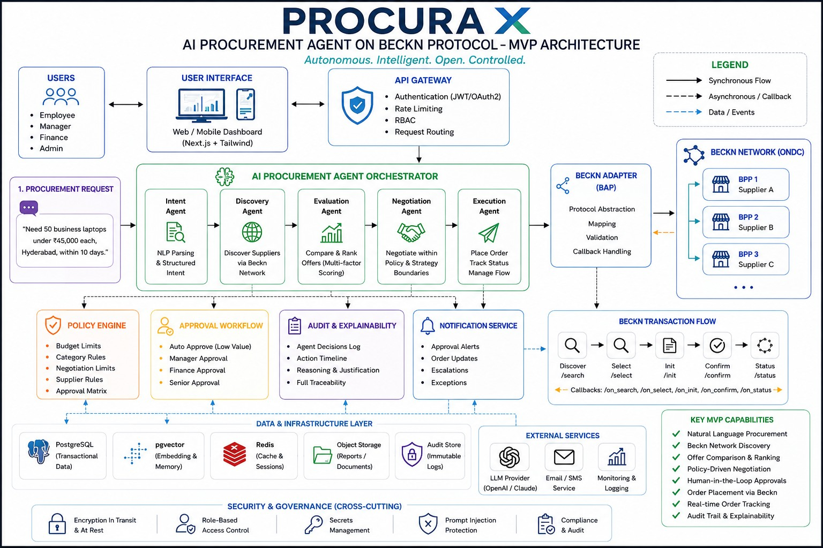
Our Solution: An AI Purchasing Employee
Example Request: "Need 50 business laptops under ₹45,000 each, for Hyderabad, within 10 days."
01
02
NATURAL LANGUAGE
STRUCTURED INTENT
03
04
SUPPLIER DISCOVERY
OFFER COMPARISON
05
06
NEGOTIATION
POLICY CHECK
07
08
APPROVAL
ORDER
Outcome
Best supplier identified
Negotiation completed
Approval routed
Order confirmed
Audit trail preserved
The AI agent is an ACTION-ORIENTED PROCUREMENT AGENT, not a chatbot.

Slide 4



Why Beckn / ONDC?
Traditional Marketplace Model
Our Open-Network Model
Closed platform ecosystem
Search one marketplace at a time
Manual supplier comparison
Limited interoperability
Platform lock-in
Open/interoperable commerce layer
AI discovers multiple providers
Automated comparison
Agent-driven negotiation
Policy-controlled execution
"BECKN IS THE COMMUNICATION LAYER — NOT THE DECISION MAKER."
AI AGENT
BECKN PROTOCOL
MULTIPLE PROVIDERS / BPPs

Slide 6
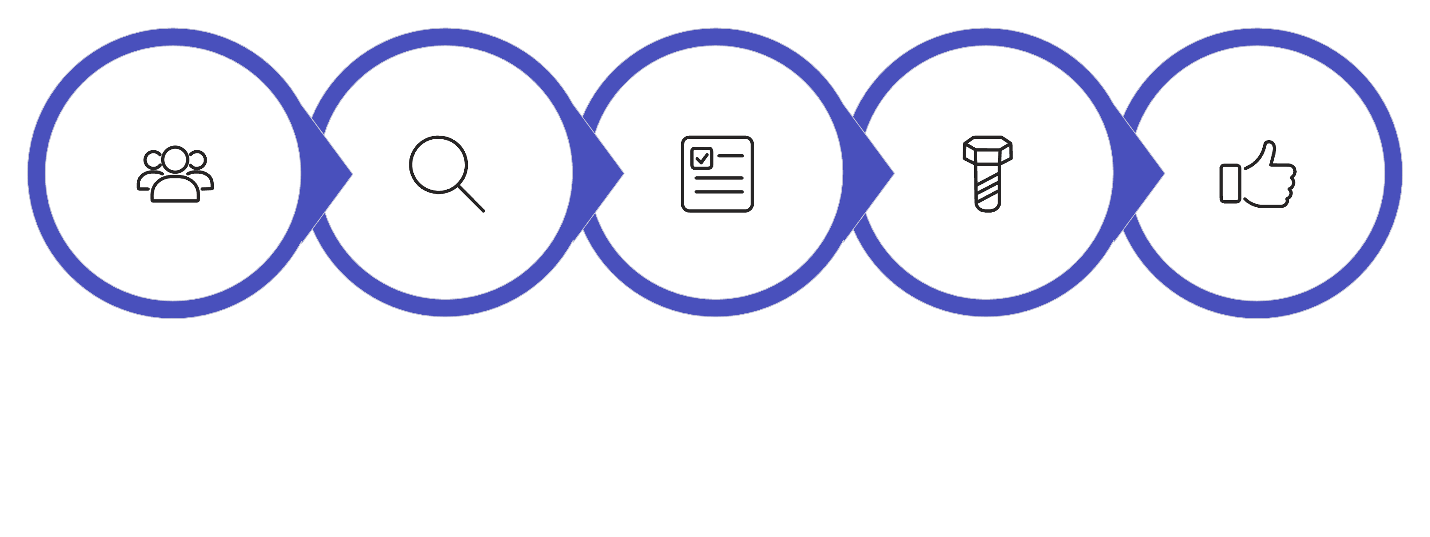

Every purchase follows a predictable Beckn cycle
Discover
Select
Initialize
Confirm
Track
BAP request → network
BPP callback → BAP
01
01
DISCOVER · search
DISCOVER · on_search
02
02
SELECT · select
SELECT · on_select
03
03
INITIALIZE · init
INITIALIZE · on_init
04
04
CONFIRM · confirm
CONFIRM · on_confirm
05
05
TRACK · status
TRACK · on_status
The AI agent decides what to buy; the Beckn Adapter translates that decision into versioned protocol messages.
AI AGENT — intent + policy
BECKN ADAPTER — protocol translation
BECKN NETWORK — discovery + routing
PROVIDER / BPP — offer + fulfilment

Slide 7
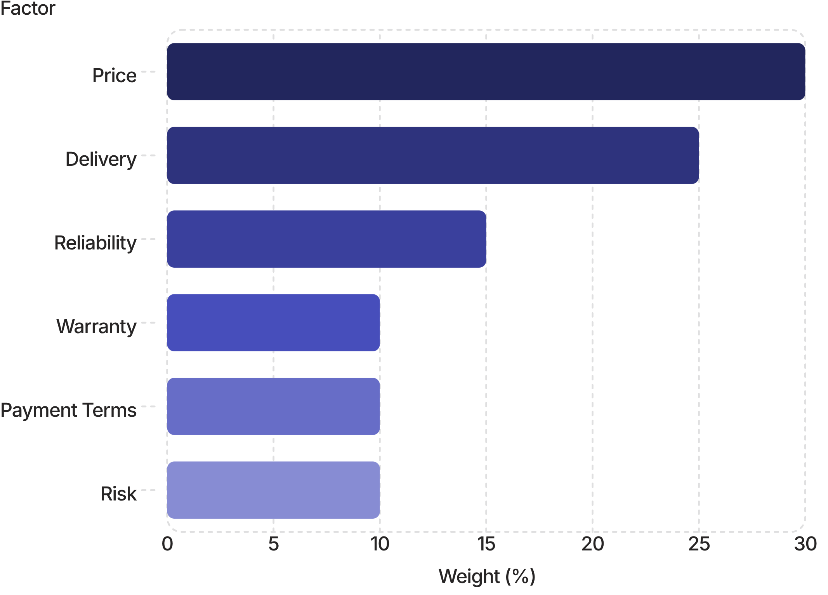
The agent optimizes total value—not just price
It ranks suppliers on six factors, then negotiates only within human-approved limits.
Weighted supplier score (100%)
Negotiation within policy
Supplier offer
₹42,800
AI counter-offer
₹41,500
Accepted within policy
₹41,500 · saves ₹1,300 (3.0%)
Human-approved guardrails
Target price + budget
Maximum negotiation rounds
Approved payment terms
Minimum supplier quality
Escalation thresholds
Optimization stops at the policy boundary; exceptions require human approval.

Slide 8
Enterprise Guardrails & Human-in-the-Loop
Approval Ladder
1
≤ ₹50,000
AUTO-EXECUTE
2
₹50,001 – ₹5,00,000
MANAGER APPROVAL
3
₹5,00,001 – ₹25,00,000
FINANCE APPROVAL
4
₹25,00,000+
SENIOR MANAGEMENT
Control Blocks
BUDGET
SUPPLIER
Maximum spend
Approved vendors / rating
NEGOTIATION
AUDIT
Maximum rounds / limits
Every material action logged
"AI decides within rules. Humans control exceptions."
Role-based access control
Policy validation
Approval workflows
Complete audit trail

Slide 9
Technology Stack & Phase-1 Prototype
FRONTEND
AI
INTEGRATION
Next.js
TypeScript
Tailwind / shadcn
LLM API
LangGraph
Structured tool calling
Beckn Adapter
ONDC / Beckn Sandbox
Mock BPPs
BACKEND
DATA
Python
FastAPI
REST APIs
PostgreSQL
pgvector
Redis

Slide 10
Thank You!
PROCURA X
Questions & Feedback
TEAM AI1 • CSE • INFOSYS REVIEW – 1

