Slide 1

DATA ANALYTICS COURSE-4 PYTHON FOR DATASCIENCE PROJECT PRESENTATION
BY
KAYALVILI K G

Slide 2

REQUIREMENTS: TOOLS : ANACONDA JUPYTER NOTEBOOK DATA REQUIREMENTS: DATASET PYTHON LIBRARIES

Slide 3
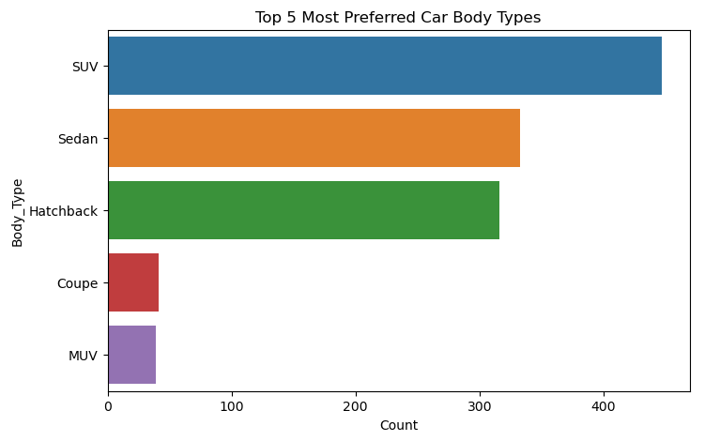
PROJECT 1 MARKET SEGMENTATION ANALYSIS
TASK 1:
The most preferred car body type is the SUV, with 447 units, followed by the Sedan with 333 units, and the Hatchback with 316 units. The Coupe and MUV are less popular, with 41 and 39 units, respectively, among the top five preferred body types.

Slide 4
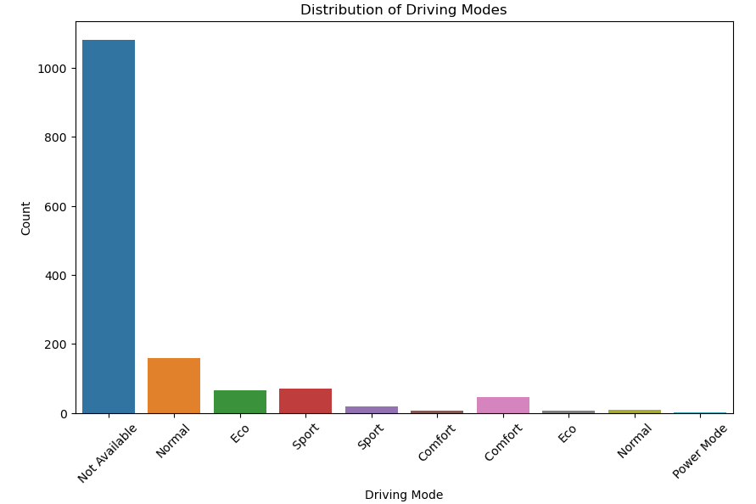
TASK 2
The cars with all the mode "Normal, Comfort, Eco, Sport, Power Mode" are 2 cars : Audi Q8 and Audi A8 L.
And there are 195 cars in total which possess some as its mode like Normal has 92 cars and ECO has 34 cars.

Slide 5
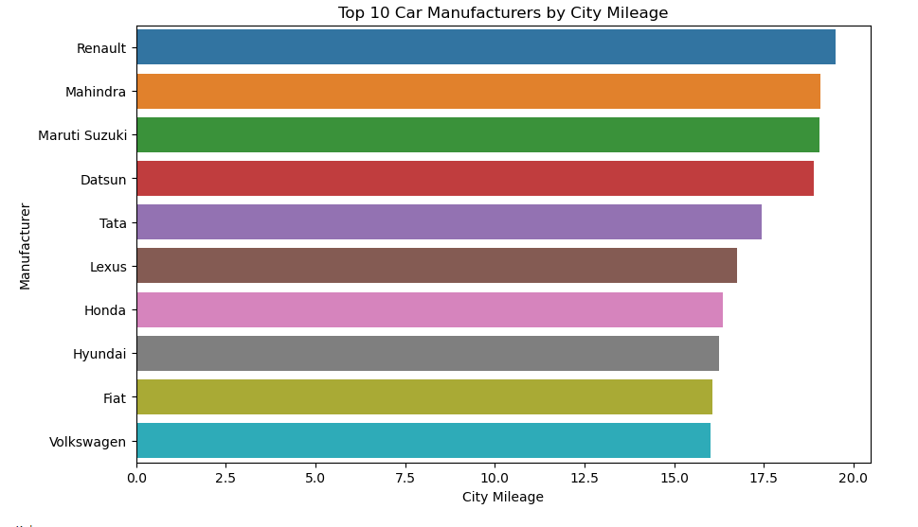
FUEL EFFICIENCY ANALYSIS
TASK 3 :
Renault has the highest city mileage based on manufacturers with 19.50 mpg and followed by Mahindra with 19.08 mpgThe top 10 car manufacturers based on average city mileage range from Renault, leading with approximately 19.50 km/l, to Volkswagen with around 16.01 km/l.

Slide 6
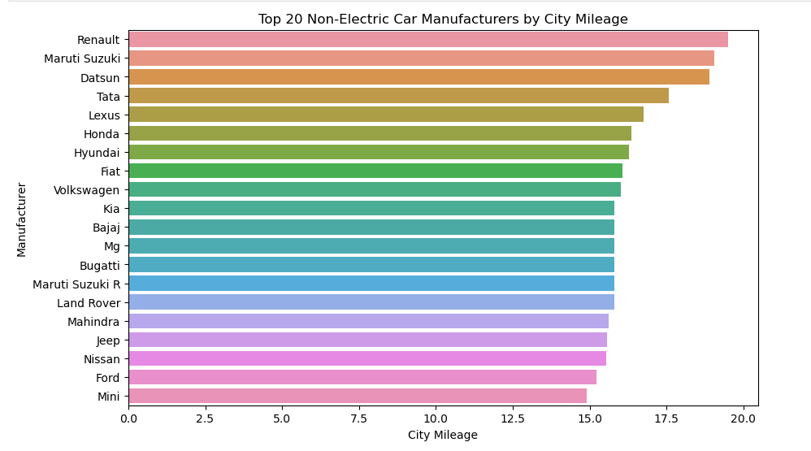
TASK 4
The chart displays the top 20 non-electric car manufacturers by their average city mileage (in kilometers per liter), with Maruti Suzuki ranking first at approximately 20 km/L and Lamborghini at the last with a mileage of about 6 km/L.

Slide 7
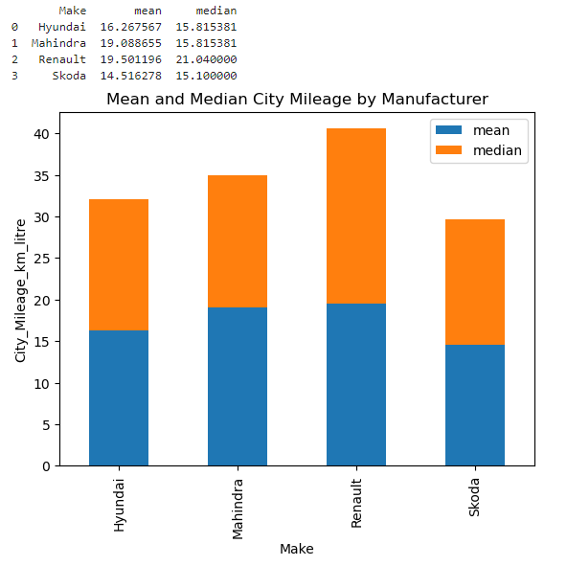
TASK 6:
The stacked column chart analysis indicates that Renault has the highest mean(19.50) and median (21.04)city mileage among the four manufacturers, highlighting its efficiency in urban driving conditions. In contrast, Skoda shows the lowest mean and median city mileage, suggesting room for improvement in fuel efficiency relative to its peers.

Slide 8
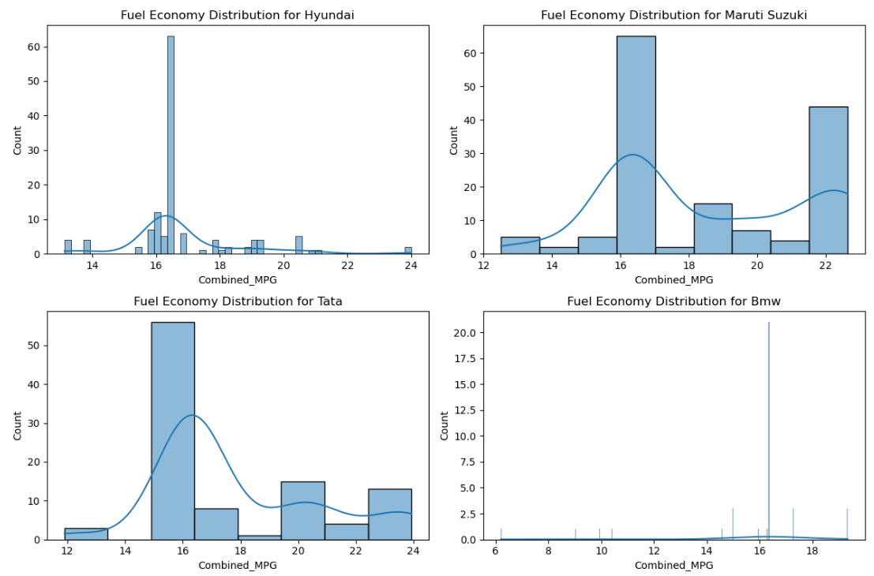
TASK 9:
The histograms reveal the distribution of fuel economy for Hyundai, Suzuki, Tata, and BMW. Among these, BMW displays the most skewed mileage distribution, with a pronounced right skew, indicating that most of its models have lower fuel efficiency, while only a few achieve higher mileage

Slide 9
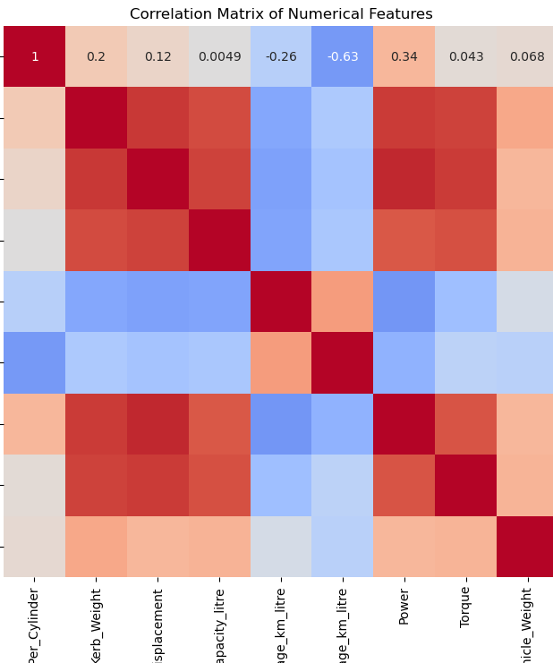
PERFORMANCE COMPARISON
TASK 13:
Based on the correlation matrix, the features that most strongly affect the city and highway mileage of cars (from Renault, Toyota, and Honda) are Kerb_Weight, Displacement, and Power:
Kerb_Weight negatively affects the mileage as indicated by a moderate negative correlation (r ≈ -0.26 for city mileage).
Displacement also negatively impacts mileage, as seen by a weak negative correlation (r ≈ -0.12).
Power shows a weak positive relationship with mileage, meaning it has a slight positive effect.

Slide 10
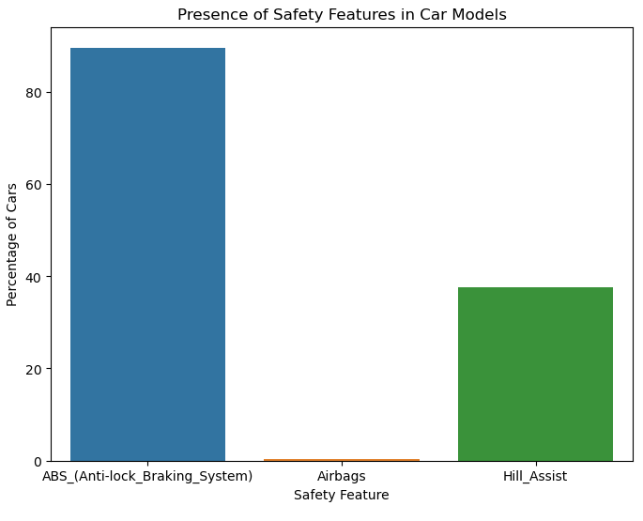
PROJECT 2
TASK 1
From the bar chart, it is evident that ABS (Anti-lock Braking System) is the most commonly available safety feature in car models, present in nearly 90% of vehicles. In contrast, Airbags and Hill Assist are minimally available, with airbags being almost non-existent and hill assist present in around 40% of cars. This suggests that safety standards across these car models are uneven, with ABS being a priority but airbags and hill assist lacking in most vehicles.

Slide 11
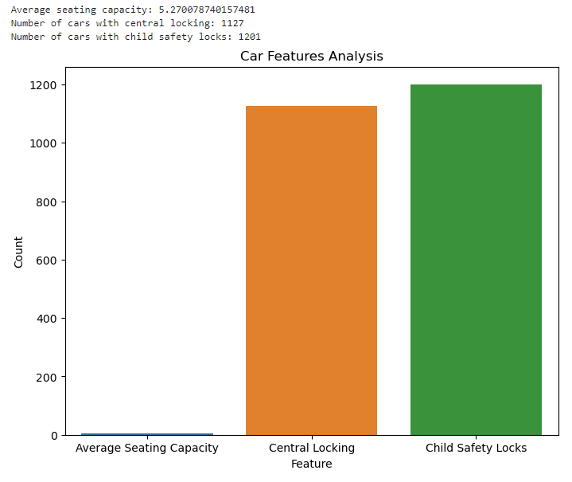
TASK 2:
The analysis reveals an average seating capacity of about 5.27, indicating a focus on accommodating families and groups. Additionally, central locking and child safety locks are prevalent features, with 1,127 and 1,201 cars respectively equipped, reflecting a strong emphasis on user convenience and family safety across the models.

Slide 12
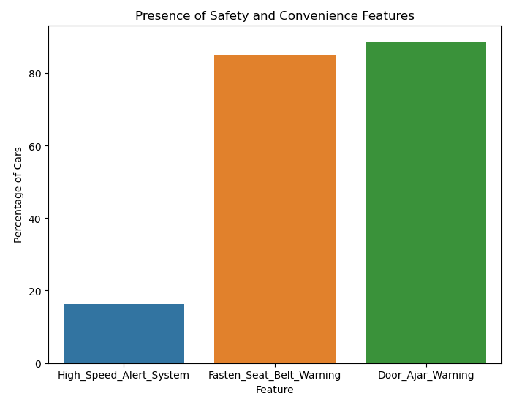
Task 3:
Fasten Seat Belt Warning appears to be the most common feature (close to 100% of cars), followed by Door Ajar Warning and then High Speed Alert System. This suggests prioritization of features that directly address passenger safety within the car itself.
Overall, a high percentage of cars possess all three safety and convenience features investigated, indicating a strong focus on incorporating these functionalities into the car models.

Slide 13

BUSSINESS INSIGHTS

Slide 14
SUMMARIZATION:
PROJECT 1: MARKETING STRATEGY
Car Body Types: SUVs are the most popular body type with 447 units, followed by Sedans (333 units) and Hatchbacks (316 units). Coupes and MUVs are less preferred, with only 41 and 39 units respectively.
Driving Modes: Only Audi Q8 and Audi A8 L offer all driving modes (Normal, Comfort, Eco, Sport, Power). In total, 195 cars possess some driving modes, with Normal being the most common (92 cars) and Eco being the least (34 cars).
Fuel Efficiency: Renault leads with the highest city mileage of 19.50 km/L, followed closely by Mahindra (19.08 km/L). The top 10 manufacturers vary significantly, with Maruti Suzuki at 20 km/L and Lamborghini at 6 km/L.
Fuel Efficiency Trends: Renault shows the highest mean and median city mileage, indicating superior urban fuel efficiency. Skoda, on the other hand, has the lowest mileage figures, suggesting a need for improved efficiency.
Distribution of Fuel Economy: Among Hyundai, Suzuki, Tata, and BMW, BMW exhibits a highly skewed distribution towards lower fuel efficiency, implying that most models are less efficient with a few exceptions.
Performance Comparison: Kerb Weight and Displacement negatively impact city and highway mileage, while Power has a slight positive effect. This suggests heavier and larger cars tend to be less fuel-efficient.

Slide 15
PROJECT 2 – SAFETY FEATURES ASSESSMENT
Safety Features: ABS is widely available in nearly 90% of vehicles, while Airbags are scarce, and Hill Assist is present in about 40% of cars. This reflects an uneven safety standard where ABS is prioritized, but Airbags and Hill Assist are less common.
User Comfort: The average seating capacity is 5.27, emphasizing family-friendly designs. Central locking and child safety locks are common, found in 1,127 and 1,201 cars respectively, underscoring a focus on convenience and safety.
Safety and Convenience Alerts: Fasten Seat Belt Warning is the most prevalent feature, closely followed by Door Ajar Warning and High Speed Alert System. This indicates a strong emphasis on basic safety features.

Slide 16
Business Conclusions
Market Preferences: SUVs and Sedans are preferred by consumers, suggesting a market demand for spacious and versatile vehicles. Car manufacturers should focus on these body types to meet market expectations.
Driving Modes: The availability of diverse driving modes is limited to specific models, indicating a niche market for vehicles with advanced driving options.
Fuel Efficiency: Manufacturers with higher city mileage, like Renault, are more competitive in the urban driving segment. Brands with lower mileage should enhance fuel efficiency to stay competitive.
Safety Standards: While ABS is widely implemented, there is a gap in other safety features like Airbags and Hill Assist. Manufacturers should aim to improve these features to enhance overall safety.
User Comfort: The focus on average seating capacity and essential features like central locking and child safety locks suggests a strong market preference for family-oriented vehicles.

Slide 17
Challenges Faced
Data Inconsistencies: Variations in data availability and completeness for safety features and dimensions sometimes led to incomplete analyses.
Feature Standardization: Differences in feature definitions across manufacturers made comparisons challenging, particularly in safety and convenience features.
Future Scope
Enhanced Data Granularity: Collecting more detailed and standardized data on features across manufacturers could improve analysis accuracy.
Extended Feature Analysis: Investigating additional features such as advanced driver assistance systems (ADAS) and infotainment options could provide a more comprehensive view of market trends.

Slide 18
THANKYOU

