Slide 1
KAYALVIZHI K
422521205302
B.Tech – Information Technology
Final Project
3/21/2024 Annual Review

Slide 2
PROJECT TITLE
BREAST CANCER PREDICTION
- USING FNN
3/21/2024 Annual Review

Slide 3

AGENDA
Problem statement
Project overview
Who are the end users
Your solution and its value preposition
The wow in your solution
Modelling
Result
3/21/2024 Annual Review

Slide 4

PROBLEM STATEMENT
Early Detection: Develop a machine learning model to accurately detect breast cancer in its early stages, leveraging clinical data and imaging features.
False Positive Reduction: Address the challenge of false positives in breast cancer diagnosis, aiming to minimize unnecessary anxiety and medical interventions for patients.
False Negative Mitigation: Mitigate the risk of false negatives to ensure that no breast cancer cases are overlooked, thus improving patient outcomes and survival rates.
3/21/2024 Annual Review

Slide 5

PROJECT OVERVIEW
Methodology: Employ advanced machine learning techniques, including neural networks, to analyze and interpret complex patterns in the data for accurate cancer detection.
Evaluation: Assess the model's performance through rigorous testing, including metrics such as accuracy, sensitivity, specificity, and area under the ROC curve.
Impact: Aim to contribute to medical advancements by providing a reliable and efficient tool for breast cancer diagnosis, ultimately leading to better prognosis and treatment strategies.
3/21/2024 Annual Review

Slide 6
WHO ARE THE END USERS?
Medical Professionals
Patients
healthcare
Institutions
Researchers
policy makers
3/21/2024 Annual Review

Slide 7

YOUR SOLUTION AND ITS VALUE PROPOSITION
Early Detection: Our machine learning model offers early detection of breast cancer, enabling timely intervention and treatment, which can significantly improve patient outcomes and survival rates.
Accuracy: Our model provides accurate predictions by leveraging advanced algorithms and robust datasets. This minimizes the risk of misdiagnosis and unnecessary procedures, thus enhancing patient confidence and reducing healthcare costs.
Personalized Care: The system facilitates personalized care by analyzing individual patient data and tailoring treatment plans based on specific risk factors and tumor characteristics, ensuring optimized outcomes for each patient.
3/21/2024 Annual Review

Slide 8

THE WOW IN YOUR SOLUTION
Early Detection: Our model excels in identifying breast cancer at its earliest stages, enabling prompt intervention and treatment initiation. This can significantly enhance survival rates and patients' quality of life.
Precision and Accuracy: Through advanced machine learning algorithms and meticulous data analysis, our solution offers highly accurate predictions, minimizing the occurrence of false positives and negatives. This precision instills confidence in both healthcare providers and patients. Personalized
Treatment: Our system facilitates personalized treatment plans tailored to each patient's unique needs by considering individual patient characteristics and tumor profiles, optimizing therapeutic efficacy and minimizing adverse effects.
3/21/2024 Annual Review
3/21/2024 Annual Review

Slide 9
MODELLING
Teams cam add wireframes
ANN
NumPy
Pandas
Matplotlib
Scikit-learn
TensorFlow
Keras
StandardScaler
matplotlib.pyplo
3/21/2024 Annual Review

Slide 10
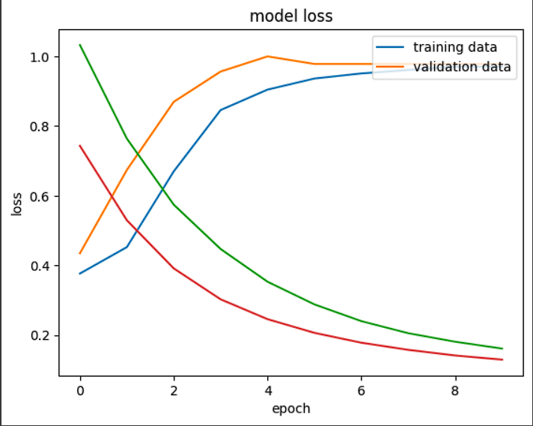
RESULTS
3/21/2024 Annual Review

