Slide 1
UNVEILING SENTIMENT: A COMPREHENSIVE API-DRIVEN WORKFLOW FOR SENTIMENT ANALYSIS OF SOCIAL MEDIA DATA
Ghanath V, Kholoud Al Nazzawi, and Kasonde Chewe

Slide 2


Introduction and Purpose of Dataset
Overview
Analyzing stress on social media
The relationship between social media posts and depression levels
Purpose Of Dataset
The selection of our dataset is directly relevant to our research
focus on measuring mental health indicators from social media posts.
The dataset provides a valuable resource for gaining in-depth insights into social media posts related to mental health.

Slide 3
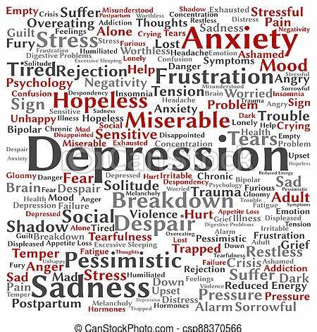
Importance of Study
The primary goal of our research is to explore the correlation between mental health disorders and social media usage.
The study aims to develop computational models for text analysis.

Slide 4
Potential Users and Applications
Psychologists, neuroscience students, and academics.
Social media companies.
Social media users.

Slide 5

Source of Data
Two primary sources: Reddit and Kaggle
The Reddit data was obtained using the Reddit API
the Kaggle dataset was directly downloaded from the Kaggle website.

Slide 6

Approach to Acquiring the Data

Slide 7
Acquiring the Data
Utilize
Utilize Kaggle and Reddit as data sources.
Download
Download prebuilt datasets from Kaggle using the Kaggle API.
Interact
Interact with Reddit's API using PRAW to generate a custom dataset.
Collect
Collect social media posts associated with different mental health conditions from various subreddits.
Store
Store the acquired datasets in separate directories.

Slide 8
Approach to Preprocessing Data
Load the downloaded datasets into pandas DataFrames.
Merge multiple datasets into a single DataFrame for efficient analysis.
Perform data cleaning to remove irrelevant data.
Handle missing or null values in the datasets.
Use pandas methods to manipulate and transform the DataFrames.

Slide 9
Data Cleaning
Merging Data Sets
Handling Null Values
Standardization

Slide 10
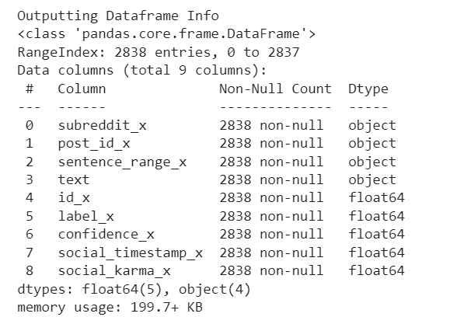
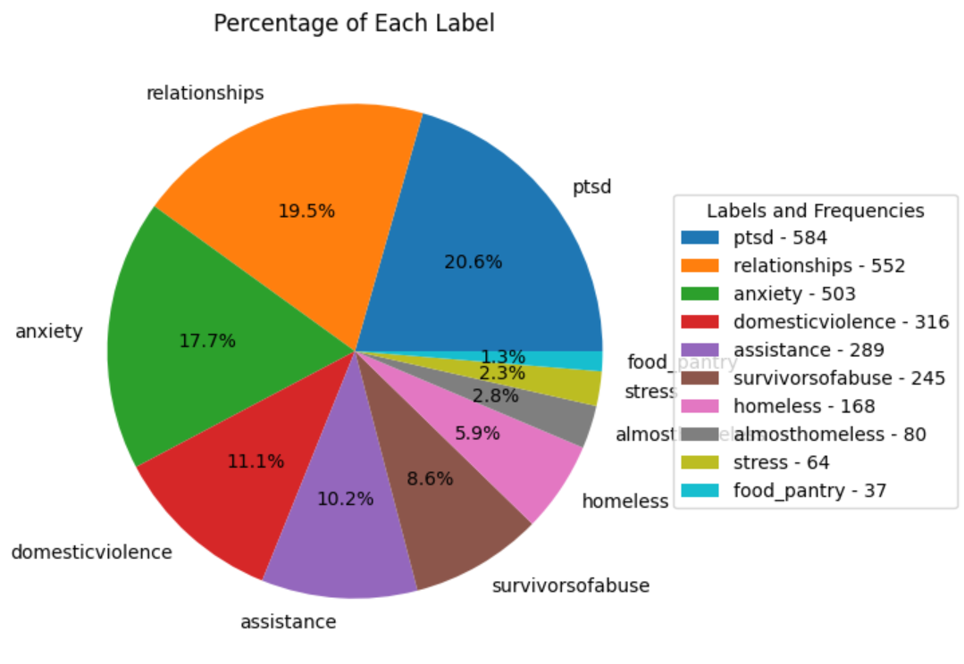
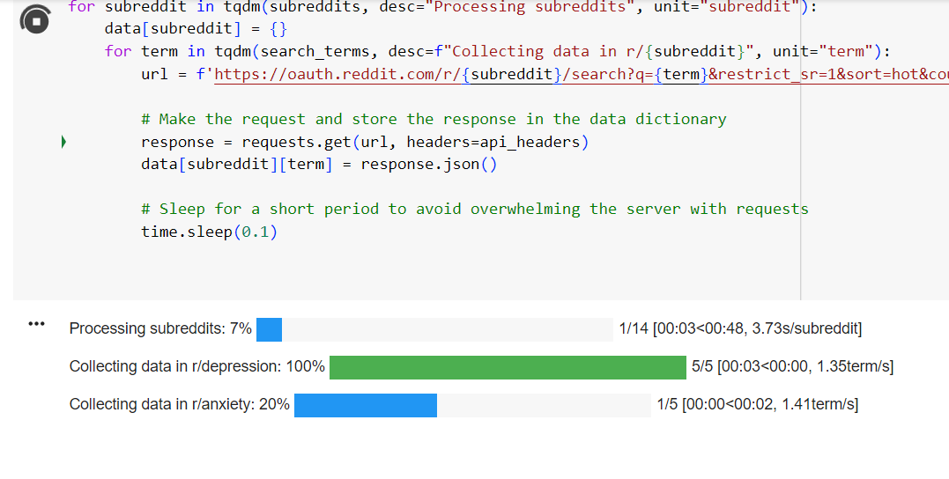
Data Insights
A
Metadata sights
Starting dataset (2838, 116)
Merged dataset (3550, 231)
Cleaned dataset (3550, 9)
B
C

Slide 11
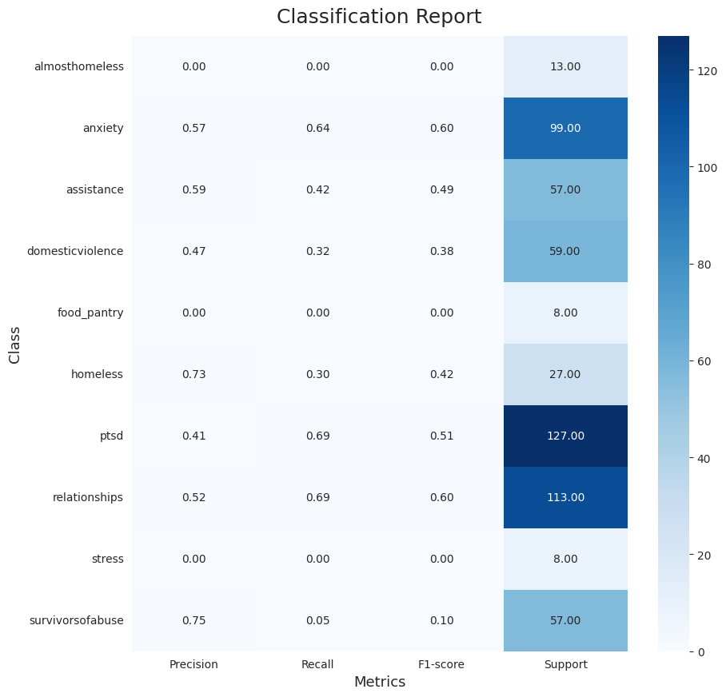
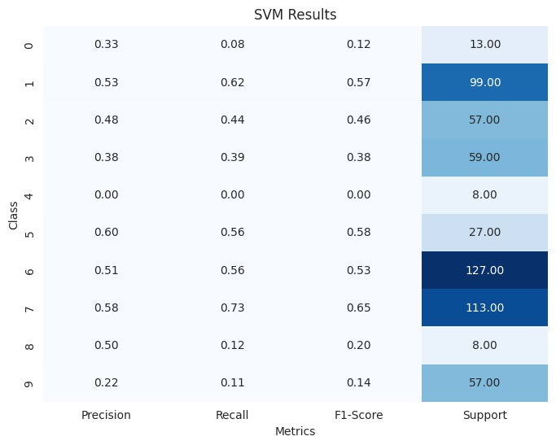
Data Insights
Social Media Data Sights
Keywords related to symptoms:
Emotional language
Traumatic events or triggers
Social withdrawal or isolation
Cognitive patterns
Physical symptoms
Time-related reference
Our model gave us insight into how the keyword relationships and language lexicons can be related to serious mental health issues
Cognitive patterns, such as negative self-talk, excessive self-blame, rumination, or distorted thinking, may be relevant features.
The presence of phrases like "I'm worthless," "It's all my fault," or "Everything always goes wrong" could be indicative of underlying mental health conditions.
Notes:
Our model is designed to classify text and predict labels such as PTSD, depression, or anxiety (a total of 10 classes in the notebook), there could be various features or patterns in the text that the model might consider. Here are some examples:
1. Keywords related to symptoms: The presence of specific keywords or phrases associated with symptoms commonly seen in PTSD, depression, or anxiety could indicate the presence of these conditions. For instance, terms like "flashbacks," "nightmares," "hopelessness," "constant worrying," or "panic attacks" might suggest the presence of relevant symptoms.
2. Emotional language: The model might pay attention to the emotional tone expressed in the text. Words conveying sadness, fear, or distress, as well as expressions of intense emotions or a negative outlook on life, could indicate the presence of mental health concerns.
3. Traumatic events or triggers: If the text mentions specific traumatic experiences, such as accidents, violence, or loss, it could be a relevant feature in predicting conditions like PTSD. Similarly, references to triggering situations or reminders of traumatic events might be informative.
4. Social withdrawal or isolation: Text that reflects a lack of interest in social interactions, mentions of loneliness, or withdrawal from previously enjoyed activities could be indicative of depression or anxiety.
5. Cognitive patterns: Certain cognitive patterns, such as negative self-talk, excessive self-blame, rumination, or distorted thinking, may be relevant features. The presence of phrases like "I'm worthless," "It's all my fault," or "Everything always goes wrong" could be indicative of underlying mental health conditions.
6. Physical symptoms: In some cases, individuals experiencing mental health difficulties may express physical symptoms. Textual mentions of sleep disturbances, appetite changes, fatigue, or somatic complaints without a clear medical cause might be relevant in predicting certain conditions.
7. Time-related references: The timeframe mentioned in the text can provide insights. For instance, if the text refers to a recent traumatic event or a prolonged period of distress, it may be relevant in identifying the presence of PTSD or chronic anxiety.
It is important to note that the accuracy and reliability of such a deep learning model would depend on the quality and diversity of the training data it has been exposed to. The model's performance would also be influenced by the complexity and subtlety of the mental health conditions it aims to predict.

Slide 12




Distribution Approach
Github
Cloud-based service for code development, management and distribution of code
Version control -> commits/ push/ requests
Git -> A bash shell
Open-source license
Facilitate free and open-source software/code development
Overcome restrictive IP
Aid academic research
Spure community support, talent and collaboration
License choice
GNU General Public License (GPL)
Alternative Licenses
MIT | Apache | BSD 2-Clause and 3 Clause | LGPL | Creative Commons | EPL
Notes:
When looking for an appropriate distribution approach we chose the Github platform from amongst other options such as Gitlabs / SourceForge/ Bitbasket/ Azure DevOps etc because it offered flexible workflow & code sharing features
Github
Github is a website and cloud-based service that helps developers store and manage their code, as well as track and control changes to their code
It has two principle functions
Version control – a way to make changes and updates to the code via commits, and push and pull requests
Git – a bash shell scripting language (based on Linux) less used feature for beginners because of desktop version
Open Source License
Open-source License facilitate free and open-source software development. Intellectual property laws restrict the modification and sharing of creative works. Free and open-source software licenses use these existing legal structures for the inverse purpose of granting freedoms that promote sharing and collaboration.
1. MIT License (MIT): This is one of the most permissive and widely used open-source licenses. It allows users to do whatever they want with the code provided they include the original copyright and license notice in any copy of the software/source code.
2. GNU General Public License (GPL): The GPL license allows users to use, copy and modify the software however they want. It's a copyleft license, which means any software that is based on or includes GPL-licensed code must also be open-sourced under the same license. There are different versions of this license, such as GPLv2 and GPLv3.
3. Apache License 2.0 (Apache): This license allows users to freely use, modify, and distribute the code, provided they include the original copyright notice and disclaimer. It also provides an express grant of patent rights from contributors to users.
4. BSD Licenses (BSD 2-Clause and 3-Clause): The BSD licenses are a family of permissive free software licenses, imposing minimal restrictions on the use and distribution of covered software. This is usually in the form of prohibiting the use of the author's name to promote derived products, without explicit permission.
5. GNU Lesser General Public License (LGPL): This is a version of GPL that has additional permissions. It’s primarily for software libraries. It allows them to be linked with non-free software.
6. Mozilla Public License 2.0 (MPL 2.0): This license allows you to use the software/code freely under open-source terms, but it requires that modifications to the original code be released under the same license. It also allows the code to be combined with code under other licenses.
7. Creative Commons Licenses: These are not typically used for software but are more common for creative works such as books, blogs, music, and images. There are several different Creative Commons licenses offering varying levels of use, alteration, and commercialization.
8. Eclipse Public License (EPL): This license is used by many projects managed by the Eclipse Foundation (like the Eclipse IDE, EclipseLink, etc.), and others. It is a strong copyleft license when it comes to linking of other software.
These licenses e

Slide 13
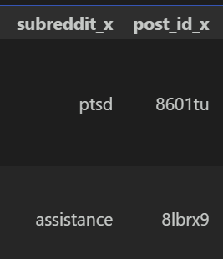

Discussion of Access Rights
Data access rights are crucial
Data Privacy and Protection
Data Ownership
Copyright Issues
User Content
Platform's Terms of Service
Access Control
Data Retention
Ethical consideration
Notes:
Data access rights are a crucial consideration in any data science project. When using de-identified social media posts, we considered both the ethical and legal dimensions. Amongst these access rights we considered:
**1. Data Privacy and Protection:**
Even though the data is de-identified, it is important to ensure that the process is thorough, and re-identification is not possible. Furthermore, depending on the jurisdiction, we may need to comply with specific privacy regulations like GDPR in the EU, or CCPA in California, USA, among others.
**2. Data Ownership:**
While the data is publicly available, it doesn't necessarily mean it's free to use for any purpose. The terms of service for each social media platform typically state that users retain ownership of their content.
**3. Copyright Issues:**
Social media posts might contain copyrighted material. While using such posts for research purposes might be protected under fair use laws, this is a gray area and needs careful consideration.
**4. User Consent:**
Even when dealing with public social media posts, using this data for research might require user consent depending on the jurisdiction and nature of the project. The best practice is to seek informed consent whenever possible.
**5. Platform's Terms of Service:**
Each social media platform has a different policy regarding data access and usage. Breaking these terms of service can lead to legal consequences.
**6. Access Control:**
In your data science project, it's crucial to control who has access to this data. Setting up access controls that follow the principle of least privilege (PoLP) is a good practice.
**7. Data Retention:**
Your project should have clear policies on how long data will be retained and when and how it will be disposed of. This should be in compliance with any applicable data retention laws and policies.
**8. Ethical considerations:**
There may be additional ethical considerations depending on the nature of your project. Even if something is legal, it might not be ethical.

Slide 14
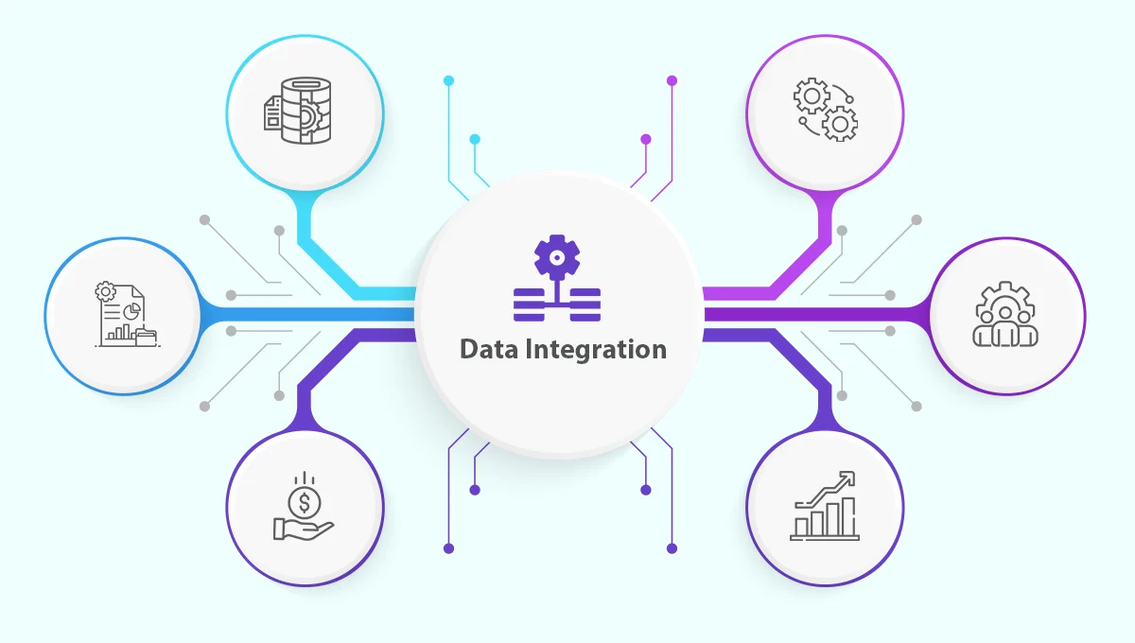
Issues and Limitations
Data Management
Unnecessary columns
Redundancy
Data Integration
Multiple social media platforms x compatible columns
Difficulty in standardization of data
Data Access
Paid API access
1000 requests on free platform
Rights of ownership? User vs Company vs Data Scientists
Data Modification
Missing values
Encoding categorical variables
Scaling numerical variables
Size of the dataset
GPU 15GB
RAM 12.7 GB
Notes:
Challenges and Limitations
Data Management: The initial dataset contained numerous unnecessary columns, which made the data processing and cleaning steps more complex and time-consuming. Efficient data management was a key challenge, particularly in ensuring only relevant features were used in the sentiment analysis model.
Data Integration: We faced difficulties while integrating multiple datasets, mainly because not all columns were similar. The inconsistent structure across different datasets added to the complexity of data preprocessing and required additional work to harmonize the datasets into a consistent format.
Data Access: Accessing data from social media platforms like Reddit and Twitter turned out to be a challenging task. Since these platforms have paid APIs, our ability to access and retrieve data was limited, which hindered us from getting as much data as we would have wanted.
Data Modification: Modifying the data to suit the requirements of our model was another challenge. This included activities like dealing with missing values, encoding categorical variables, and scaling numerical variables.
Size of the Dataset: The size of the dataset posed another significant challenge. Training the sentiment analysis model on a large dataset is computationally expensive and time-consuming. We needed to balance the need for a large enough dataset to train a robust and accurate model with the computational resources required.

Slide 15
Team and Contributions
Team Members​ | Contributions​
Kholoud Al Nazzawi (ka974@drexel.edu) MS Data Science (1st year)​ | My main contribution was in the field of data cleaning, where I focused on identifying and removing unnecessary data from the dataset. Through a systematic analysis, I determined variables that were not relevant, and eliminated duplicate records. This process resulted in a streamlined and more accurate dataset, enhancing the quality and effectiveness of subsequent analyses and modeling.​ ​
Ghanath V (gv374@drexel.edu) – MS Cyber Security (1st year)​ | Made significant contributions to the project by handling data cleaning tasks such as standardization and visualization. I ensured the data was consistent and compatible by applying standardization techniques and addressed missing values. Additionally, I created informative visualizations using Python libraries, enabling better understanding of the dataset. I also played a key role in documenting our data cleaning processes, ensuring clarity and transparency for future reference.​
Kasonde Chewe (kc3745@drexel.edu) – MS Bioinformatics (1st year)​ | I assisted with preprocessing stages including data cleaning and merging steps. My main contributions were creating figures and illustrations, peer review and model selection, evaluation and optimization in the post data acquisition analysis stages. I also aided in managing project structure dependencies and directories and command line handling. ​
Notes:
Kholoud Al Nazzawi (ka974@drexel.edu) - MS Data Science (1st year), Programming background includes C++, Python, PHP, HTML, and CSS. For this team project, I aspire to utilize my expertise to make a valuable contribution to the project while also helping with project management.

