Slide 1
FINAL PROJECT proposal
(DS102 AND DS104)

Slide 2
Main data set
https://www.kaggle.com/larsen0966/student-performance-data-set
Student-por.csv
Data set description: 649 row x 33 column Dataset based off secondary school students (15-22) in portugal for math and portugese only.
Records: Able to determine the age, sex, household type, willingness to go to the school, family background, availability of external support and non academic pursuits

Slide 3


Problem statement
This is an attempt to extrapolate data into a singapore context by supplementing with additional singapore datasets.
How to improve the pain points of Students in Singaporeans as a whole, while focusing on:
Key Points:
Race
Gender
Ideals
Health
Study/life balance
internal/External support
Family Background
Travel time to school
income
Potential Stakeholders/clients:
Government
Schools

Slide 4
SUB-QUESTION (RAce)
Relevant columns
While Race is not part of the dataset we can proxy income distribution with Race to double confirm our findings against actual income disparities. Both of which contrasting with grades
Special Malay Bursary (University)
Education Trust Fund – Siddiqui Assistance Scheme (NITEC Bursary & PFP Bursary)
The scheme was introduced in March 2020. It is to support deserving Muslim students, prioritising those from financially disadvantaged families…
https://www.mendaki.org.sg/assistance-landing/
The only relevant education help in budget 2021 is For families with children: An additional top-up of S$200 for each Singaporean child under 21 through his or her relevant education account

Slide 5
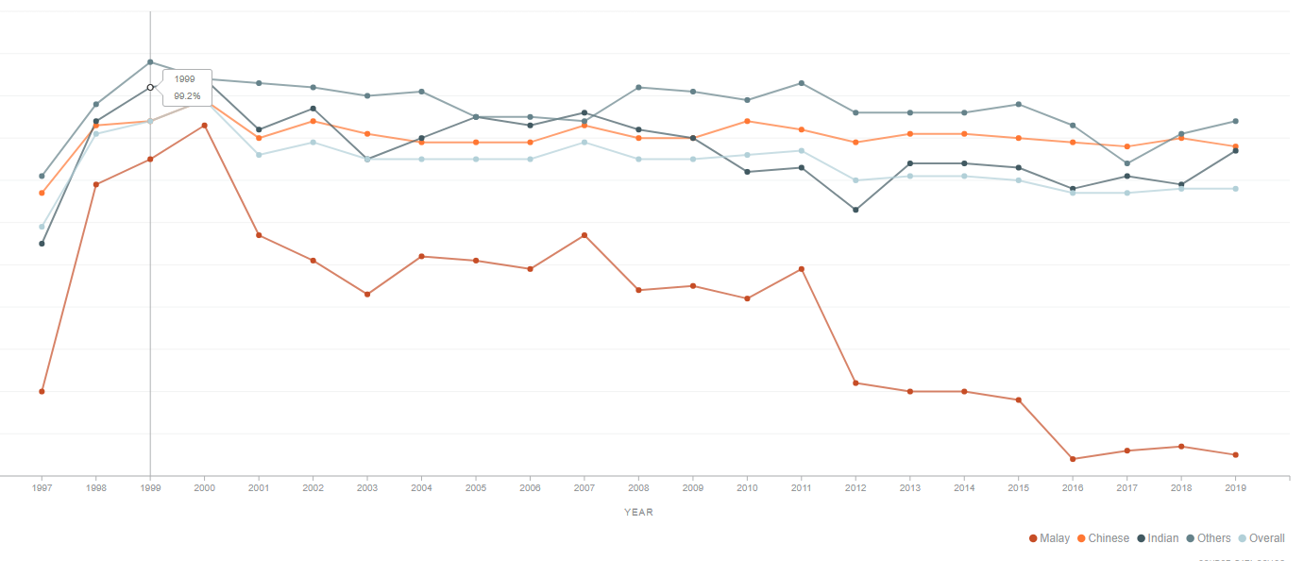
SUB-QUESTION (RAce)
Is there enough funding going to minorities in singapore?
looking at recent grades by ethnic groups shows that it isnt enough
Perhaps there is more to play here: family background (Broken family etc.)

Slide 6
SUB-QUESTION (IDEALS)
Relevant columns
Reason to choose this school (nominal: close to 'home', school 'reputation', 'course' preference or 'other')
higher
wants to take higher education (binary: yes or no)
activities
extra-curricular activities (binary: yes or no)
What are students general motivation to study?
Does it affect grades?
Is the Singaporean education too academics based?
Mental health?
Mental Well-being Survey
https://data.gov.sg/dataset/mental-well-being-survey
How does this affect Singapore's culture? "Unable to produce musicians" "Only good at math and science and not humanitarian subjects like the Arts"
"All work no play"

Slide 7
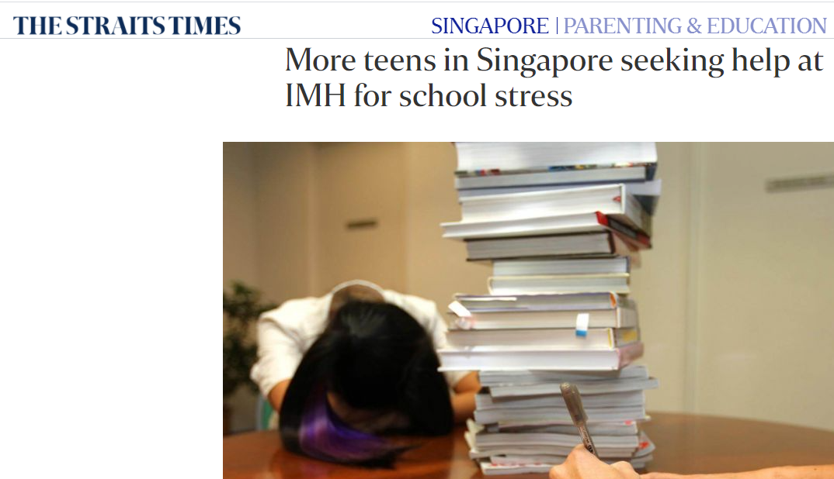
SUB-QUESTION (IDEALS)
News postings
Reason to choose this school (nominal: close to 'home', school 'reputation', 'course' preference or 'other')
higher
wants to take higher education (binary: yes or no)
activities
extra-curricular activities (binary: yes or no)
What are students general motivation to study?
Does it affect grades?
https://www.channelnewsasia.com/news/commentary/hyper-competitive-culture-breeding-severe-test-anxiety-among-10744150

Slide 8
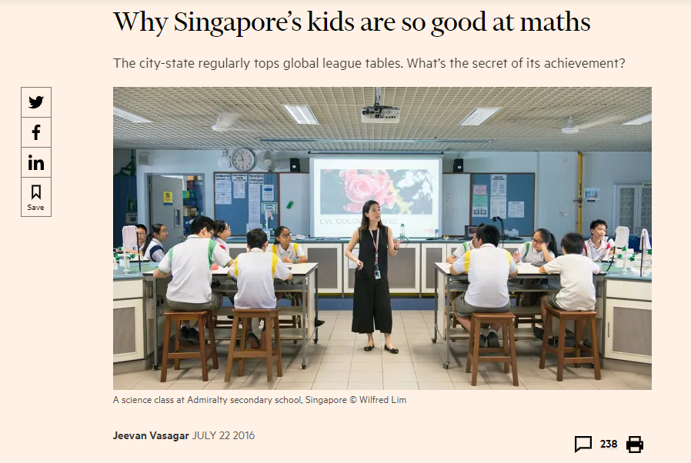
SUB-QUESTION (IDEALS)
News postings
Reason to choose this school (nominal: close to 'home', school 'reputation', 'course' preference or 'other')
higher
wants to take higher education (binary: yes or no)
activities
extra-curricular activities (binary: yes or no)
What are students general motivation to study?
Does it affect grades?
https://www.ft.com/content/2e4c61f2-4ec8-11e6-8172-e39ecd3b86fc

Slide 9
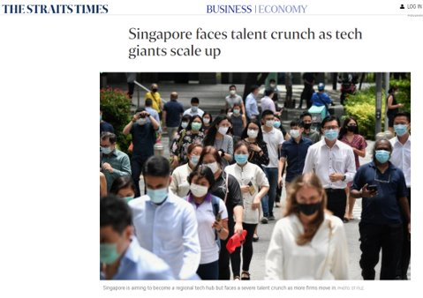

SUB-QUESTION (IDEALS)
Potential client goals
- Improve GDP, aim for Singapore to be of a certain skilset
- Improve overall citizen happiness

Slide 10
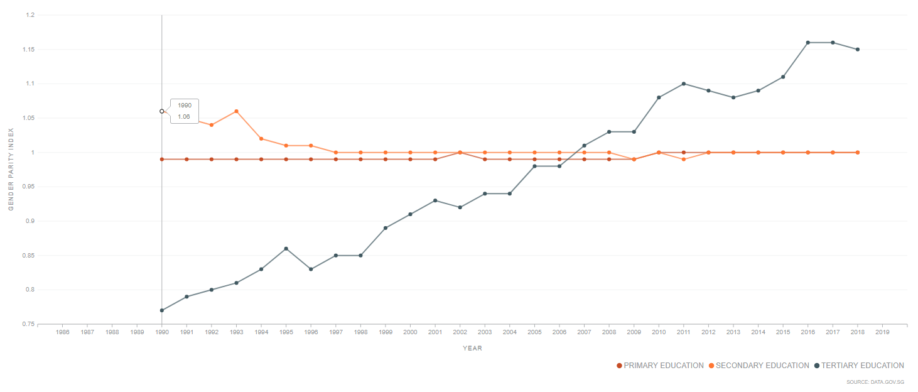
Sub-question: GENDER
A glance at education: Gender equality
We can see here that as the years pass by, the more favourable it is for females
The higher the gender parity index, the more favourable it is to females and vice versa.
ensuring the access of women and men to the same material conditions opportunities, opportunities to choose a specific university course of their choice
https://data.gov.sg/dataset/gender-parity-index-for-primary-secondary-tertiary-students?view_id=abb08fe3-d3d7-4b7e-af7f-7ce1187bd4ca&resource_id=56122c03-3fd7-4146-ab22-049c1008ba46

Slide 11
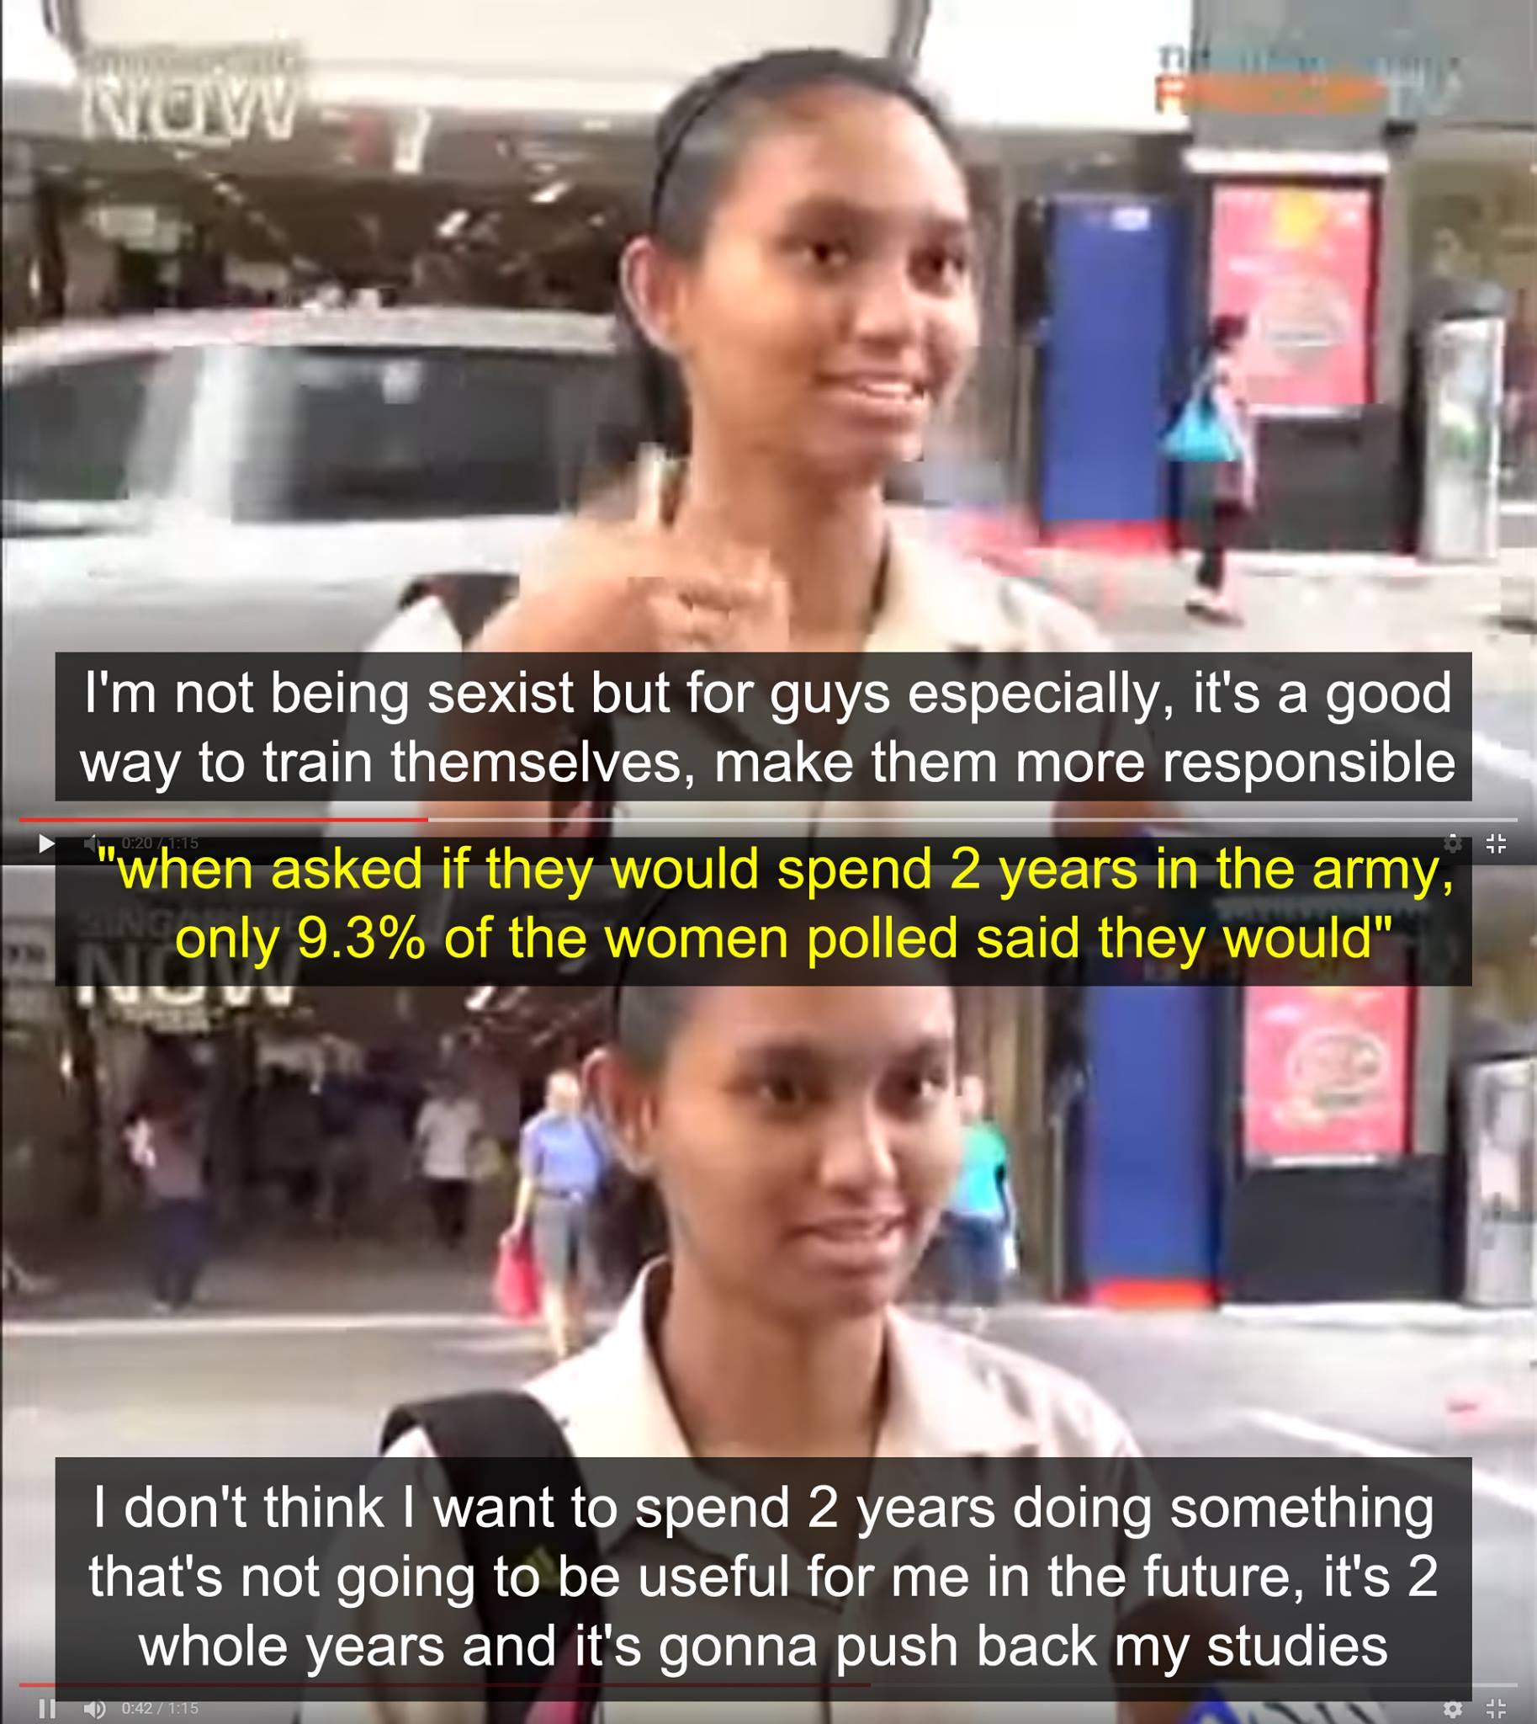
SUB-QUESTION: GENDER
FOOD FOR THOUGHT?
Tangible issues:
Males: Mandatory National Service pre university
Females: None
Other indirect balances that singaporeans input to offset this inequality:
Males supposedly get 200 SGD more per month as an indirect compensation for serving NS
http://gssq.blogspot.com/2013/12/gender-equality-in-singapore.html

Slide 12
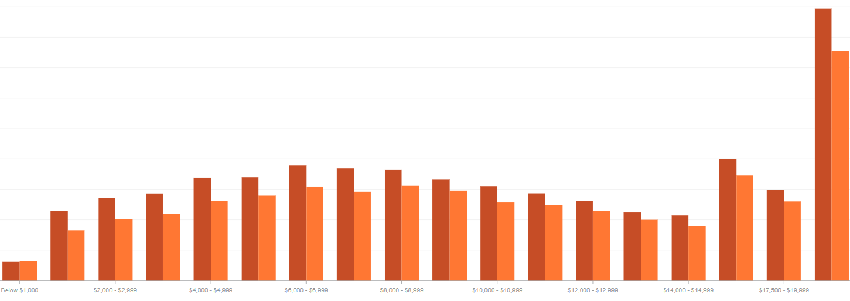
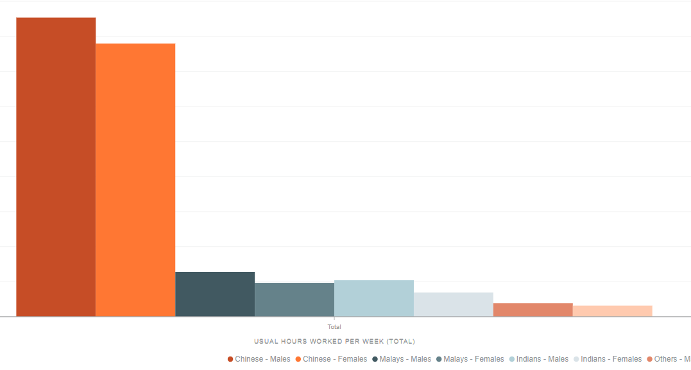
SUB-Question: gender
Is there more action to take from the government for gender equality in singapore?
Dataset can be crossed examined with "Enrolment - Pre-University, By Age & Sex"
Determine how this impacts income growth in the longrun
AMBIGUOUS
But Man also work
longer hours per week
Man earn more per month
Monthly Household Income from Work and Sex, 2015
Hours Worked Per Week, Ethnic Group and Sex, 2015
https://data.gov.sg/dataset/rwp-aged-15-yrs-over-by-mode-of-transport-to-work-monthly-household-income-from-work-sex-2015
https://data.gov.sg/dataset/resident-working-persons-aged-15-years-and-over-by-usual-hours-worked-per-week-ethnic-group-sex-2015

Slide 13
SUB-QUESTION (health) (social, physical & mental health)
Relevant columns
health
current health status (numeric: from 1 - very bad to 5 - very good)
absences
number of school absences (numeric: from 0 to 93)
Walc
weekend alcohol consumption (numeric: from 1 - very low to 5 - very high)
famrel
quality of family relationships (numeric: from 1 - very bad to 5 - excellent)
​
Does more absence in class affect grades?
Is it related to alchohol intake or family related problems at home?
is it possible to detect family problems at home and reduce such absenteeism in school?

Slide 14
SUB-QUESTION (Study/ life balance)
Relevant columns
freetime
free time after school (numeric: from 1 - very low to 5 - very high)
goout
going out with friends (numeric: from 1 - very low to 5 - very high)
romantic
with a romantic relationship (binary: yes or no)
​
Does more free time equate to better grades?
contrast with datasets from SG

Slide 15
SUB-QUESTION (Travel time to school)
Relevant columns
traveltime
home to school travel time (numeric: 1 - <15 min., 2 - 15 to 30 min., 3 - 30 min. to 1 hour, or 4 - >1 hour)
studytime
weekly study time (numeric: 1 - <2 hours, 2 - 2 to 5 hours, 3 - 5 to 10 hours, or 4 - >10 hours)
​
Does less travel to school equate to more study time?
If it does... does it translate to grades/ overall happiness of the family?
COVID-19's New normal -> more SFH (School from home)

Slide 16
SUB-QUESTION (income)
Relevant columns
famsize
family size (binary: 'LE3' - less or equal to 3 or 'GT3' - greater than 3)
Pstatus
parent's cohabitation status (binary: 'T' - living together or 'A' - apart)
Medu
mother's education (numeric: 0 - none, 1 - primary education (4th grade), 2 - 5th to 9th grade, 3 - secondary education or 4 - higher education)
Mjob
mother's job (nominal: 'teacher', 'health' care related, civil 'services' (e.g. administrative or police), 'at_home' or 'other')
Does meritocracy truly exist in Singapore?
If the apple is shown to statistically to not fall far from the tree, could there be measures to mitigate the inequality faced?
This can probably reduce brain drain in the future for singapore, making Singaporeans feel like their country is their home

Slide 17
SUB-QUESTION (income)
income inequality
1) higher rates of health and social problems
2) lower rates of social goods,^{[1]}
3) lower population-wide satisfaction and happiness^{[2][3]}
4) lower level of economic growth when human capital is neglected for high-end consumption.^{[4]}
For the top 21 industrialised countries, counting each person equally, life expectancy is lower in more unequal countries (r = -.907).[5]
A similar relationship exists among US states (r = -.620).[6]
Potential client goals
Reduce the negative effects early on in Singaporeans lives to mitigate the harmful effects of income disparity

Slide 18
SUB-QUESTION (EXT. /int. SUPPORT) lead on from income
Relevant columns
paid
extra paid classes within the course subject (Math or Portuguese) (binary: yes or no)
famsup
family educational support (binary: yes or no)
schoolsup
extra educational support (binary: yes or no)
How does internal and external support from govt. / family aid in grades?
If there is a clear difference perhaps more funding from the government towards students with no such aids should be provided to help level the playing field

