Slide 1
ADER: Adaptively Distilled Exemplar Replay Towards Continual Learning for Session-based Recommendation
FEI MI, XIAOYU LIN, and BOI FALTINGS,
Artificial Intelligence Laboratory,
Swiss Federal Institute of Technology Lausanne (EPFL), Switzerland
RecSys，2020
张钰波
Dec. 22, 2020

Slide 2
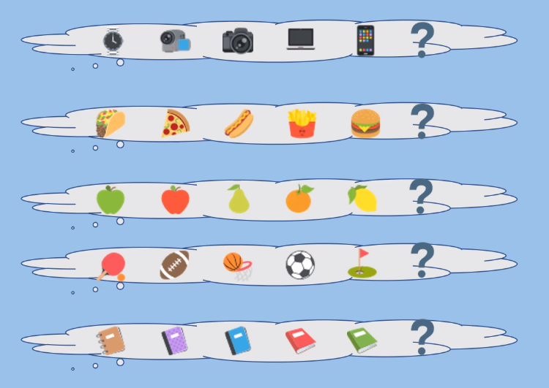
Background
What is a session-based recommendation?
The session-based recommender system predicts the items that the user will interact with according to the current user's session information.

Slide 3

Motivation
Always developed in an offline manner
Trained on a very large static training set
Various neural approaches
Recommender needs to be periodically updated
Continual learning
Catastrophic forgetting
Choose exemplars: Herding algorithm
Use exemplars: Knowledge distillation
ADER: exemplar replay

Slide 4
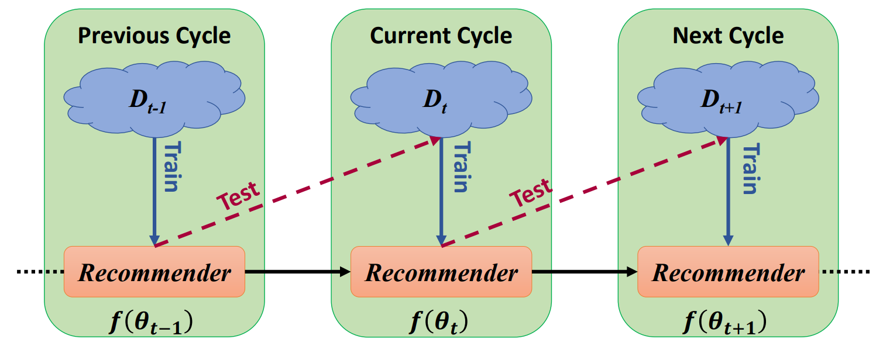
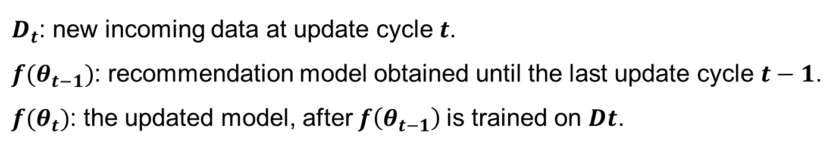
Model
Continual Learning Setup
$D_{t}$: new incoming data at update cycle $t$.
$f(θ_{t−1})$: recommendation model obtained until the last update cycle $t−1$.
$f(θ_{t})$: the updated model, after $f\left(θ_{t−1}\right)$is trained on 𝑫𝒕.

Slide 5
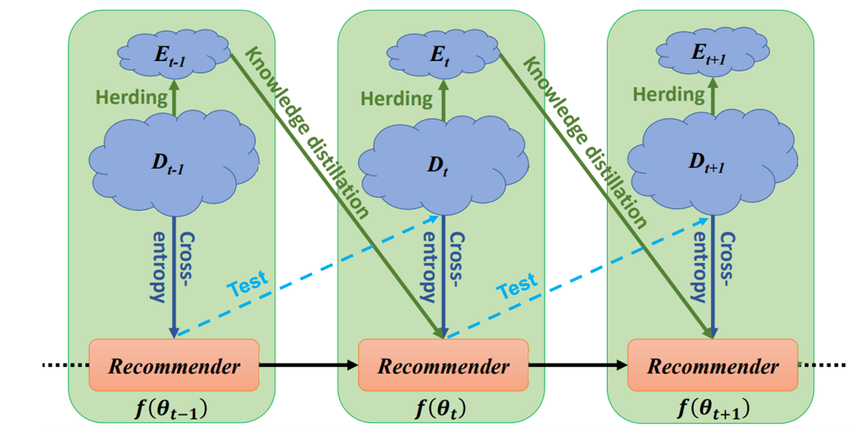
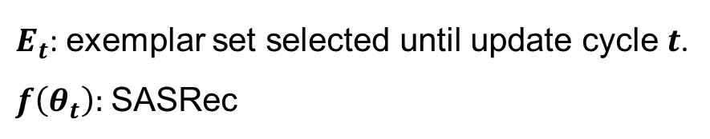
Model
Proposed Method
$E_{t}$: exemplar set selected until update cycle $t$.
$f\left(θ_{t}\right):$SASRec
Wang-Cheng Kang and Julian McAuley. 2018. Self-attentive sequential recommendation. In 2018 IEEE International Conference on Data Mining(ICDM). IEEE, 197–206.

Slide 6
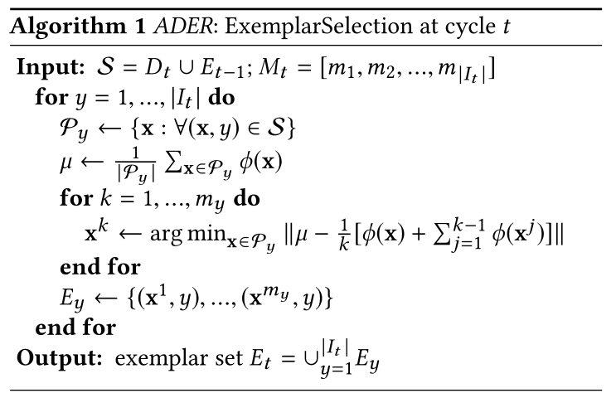
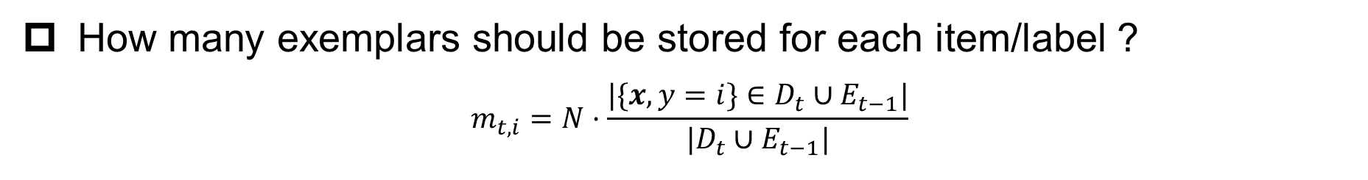
Exemplar Replay
How many exemplars should be stored for each item/label ?
$$m_{t,i}=N·\frac{|\{x,y=i\}∈D_{t}∪E_{t−1}|}{|D_{t}∪E_{t−1}|}$$
the probability that item $i$appears in the current update cycle
What is the criterion for selecting exemplars of an item/label ?
Herding technique
average feature vector
Sylvestre-Alvise Rebuffi, Alexander Kolesnikov, Georg Sperl, and Christoph H Lampert. 2017. icarl: Incremental classifier and representation learning.

Slide 7
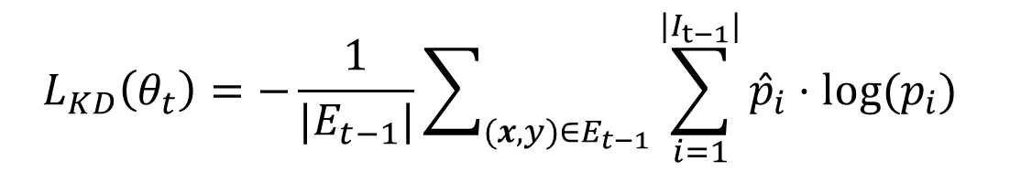
Adaptive Distillation on Exemplars
The number of exemplars is small
The constraint is not strong enough
Knowledge distillation loss
Knowledge Distillation (KD) loss on exemplars $E_{t−1}:$
$$L_{KD}\left(θ_{t}\right)=−\frac{1}{|E_{t−1}|}\sum_{(x,y)∈E_{t−1}}{\sum_{i=1}^{|I_{t−1}|}{{\hat{p}}_{i}·\text{log}\text{(}p_{i}\text{)} }}$$
[ ${\hat{p}}_{1},…,{\hat{p}}_{|I_{t−1}|}$] is predicted distribution generated by $f\left(θ_{t−1}\right)，$[ $p_{1},…,p_{|I_{t−1}|}$] is the prediction of $f(θ_{t})$
Geoffrey Hinton, Oriol Vinyals, and Jeff Dean. 2015. Distilling the knowledge in a neural network. arXiv preprint arXiv:1503.02531 (2015).

Slide 8
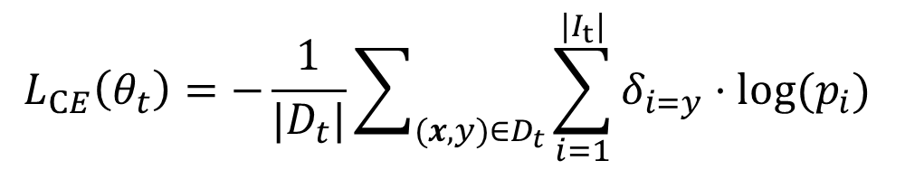
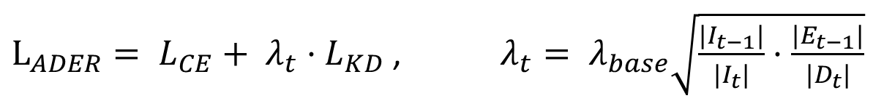
Adaptive Distillation on Exemplars
Regular Cross-Entropy (CE) loss computed w.r.t. $D_{t}$:
$$L_{CE}\left(θ_{t}\right)=−\frac{1}{|D_{t}|}\sum_{(x,y)∈D_{t}}{\sum_{i=1}^{|I_{t}|}{δ_{i=y}·\text{log}\text{(}p_{i}\text{)} }}$$
Propose an adaptive weight $λ_{t}$ to combine $L_{KD} with L_{CE}：$
$L_{ADER}= L_{CE}+ λ_{t}·L_{KD}$ , $λ_{t}= λ_{base}\sqrt{\frac{|I_{t−1}|}{|I_{t}|}·\frac{|E_{t−1}|}{|D_{t}|}}$

Slide 9
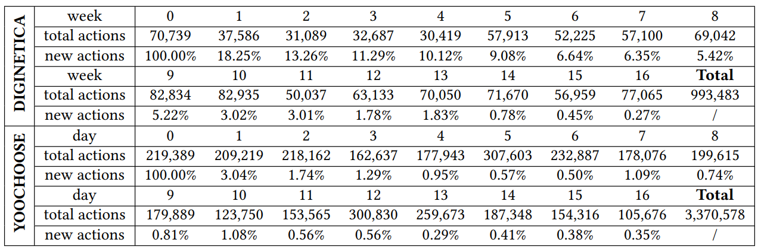
Experiments
Dataset
DIGINETICA: contains click-streams data on a e-commerce site over a 5 months
YOOCHOOSE: click-streams on another e-commerce site over 6 months
Evaluation Metrics
1) Recall @k 2) MRR @k
Reported the mean value of these two metrics averaged over all 16 update cycles.

Slide 10
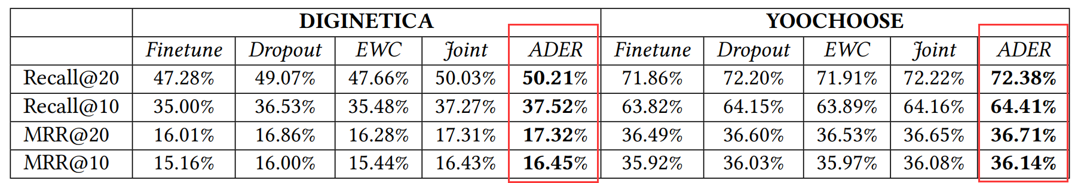
Experiments
Baseline Methods
Finetune: The recommender trained till the last task is trained with the data from the current task.
Dropout: Based on Finetune, we applied dropout to every self-attention and feed-forward layer.
EWC: Regularizing parameters important to previous data.
Joint: In each cycle, the recommender is trained (with dropout) using data from the current and all historical cycles.
Seyed-Iman Mirzadeh, Mehrdad Farajtabar, and Hassan Ghasemzadeh. 2020. Dropout as an Implicit Gating Mechanism For Continual Learning
James Kirkpatrick, Razvan Pascanu, Neil Rabinowitz, Joel Veness, Guillaume Desjardins, Andrei A Rusu, Kieran Milan, John Quan, Tiago Ramalho,Agnieszka Grabska-Barwinska, et al. 2017. Overcoming catastrophic forgetting in neural networks.

Slide 11
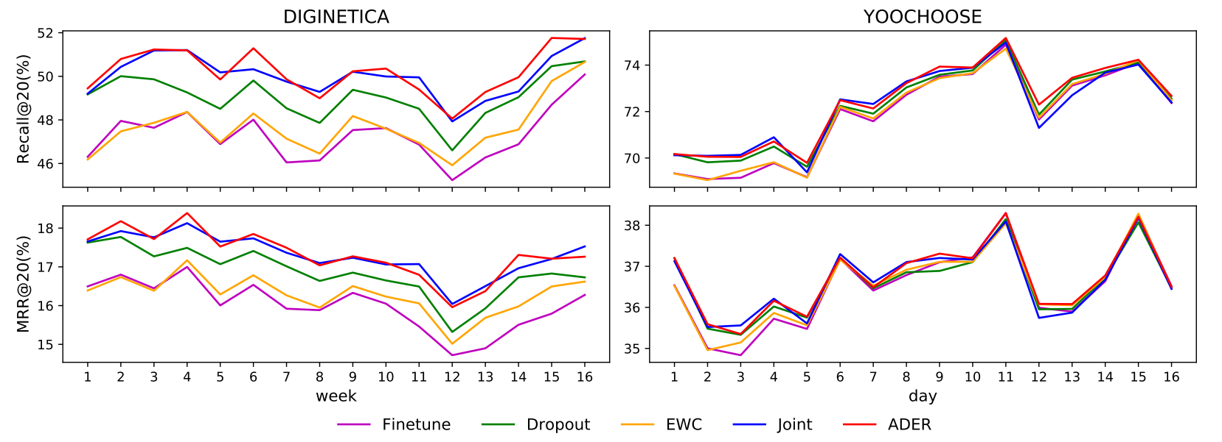
Experiments

Slide 12
Summary
The first to study the practical continual learning setting for the session-based recommendation task.
Propose a method called Adaptively Distilled Exemplar Replay (ADER) for this task, and benchmark it with continual learning techniques.

Slide 13
Thank you !

