Slide 1

Disentangled Graph Collaborative Filtering
SIGIR 2020
张钰波 2021.5.28

Slide 2
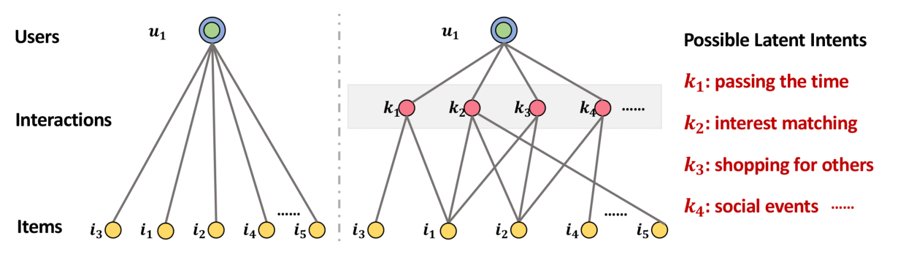
Motivation
Users generally has multiple intents to adopt certain items
Different intents could motivate different user behaviors
Basic CF idea: Similar users have similar preferences on items.
However: Obscure intents would confound the CF modeling of user similarity.
Conditional CF idea: With similar intents, similar users have similar preferences on items.

Slide 3
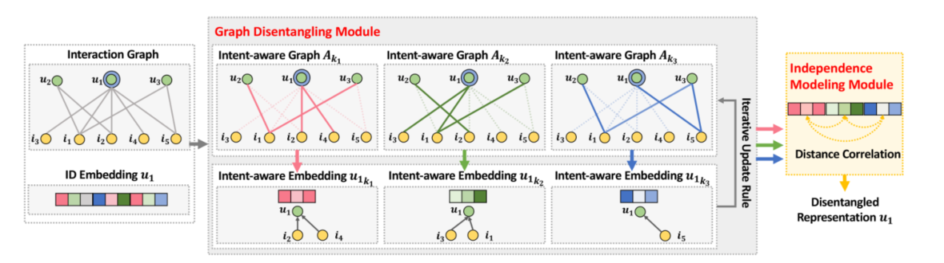
Embedding & Graph Initialization
Assuming K latent intents behind user behaviors
Intent-aware Embedding initialization
The chunked representation of the k-th intent
Intent-aware Graph initialization
The confidence of the $\left(u,i\right)$ interaction being derived by the k-th intent

Slide 4
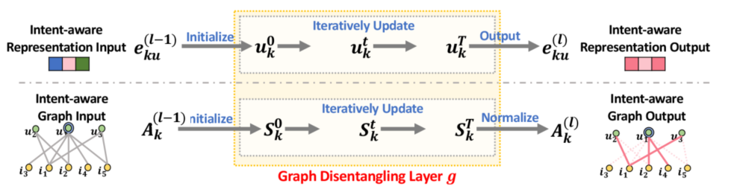
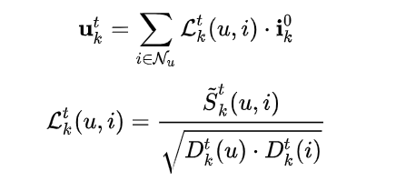





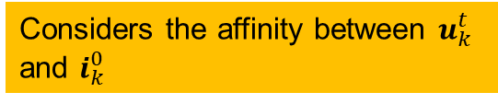
Graph Disentangling Layer
Dynamic Neighbor Routing Mechanism
Adaptively measure the intent-specific strengths of user-item connections
Information Propagation Mechanism
Distill the relevant information from higher-order user-item connections
Illustrate which intents should get more contributions to user behavior $\left(u,i\right)$
Information propagation and aggregation
Considers the affinity between $u_{k}^{t}$ and $i_{k}^{0}$

Slide 5




Independence Modeling Module
Disentangled intents should be independent of each others
$E_{k}∈ ℝ^{\left(M+N\right)×\frac{d}{K}}$is the embedding look-up table

Slide 6
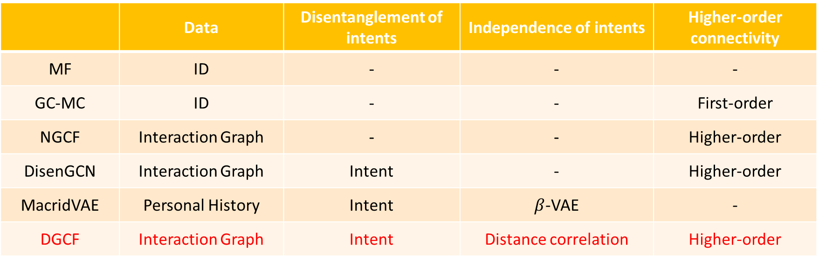
Experimental Results
Datasets
Gowalla, Amazon-Book, Yelp2018
Evaluation Metrics
recall@k, ndcg@k
Baselines
 | Data | Disentanglement of intents | Independence of intents | Higher-order connectivity
MF | ID | - | - | -
GC-MC | ID | - | - | First-order
NGCF | Interaction Graph | - | - | Higher-order
DisenGCN | Interaction Graph | Intent | - | Higher-order
MacridVAE | Personal History | Intent | $β$-VAE | -
DGCF | Interaction Graph | Intent | Distance correlation | Higher-order

Slide 7
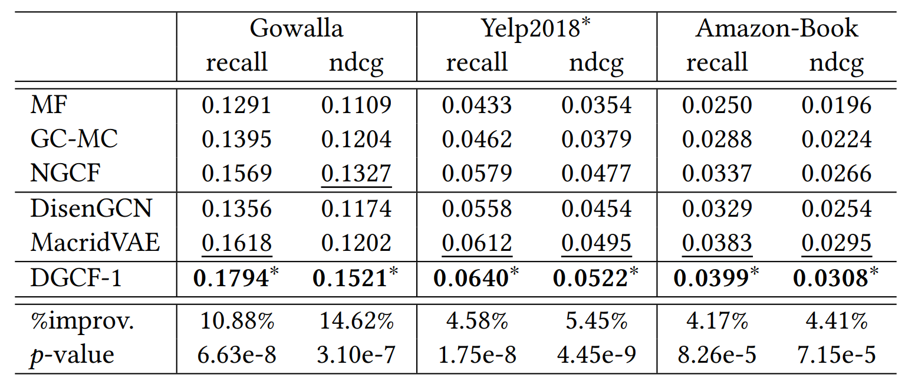
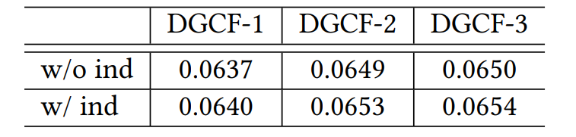
Experimental Results

Slide 8
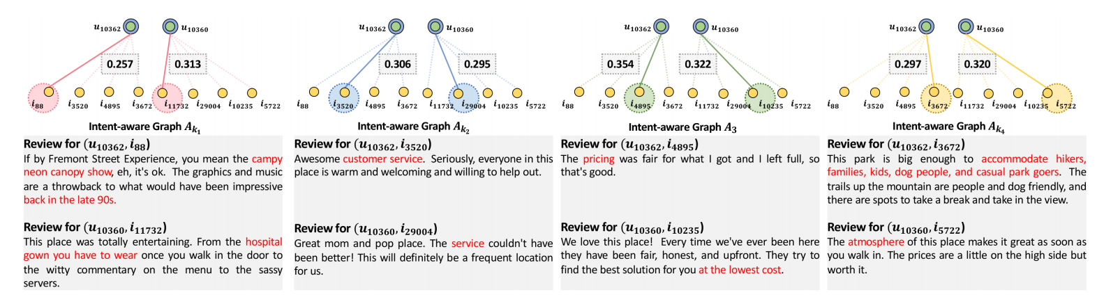
Experimental Results

Slide 9
Summarization
将 ICML 2019 的工作DisenGCN用在了推荐上，最大的不同是加入了独立建模模块，但是几乎没有作用。
阐明了协同过滤中用户和物品不同交互关系的重要性，能学到更好的表征以及具有更好的解释性。
和NGCF相比，DGCF在不需要学习额外参数的情况下，取得了显著的更好效果。

