Slide 1
PART A
STRUCTURE → NAME

Slide 2
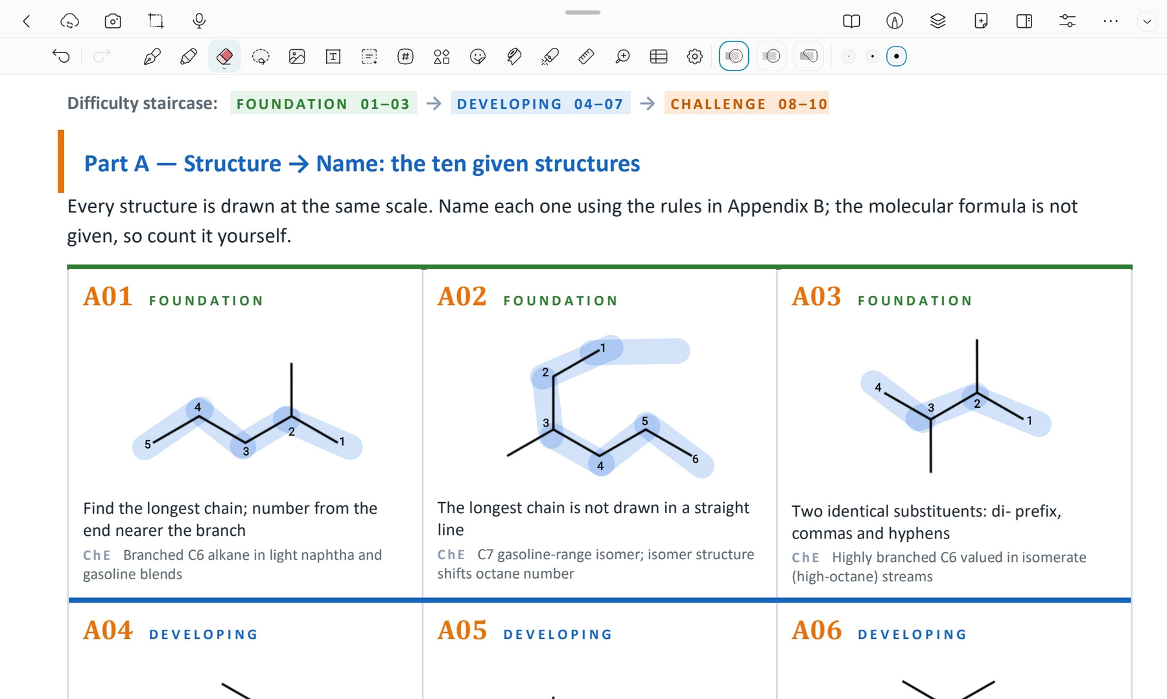
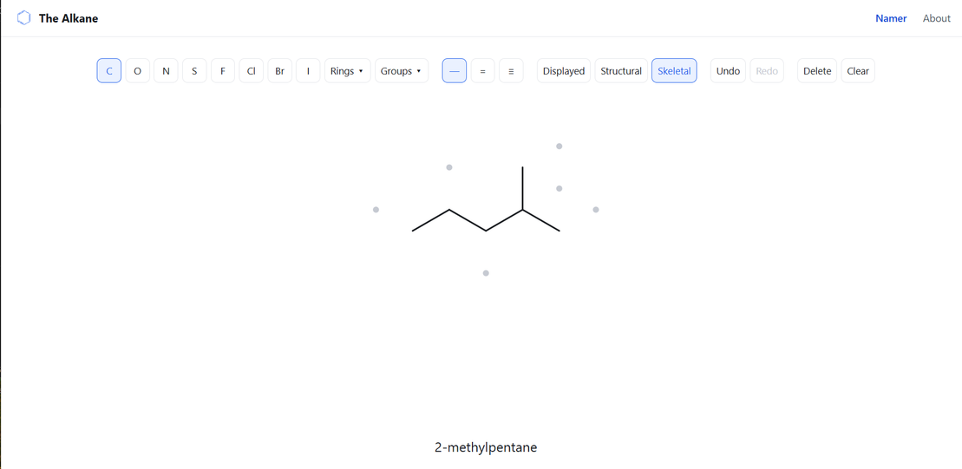
CARD A01 — STRUCTURE → NAME
Level: Foundation Molecular formula: C6H14
1. NUMBERED PARENT
2. NAMING TRAIL
Parent: longest chain = 5 C → Pentane. Other one 5-C paths exist, but each carries one methyl group.
Numbering: left → right gives 4; right → left gives 2. First point of difference: 2 < 4, so number from the right.
Substituents: methyl on C2 → 2-methyl.
3. MY NAME
4. THE ALKANE CHECK
2-methylpentane
Returned name: 2-methylpentane
✓ Match
VERIFICATION STRIP
✓ longest chain/ring | ✓ lowest locants | ✓ punctuation | ✓ formula counted

Slide 3
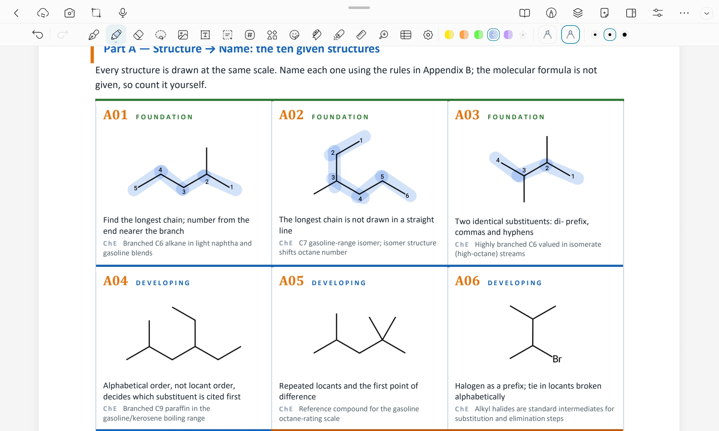
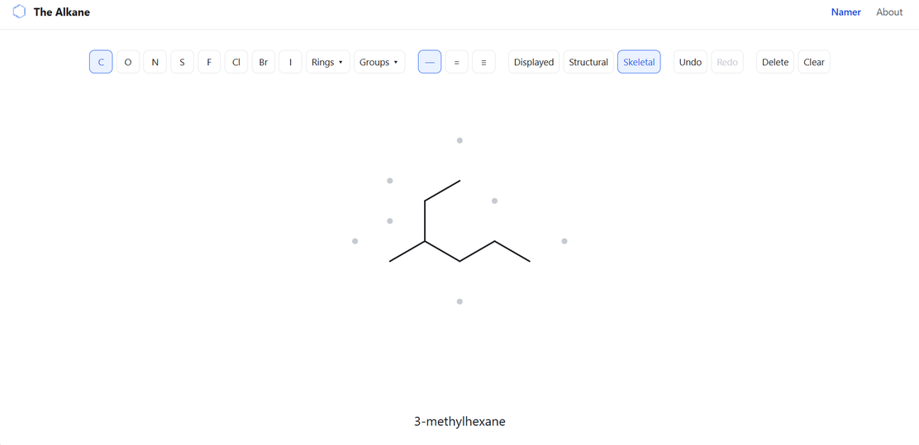
CARD A02 — STRUCTURE → NAME
Level: Foundation Molecular formula: C7H16
1. NUMBERED PARENT
2. NAMING TRAIL
Parent: longest chain = 6 C → Hexane. Several 6-C paths exist, but each carries one methyl group.
Numbering: left → right gives 3; right → left gives 4. First point of difference: 3 < 4, so number from the left.
Substituents: methyl on C3 → 3-methyl.
3. MY NAME
4. THE ALKANE CHECK
3-methylhexane
Returned name: 3-methylhexane
✓ Match
VERIFICATION STRIP
✓ longest chain/ring | ✓ lowest locants | ✓ punctuation | ✓ formula counted

Slide 4
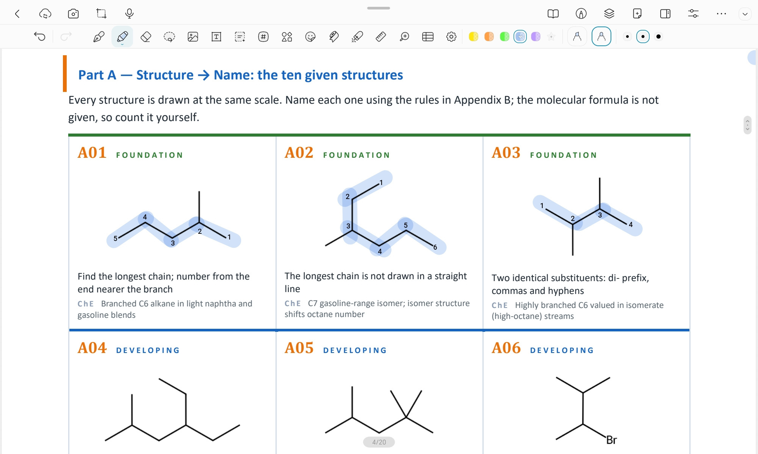
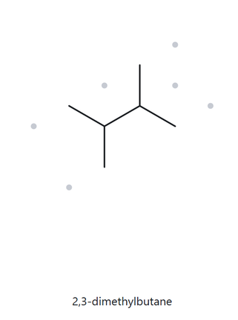
CARD A03 — STRUCTURE → NAME
Level: Foundation Molecular formula: C6H14
1. NUMBERED PARENT
2. NAMING TRAIL
Parent: longest chain = 4 C → butane. Several 4-C paths exist, but each carries two methyl groups.
Numbering: left → right gives 2,3; right → left gives 3,2. First point of difference: 2 < 3, so number from the left.
Substituents: methyl on C2 and C3 → 2,3-dimethyl.
3. MY NAME
4. THE ALKANE CHECK
2,3-dimethylbutane
Returned name: 2,3-dimethylbutane
✓ Match
VERIFICATION STRIP
✓ longest chain/ring | ✓ lowest locants | ✓ punctuation | ✓ formula counted

Slide 5
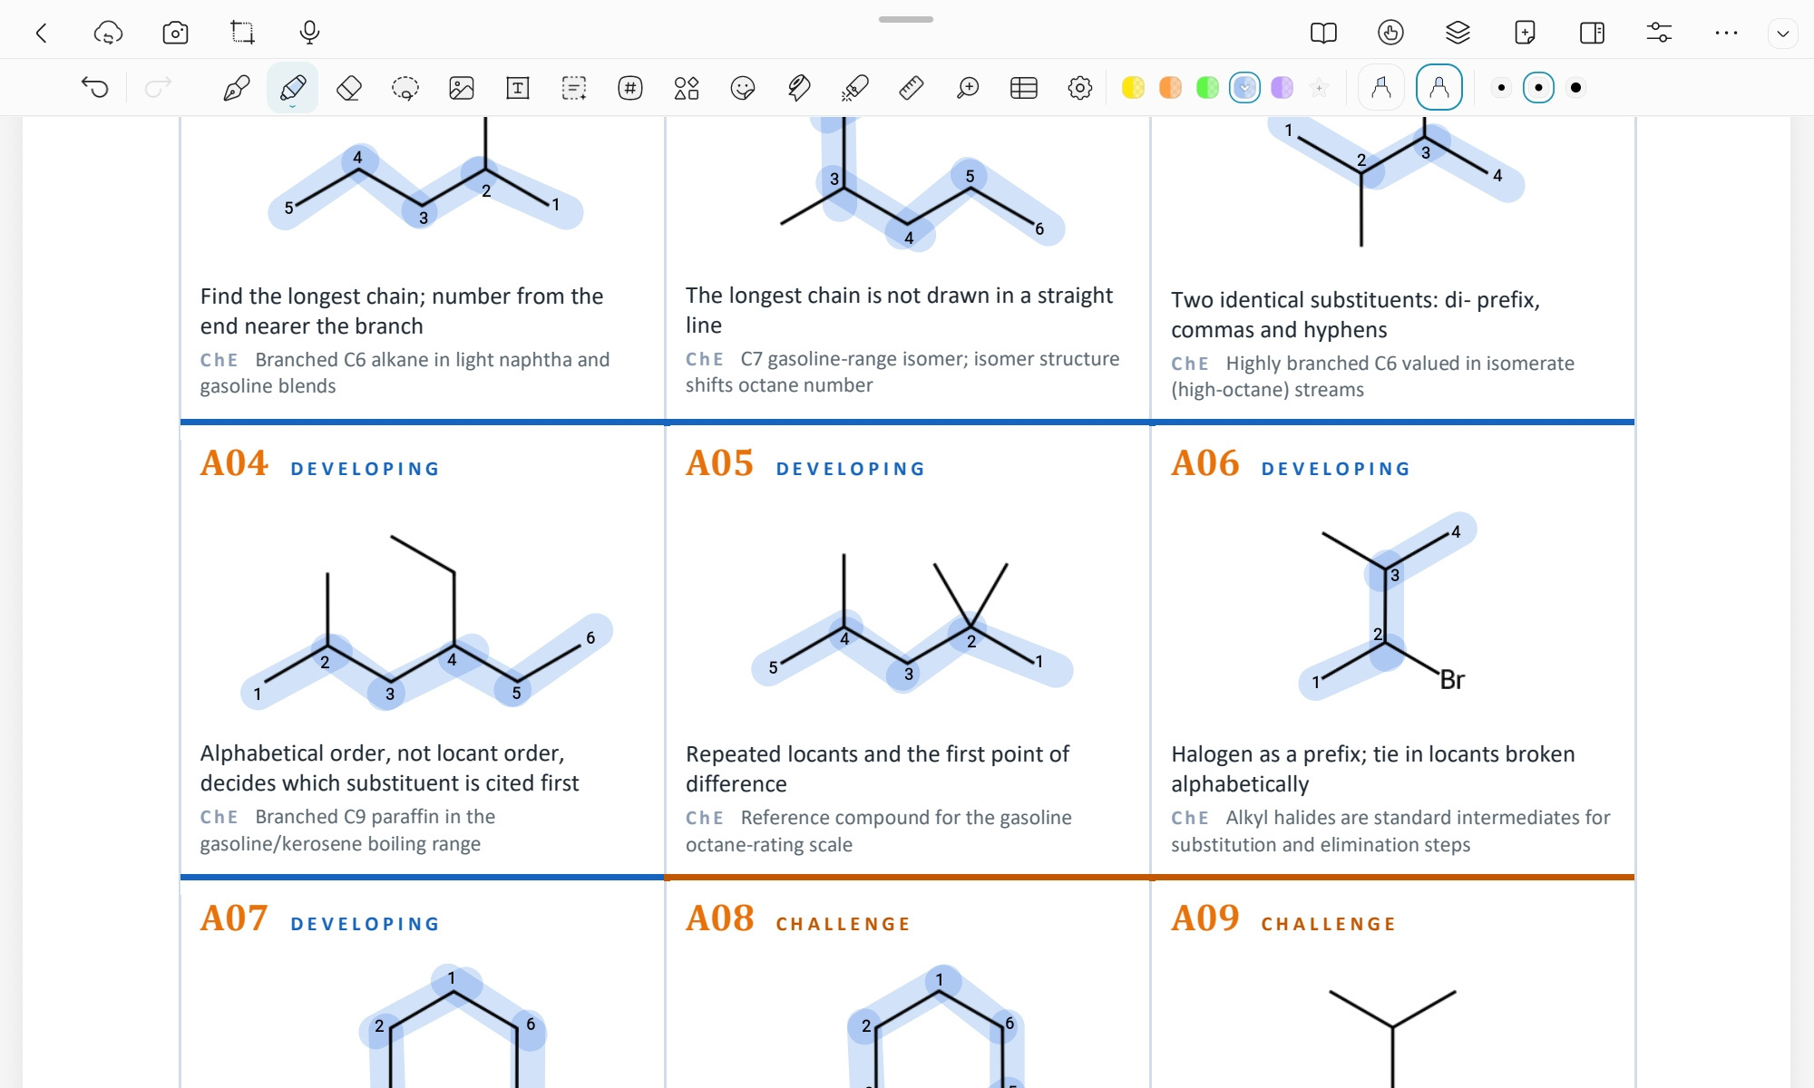
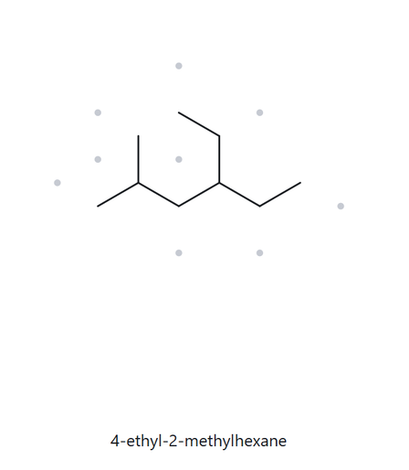
CARD A04 — STRUCTURE → NAME
Level: Developing Molecular formula: C9H20
1. NUMBERED PARENT
2. NAMING TRAIL
Parent: longest chain = 6 C → hexane. Several 6-C paths exist, but each carries one methyl group and one ethyl group.
Numbering: left → right gives 2,4; right → left gives 3,5. First point of difference: 2 < 3, so number from the left.
Substituents: methyl on C2 and ethyl on C4 → 4-ethyl-2-methyl.
3. MY NAME
4. THE ALKANE CHECK
4-ethyl-2-methylhexane
Returned name: 4-ethyl-2-methylhexane
✓ Match
VERIFICATION STRIP
✓ longest chain/ring | ✓ lowest locants | ✓ alphabetical order | ✓ punctuation | ✓ formula counted

Slide 6
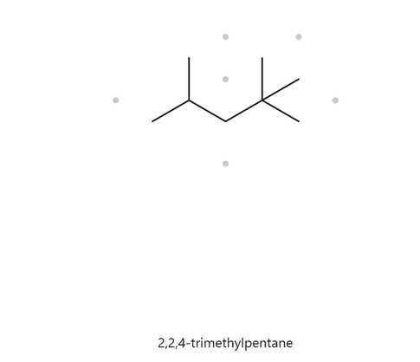
CARD A05 — STRUCTURE → NAME
Level: Developing Molecular formula: C8H18
1. NUMBERED PARENT
2. NAMING TRAIL
Parent: longest chain = 5 C → hexane. Several 5-C paths exist, but each carries three methyl groups.
Numbering: left → right gives 2,4,4; right → left gives 2,2,4. First point of difference: 2 < 4, so number from the right.
Substituents: methyl on C2 and C4 → 2,2,4-trimethyl.
3. MY NAME
4. THE ALKANE CHECK
2,2,4-trimethylpentane
Returned name: 2,2,4-trimethylpentane
✓ Match
VERIFICATION STRIP
✓ longest chain/ring | ✓ lowest locants | ✓ punctuation | ✓ formula counted

Slide 7
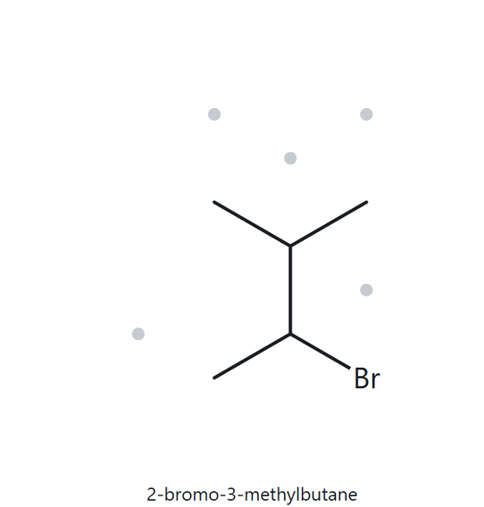
CARD A06 — STRUCTURE → NAME
Level: Developing Molecular formula: C5H11Br
1. NUMBERED PARENT
2. NAMING TRAIL
Parent: longest chain = 4 C → butane. Several 4-C paths exist, but each carries bromine and one methyl group.
Numbering: left → right gives 2,3; right → left gives 2,3. Same point, either direction, so use the alphabetical tie-breaker.
Substituents: bromo on C2 and methyl on C3 → 2-bromo, 3-methyl
3. MY NAME
4. THE ALKANE CHECK
2-bromo-3-methylbutane
Returned name: 2-bromo-3-methylbutane
✓ Match
VERIFICATION STRIP
✓ longest chain/ring | ✓ lowest locants | ✓ alphabetical order | ✓ punctuation | ✓ formula counted

Slide 8
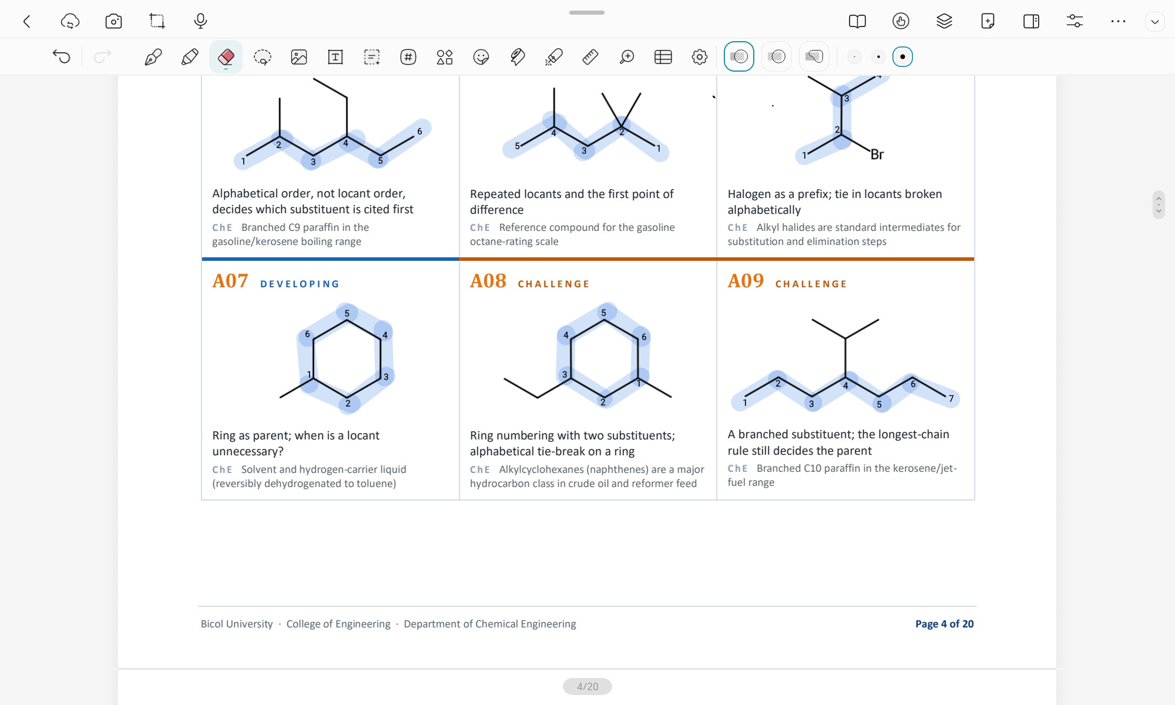
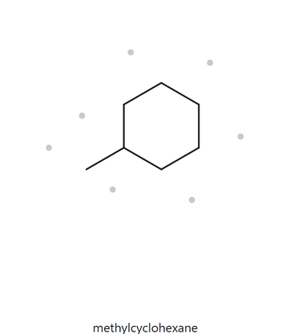
CARD A07 — STRUCTURE → NAME
Level: Developing Molecular formula: C7H14
1. NUMBERED PARENT
2. NAMING TRAIL
Parent: Ring present → ring is the parent → cyclohexane (6 C).
Numbering: Only one substituent is attached to the ring, so a locant is unnecessary.
Substituents: methyl on C1→ 1-methyl
3. MY NAME
4. THE ALKANE CHECK
methylcyclohexane
Returned name: methylcyclohexane
✓ Match
VERIFICATION STRIP
✓ longest chain/ring | ✓ lowest locants | ✓ punctuation | ✓ formula counted

Slide 9
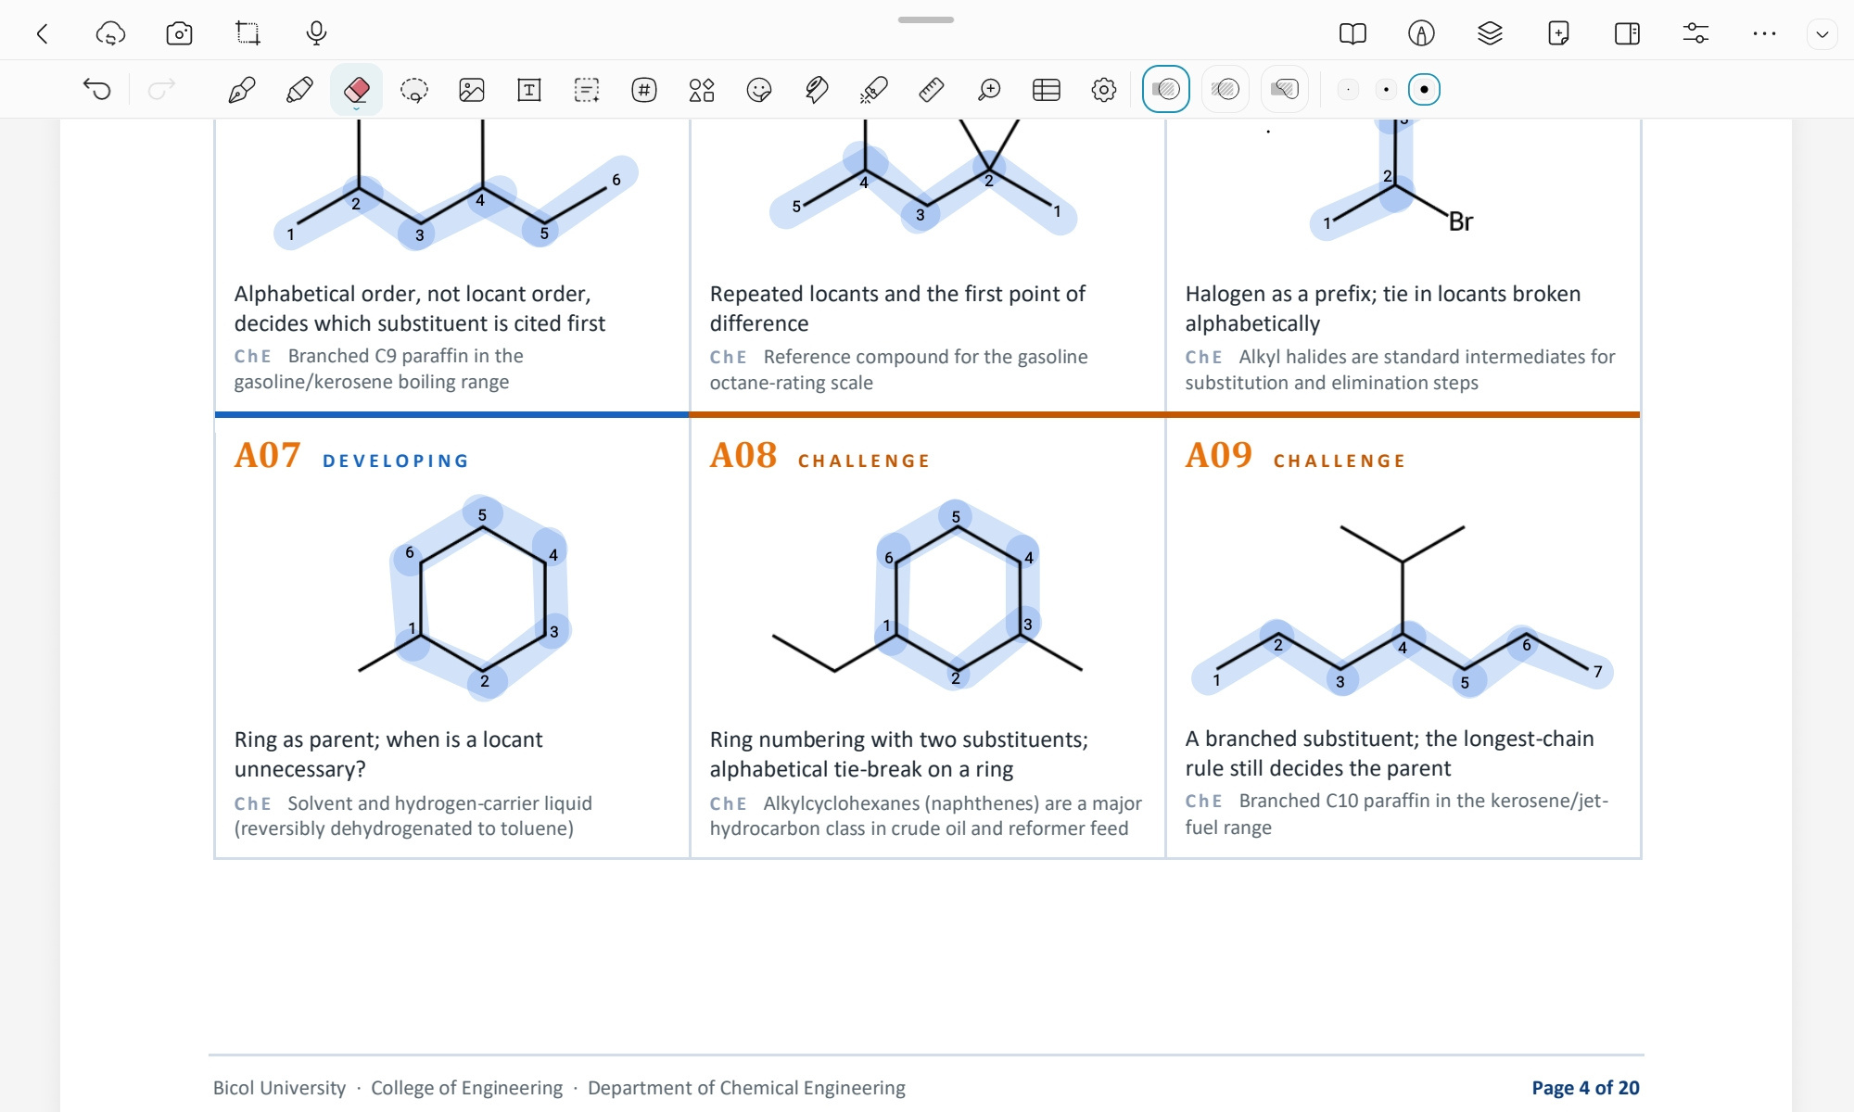
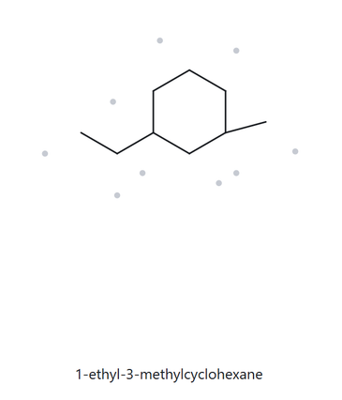
CARD A08 — STRUCTURE → NAME
Level: Challenge Molecular formula: C9H18
1. NUMBERED PARENT
2. NAMING TRAIL
Parent: Ring present → ring is the parent → cyclohexane (6 C).
Numbering: Both directions give locants 1 and 3, so use the alphabetical tie-breaker.
Substituents: ethyl on C1 and methyl on C3 → 1-ethyl,3-methyl
3. MY NAME
4. THE ALKANE CHECK
1-ethyl-3 -methylcyclohexane
Returned name: 1-ethyl-3-
methylcyclohexane
✓ Match
VERIFICATION STRIP
✓ longest chain/ring | ✓ lowest locants | ✓ alphabetical order | ✓ punctuation | ✓ formula counted

Slide 10
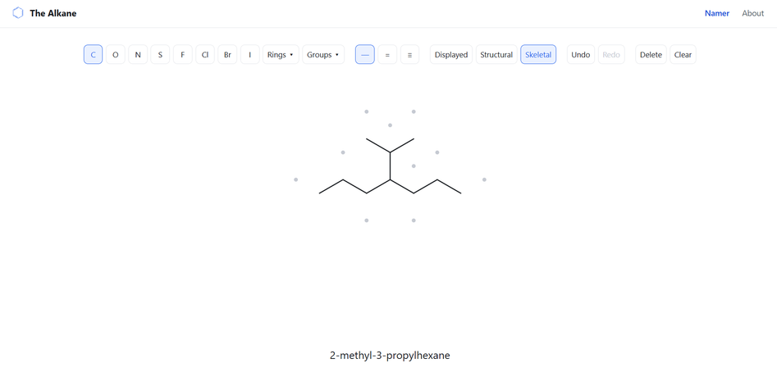
CARD A09 — STRUCTURE → NAME
Level: Challenge Molecular formula: C10H22
1. NUMBERED PARENT
2. NAMING TRAIL
Parent: longest chain = 7 C → heptane. The longest chain runs along the bottom zigzag, and the upper branch is a three-carbon substituent attached through its middle carbon.
Numbering: Both directions give locant 4.
Substituents: isopropyl on C4 → 4-isopropyl
3. MY NAME
4. THE ALKANE CHECK
4-isopropylheptane
Returned name: 2-methyl-3-propylhexane
✗ Mismatch
Explanation: The longest continuous chain contains 7 carbon atoms. Therefore, the correct parent is heptane, giving 4-isopropylheptane.
VERIFICATION STRIP
✓ longest chain/ring | ✓ lowest locants | ✓ punctuation | ✓ formula counted

Slide 11
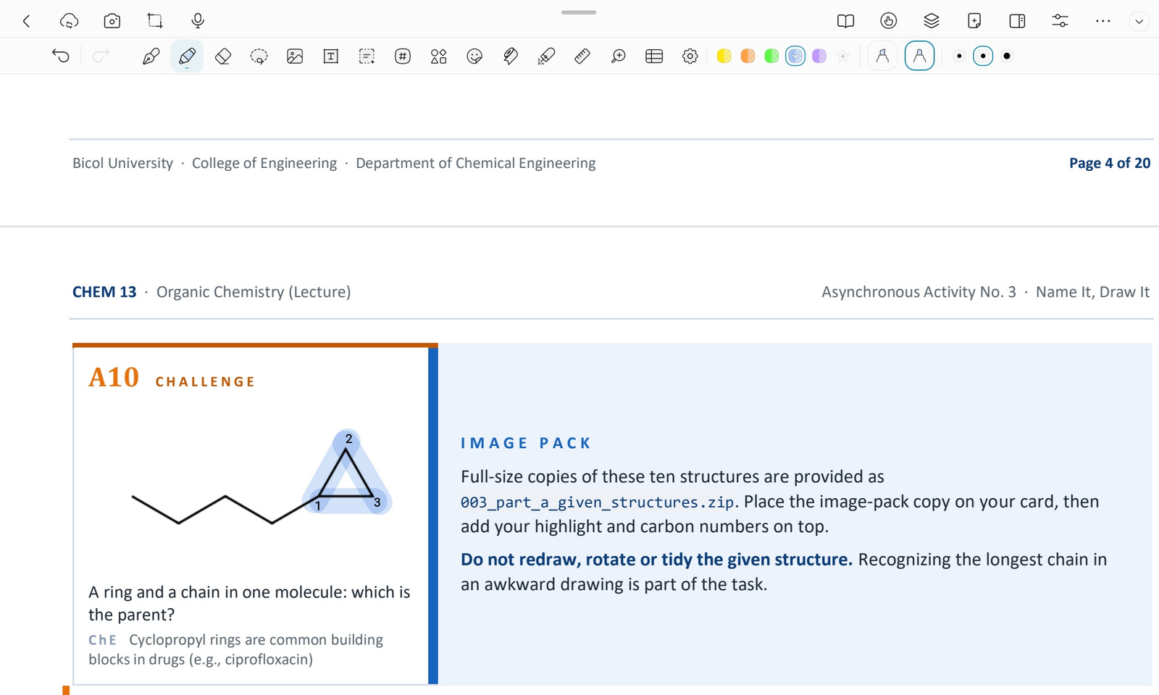
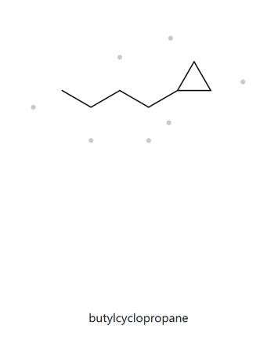
CARD A10 — STRUCTURE → NAME
Level: Challenge Molecular formula: C7H14
1. NUMBERED PARENT
2. NAMING TRAIL
Parent: Ring present → ring is the parent → cyclopropane (3 C).
Numbering: A ring with one substituent needs no locant.
Substituents: butyl on C1 → butyl
3. MY NAME
4. THE ALKANE CHECK
butylcyclopropane
Returned name: butylcyclopropane
✓ Match
VERIFICATION STRIP
✓ longest chain/ring | ✓ lowest locants | ✓ punctuation | ✓ formula counted

Slide 12
PART B
NAME → STRUCTURE

Slide 13
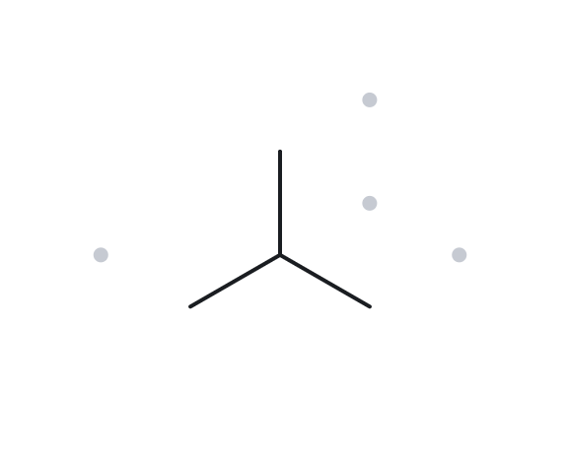
CARD B01 — NAME → STRUCTURE
Level: Foundation Given name: 2-methylpropane
1. NAME DECODED
2. BOND-LINE STRUCTURE
(THE ALKANE)
Parent: propane→ a 3-carbon chain
Substituents: methyl on C2
Expected formula: 3 + 1 = 4 C; acyclic alkane → C4H10
3. FORMULA CHECK
4. BACK-CHECK
Counted from the drawing: C4H10
Acyclic Alkane:
CnH2n+2 = C4H10
C4H10 ✓
Returned by The Alkane:
2-methylpropane
✓ Same as the given name
VERIFICATION STRIP
✓ parent length matches | ✓ positions | ✓ formula | ✓ back-check

Slide 14
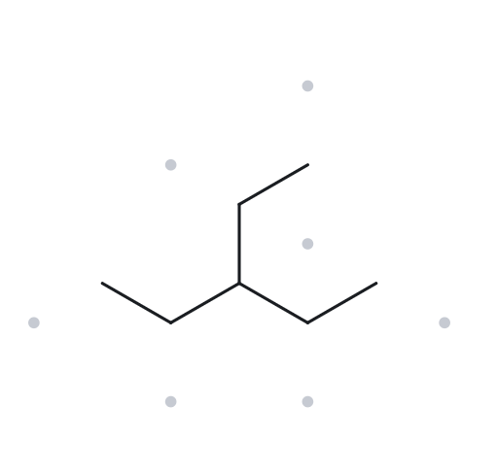
CARD B02 — NAME → STRUCTURE
Level: Foundation Given name: 3-ethylpentane
1. NAME DECODED
2. BOND-LINE STRUCTURE
(THE ALKANE)
Parent: pentane→ a 5-carbon chain
Substituents: ethyl on C3
Expected formula: 5 + 2 = 7 C; acyclic alkane → C7H16
3. FORMULA CHECK
4. BACK-CHECK
Counted from the drawing: C7H16
Acyclic Alkane:
CnH2n+2 = C7H16
C7H16 ✓
Returned by The Alkane:
3-ethylpentane
✓ Same as the given name
VERIFICATION STRIP
✓ parent length matches | ✓ positions | ✓ formula | ✓ back-check

Slide 15
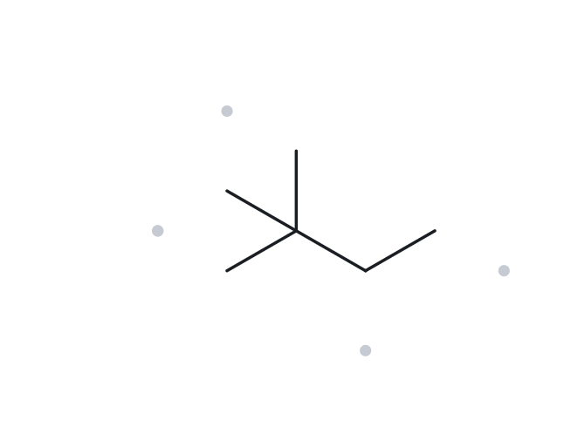
CARD B03 — NAME → STRUCTURE
Level: Foundation Given name: 2,2-dimethylbutane
1. NAME DECODED
2. BOND-LINE STRUCTURE
(THE ALKANE)
Parent: butane→ a 4-carbon chain
Substituents: methyl on C2
Expected formula: 4 + 2 = 6 C; acyclic alkane → C6H14
3. FORMULA CHECK
4. BACK-CHECK
Counted from the drawing: C7H16
Acyclic Alkane:
CnH2n+2 = C6H14
C6H14 ✓
Returned by The Alkane:
2,2-dimethylbutane
✓ Same as the given name
VERIFICATION STRIP
✓ parent length matches | ✓ positions | ✓ formula | ✓ back-check

Slide 16
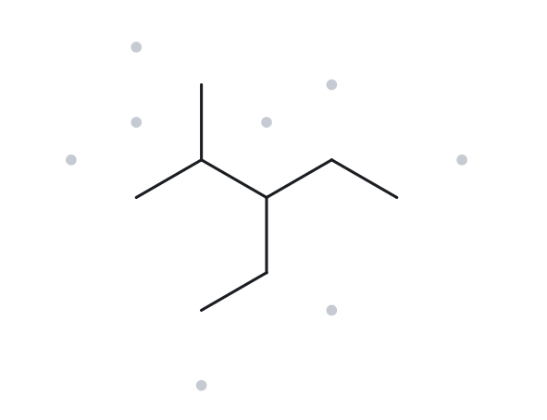
CARD B04 — NAME → STRUCTURE
Level: Developing Given name: 3-ethyl-2-methylpentane
1. NAME DECODED
2. BOND-LINE STRUCTURE
(THE ALKANE)
Parent: pentane → a 5-carbon chain
Substituents: ethyl on C3 ; methyl on C2
Expected formula: 5 + 2 + 1 = 8 C; acyclic alkane → C8H18
3. FORMULA CHECK
4. BACK-CHECK
Counted from the drawing: C8H18
Acyclic Alkane:
CnH2n+2 = C8H18
C8H18 ✓
Returned by The Alkane:
3-ethyl-2-methylpentane
✓ Same as the given name
VERIFICATION STRIP
✓ parent length matches | ✓ positions | ✓ formula | ✓ back-check

Slide 17
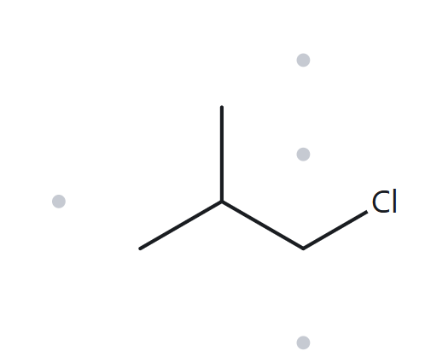
CARD B05 — NAME → STRUCTURE
Level: Developing Given name: 1-chloro-2-methylpropane
1. NAME DECODED
2. BOND-LINE STRUCTURE
(THE ALKANE)
Parent: propane → a 3-carbon chain
Substituents: chloro on C1 ; methyl on C2
Expected formula: 3 + 1 = 4 C; acyclic alkane → C4H10; Cl replaces one H → C4H9Cl
3. FORMULA CHECK
4. BACK-CHECK
Counted from the drawing: C4H9Cl
Acyclic Alkane:
CnH2n+2 = C4H10; minus one H for Cl =C4H9Cl
C4H9Cl ✓
Returned by The Alkane:
1-chloro-2-methylpropane
✓ Same as the given name
VERIFICATION STRIP
✓ parent length matches | ✓ positions | ✓ formula | ✓ back-check

Slide 18
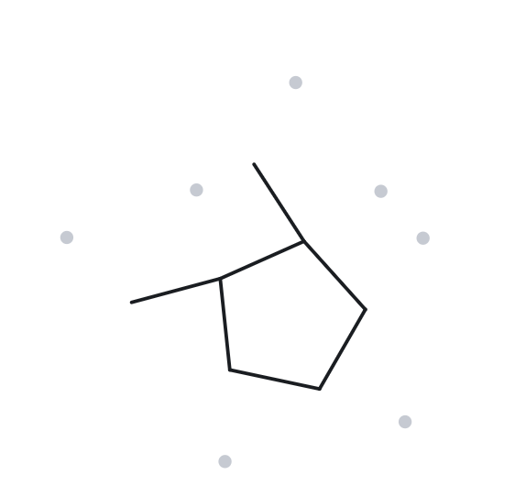
CARD B06 — NAME → STRUCTURE
Level: Developing Given name: 1,2-dimethylcyclopentane
1. NAME DECODED
2. BOND-LINE STRUCTURE
(THE ALKANE)
Parent: cyclopentane→ a 5-carbon ring
Substituents: methyl on C1 ; methyl on C2
Expected formula: 5 + 2 = 7 C; one ring → C7H14
3. FORMULA CHECK
4. BACK-CHECK
Counted from the drawing: C7H14
One Ring:
CnH2n = C7H14
C7H14 ✓
Returned by The Alkane:
1,2-dimethylcyclopentane
✓ Same as the given name
VERIFICATION STRIP
✓ parent length matches | ✓ positions | ✓ formula | ✓ back-check

Slide 19
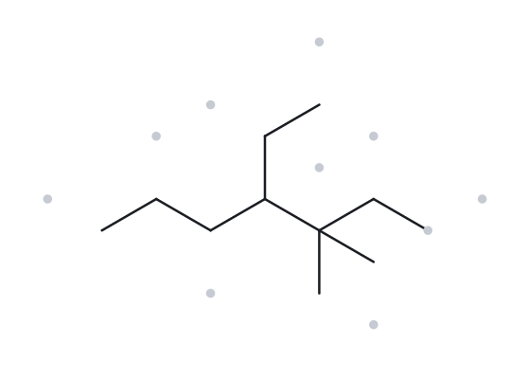
CARD B07 — NAME → STRUCTURE
Level: Developing Given name: 4-ethyl-3,3-dimethylheptane
1. NAME DECODED
2. BOND-LINE STRUCTURE
(THE ALKANE)
Parent: heptane→ a 7-carbon chain
Substituents: ethyl on C4; methyl on C3
Expected formula: 7 + 2 + 2 = 11 C; acyclic alkane → C11H24
3. FORMULA CHECK
4. BACK-CHECK
Counted from the drawing: C11H24
One Ring:
CnH2n = C11H24
C11H24 ✓
Returned by The Alkane:
4-ethyl-3,3-dimethylheptane
✓ Same as the given name
VERIFICATION STRIP
✓ parent length matches | ✓ positions | ✓ formula | ✓ back-check

Slide 20
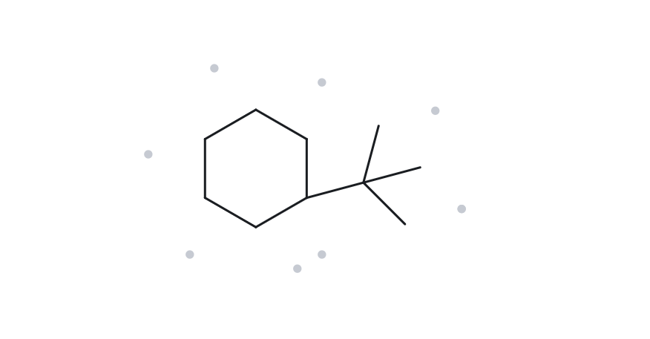
CARD B08 — NAME → STRUCTURE
Level: Challenge Given name: tert-butylcyclohexane
1. NAME DECODED
2. BOND-LINE STRUCTURE
(THE ALKANE)
Parent: cyclohexane → a 6-carbon ring
Substituents: tert-butyl on C1
Expected formula: 6 + 4 = 10 C; one ring → C10H24
3. FORMULA CHECK
4. BACK-CHECK
Returned by The Alkane:
(1,1-dimethylethyl)cyclohexane
✓ Same as the given name
Explanation: “tert-Butyl” is the common name for the substituent, while “1,1-dimethylethyl” is its systematic name. Both names describe the same substituent and therefore refer to the same compound. Both represent the same group:
-C(CH3)3
Counted from the drawing: C10H24
One Ring:
CnH2n = C10H24
C10H24 ✓
VERIFICATION STRIP
✓ parent length matches | ✓ positions | ✓ formula | ✓ back-check

Slide 21
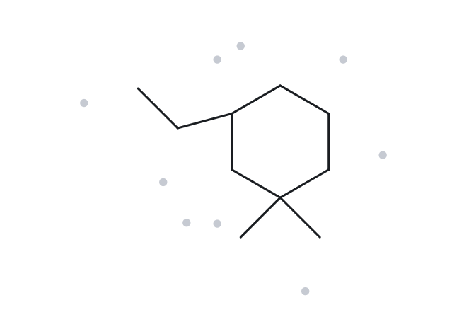
CARD B09 — NAME → STRUCTURE
Level: Challenge Given name: 3-ethyl-1,1-dimethylcyclohexane
1. NAME DECODED
2. BOND-LINE STRUCTURE
(THE ALKANE)
Parent: cyclohexane → a 6-carbon ring
Substituents: ethyl on C3; methyl on C1
Expected formula: 6 + 2 + 2 = 10 C; one ring → C10H20
3. FORMULA CHECK
4. BACK-CHECK
Counted from the drawing: C10H20
One Ring:
CnH2n = C10H20
C10H20 ✓
Returned by The Alkane:
3-ethyl-1,1-dimethylcyclohexane
✓ Same as the given name
VERIFICATION STRIP
✓ parent length matches | ✓ positions | ✓ formula | ✓ back-check

Slide 22
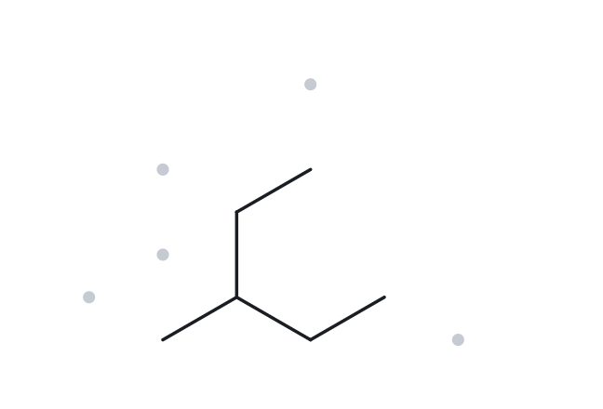
CARD B010 — NAME → STRUCTURE
Level: Challenge Given name: 2-ethylbutane
1. NAME DECODED
2. BOND-LINE STRUCTURE
(THE ALKANE)
Parent: butane→ a 4-carbon chain
Substituents: ethyl on C2;
Expected formula: 4 + 2 = 6 C; acyclic alkane → C6H14
3. FORMULA CHECK
4. BACK-CHECK
Returned by The Alkane:
3-methylpentane
✗ Given name is not the correct IUPAC name
Explanation: The given name, 2-ethylbutane, uses a four-carbon parent chain. However, the structure has a longer continuous chain of five carbon atoms, so the parent name must be pentane. The remaining carbon is a methyl substituent attached to carbon 3. Therefore, the correct IUPAC name is 3-methylpentane.
Counted from the drawing: C6H14
Acyclic Alkane:
CnH2n+2 = C6H14
C6H14 ✓
VERIFICATION STRIP
✓ parent length matches | ✓ positions | ✓ formula | ✓ back-check

