Slide 1
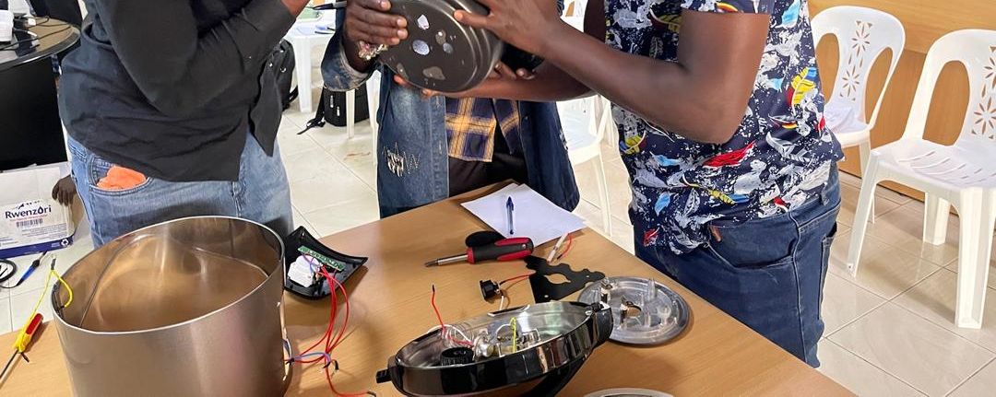
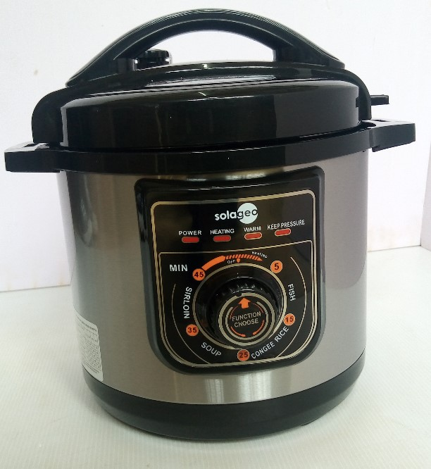
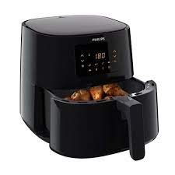
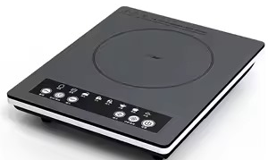
Training of Trainers (ToT) Program
For e-Cooking Appliances Repair and Maintenance

Slide 2
Core Trainers
Name | Modules handled
Agaba Jimmy | Pending *
Kayeera Nathan | Pending *
Kayemba Charles | Pending *
Nabanoba Jenny | Pending *
Nabagesera Angela | Pending *

Slide 3
Reserve Trainer
Name | Modules handled
Steven (UMEME) | Pending *

Slide 4
Program Overview
The Training of Trainers (ToT) Program aims to equip the core trainers with advanced knowledge and pedagogical skills to effectively deliver training on the repair and maintenance of eCooking appliances, focusing on Electric Pressure Cookers (EPCs), Induction Cookers, and Air Fryers.

Slide 5
Training Objectives
To master the use of diagnostic tools and interpret error codes effectively
To enhance training delivery skills, focusing on interactive and practical learning methods

Slide 6
Training Modules
Module | Description
Module 1 | Introduction to eCooking Appliances (Overview of EPCs, Induction Cookers, and Air Fryers)
Module 2 | Use and Operation (Step-by-step operations and demonstrations)
Module 3 | Tools and Safety Precautions (Essential tools and safety guidelines)
Module 4 | Dismantling and Component Identification (Hands-on dismantling techniques)
Module 5 | Diagnosing Common Faults (Identifying and resolving faults)
Module 6 | Component Testing and Repair Techniques (Testing components and replacement procedures)
Module 7 | End-of-Life Management and E-Waste Handling (E-waste management and sustainability)
Module 8 | Customer Service and Entrepreneurship (Effective communication and business strategies)
Module 9 | Training Delivery Techniques (Adult learning principles and classroom management)

Slide 7
Training Schedule DAY 1 (wed)
Time | Activity
08:00 - 08:30 | Arrival and Welcome Remarks
08:30 - 09:00 | Introduction to Training Objectives
09:00 - 10:00 | Introduction to e-Cooking Appliances
10:00 - 10:30 | Tea Break
10:30 - 12:00 | Use and Operation (Demonstrations)
12:00 - 13:00 | Tools and Safety Precautions
13:00 - 14:00 | Lunch Break
14:00 - 15:30 | Dismantling and Component Identification
15:30 - 16:00 | Tea Break
16:00 - 17:00 | Review of Day’s Learning, Q&A Session

Slide 8
Training Schedule DAY 2 (THUR)
Time | Activity
08:00 - 08:30 | Arrival and Welcome Remarks plus Recap of D1
08:30 - 10:00 | Diagnosing Common Faults (Practical Exercises)
10:00 - 10:30 | Tea Break
10:30 - 12:00 | Component Testing and Repair Techniques
12:00 - 13:00 | End-of-Life Management and E-Waste Handling
13:00 - 14:00 | Lunch Break
14:00 - 15:00 | Customer Service and Entrepreneurship *
15:00 - 16:00 | Training Delivery Techniques
16:00 - 17:00 | Feedback, and preparation for Monday training

Slide 9
Logistics & Resources
Training venue setup with workstations for hands-on practice. (That is Solar Lab and Bio Lab).
Provision of training materials, tools, and equipment.
Refreshments and safety gear if necessary.

Slide 10
Evaluation & Feedback
Continuous feedback, online evaluation forms, and improvement planning.
Online End-of-training evaluation forms.
Reflection and improvement planning.
END

