Slide 1
Online Retail A Case Study
Kayhan Babaee
Nov 2021

Slide 2
Agenda
Goals
About Data

Slide 3
Goals
How would you build a model to order supplies of a given product based on the time of year?
Write some code for data preprocessing and data exploration
Walk us through your thinking on how you approach the problem
Describe the models you would use and the pros/cons.
Using NLP techniques (if they make sense ofc) would be cool to see

Slide 4
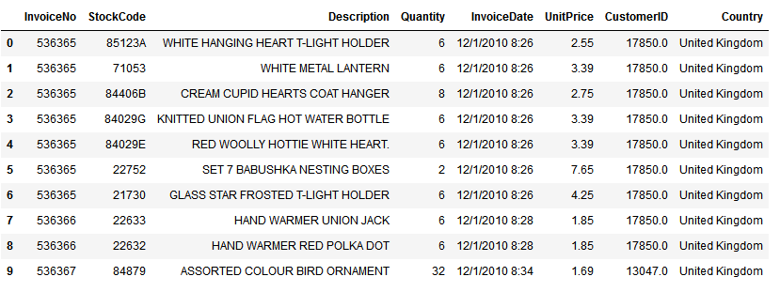
About Data
Transactional data of an online retailer with one year duration (2010-2011) and half of million entries
Fields:
InvoiceNo
StockCode
Description
Quantity
InvoiceDate
UnitPrice
CustomerID
Country

Slide 5
Planning and Assumptions
Based on the data fields and goals:
We can use product descriptions to group products and study the behavior of the groups. Therefore when we have a new product description, we can guess how much it can sell.
Pros: This can be useful as we are not bound to a specific id product.
Cons: there’s a chance that this hypothesis is wrong.
We can use product sales directly and group products based on that.
Pros: chance of grouping is much higher
Cons: we are bound to a specific id product.
Hybrid:
Pros: probably much higher accuracy than both
Cons: hard to implement and tune

Slide 6

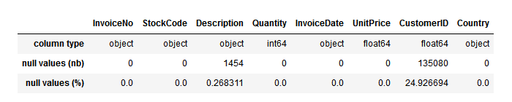
Discovery and cleaning
25% null for customer ids which can be caused by the guest customer. less than 0.5% null values for descriptions. changing null customers to id= -1 and null description to empty cell.
Convert invoice date to datetime format.

Slide 7
Discovery and cleaning
For InvoiceNo, StockCode, Description, Country:
Remove all trailing and leading spaces
Make sure they are lower case
U.K by far and Germany and France are the prominent countries in order-level data.

Slide 8
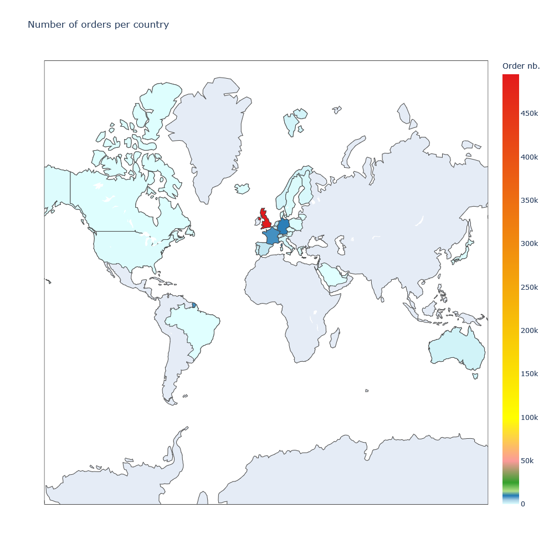

Slide 9
Discovery and cleaning
Checking unique values in each columns:
InvoiceNo unique count and percentage: 25900, 4.78
StockCode unique count and percentage: 3958, 0.73
Description unique count and percentage: 4195, 0.77
Quantity unique count and percentage: 722, 0.13
InvoiceDate unique count and percentage: 23260, 4.29
UnitPrice unique count and percentage: 1630, 0.30
CustomerID unique count and percentage: 4373, 0.81
Country unique count and percentage: 38, 0.01
As it was mentioned before data seems to be very spotty (looking at InvoiceDate).

Slide 10
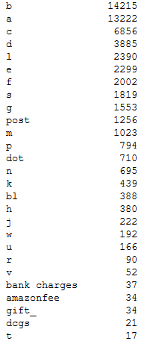
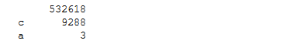
Discovery and cleaning
Character and numbers are separated for these two columns:
InvoiceNo and StockCode
This can help us to find the cancelled orders (with c in InvoiceNo) and find the root products (not variant) of each sales.
Extracted
characters

Slide 11
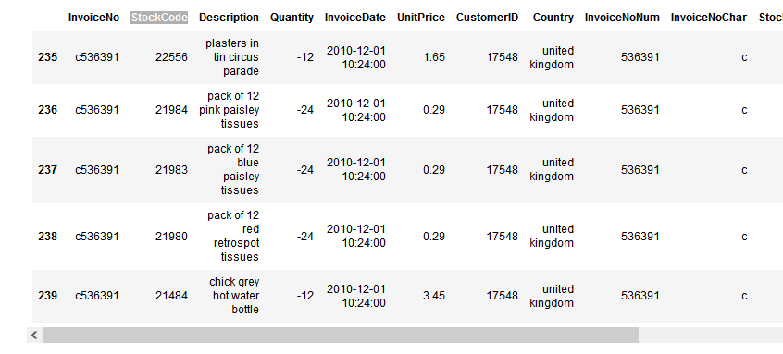
Discovery and cleaning
cancelled orders seems to not carry useful information and there’s no counter part (main order based on invoice id) in data. They will be removed.

Slide 12

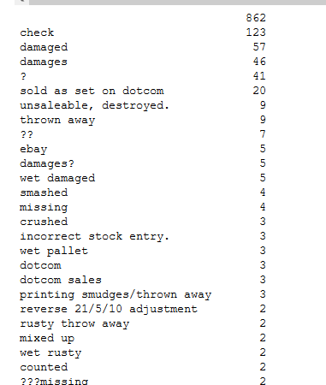
Discovery and cleaning
Orders with minus quantity are not useful too.

Slide 13
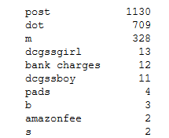

Discovery and cleaning
Orders that StockCode can’t be extracted as digits will be removed.

Slide 14
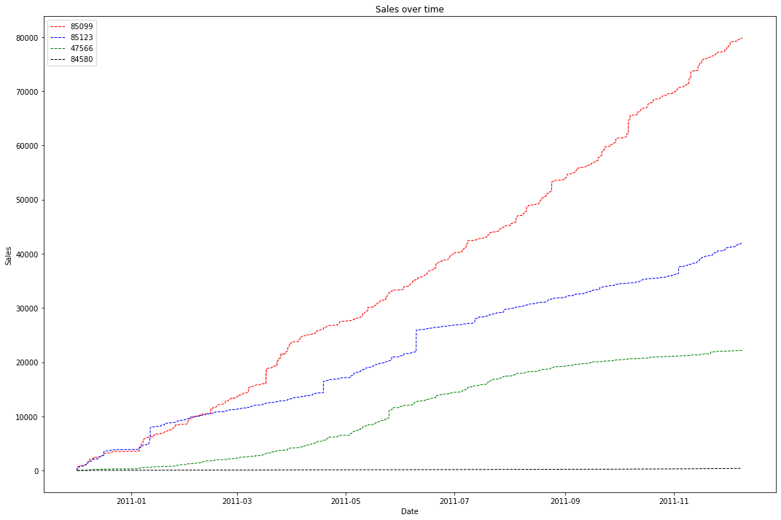
Cumulative sum of most frequent

Slide 15
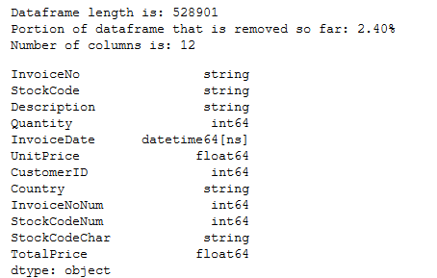
Discovery and cleaning
Try to replace products with zero unit price with average of stock code products.
Try to assign description to products without description using stock code.
Clean data saved in the data directory.

Slide 16
Approach 1: Use description

Slide 17
Approach 2: Use Sales Quantity

Slide 18
K-means

Slide 19
Result and discussions
Planned Goals:
Achieved Goals:
Suggestions:

Slide 20
Question(s)??

